Slide 1
目录
line
lineCap
arc
clearRect
案例
drawImage
globalCompositeOperation
案例
clip
案例
getImageData/putImageData
案例
quadraticCurveTo
案例

Slide 2
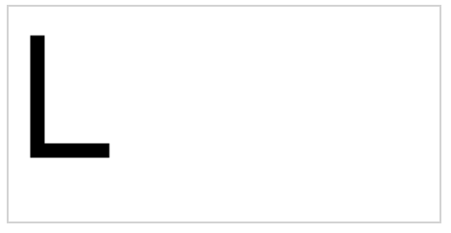
代码
结果
var c=document.getElementById("myCanvas");
var ctx=c.getContext("2d");
ctx.beginPath();
ctx.lineWidth = 10
ctx.moveTo(20,20);
ctx.lineTo(20,100);
ctx.lineTo(70,100);
ctx.stroke();
设置画笔宽度 10
移动画笔移动到 (20,20)
表示画笔从(20,20)画到(20,100)的状态(没有真的画)
同上
现在真的画了

Slide 3
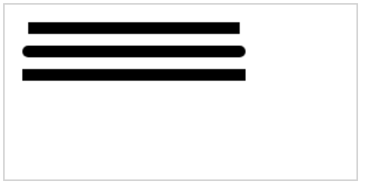
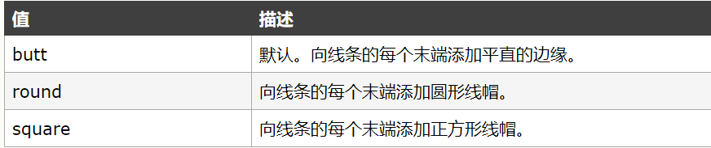
lineCap
结果
var c=document.getElementById("myCanvas");
var ctx=c.getContext("2d");
ctx.beginPath();
ctx.lineWidth=10;
ctx.lineCap="butt";
ctx.moveTo(20,20);
ctx.lineTo(200,20);
ctx.stroke();
ctx.beginPath();
ctx.lineCap="round";
ctx.moveTo(20,40);
ctx.lineTo(200,40);
ctx.stroke();
ctx.beginPath();
ctx.lineCap="square";
ctx.moveTo(20,60);
ctx.lineTo(200,60);
ctx.stroke();
线条末端平直
线条末端圆形
线条末端添加正方向

Slide 4
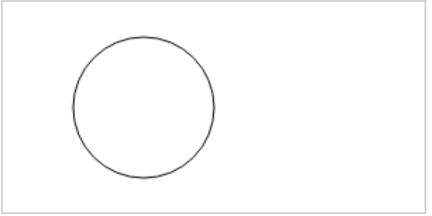
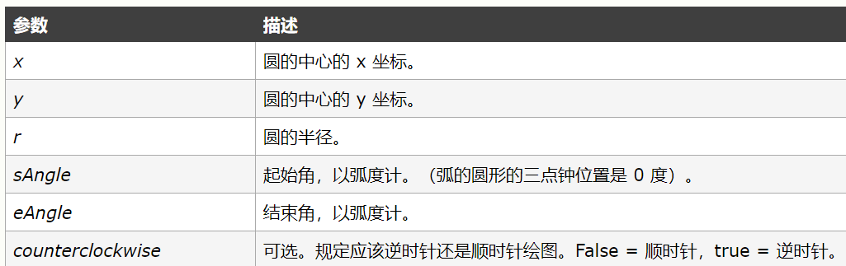
结果
arc
var c=document.getElementById("myCanvas");
var ctx=c.getContext("2d");
ctx.beginPath();
ctx.arc(100,75,50,0,2*Math.PI);
ctx.stroke();
结束角
中心点x坐标
起始角
中心点y坐标
圆半径

Slide 5
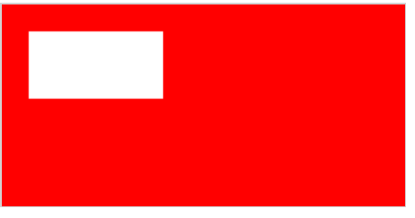
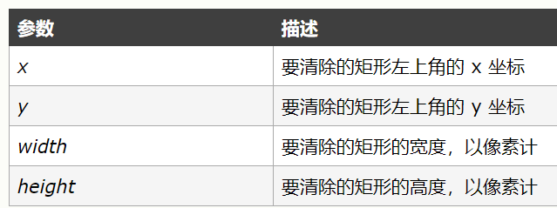
代码 clearR ect
结果
var c=document.getElementById("myCanvas");
var ctx=c.getContext("2d");
ctx.fillStyle="red";
ctx.fillRect(0,0,300,150);
ctx.clearRect(20,20,100,50);

Slide 6
把上面的知识结合事件做一个笔刷

Slide 7
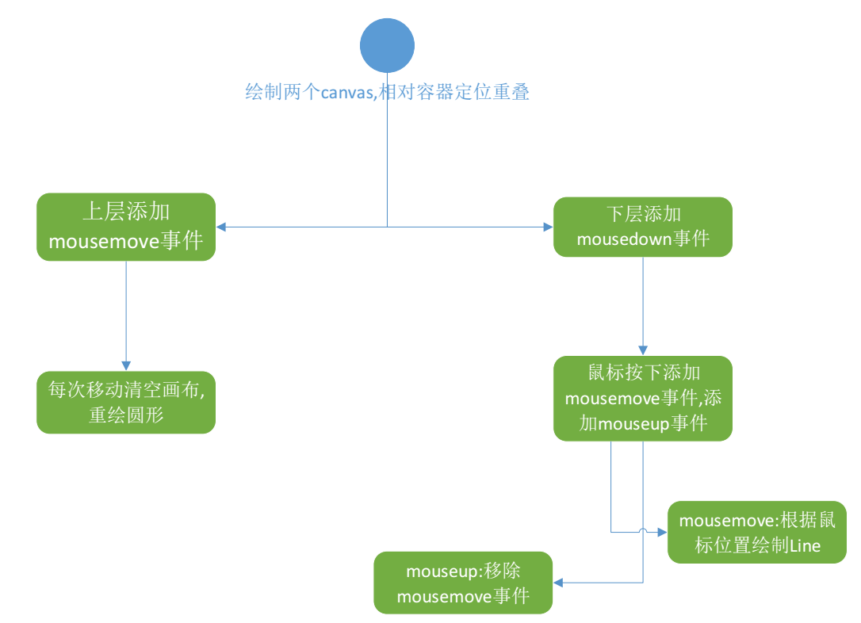

Slide 8
代码 绘制指针
canvas.addEventListener('mousemove', zhizhenfun);
function zhizhenfun(e) {
ctx2.clearRect(0, 0, canvasDom.width, canvasDom.height);
const offset = e.target.getBoundingClientRect();
const x1 = e.clientX - offset.left;
const y1 = e.clientY - offset.top;
const size = 20;
ctx2.lineWidth = 1;
ctx2.beginPath();
ctx2.arc(x1, y1, size, 0, 2 * Math.PI);
ctx2.stroke();
}
清空画布
获得鼠标对画布的位置
重绘圆

Slide 9
代码 绘制笔刷
canvas.addEventListener('mousedown', function () {
const that = this;
ctx1.beginPath();
const size = 40;
ctx1.lineWidth = size;
ctx1.lineCap = "round";
ctx1.lineJoin = "round";
ctx1.strokeStyle = 'rgba(255, 0, 0, 1)';
canvas.addEventListener('mousemove', movefun);
function up() {
canvas.removeEventListener('mousemove', movefun);
canvas.removeEventListener('mouseup', that.up);
}
that.up = up;
canvas.addEventListener('mouseup', up);
});
function movefun(e) {
const offset = e.target.getBoundingClientRect();
const x1 = e.clientX - offset.left;
const y1 = e.clientY - offset.top;
ctx1.lineTo(x1, y1);
ctx1.stroke();
}
设置线条宽度,两端圆
链接出平滑,填充
颜色等

Slide 10
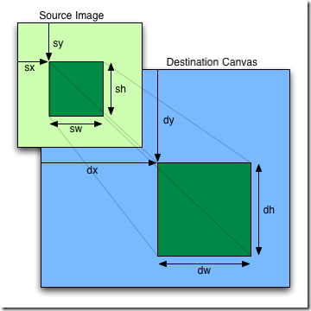
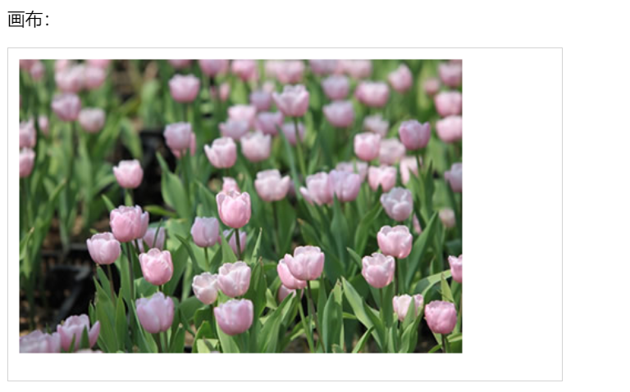
drawImage
三种函数原型：
drawImage(image, dx, dy)
drawImage(image, dx, dy, dw, dh)
drawImage(image, sx, sy, sw, sh, dx, dy, dw, dh)
var img=document.getElementById("tulip");
ctx.drawImage(img,10,10);

Slide 11
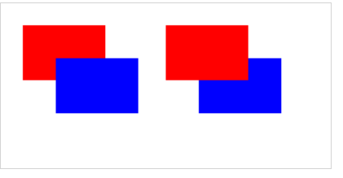
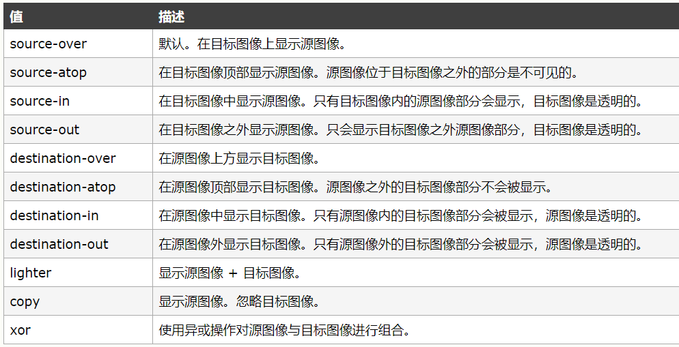
globalCompositeOperation
结果
var c=document.getElementById("myCanvas");
var ctx=c.getContext("2d");
ctx.fillStyle="red";
ctx.fillRect(20,20,75,50);
ctx.fillStyle="blue";
ctx.globalCompositeOperation="source-over";
ctx.fillRect(50,50,75,50);
ctx.fillStyle="red";
ctx.fillRect(150,20,75,50);
ctx.fillStyle="blue";
ctx.globalCompositeOperation="destination-over";
ctx.fillRect(180,50,75,50);

Slide 12
结合上述知识做两个个案例
笔刷+图片
擦除图片

Slide 13
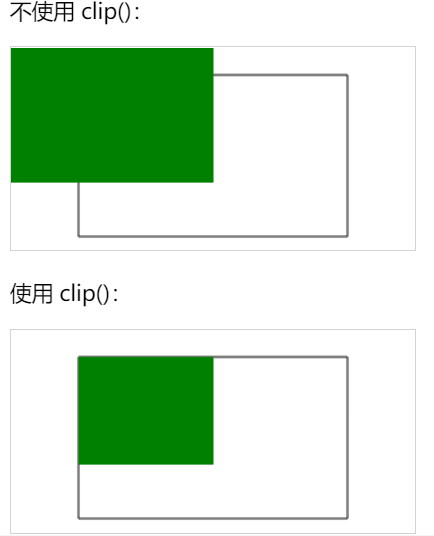
结果
clip
//不适用clip()
ctx.rect(50,20,200,120);
ctx.stroke();
ctx.fillStyle="green";
ctx.fillRect(0,0,150,100);
// 使用clip()
ctx.rect(50,20,200,120);
ctx.stroke();
ctx.clip();
ctx.fillStyle="green";
ctx.fillRect(0,0,150,100);

Slide 14
drawImage
drawImage除了可以绘制图片外,还可以绘制canvas,vedio等,本次案例利用drawImage可绘制canvas的特性,结合clip和事件,做一个放大镜

Slide 15
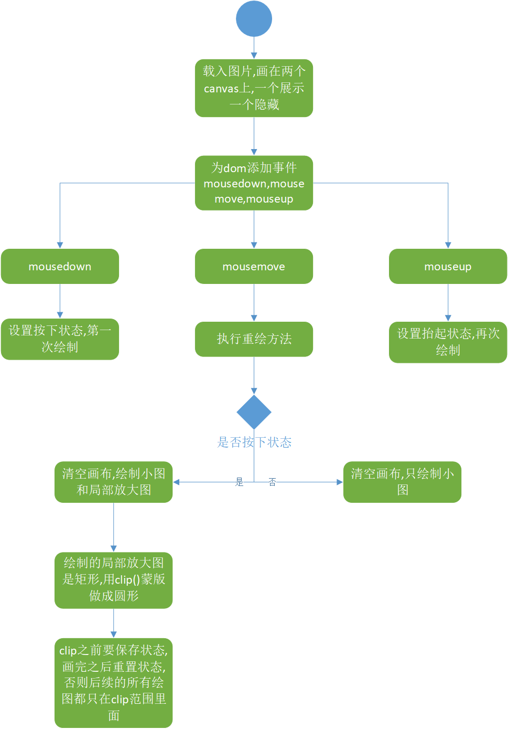

Slide 16
img.onload = () => {
ctx.drawImage(img, 0, 0, img.width, img.height, 0, 0, $width, $height);
ctx2.drawImage(img, 0, 0, img.width, img.height, 0, 0, $width * $scale, $height * $scale);
};
显示的画布,画的图片是指定的大小
隐藏的画布,画的是大图
function drawBig(point) {
let r = 80;
ctx.save();
ctx.beginPath();
ctx.arc(point.x, point.y, r, 0, 2 * Math.PI);
ctx.closePath();
ctx.stroke();
ctx.clip();
ctx.drawImage(canvas2,
(point.x * $scale -r), (point.y * $scale - r), 2*r, 2*r,
point.x-r, point.y-r, 2*r, 2*r);
ctx.restore();
}
保存状态
上面画的圆变成蒙版,之后的图形都会被这个圆截取
根据半径绘制把大图截取,绘制到canvas1上
恢复状态

Slide 17
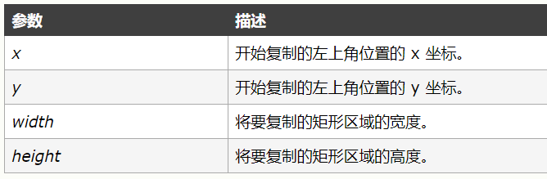
getImageData
var imgData=ctx.getImageData(0,0,c.width,c.height);
//像素数组,长度是 宽*高的4倍
let pixelArray = imgData.data;
let r = pixelArray[4 * i + 0],
let g = pixelArray[4 * i + 1],
let b = pixelArray[4 * i + 2],
let a = pixelArray[4 * i + 3],

Slide 18
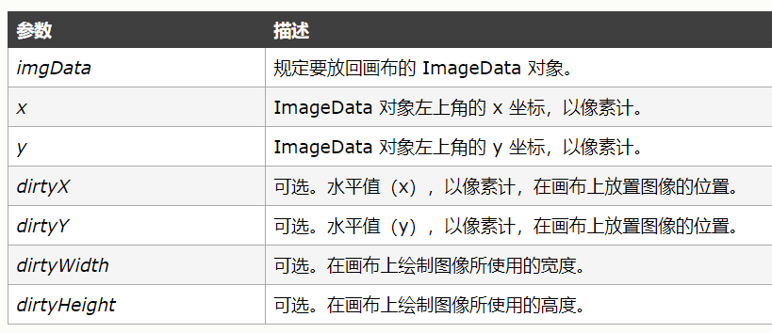
putImageData
context.putImageData(imgData,x,y,dirtyX,dirtyY,dirtyWidth,dirtyHeight);

Slide 19
通过对像素进行操作,可以使用简单的图像算法制作简单的滤镜

Slide 20
反转
function reverse() {
let imageData = ctx.getImageData(0, 0, $width, $height);
let pixelArray = imageData.data;
for (var i = 0; i < $width * $height; i++) {
let rgba = getRGBA(pixelArray, i);
pixelArray[4 * i + 0] = 255 - rgba.r;
pixelArray[4 * i + 1] = 255 - rgba.g;
pixelArray[4 * i + 2] = 255 - rgba.b;
}
ctx2.putImageData(imageData, 0, 0, 0, 0, $width, $height);
}
只需用255减去对每个像素的rgb值即可

Slide 21
灰度
function grey() {
let imageData = ctx.getImageData(0, 0, $width, $height);
let pixelArray = imageData.data;
for (var i = 0; i < $width * $height; i++) {
let rgba = getRGBA(pixelArray, i);
let grey = rgba.r * 0.3 + rgba.g * 0.59 + rgba.b * 0.11;
pixelArray[4 * i + 0] = grey;
pixelArray[4 * i + 1] = grey;
pixelArray[4 * i + 2] = grey;
}
ctx2.putImageData(imageData, 0, 0, 0, 0, $width, $height);
}
调用灰度的公式计算得rgb的灰度值即可

Slide 22
高斯模糊
let blurR = 2;
let totalNum = (2 * blurR +1)*(2 * blurR +1)
for (let i = blurR; i < $height -blurR; i++) {
for (let j = blurR; j < $width -blurR; j++) {
let totalR = 0,totalG = 0,totalB = 0;
for (let dx = -blurR; dx <= blurR; dx++) {
for (let dy = -blurR; dy <= blurR; dy++) {
let x = i + dx;
let y = j + dy;
let p = x * $width + y;
let rgba = getRGBA(tempPixelArray,p);
totalR += rgba.r;
totalG += rgba.g;
totalB += rgba.b;
}
}
模糊半径
let pexel = i * $width + j;
pixelArray[pexel*4 +0] = totalR/totalNum;
pixelArray[pexel*4 +1] = totalG/totalNum;
pixelArray[pexel*4 +2] = totalB/totalNum;
}
}
计算rgb的9宫格的和,为求平均值
把这个坐标的rgb换成平均数
九宫格里面的坐标计算

Slide 23
马赛克
for (let dx = 0; dx <= size; dx++) {
for (let dy = 0; dy <= size; dy++) {
let x = i + dx;
let y = j + dy;
let p = x * $width + y;
pixelArray[p*4 +0] = rangeR;
pixelArray[p*4 +1] = rangeG;
pixelArray[p*4 +2] = rangeB;
}
}
}
}
let size = 10;
let totalNum = size*size;
for (let i = 0; i < $height; i+=size) {
for (let j = 0; j < $width; j+=size) {
let totalR = 0,totalG = 0,totalB = 0;
for (let dx = 0; dx < size; dx++) {
for (let dy = 0; dy < size; dy++) {
let x = i + dx;
let y = j + dy;
let p = x * $width + y;
let rgba = getRGBA(tempPixelArray,p);
totalR += rgba.r;
totalG += rgba.g;
totalB += rgba.b;
}
}
let pexel = i * $width + j;
let rangeR = totalR/totalNum;
let rangeG = totalG/totalNum;
let rangeB = totalB/totalNum;

Slide 24
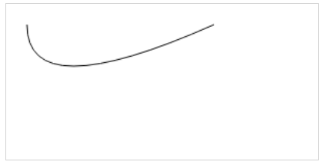
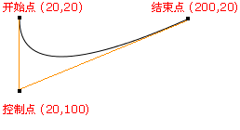
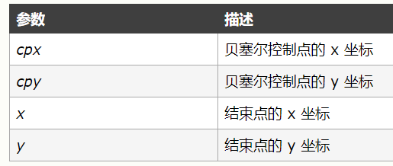
quadraticCurveTo
结果
ctx.beginPath();
ctx.moveTo(20,20);
ctx.quadraticCurveTo(20,100,200,20);
ctx.stroke();

Slide 25
结合上面知识画一个二次贝塞尔辅助线

Slide 26

一次贝塞尔
二次贝塞尔
三次贝塞尔

