Slide 1
Advancing and iterating on technology + dissemination, launching an offensive on two pillars\nGAC Toyota’s battle for discourse power has already begun, and the results are significant
Evolution of intelligent electrification:
Iteration of dissemination:
Quality as the foundation, a leap in technology\nA technological counteroffensive in the new-energy era
Topics explode, traffic is king\nA dissemination offensive in the new-media era
9th-generation Camry
Allion 3X
Next-generation Wildlander
Drawing on the successful experience of the Allion 3X\nToyota is following a distinctive dissemination path that is plannable, controllable, and predictable
A global car, with a China cockpit firing the first shot in GAC Toyota’s technological counteroffensive
As the first car in the 140,000-yuan class with advanced intelligent driving, it establishes GAC Toyota’s intelligent-driving position
The China cockpit evolves further, a milestone in the iteration of GAC Toyota’s intelligence and technology

Slide 2
Advancing with two pillars—technological evolution and iterative dissemination\nGAC Toyota’s battle for discourse power has already begun, and the results are remarkable
Evolution of intelligent electrification:
Iteration of dissemination:
Quality as the foundation, technology making leaps\nA technological counteroffensive in the new-energy era
Topic explosion, traffic is king\nA dissemination offensive in the new-media era
9th-generation Camry
Allion 3X
New-generation Wildlander
Building on the successful experience of the Allion 3X\nToyota is following a distinctive dissemination path that is plannable, controllable, and predictable
A global car with a China cockpit fires the first shot of GAC Toyota’s technological counteroffensive
As the first 140k-class vehicle with advanced intelligent driving, it establishes GAC Toyota’s position in intelligent driving
The China cockpit evolves further, a milestone in GAC Toyota’s iteration of intelligence and technology
Notes:
多种字号的文本，AI翻译未按照中文版字号大小去区分，统一都是大字

Slide 3
Guangqi Toyota Traffic Shockwave Tactics Practice Support ///
Predict
Build a high-quality media matrix
Volume can be predicted
Push
Match vehicle milestones with topics
Pace can be controlled
Plan
Establish core dissemination labels
Content can be standardized
Centered on central Party and government media, amplify through major industry influencers and vertical media to build a traffic-focused media matrix
Through the relay of the Wilanda global launch event, the dissemination pace can be flexibly sped up or slowed down, boosting excitement around Wilanda’s model update information
In line with the dissemination pace, output high-density content at key milestones to maintain momentum and focus on spreading core topics

Slide 4
GAC Toyota Traffic Shockwave Tactics in Practice
Support ///
Predict
Build a high-quality media matrix
Voice volume can be forecast
Push
Match vehicle milestones with hot topics
Pace can be controlled
Plan
Establish core dissemination labels
Content can be standardized
Centered on central Party and government media, amplify through industry KOLs and vertical media to build a traffic-focused media matrix
Through the relay of the Wilanda global launch event, the dissemination pace can be flexibly sped up or slowed down, boosting momentum for Wilanda’s model-change information
In line with the dissemination pace, output high-density content at key milestones to sustain heat and focus on spreading core topics
Notes:
1、黑色字体经常翻译版本是白色字体
2、中文字体已经有标题分行，且字体大小有区隔。日文翻译过来无分行，字体无区隔

Slide 5






Media statements
Central party-and-government media and top industry influencers take a clear stance, further amplifying the spotlight
Through the dissemination of #GAC Toyota grand brand strategy# and #Wildlander major refresh#, raise value expectations.
Promote the intelligent evolution of all GAC Toyota models
————
Using smart technology as the entry point, the smart upgrade of the Wildlander enhances its benchmark significance for the smart transformation of joint-venture automakers.
Brand strategy rebuilds market competitiveness
————
Using the strategy of smart upgrades across all GAC Toyota models as the entry point, examine its impact on the industry’s technology paths and user perceptions.
Wildlander major refresh: intelligent taste as the core highlight
————
Using the Wildlander refresh information as the entry point, focus on specific product upgrade points to raise expectations for the new Wildlander.
Example topics
#Wildlander major refresh, upgrade of GAC Toyota’s brand strategy#
#GAC Toyota releases the “Intelligent Evolution, ICE & EV Intelligence” strategy; intelligent electrification enters the second half#
Example topics
#Wildlander global debut, potential to reshape the hybrid competitive landscape#
#New Wildlander global debut, GAC Toyota takes another important step in intelligent electrification#
Example topics
#Wildlander world premiere: how long until domestic launch?#
#The most intelligent Wildlander ever, coming soon#
@Sohu Auto, @Autohome
@Understand Cars in 30 Seconds, @Yan Chuang Talks Cars
@People’s Daily, @Xinhua News Agency
Deepen GAC Toyota’s “ICE & EV Intelligence” grand brand strategy and raise expectations.

Slide 6
Media statements
Central party-and-government media and leading industry influencers take a clear stance, further amplifying the spotlight
Through dissemination of #GAC Toyota’s grand brand strategy# and #Wildlander major refresh#, raise value expectations
Promote the intelligent evolution of all GAC Toyota models
————
Using smart technology as the entry point, the smart upgrade of the Wildlander enhances its benchmark significance for the intelligent transformation of joint-venture automakers
Brand strategy rebuilds market competitiveness
————
Using the strategy of smart upgrades across all GAC Toyota models as the entry point, examine its impact on the industry’s technology routes and user perceptions
Wildlander major refresh: smart taste is the core highlight
————
Using the Wildlander refresh news as the entry point, focus on specific product upgrade points to raise expectations for the new Wildlander
Example topics
#Wildlander major refresh, upgrade of GAC Toyota’s brand strategy#
#GAC Toyota announces the “Intelligent Evolution, Same Intelligence for ICE and EV” strategy; intelligent electrification enters the second half#
Example topics
#Global debut of the Wildlander, potentially reshaping the hybrid competitive landscape#
#Global debut of the new Wildlander, GAC Toyota takes another key step in intelligent electrification#
Example topics
#Wildlander global premiere—how long until domestic launch?#
#The smartest Wildlander ever, coming soon#
@People’s Daily, @Xinhua News Agency
@Sohu Auto, @Autohome
@Understand Cars in 30 Seconds, @Yan Chuang Talks Cars
Deepen GAC Toyota’s “Same Intelligence for ICE and EV” grand brand strategy and raise expectations
Notes:
1、有色块叠加文字，翻译版色块不见了
2、多种字号的文本，AI翻译未按照中文版字号大小去区分，统一都是大字。文字互相遮挡

Slide 7
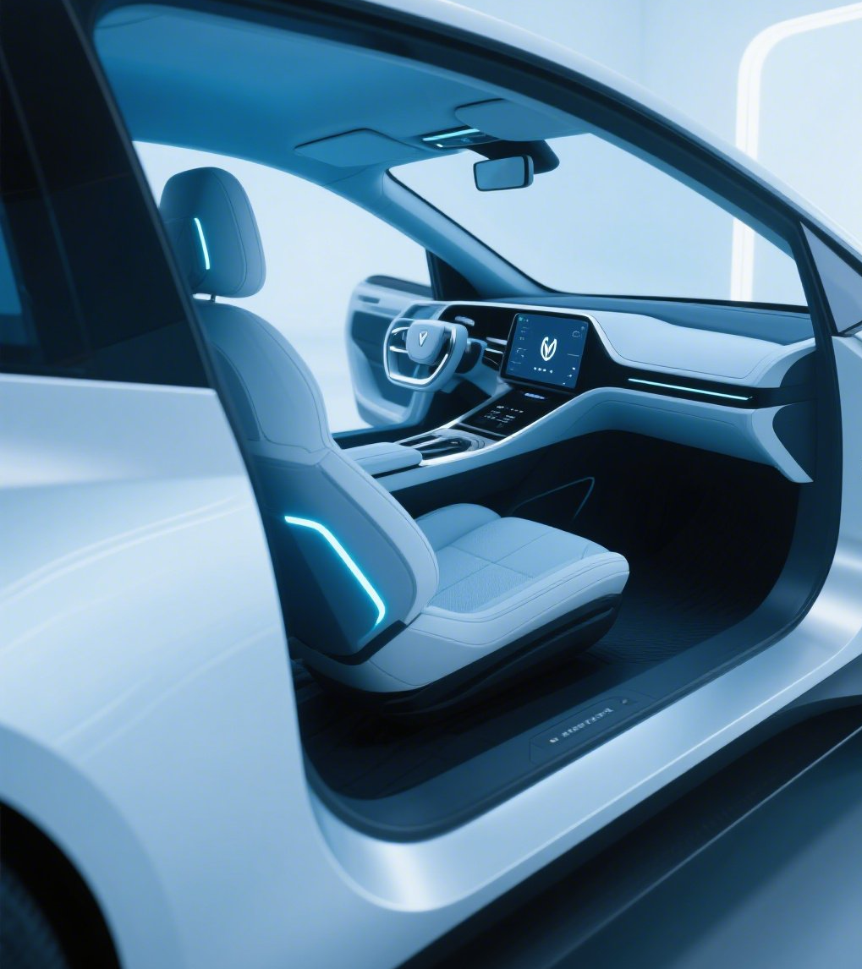
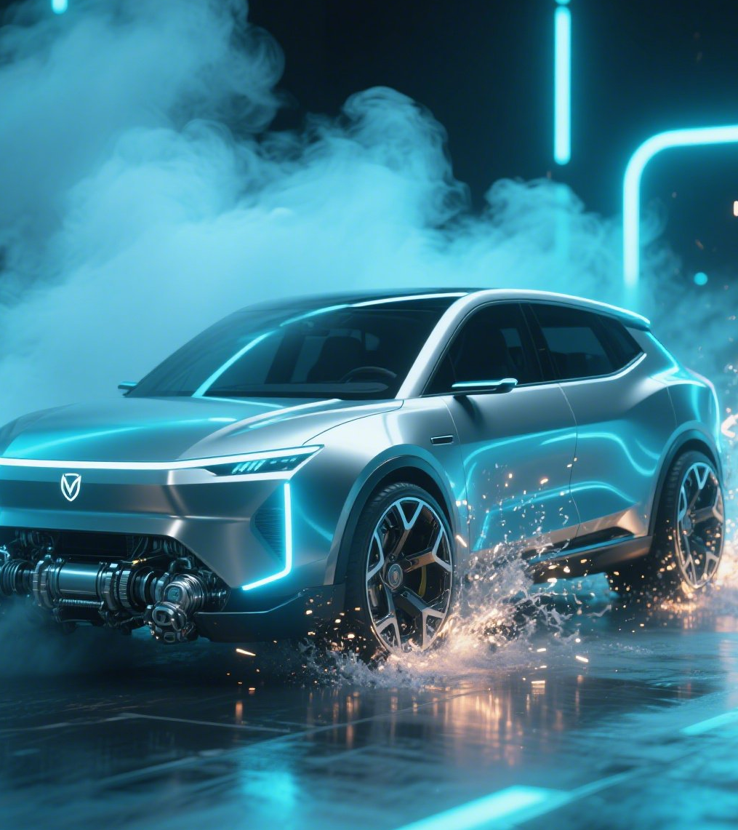
#Weilander China cabin, perceptual hybrid duality#
Test Drive Play 01
A
B
A single test drive route cannot demonstrate the new Weilander’s multidimensional improvements
Each test drive is divided into two sections—A and B—
Static smart cabin test drive
Dynamic dual-engine perceptual test drive
Discover empathy: daily conversation and multi-person simultaneous conversation, 1-second-class response speed, responds to multiple intents with a single utterance
Feel smoothness: OMS cabin sensing system, AI video sensing technology, Yancheng operation functions
Enjoy comfort: 15.6-inch ultra-large display, integrated physical button functions
…
More powerful: 5th-generation 2.0/2.5L HEV system, 32% higher output, millisecond response comparable to EVs
More rugged: bold front fascia that conveys strength, enhanced SUV character, rugged C-position design
More fuel-efficient: fuel consumption as low as 4.2L, about 30% lower than same-class gasoline vehicles, ultra-long range of over 1,000 km, no need to visit a gas station for a month under normal use
…

Slide 8
#Weylander China Cabin, Perceptive Hybrid Duality#
Test Drive Play 01
A
B
A test drive on a single route cannot demonstrate the new Weylander’s multidimensional improvements.
Each test drive is divided into two sections—A and B—
Static Smart Cabin Test Drive
Dynamic Dual-Engine Perception Test Drive
Discover empathy: everyday conversation and multi-person simultaneous conversation, 1-second-class response speed, responding to multiple intents with a single sentence
Feel the smoothness: OMS cabin sensing system, AI visual sensing technology, Yancheng operation functions
Enjoy comfort: 15.6-inch ultra-large display, integrated physical button functions
…
More powerful: 5th-generation 2.0/2.5L HEV system, 32% higher output, millisecond response comparable to an EV
More rugged: a bold front fascia that conveys strength, enhanced SUV character, and a rugged C-position design
More fuel-efficient: fuel consumption as low as 4.2L, about 30% lower than gasoline vehicles in the same class, 1,000+ km ultra-long range, and with normal use you won’t need to visit a gas station for a month
…
Notes:
1、有底版的，白色字体翻译过来又是黑色字体
2、文字溢出文本框

