Slide 1
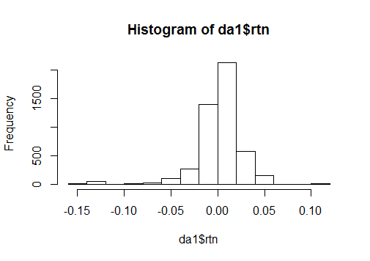
Intra day return - distribution
X..da1.rtn
nobs 4731.000000
NAs 0.000000
Minimum -0.159970
Maximum 0.114501
1. Quartile -0.006768
3. Quartile 0.013946
Mean 0.001875
Median 0.004416
Sum 8.870051
SE Mean 0.000370
LCL Mean 0.001149
UCL Mean 0.002600
Variance 0.000648
Stdev 0.025456
Skewness -1.967781
Kurtosis 10.922852

Slide 2
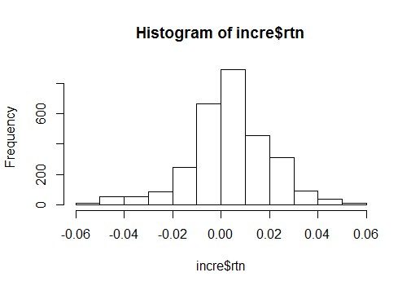
Gap up conditions – Intraday distribution
X..incre.rtn
nobs 2913.000000
NAs 0.000000
Minimum -0.057851
Maximum 0.054246
1. Quartile -0.004910
3. Quartile 0.013338
Mean 0.003716
Median 0.004264
Sum 10.823978
SE Mean 0.000312
LCL Mean 0.003104
UCL Mean 0.004327
Variance 0.000283
Stdev 0.016834
Skewness -0.414228
Kurtosis 1.610631

Slide 3
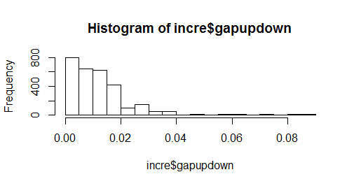
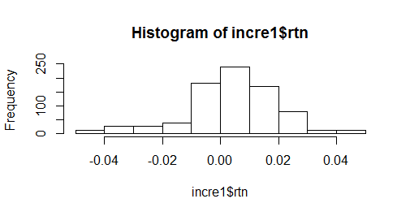
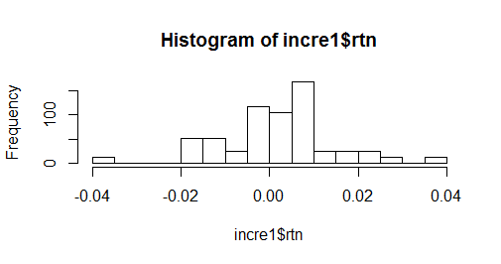
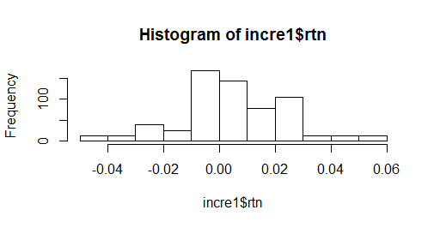
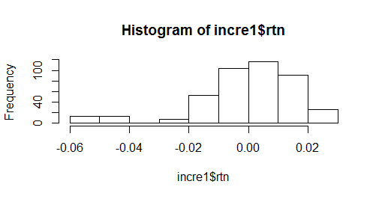
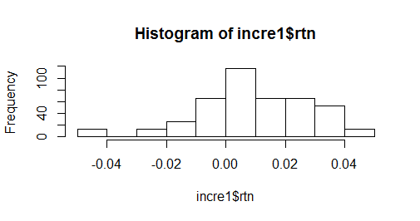
Gap up conditions – Intraday distribution
if it's gapped up (or down) by X at day D, what is the distribution Y of intraday return
Gapup distribution – 0-0.005, 0.005-0.01, 0.01-0.015, 0.015-0.02, 0.02+

Slide 4
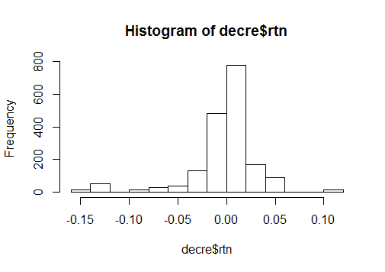
Gap down conditions – Intraday distribution
X..decre.rtn
nobs 1805.000000
NAs 0.000000
Minimum -0.159970
Maximum 0.114501
1. Quartile -0.011241
3. Quartile 0.014842
Mean -0.001384
Median 0.004696
Sum -2.497839
SE Mean 0.000820
LCL Mean -0.002992
UCL Mean 0.000225
Variance 0.001214
Stdev 0.034842
Skewness -1.725512
Kurtosis 6.290910

Slide 5
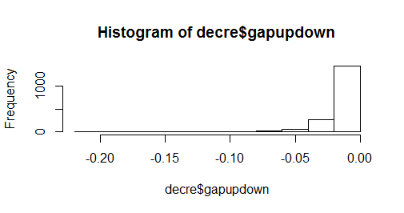
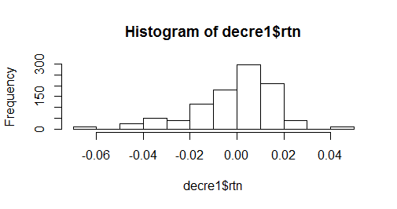
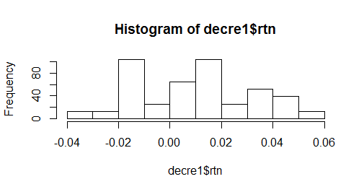
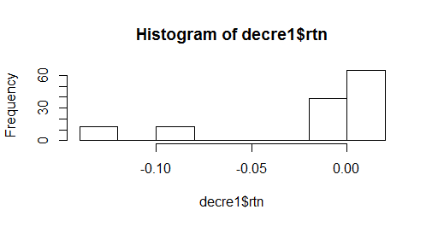
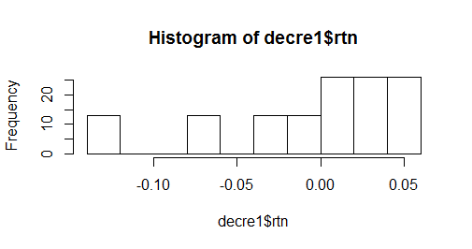
Gap down conditions – Intraday distribution
if it's gapped up (or down) by X at day D, what is the distribution Y of intraday return
Gapdown distribution – 0-(-0.01), (-0.01)-(-0.02), (-0.02)-(-0.03), (-0.03)-(-0.04), -0.04+

Slide 6
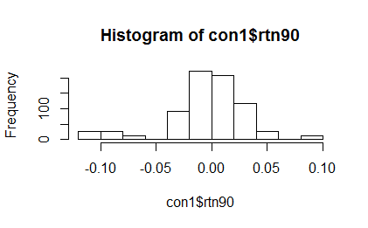
if the lowest price in the first 90min lower than the previous day lowest (by at least 1 cent), what is the return for the rest of day
X..con1.rtn90
nobs 741.000000
NAs 0.000000
Minimum -0.107162
Maximum 0.087684
1. Quartile -0.014479
3. Quartile 0.016571
Mean -0.004096
Median -0.001291
Sum -3.035364
SE Mean 0.001268
LCL Mean -0.006585
UCL Mean -0.001608
Variance 0.001190
Stdev 0.034503
Skewness -0.969279
Kurtosis 2.037144

Slide 7
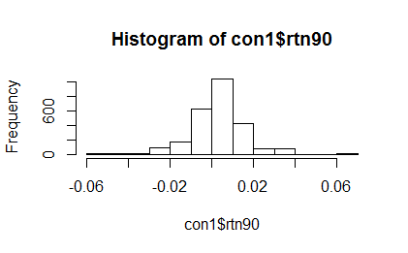
if the lowest price in the first 90min higher than the previous day lowest (by at least 1 cent), what is the return for the rest of day
X..con1.rtn90
nobs 2646.000000
NAs 0.000000
Minimum -0.057143
Maximum 0.066054
1. Quartile -0.003158
3. Quartile 0.009590
Mean 0.002788
Median 0.003948
Sum 7.375961
SE Mean 0.000283
LCL Mean 0.002233
UCL Mean 0.003342
Variance 0.000212
Stdev 0.014549
Skewness -0.378601
Kurtosis 3.703637

Slide 8
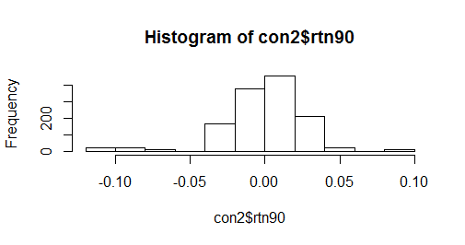
if the highest price in the first 90min lower than the previous day highest (by at least 1 cent), what is the return for the rest of day
X..con2.rtn90
nobs 1313.000000
NAs 0.000000
Minimum -0.107162
Maximum 0.087684
1. Quartile -0.013094
3. Quartile 0.015050
Mean -0.001362
Median 0.002115
Sum -1.788019
SE Mean 0.000801
LCL Mean -0.002933
UCL Mean 0.000209
Variance 0.000842
Stdev 0.029022
Skewness -1.084745
Kurtosis 3.303349

Slide 9
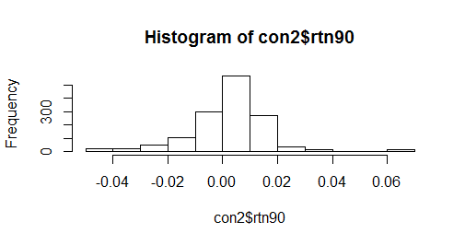
if the highest price in the first 90min higher than the previous day highest (by at least 1 cent), what is the return for the rest of day
X..con2.rtn90
nobs 1417.000000
NAs 0.000000
Minimum -0.049061
Maximum 0.066054
1. Quartile -0.001494
3. Quartile 0.009520
Mean 0.002077
Median 0.002645
Sum 2.943467
SE Mean 0.000402
LCL Mean 0.001288
UCL Mean 0.002867
Variance 0.000229
Stdev 0.015148
Skewness -0.306230
Kurtosis 4.156948

