Slide 1
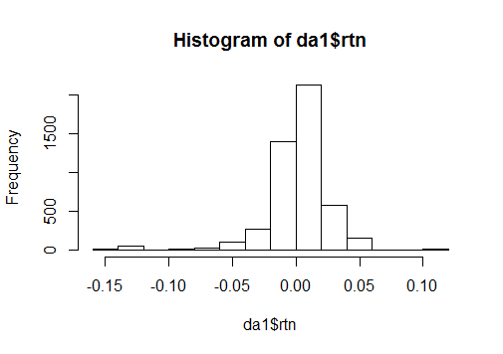
Intra day return - distribution
X..da1.rtn
nobs 4731.000000
NAs 0.000000
Minimum -0.159970
Maximum 0.114501
1. Quartile -0.006768
3. Quartile 0.013946
Mean 0.001875
Median 0.004416
Sum 8.870051
SE Mean 0.000370
LCL Mean 0.001149
UCL Mean 0.002600
Variance 0.000648
Stdev 0.025456
Skewness -1.967781
Kurtosis 10.922852

Slide 2
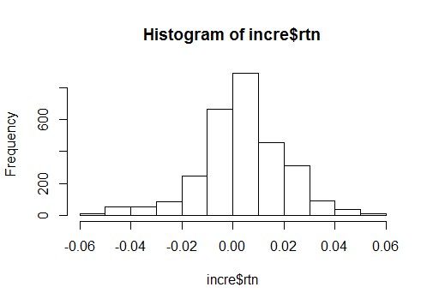
Gap up conditions – Intraday distribution
X..incre.rtn
nobs 2913.000000
NAs 0.000000
Minimum -0.057851
Maximum 0.054246
1. Quartile -0.004910
3. Quartile 0.013338
Mean 0.003716
Median 0.004264
Sum 10.823978
SE Mean 0.000312
LCL Mean 0.003104
UCL Mean 0.004327
Variance 0.000283
Stdev 0.016834
Skewness -0.414228
Kurtosis 1.610631

Slide 3
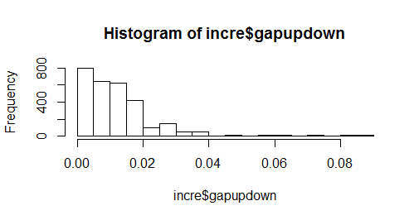
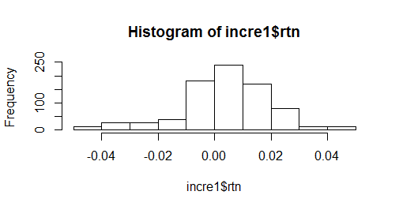
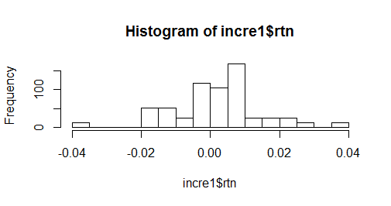
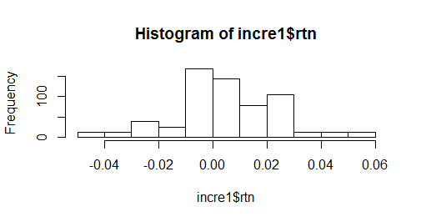
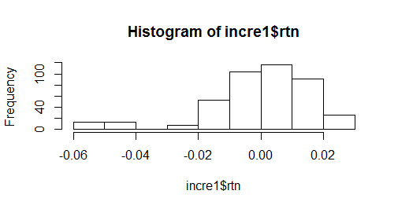
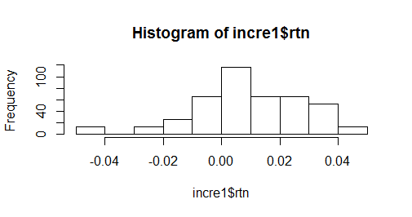
Gap up conditions – Intraday distribution
if it's gapped up (or down) by X at day D, what is the distribution Y of intraday return
Gapup distribution – 0-0.005, 0.005-0.01, 0.01-0.015, 0.015-0.02, 0.02+

Slide 4
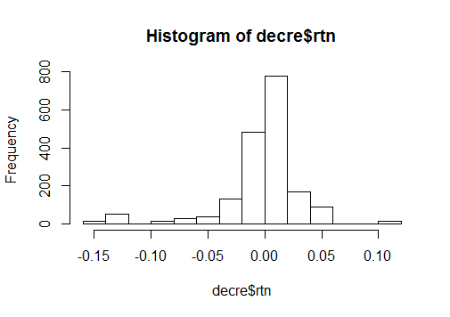
Gap down conditions – Intraday distribution
X..decre.rtn
nobs 1805.000000
NAs 0.000000
Minimum -0.159970
Maximum 0.114501
1. Quartile -0.011241
3. Quartile 0.014842
Mean -0.001384
Median 0.004696
Sum -2.497839
SE Mean 0.000820
LCL Mean -0.002992
UCL Mean 0.000225
Variance 0.001214
Stdev 0.034842
Skewness -1.725512
Kurtosis 6.290910

Slide 5
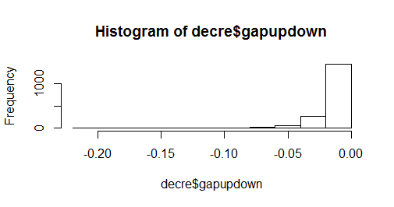
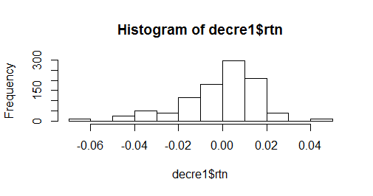
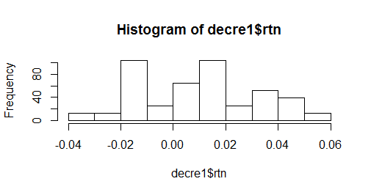
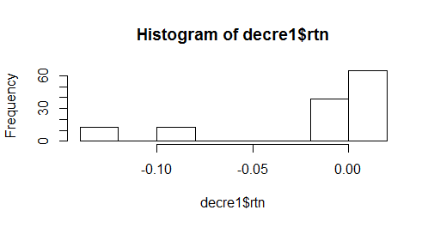
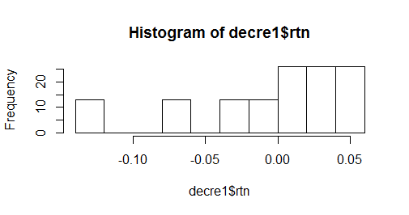
Gap down conditions – Intraday distribution
if it's gapped up (or down) by X at day D, what is the distribution Y of intraday return
Gapdown distribution – 0-(-0.01), (-0.01)-(-0.02), (-0.02)-(-0.03), (-0.03)-(-0.04), -0.04+

