Slide 1

I2PP4DA
Tutor: Weiyuan Du

Slide 2
Outline
Control flow
Loops
Tutorial Exercises
Homework

Slide 3
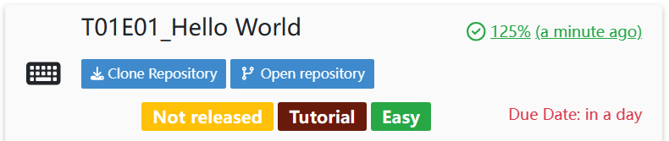
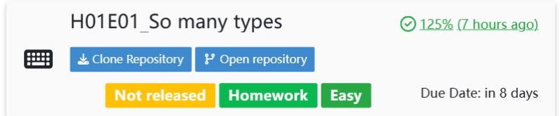
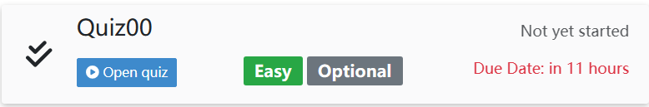
Exercise category
Tutorial exercise
with a Tutorial label
4 points and 1 bonus point = 5 points
Homework exercise
With a Homework label
4 points and 1 bonus point = 5 points
Quizes
Mon 10:15 – 10:20 of the tutorial session

Slide 4




Environment for the lectures
Anaconda Distribution | Anaconda
Vscode Visual Studio Code - Code Editing. Redefined
Pycharm https://www.jetbrains.com/pycharm/download/
Jupyter notebook Project Jupyter | Home
Pip ( download for python package)
WSL (windows subsystem for Linux)
Terminal (Mac os)
Git (will be used frequently during the exercises)
Copyrights, all the images are from wiki

Slide 5
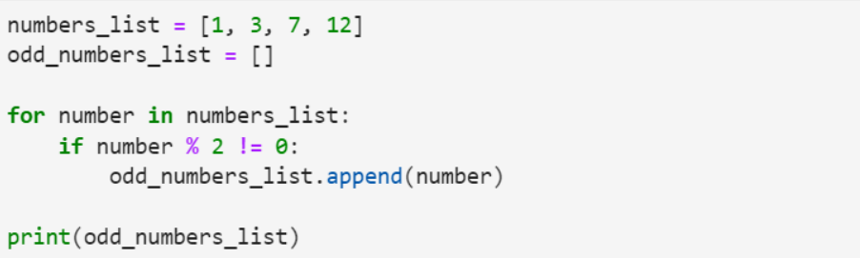
A Normal Python program
Either from defined variable or list
Here we defined a numbers_list = [1,3,7,12]

Slide 6
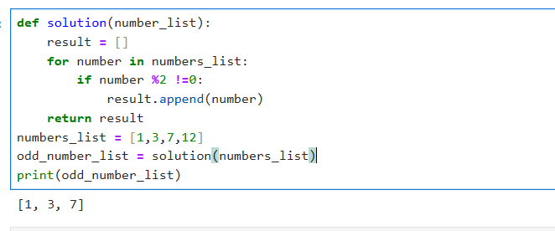
Function Based Programming
Learn by doing!

Slide 7
Any Questions?
Thanks for coming to the tutor session!

