Slide 1

I2PP4DA
Tutor: Weiyuan Du

Slide 2
Outline
List
Tuple
Dictionary
Function
Tutorial Exercises
Homework

Slide 3
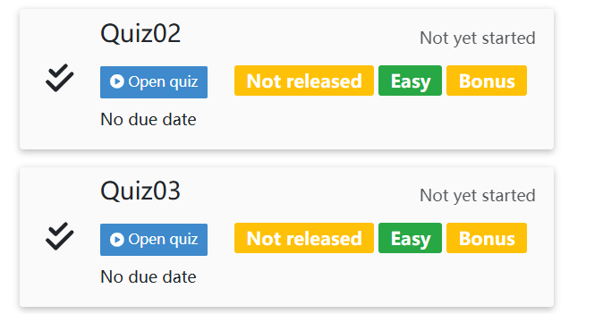
Quiz Time

Slide 4
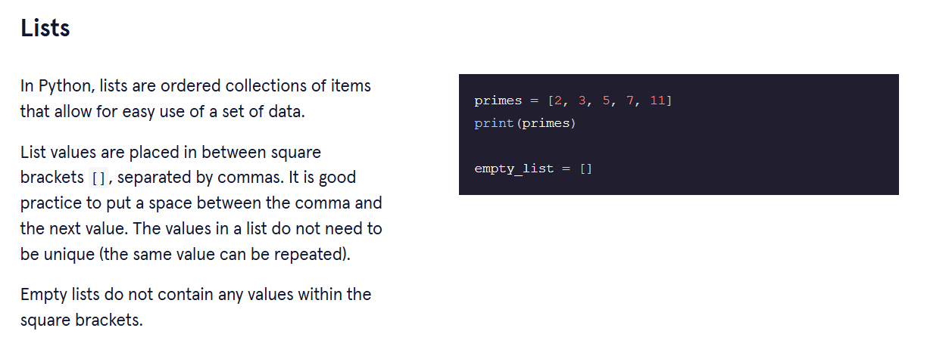
List

Slide 5
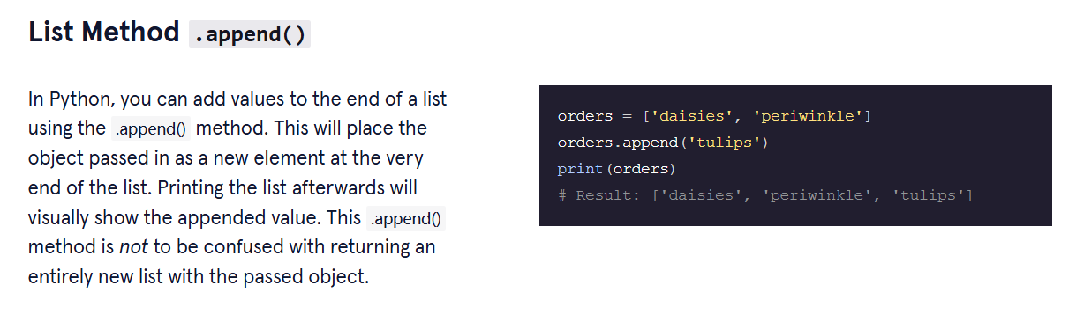
List

Slide 6
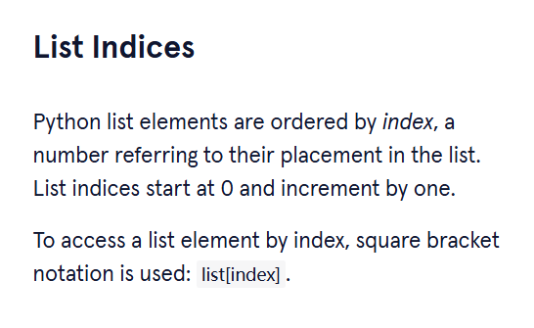
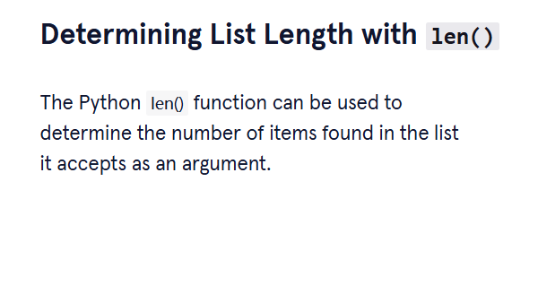
List

Slide 7
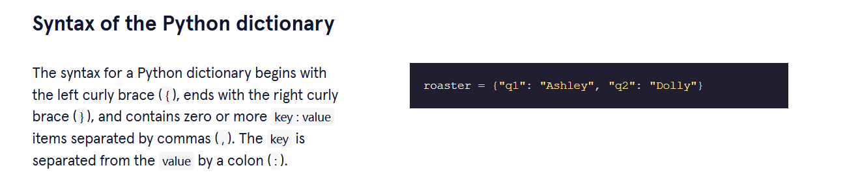
Dictionary

Slide 8
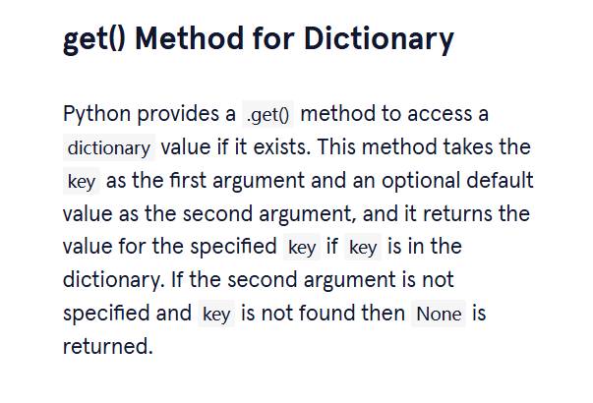
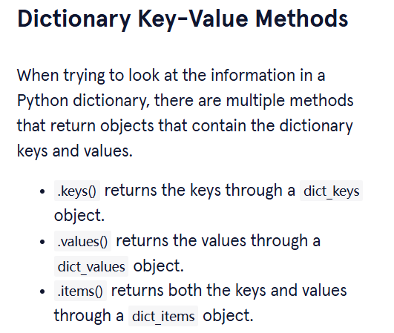
Dictionary

Slide 9
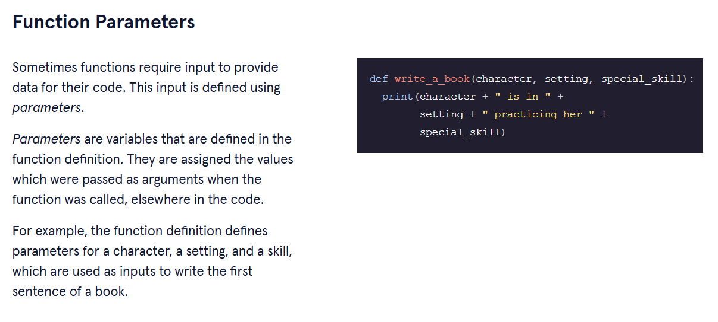
Function

Slide 10
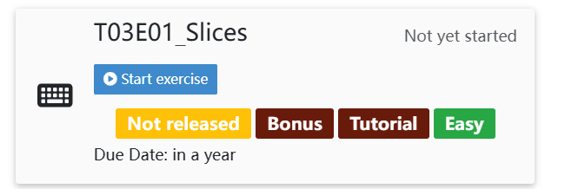
Tutorial

Slide 11
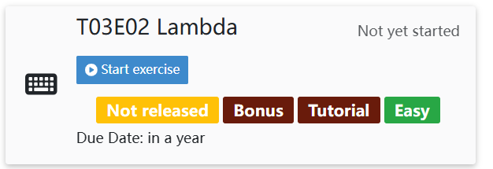
Tutorial

Slide 12
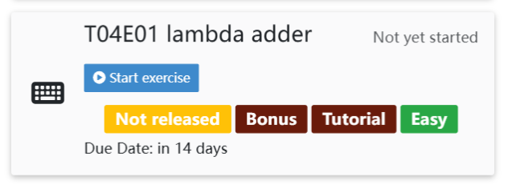
Tutorial

Slide 13
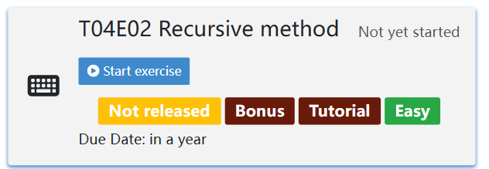
Tutorial

Slide 14
Any Questions? Thanks for coming to the tutor session!

