Slide 1

I2PP4DA
Tutor: Weiyuan Du

Slide 2
Outline
Organization
Prepare for the lecture
Tutorial Exercises
Homework

Slide 3
Welcome to I2PP4DA
Teaching concept: interactive learning
Synchronous: lecture with interactive exercise, tutor sessions
Asynchronous: lecture slides, readings, and homework for self-study
Expectation
Be open to new technologies, learning methods, and teaching approaches.
Be active and curious, and learn organize yourself
Be kind and patient : bear with us if something dose no work out as expected
Main goals
You improve your skills in programming and problem solving
You learn the knowledge of basic Data analysis
You can achieve the best possible grade in the course.

Slide 4
Copyright
Lecture slides and exercise recourses are copyright-protected
You are not allowed to distribute them to other people
You are not allowed to publish them on the Internet
All course material is protected by copyright and has been copied by and solely for the university's educational purposes under license. You may not sell, alter, or further reproduce or distribute any part of this material to any other person. Where provided to you in electronic format, you may only print it for your private study and research.
Failure to comply with the terms of this warning may expose you to legal action for copyright infringement and/or disciplinary action by the university.

Slide 5
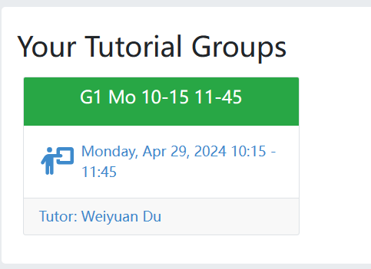
Tutor Session
Onsite tutor session on Monday
• 10:15 - 11:45
• There is no obligation to attend, but it is highly recommended
• All the material is on Artemis
• Read carefully the code of conduct
The tutor session might finish ahead of the time

Slide 6
Tutor sessions and exercise rules
• Make sure to attend the tutor sessions
• You can only submit solutions to exercises on Artemis
• Each exercise has a due date
• If you miss the deadline, your solution will not be graded
• Important: exercises must be completed and submitted independently
• It would help if you had a unique solution to the exercises
• Plagiarism, i.e., copying unthinkingly without understanding the concepts and without applying the skills, might be tempting, but you betray yourself

Slide 7
Consequences of plagiarism
Allgemeine Prüfungs- und Studienordnung (APSO) https://portal.mytum.de/archiv/kompendium_rechtsangelegenheiten/apso/Lesb-F-APSO-vom-18-03-2011-mit-5-AeS-vom-21-12-2020.pdf/download
• Only available in German, but translated to English here for your convenience
• § 22: “If the student attempts to influence the result of an examination by cheating or using unauthorized aids, the examination in question will be graded unsatisfactory”, i.e. 5,0 (U)
• § 24: “Otherwise, failed module examinations may be repeated as often as desired, subject to the deadlines specified in § 10. This does not apply in the case of failure due to cheating or a breach of regulations according to § 22. In this case, the failed examination may only be repeated once.”

Slide 8
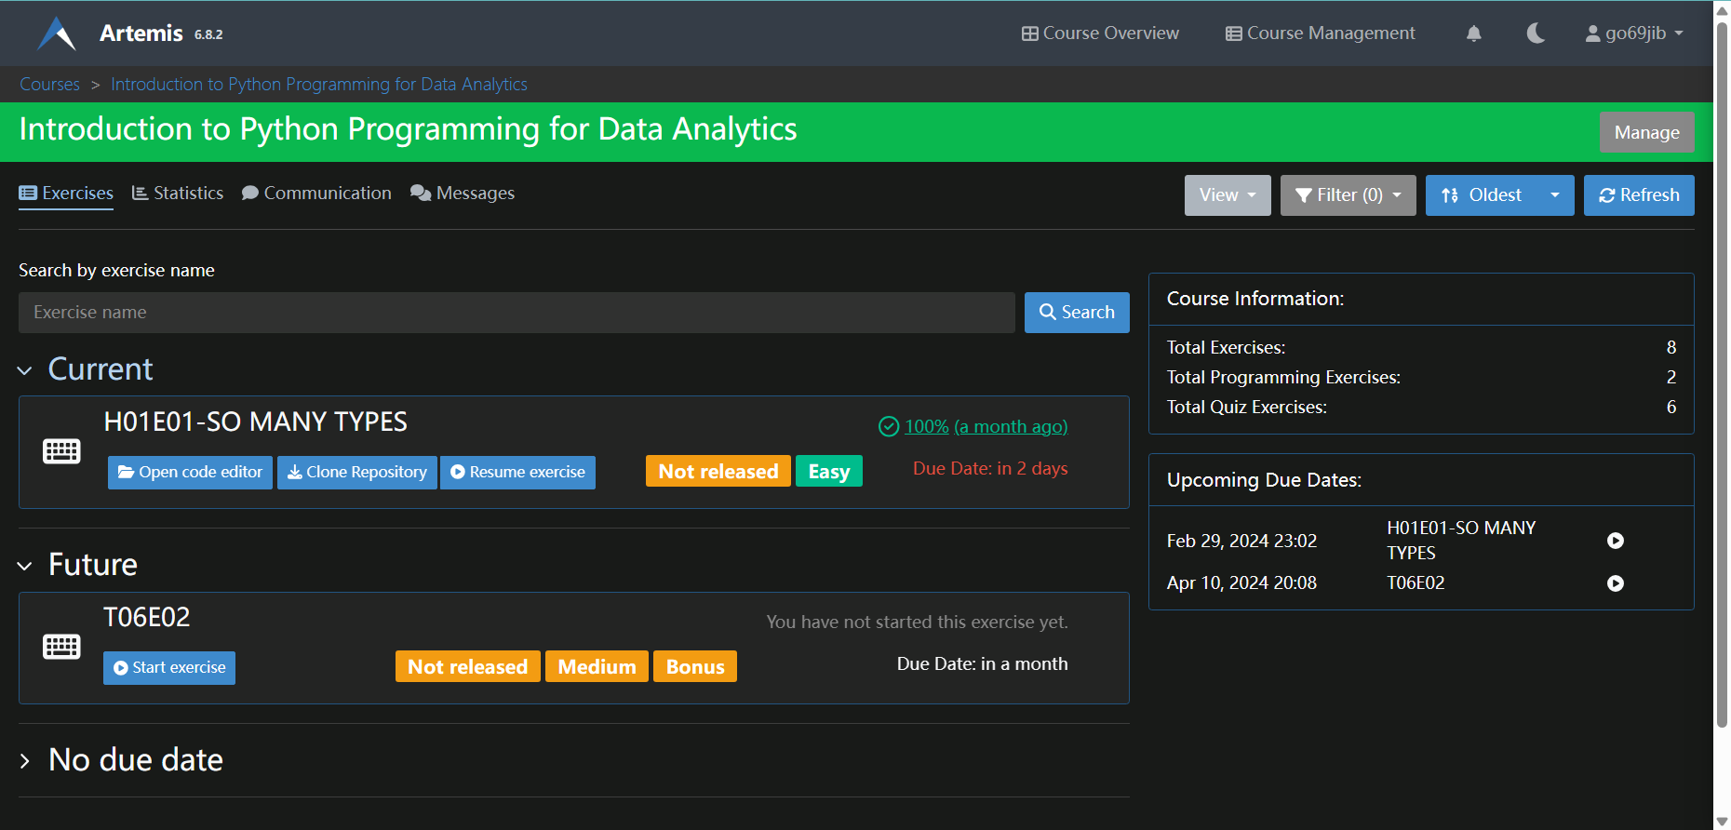
Artemis
https://artemis.ase.in.tum.de

Slide 9
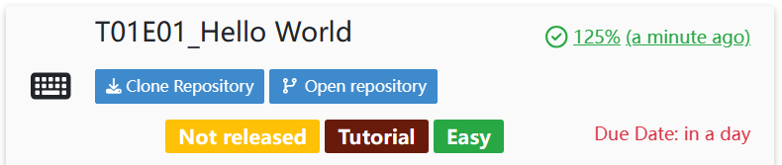
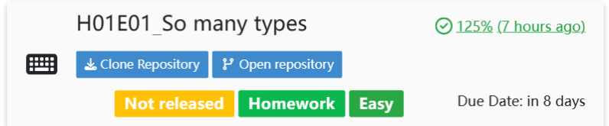
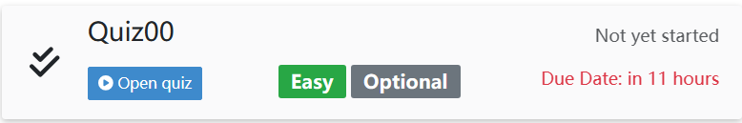
Exercise category
Tutorial exercise
with a Tutorial label
4 points and 1 bonus point = 5 points
Homework exercise
With a Homework label
4 points and 1 bonus point = 5 points
Quizes
Mon 10:15 – 10:20 of the tutorial session

Slide 10
Typical schedule of the tutor sessions meetings
1. Short review (max. 20 min) of the lecture content (no repetition)
• Your tutor quickly shows the roadmap, outline, and summary slides of the lecture
• You can ask questions if something is unclear (prepare them in advance)
2. Tutor exercises (40 min)
• Solve exercises in the tutor sessions
3. A short discussion of the new homework (max. 15 min)
• Your tutor quickly shows the new homework
• You can ask questions if something is unclear (prepare them in advance)
No worries! There will be a short break between.

Slide 11
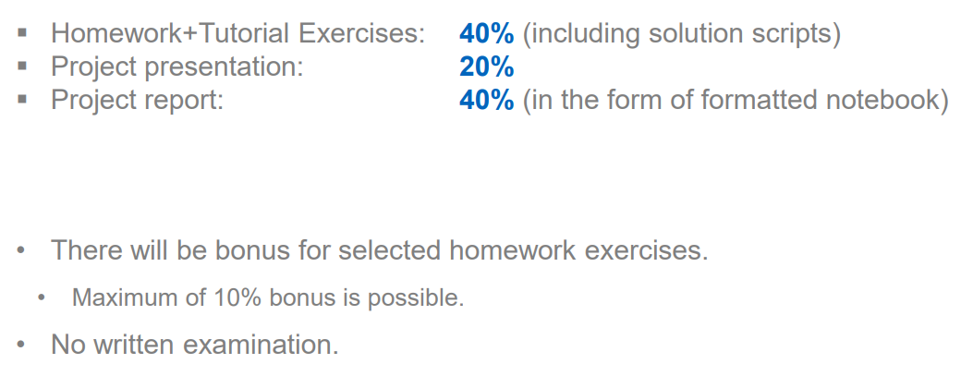
Grading

Slide 12




Environment for the lectures
Anaconda Distribution | Anaconda
Vscode Visual Studio Code - Code Editing. Redefined
Pycharm https://www.jetbrains.com/pycharm/download/
Jupyter notebook Project Jupyter | Home
Pip ( download for python package)
WSL (windows subsystem for Linux)
Terminal (Mac os)
Git (will be used frequently during the exercises)
Copyrights, all the images are from wiki

Slide 13
Any Questions? Thanks for coming to the tutor session!

