Slide 2
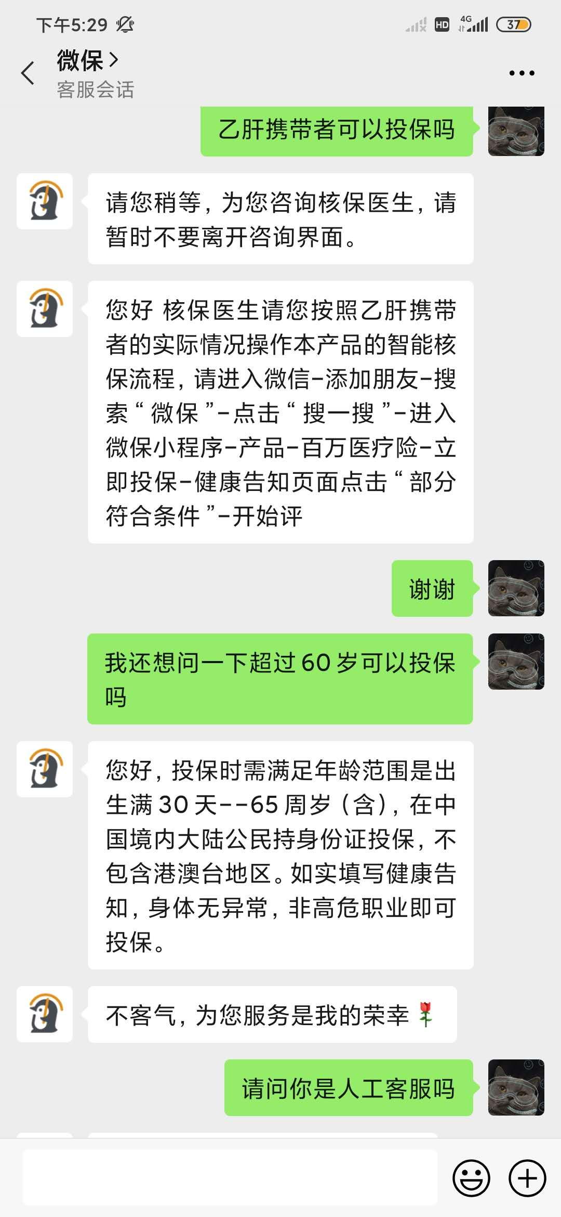
Customer Support (Answerer)
Customer (Asker)
Text input box for customers

Slide 3
Describing Information Need
Understanding Received Information
Maintaining Conversation
Intention
Message Category
New Questions
Repeat & Rephrase
Context & Details
Clarification & Feedback
Chit-chat & Nudge
(express)
(refine)
(enrich)

Slide 4
Q->? (all)
0.225
ANS
FQS
0.034
0.071
CH
FQO
0.099
0.181
Q
BG
REP
0.032
0.076
SUP
CLR
0.082
0.036
Other
END
0.021
0.141

Slide 5
Q->? (AI)
0.233
ANS
FQS
0
0.064
CH
FQO
0.087
0.180
Q
BG
REP
0.029
0.105
SUP
CLR
0.064
0.029
Other
END
0.017
0.192

Slide 6
Q->? (human)
0.262
ANS
FQS
0.054
0.074
CH
FQO
0.134
0.154
Q
BG
REP
0.013
0.034
SUP
CLR
0.060
0.054
Other
END
0.020
0.141

Slide 7
Q->? (mix)
0.192
ANS
FQS
0.049
0.074
CH
FQO
0.084
0.202
Q
BG
REP
0.049
0.084
SUP
CLR
0.113
0.030
Other
END
0.025
0.099

Slide 8
Q→?
Lower Q→REP in human-only
More Q→CLR in human-only
More Q→CH in human-only (even though the overall % of CH in human-only is the lowest)
Q→ANS does not exist in AI-only
More Q→SUP in hybrid
?→Q
Lower BG→Q in human-only
Lower FQS→Q and FQO→Q in human-only
Higher Q→Q in human-only
Higher CH→Q in AI-only

Slide 9
?->Q (AI)
0.233
ANS
FQS
0
0.017
CH
FQO
0.070
0.081
Q
BG
REP
0.128
0.012
SUP
CLR
0
0.012
Other
BEGIN
0.012
0.436

Slide 10
?->Q (human)
0.262
ANS
FQS
0.007
0
CH
FQO
0.034
0.027
Q
BG
REP
0.013
0.007
SUP
CLR
0
0.020
Other
BEGIN
0.013
0.617

Slide 11
?->Q (mix)
0.192
ANS
FQS
0.010
0.035
CH
FQO
0.039
0.074
Q
BG
REP
0.158
0.035
SUP
CLR
0.054
0.015
Other
BEGIN
0.010
0.379

Slide 12
BEGIN->? (AI)
0.75
ANS
Q
FQS
0
0
CH
FQO
0.12
0
BEGIN
BG
REP
0.12
0
SUP
Other
CLR
0
0
0.01

Slide 13
BEGIN->? (human)
0.92
ANS
Q
FQS
0
0
CH
FQO
0.04
0
BEGIN
BG
REP
0.02
0
SUP
Other
CLR
0
0
0.02

Slide 14
BEGIN->? (mix)
0.77
ANS
Q
FQS
0
0
CH
FQO
0.10
0
BEGIN
BG
REP
0.13
0
SUP
Other
CLR
0
0
0

Slide 15
?->END (AI)
0.33
ANS
Q
FQS
0.01
0.06
CH
FQO
0.22
0.19
END
BG
REP
0.01
0.12
SUP
Other
CLR
0.03
0.03
0

Slide 16
?->END (human)
0.21
ANS
Q
FQS
0.08
0.11
CH
FQO
0.24
0.18
END
BG
REP
0
0.05
SUP
Other
CLR
0.05
0.07
0.01

Slide 17
?->END (mix)
0.20
ANS
Q
FQS
0.05
0.05
CH
FQO
0.36
0.10
END
BG
REP
0
0.05
SUP
Other
CLR
0.08
0.07
0.04

Slide 18
BEGIN and END
Higher BEGIN→Q in human-only
Higher REP->END in AI only

