Slide 1

Bike Availability in Washington DC
Group name: VanMoof
Prepared by: Clare Cruz
Tristal Li
Zhuoheng Han
Wei-Yu Tseng
For client: Capital Bikeshare
Presented in class:
Perspectives in Data Science (36-601) & Professional Skills for Statisticians (36-611)
DATE: 11/15/2021

Slide 2
Executive Summary
Data: June 2019 capital bike share trip data with location information
Bike availability (%): (# of bikes in a station)/(total bike capacity of that station) * 100%
Time: Day of the month, Hours in a day, Weekdays or Weekends
Location: Longitude & Latitude, City map of Washington DC
Methods: Exploratory data analysis (EDA) – Charts & Maps
Results & Conclusions:
Overall Bike Availability Over a Day: Usually higher availability over night than daytime
Weekday vs. Weekend: Bike availability on weekends and weekdays is comparable
Bikeshare Station’s Locations & Capacity: More bikeshare stations and higher capacity in downtown than suburbs
Commuting Patterns: Higher bike availability in commercial areas after morning commute, and in residential areas after evening commute

Slide 3
Data Description
Data origin: Historical data on Capital Bikeshare usage⁽¹⁾
Data sets:
Capital Bikeshare trip data during the month of June 2019 (To eliminate influence of Covid)
Capital Bikeshare station locations and capacity
Main factors:
Bike availability (%): (# of bikes in a station)/(total bike capacity of that station) * 100%
Time: Day of the month, Hours in a day, Weekdays or Weekends
Location: Longitude & Latitude, City map of Washington DC
Main data manipulation steps:
Determine how many bikes are at each station at the beginning of June 2019
Calculate how many bikes were reshuffled by the vans and add data points for those transitions
Calculate the number of bikes that have arrived and departed from each station for every hour
Determine the difference between arrivals and departures, and calculate the rolling sum
(1). Data accessed from: https://www.capitalbikeshare.com/system-data

Slide 4
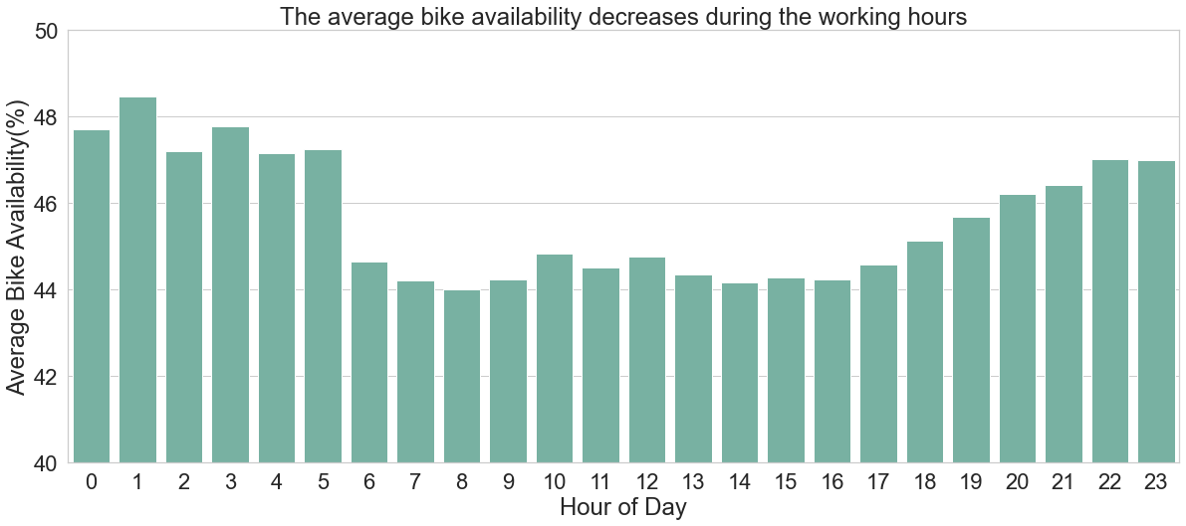
Overall Bike Availability in a Day
Higher average bike availability over night than daytime
Bike availability decrease sharply at 6 a.m., and increase gradually between 5 and 10 p.m.
Conclusion: Average bike availability is lower in working hours
Possible reason: More bikes are in use during daytime; Working and living schedules

Slide 5
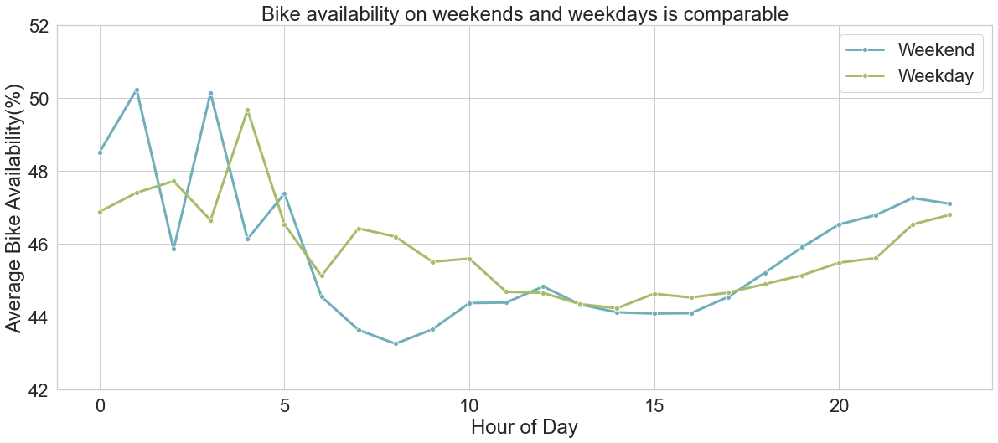
Weekday vs. Weekend
The trend of two lines are similar except for some small fluctuations
Conclusion: Although we originally thought that weekend vs. weekday can influence bike availability over a day, our analysis shows that they are similar

Slide 6
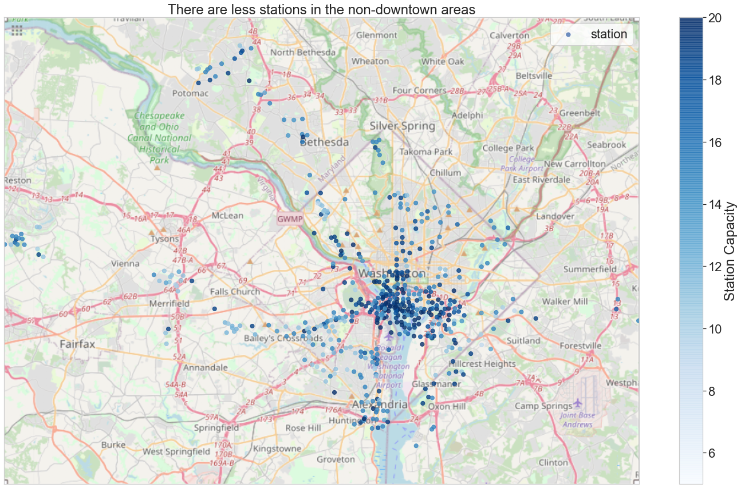
Bikeshare Station’s Locations & Capacity
Observations:
Higher density of bikeshare stations in downtown than suburbs; Some small cluster of bike stations in outskirts
Higher bikeshare station capacity in downtown areas
Possible reasons:
Larger population & more companies in downtown
Clusters of populations and companies in outskirts
Conclusion:
Future analysis should separate downtown and suburban areas

Slide 7
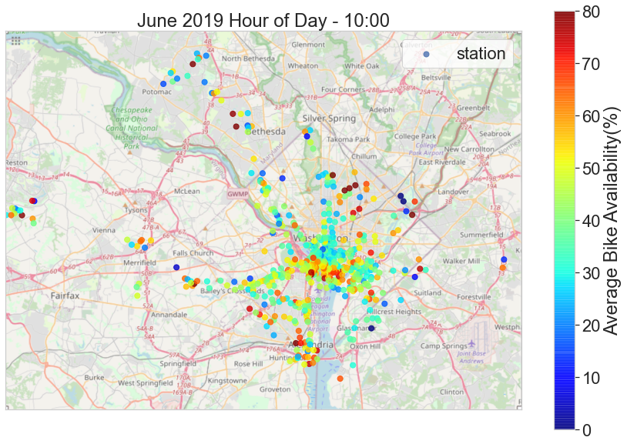
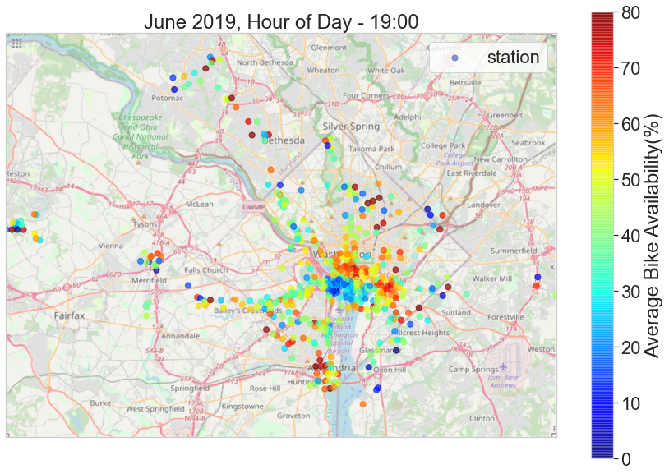
Commuting Patterns
Commuting patterns transfer bike availability throughout the day
Bikes are parked in commercial area after commuting in the morning
They come back to the residential area after commuting in the evening
Conclusion: Commuting pattern can influence the bike availability distribution over a day
Notes:
Team info: Good morning! My name is xxx, and I’m here with my teammates xxxx. We are team VanMoof. Today we are going to present a key finding from our EDA, which is how the commuting patterns transfer bike availability throughout the day.
Definitions: Before we talk about our analysis, we can define bike availability. Bike availability is the number of bikes in a station at a time divided by the total capacity. In other words, bike availability is the proportion of bikes in a station that are available for a customer to start riding. Once we have this metric, we performed our EDA, where we found that the bike availability is usually higher over night than daytime; Bike availability on weekends and weekdays is comparable; and there are more bikeshare stations and higher capacity in downtown than suburbs. Another one of our key findings is that bike availability is usually changing from working hours to non-working hours, which we will discuss more about that here.
Time: We saw that during working hours, the bike availabilities are moving. People usually stop to commute around 10 am in the morning and 7 pm in the evening, so we choose these two times as our main focus.
Visualization: Each point on the graphs represents a bikeshare station. Their colors can show their average bike availability. We average the bike availability of the two times throughout the month June 2019. Reddish color means high bike availability, and blueish color means low bike availability. On the graphs, we can see two clusters in the black and red circles. Between the two times, pattern of stations in the black and red circles shifts. After further investigation, we found that the black circle represents the residential area, and the red circle is the commercial area.
Conclusion: We can thus conclude that bikes are parked in commercial area after commuting in the morning, and they come back to the residential area after commuting in the evening. So commuting pattern can influence the bike availability distribution over a day.
Next steps: We now know that location and time are very important in predicting bike availability, and we will likely to include both of them in our modelling process.

Slide 8
Q & A

