Slide 1

Predicting Bike Availability in Washington DC
Group name: VanMoof
Prepared by: Clare Cruz
Tristal Li
Zhuoheng Han
Wei-Yu Tseng
For client: Capital Bikeshare
Presented in class:
Perspectives in Data Science (36-601) & Professional Skills for Statisticians (36-611)
DATE: 11/30/2021

Slide 2
Agenda
Slide
2
3
4
5
6
7
8
9
10
11 – 23
Executive Summary
Introduction
Background
Data Description
Model
Result
Recommendations
Keeping the Model Working
Next Steps & Wish List
Technical Appendix

Slide 3
Executive Summary
Purpose: Capital Bikeshare has asked Vanmoof to build a sustainable model to predict availability of bikes by station for any given time period
Methods: Statistical Modeling – Random Forest Regression Model using the average squared error as the accuracy measurement
Results: Overall Accuracy – Mean Squared Error (MSE): 0.03
Recommendations:
Bike reshuffling should adjust to the average temperature and hour
Our model should be put into production because it is unbiased, valid, and accurate
Keeping the Model Working:
Make sure the data is clean and consistent
Run the data cleaning and modeling module
Input the station number and values for prediction

Slide 4
Introduction
Why are we here?
Build a sustainable model to predict availability of bikes by station
The model is intended to improve bike availability by scheduling contractors who reshuffle bikes from/to bike stations
Scope
Exploratory data analysis
Production level predictive model
Project plan and 3 status reports
Presentation deck

Slide 5
Background
Capital Bikeshare Input
There is a relocation van that redistributes bikes
For large events, the capacity of bike stations increases⁽¹⁾
The model should focus on bike availability (to be defined in the project)
The model needs to be dynamic, so that the analysts at Capital Bikeshare can continue to utilize it
Assumptions
Because of the relocation van, a bike is not guaranteed to stay at the station where it was left
There may be new or relocated stations
Bikes can occasionally be stolen or broken
Aggregation information by time is representative of the true bike availability
(1). A fact we discovered in the data

Slide 6
Data Description
Datasets:
Capital Bikeshare trip data in the year 2019^{(1 & 2)} (To eliminate influence of Covid)
Capital Bikeshare station locations and capacity
Daily weather data from NCEI⁽³⁾
Variables:
Category | Factor |  | Why include?
Predictive Variable | Bike Availability (%) |  | The factor we want to predict
Station | Station IDs |  | Unique identifier for each station
Time | Hour of day | Day of Week | Time can influence bike availability
Special events | Holidays |  | Special events may result in abnormal patterns
Weather | Precipitation (In) |  | People are less likely to ride a bike on rainy days
 |  |  | People are less likely to ride a bike on snowy days
 | Snow (In)
 |  |  | People tend to not riding a bike in extreme temperatures
 | Temperatures (F)
(1). Data accessed from: https://www.capitalbikeshare.com/system-data
(2). We used closing data from Dec. 2018 to help calculate bike availability, but it is not in the model
(3). National Centers for Environmental Information (NCEI), Data accessed from: https://www.ncei.noaa.gov/

Slide 7
Model Selection
Classification vs. Regression
We did not use classification for this project since the response is numerical, and dividing the groups would take more experimentation to see what would work best
We choose to use a random forest regression model since it has the power to handle a large data set with higher dimensionality ⁽¹⁾
Accuracy Measurement
Mean Squared Error (MSE) = Avg[(Real value – Predicted value)^2]
Why MSE?⁽²⁾
Our model is regression
MSE is interpretable
The model is trained on 80% of the data and tested on the remaining 20%
(1). More detail on the MSE can be found in the technical appendix Page 16
(2). More detail on the models that were tested can be found in the technical appendix Page 14

Slide 8
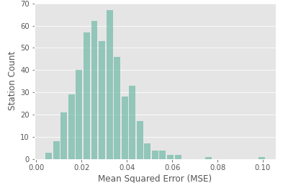

Results
Overall Accuracy – Measured by Mean Squared Error: 0.03
This means: For each predicted value from our model, its expected deviation from the true bike availability is $\sqrt{0.03}=0.17$
In context, for a station that hold ten bikes, the model’s predictions will be off by 2 bikes on average. For a station of 30 bikes, the model will only be off by 5 bikes or so
The distribution of MSE’s are centered around 0.03

Slide 9
Recommendations
Our model should be put into production – why?
The model is fairly accurate, errors are minimized
The model is valid for every station and hour in the dataset
The model is unbiased⁽¹⁾
Potential Optimizations:
Average Temperature – Van reshuffling schedules should adjust for the daily temperature
Hour of the Day – Van reshuffling schedules should adjust to the hour of the day, especially commuting hours
(1). See Technical Appendix Page 17

Slide 10
Keeping the Model Working
Data
Update the bike trips, weather, and capacity database monthly
Make sure the data is in consistent format (column names & data types)
User Input
Apply the data cleaning module to clean the new data
In the modeling module, the user inputs the station number and the values of our predictors for a prediction
Data Cleaning Module
CSV File
Model Module
User Input
Predicted Availability
Notes:
Model is not biased, error is minimized, model is valid for every station.

Slide 11
Next Steps & Wish List
Next Steps
Universal data processing algorithm
Add more variables that could be useful for prediction such as:
Metro and Bus Locations
Local Events Calendar
Restructure current datasets to include bike ID
Wish List
Implement an online learning algorithm that can be automatically updated when more data comes in
Compile the Python functions into an app, which can be performed in a webpage to increase the user friendliness of the model
Structure the model to output potential van schedules

Slide 12
Q & A

Slide 13
Technical Appendix
Github Link to the works: https://github.com/Tristal25/Capital_bikeshare_36601.git

Slide 14
Outline for Technical Appendix
Key terminologies
Random Forest Regression Algorithm
Mean Squared Error (MSE)
Model selection – Tested Model Algorithms
Model evaluation – Accuracy by Locations
EDA
Summary
Contents

Slide 15
Tested Model Algorithms
Logistic Regression – It predicts values between 0 and 1 that follows a similar structure to simple linear regression
K Nearest Neighbors Classification – It takes k nearest distances to predict the class. It predicts low (20%), medium (20%-80%), and high (80%) group with average accuracy 60% for one station
Random Forest Classification - The output is the class selected from most trees. It predicts low (20%), medium (20%-80%), and high (80%) group with average accuracy 68% for one station

Slide 16
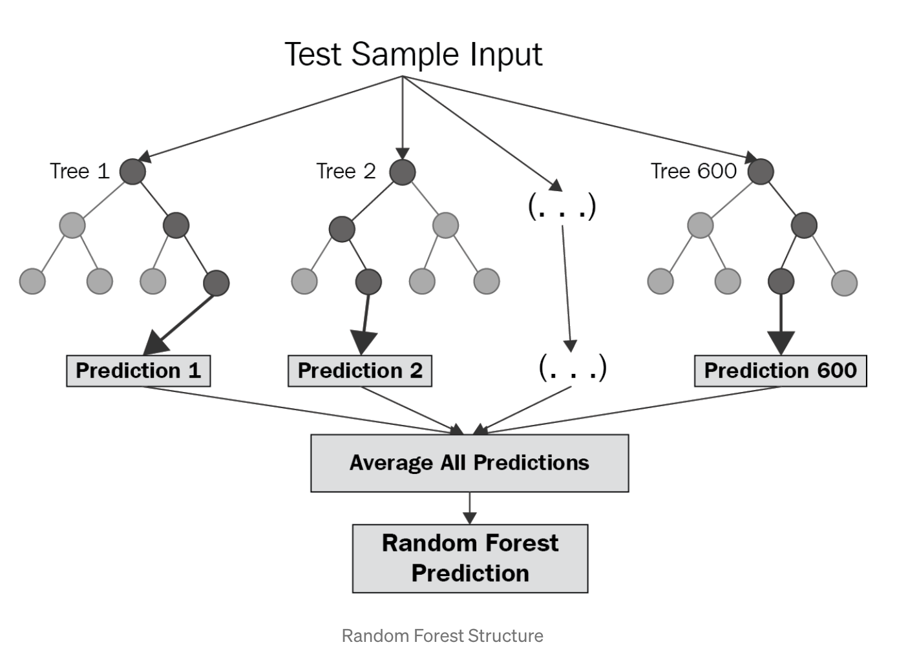
Random Forest Regression Algorithm
Step 1 – Sample the data with replacement X times. Where X is determined by the analyst
Step 2 – Fit a decision tree to each of the X data samples.
A decision tree is a model that utilizes several layers of binary decisions to predict an outcome
Step 3 – For each of the X samples, predict the value for an observation
Step 4 – Average the predictions across all the samples

Slide 17
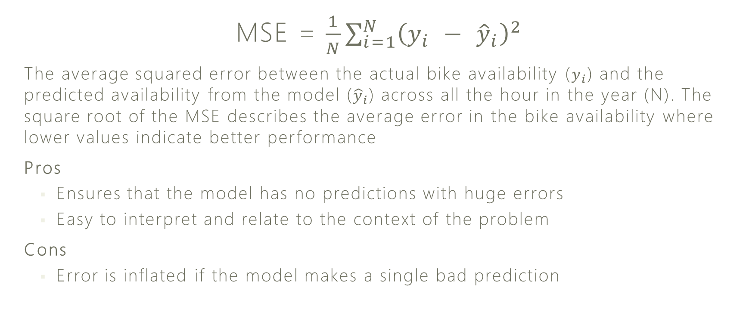
Mean Squared Error (MSE)
MSE = $\frac{1}{N}\sum_{i=1}^{N}{{\left(y_{i} − {\hat{y}}_{i}\right)}^{2}}$
The average squared error between the actual bike availability ($y_{i}$) and the predicted availability from the model (${\hat{y}}_{i}$) across all the hour in the year (N). The square root of the MSE describes the average error in the bike availability where lower values indicate better performance
Pros
Ensures that the model has no predictions with huge errors
Easy to interpret and relate to the context of the problem
Cons
Error is inflated if the model makes a single bad prediction

Slide 18
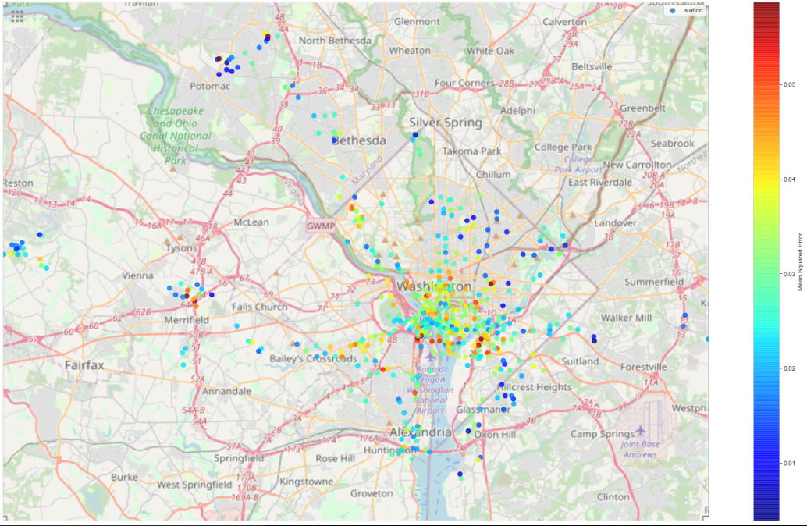
Model Accuracy by Location
Observations: Stations in the outskirts tend to have better accuracy. But the stations with the worst accuracy are not clustered into any specific area
Conclusion: The model is not bias towards stations by location.

Slide 19
Exploratory Data Analysis

Slide 20
EDA Summary
Overall Bike Availability Over a Day:
Usually there is higher availability overnight than daytime
Weekday vs. Weekend:
Bike availability on weekends and weekdays is comparable
Bikeshare Station’s Locations & Capacity:
More bikeshare stations and higher capacity in downtown than suburbs
Commuting Patterns:
Higher bike availability in commercial areas after morning commute, and in residential areas after evening commute

Slide 21
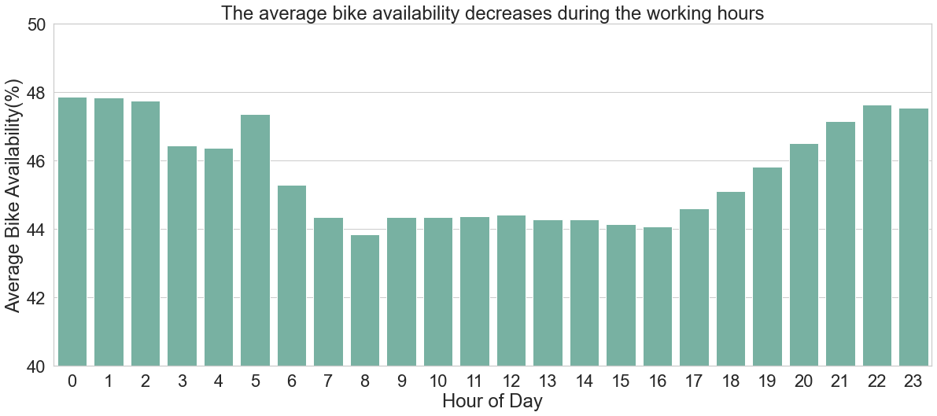
Overall Bike Availability in a Day
Higher average bike availability overnight than daytime
Bike availability decrease sharply at 6 a.m., and increase gradually between 5 and 10 p.m.
Conclusion: Average bike availability is lower in working hours
Possible reason: More bikes are in use during daytime; Working and living schedules

Slide 22
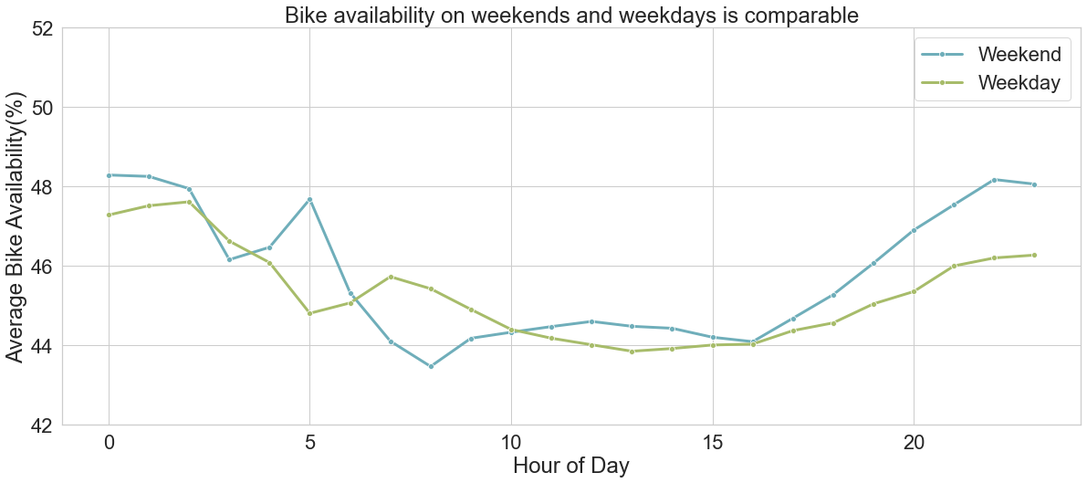
Weekday vs. Weekend
The trend of two lines are similar except for some small fluctuations
Conclusion: Although we originally thought that weekend vs. weekday can influence bike availability over a day, our analysis shows that they are similar

Slide 23
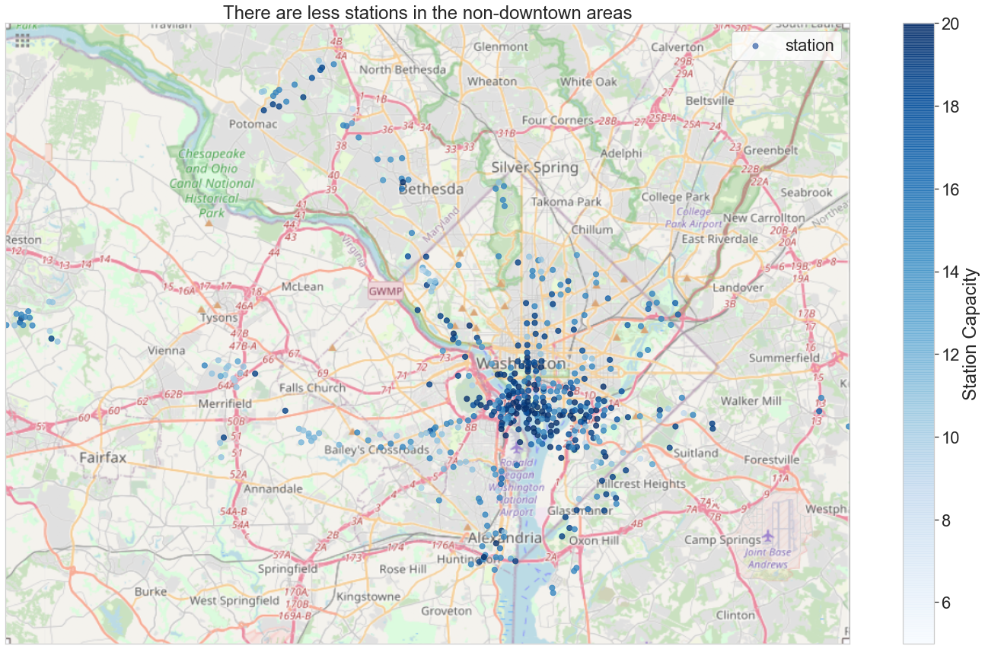
Bikeshare Station’s Locations & Capacity
Observations:
Higher density of bikeshare stations in downtown than suburbs; Some small cluster of bike stations in outskirts
Higher bikeshare station capacity in downtown areas
Possible reasons:
Larger population & more companies in downtown
Clusters of populations and companies in outskirts
Conclusion:
Future analysis should separate downtown and suburban areas

Slide 24
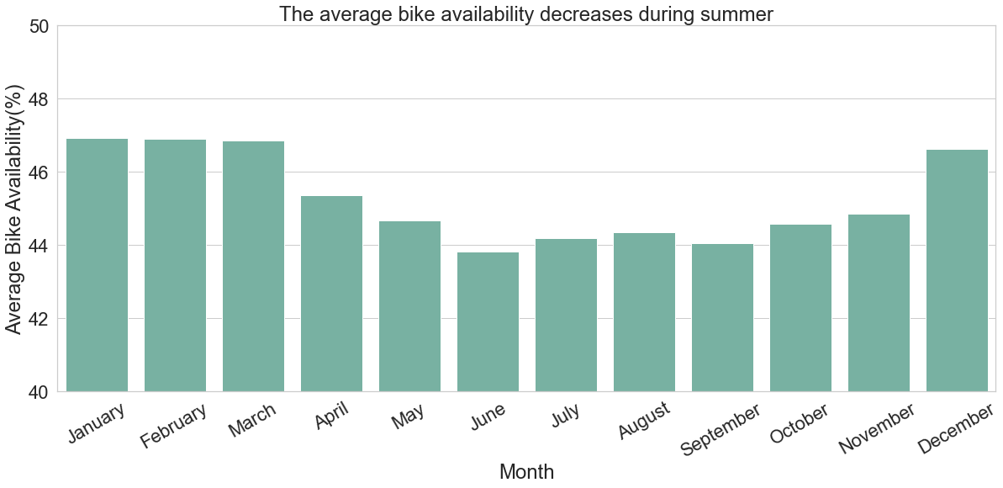
Bike Availability by Month
Conclusion: Average bike availability is lower in summer than other seasons
Possible reason: More bikes are in use during summer because of the good weather

