Slide 1
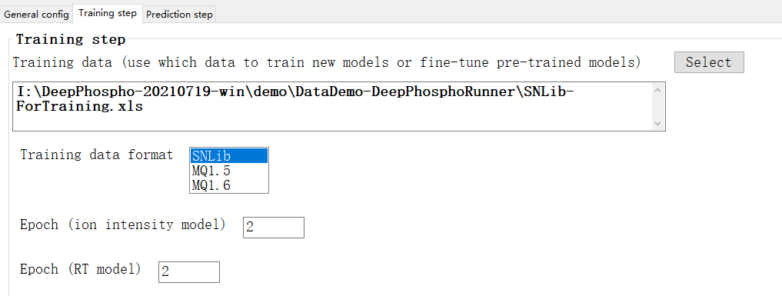
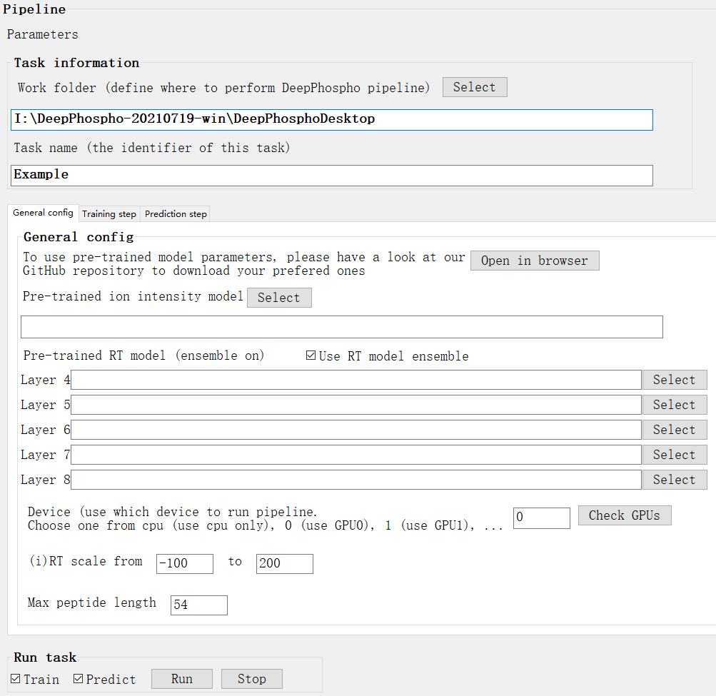
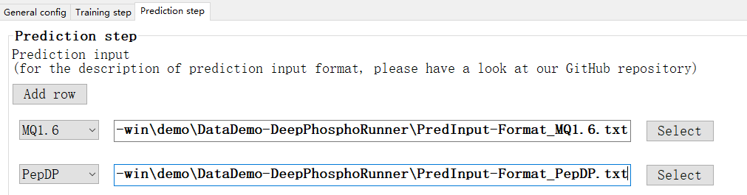

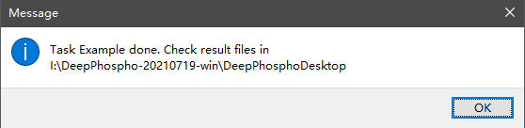
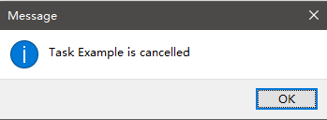
1
Launch DeepPhospho desktop in two ways
3
Switch to training step settings
Select training data in demo data folder
Pipeline will be performed in folder DeepPhosphoDesktop and generated items will have an identifier Example
Keep training data format as SNLib since this file is a spectral library exported from Spectronaut
Set both ion and RT model epoch to 2 to make example run fast
We would recommend to use pre-trained weights (described in GitHub page) but here we skip this and go ahead
4
Switch to prediction step settings
Select prediction data in demo data folder and assign corresponded formats
Empty these fields will make runner train new models from scratch
2
5
Keep “Train” and “Predict” checked and run task
Choose your device. If you are not sure if GPU is available, click this button and it will switch to cpu if there is no available GPU
6
Wait for task finished or stop task

Slide 2
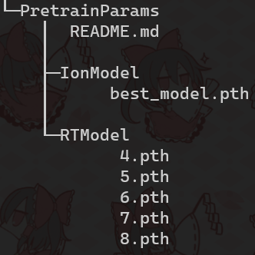
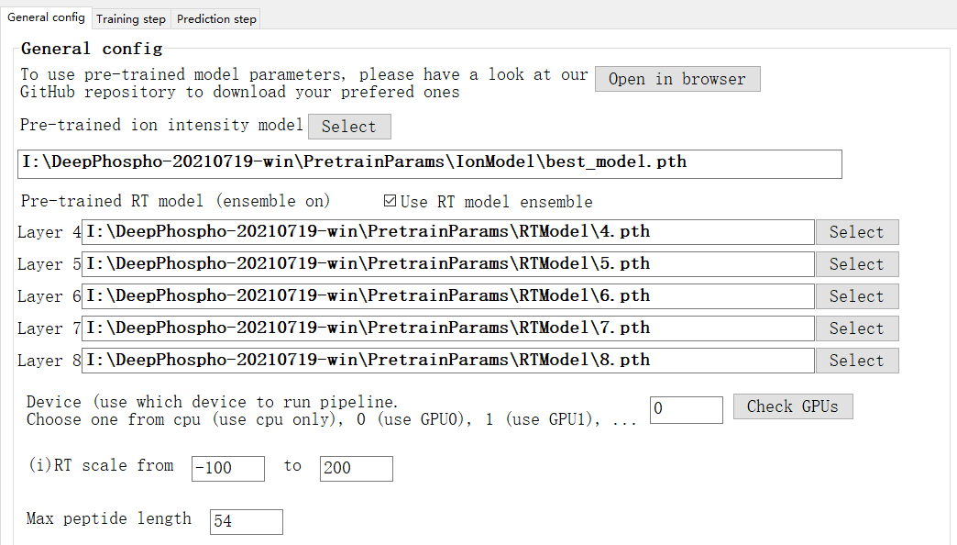
If you have downloaded pre-trained model parameter files and arranged them like this structure, these fields will be filled when app is launched

Slide 3
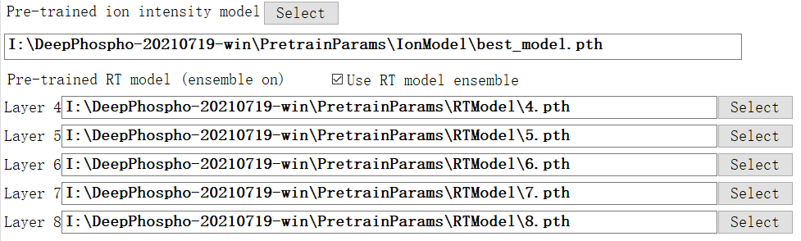
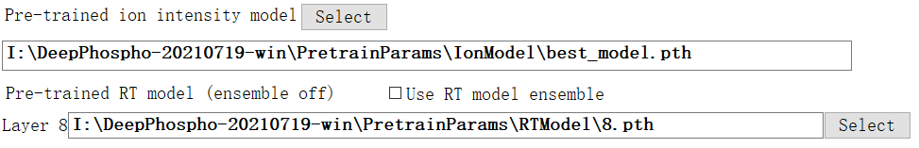
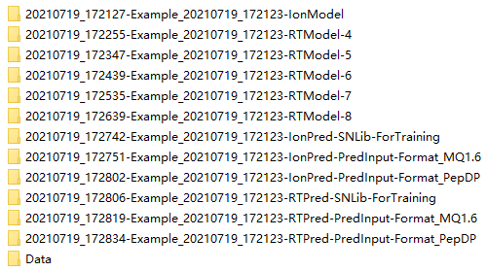
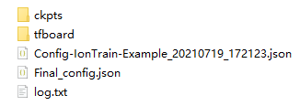
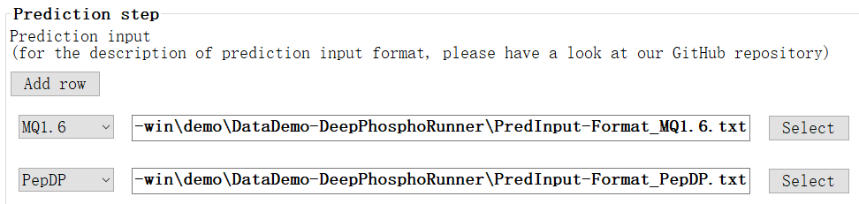
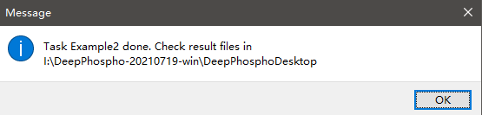

1
Switch off RT ensemble
2
Select pre-trained model parameter files
If the PretrainParams directory is defined as described, the pre-trained model weights will be loaded at app launching. The auto loaded files will like the filled text below.
You can also use the newly trained models at the previous example.
3
Define under-predicted data
4
Only check Predict option
5
Finished in one minute for 5000 peptide precursors

