Slide 1
In essence, the Actor is an object containing
The possible types of Command it can obey
The logic to be executed for each Command

Slide 2
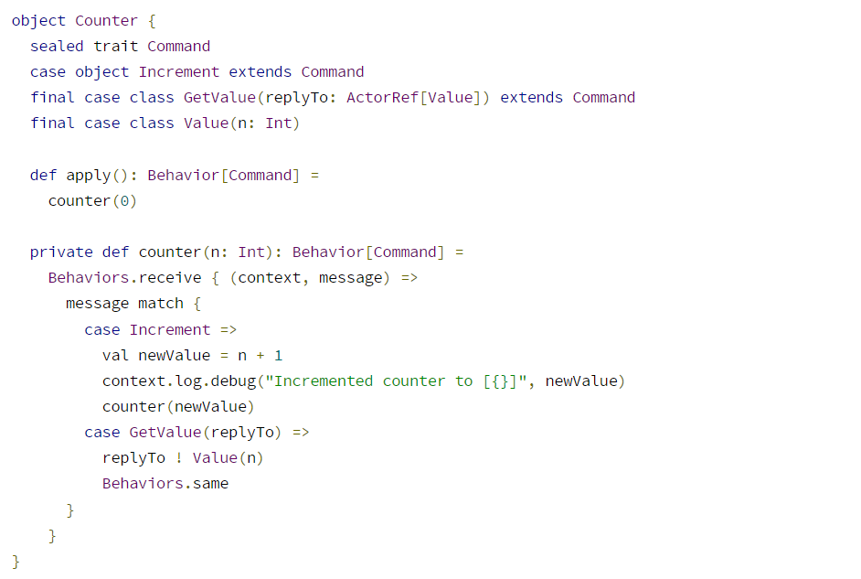
FP-Style Actor
Reply to another Actor with Value Command
2 different commands the Counter actor can obey
Upon receiving the Increment Command:
Get the state in the argument,
Update it,
Return similar Behavior object, same behavior but updated state
Return behavior object holding updated state object

Slide 3
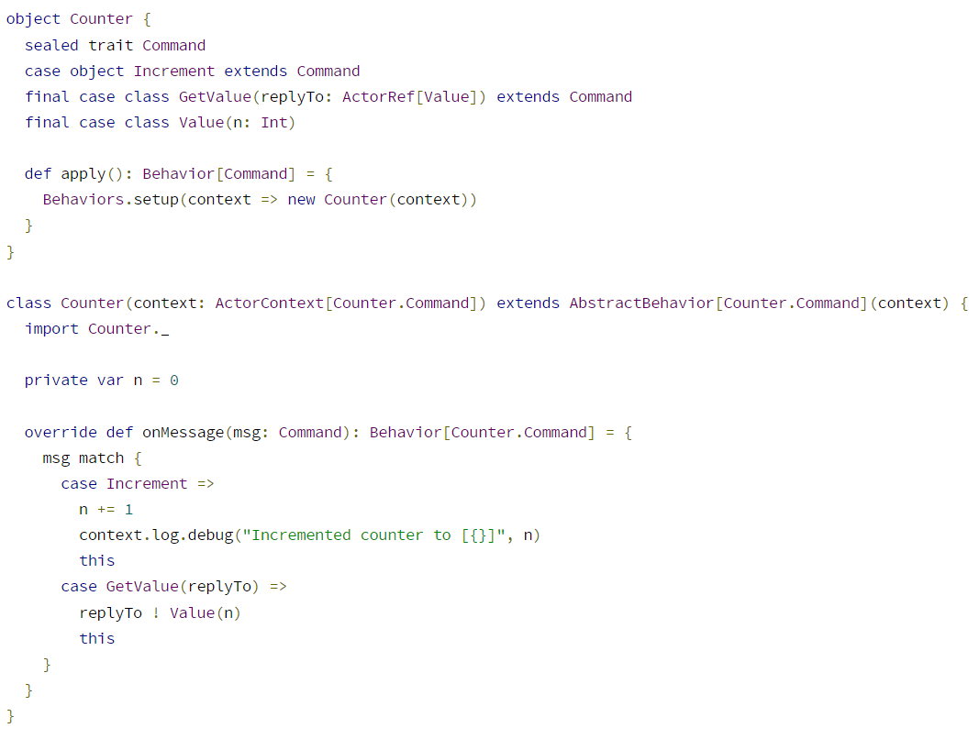
Unlike in FP-style, the constructor of the actor needs to accept ActorContext as argument.
Is it because FP style is implicit?
Similar to FP-style, Behavior object is returned

