Slide 1
Multi-Agent Reinforcement Learning- Based Resource Management for End-to-End Network Slicing
Published in: IEEE Access
Date of Publication: April 12, 2021
Author: YOHAN KIM, HYUK LIM
Speaker: Zhun-Sheng Chen, Zi-Jun Wei
Advisor: Yi-Huai Hsu
2024/04/03

Slide 2
Outline
Introduction
System Model
MDP Model
RL for End-to-End Network Slicing
Performance Evaluation

Slide 3
Intorduction
According to exponential growth of mobile services and the advance in IoT and smart devices, the data traffic required continues to increase.
Use PPO to design ICPRA and JCPRA algorithms to improve resource efficiency and QoS in the MEC environment

Slide 4
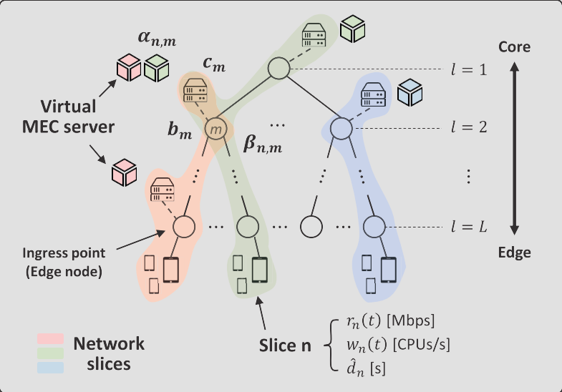
System Model

Slide 5
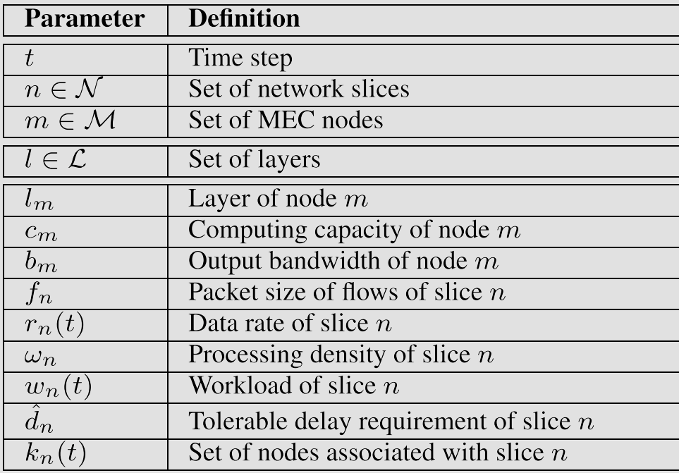
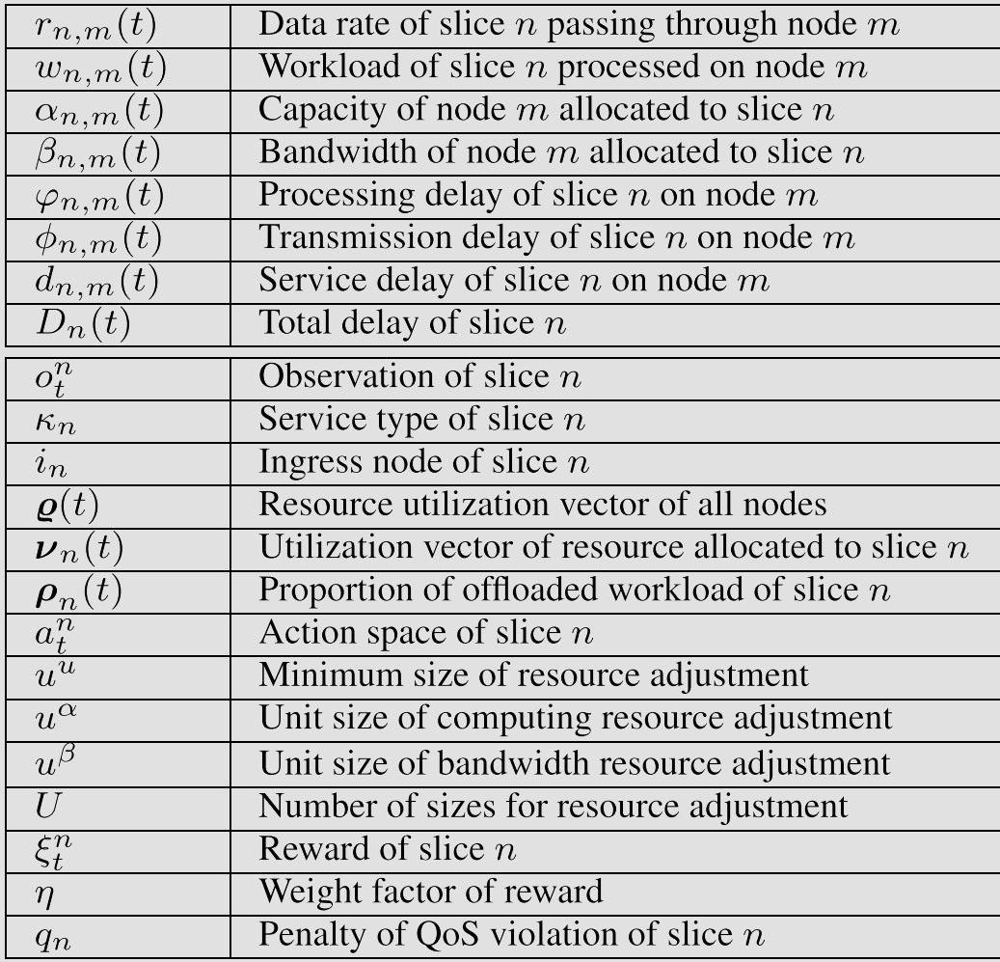
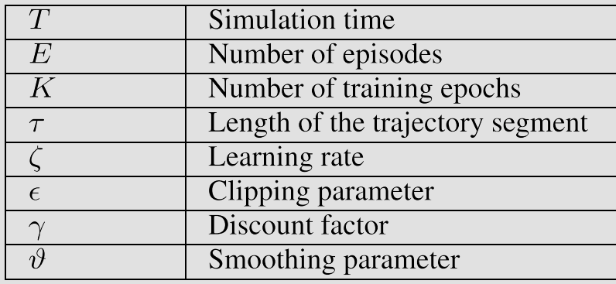
System Model

Slide 6
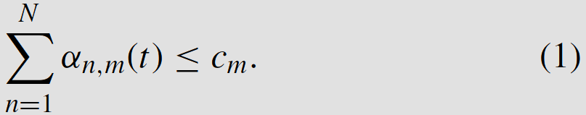
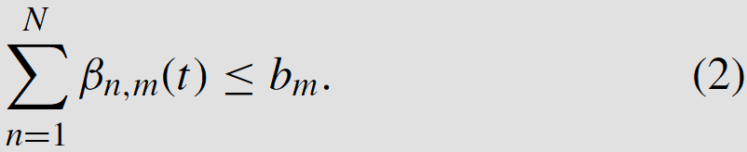
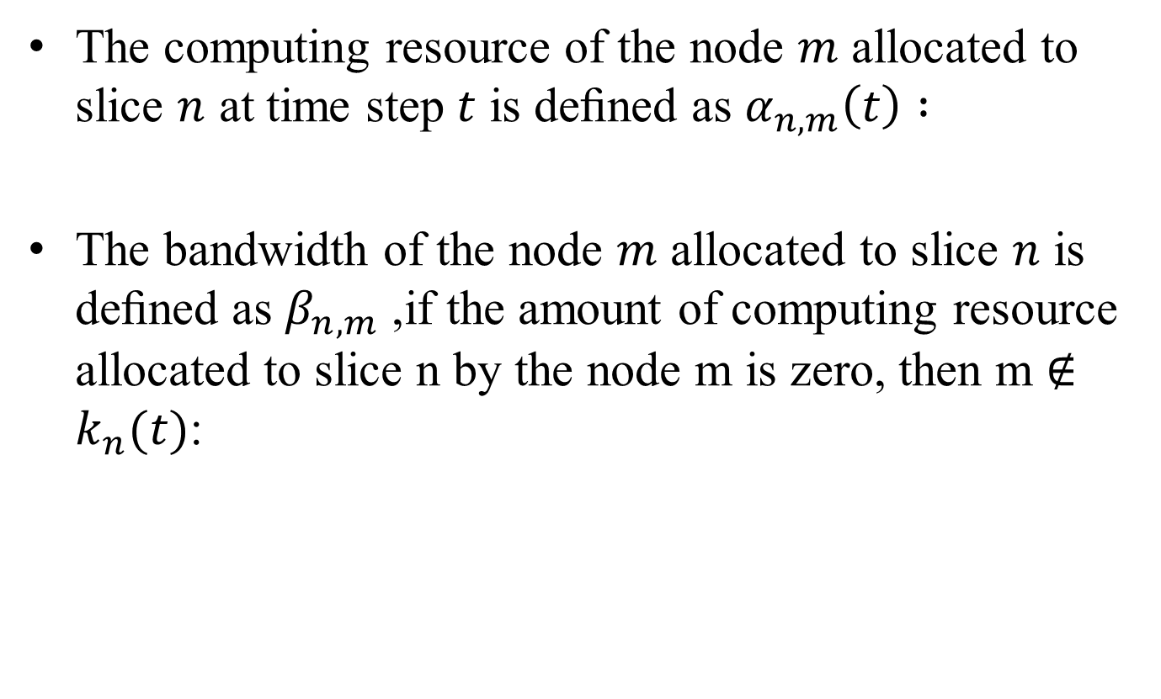
System Model
The computing resource of the node $m$ allocated to slice $n$ at time step $t$ is deﬁned as $α_{n,m}\left(t\right) :$
The bandwidth of the node $m$ allocated to slice $n$ is deﬁned as $β_{n,m}$ ,if the amount of computing resource allocated to slice n by the node m is zero, then m $∉$ $k_{n}(t)$:

Slide 7
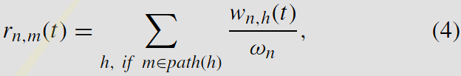
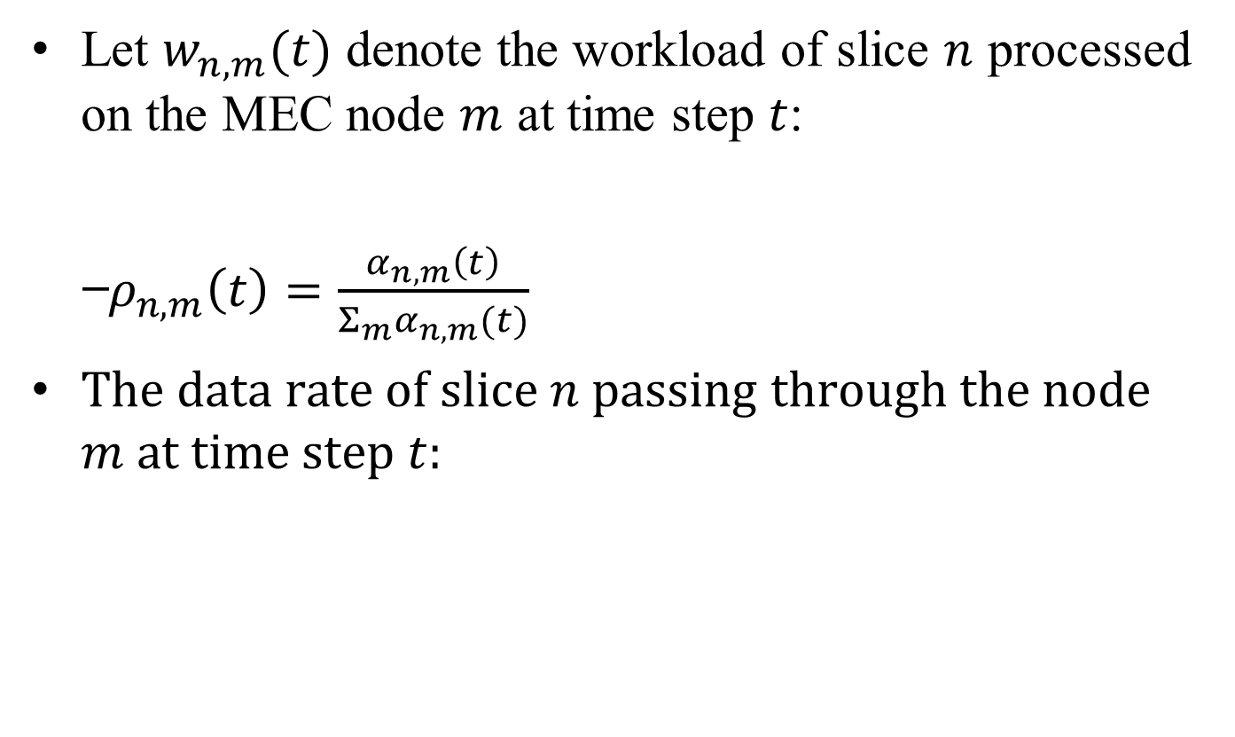
System Model
Let $w_{n,m}(t)$ denote the workload of slice $n$ processed on the MEC node $m$ at time step $t$:
̶ $ρ_{n,m}\left(t\right)=\frac{α_{n,m}\left(t\right)}{Σ_{m}α_{n,m}(t)}$
The data rate of slice $n$ passing through the node $m$ at time step $t:$
Notes:
$ρ_{n,m}\left(t\right):$分配計算資源的比例
$α_{n,m}(t):$分配給node的容量
Where $Σρ$ = 1
$w_{n,h}\left(t\right): 工作量$ $h:$ 入口到MEC節點的路徑集
$ω_{n}:$處理密度

Slide 8
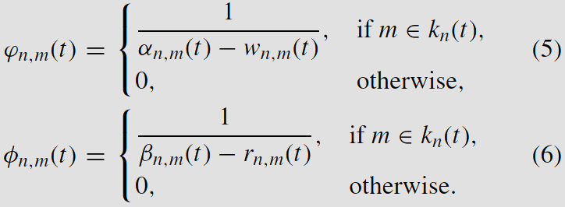

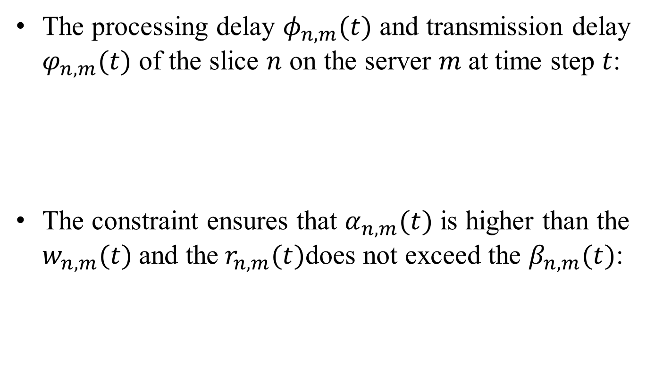
System Model
The processing delay $φ_{n,m}(t)$ and transmission delay $φ_{n,m}(t)$ of the slice $n$ on the server $m$at time step $t$:
The constraint ensures that $α_{n,m}(t)$ is higher than the $w_{n,m}(t)$and the${ r}_{n,m}(t)$does not exceed the $β_{n,m}(t)$:
Notes:
$φ_{n,m}(t):$處理延遲
$φ_{n,m}(t)$:傳輸延遲
$β_{n,m}(t):$ 分配給node m的BW
$r_{n,m}(t):$ data rate
$w_{n,h}\left(t\right):$工作量

Slide 9
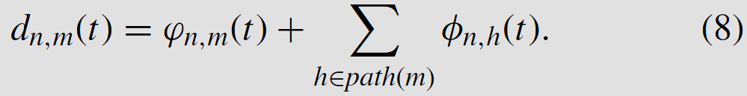
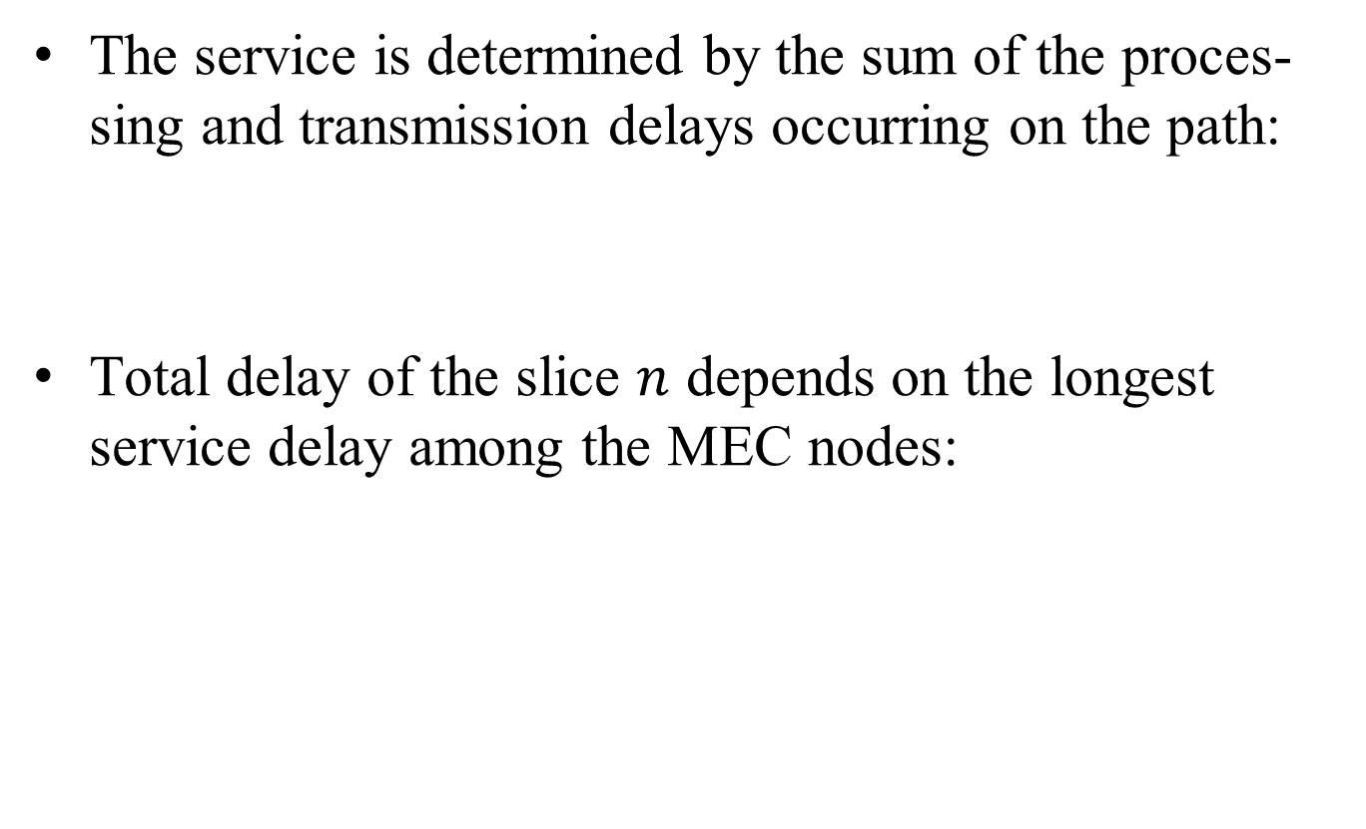
System Model
The service is determined by the sum of the proces-sing and transmission delays occurring on the path:
Total delay of the slice $n$ depends on the longest service delay among the MEC nodes:
Notes:
1. 服務由路徑上發生的處理和傳輸延遲總和決定
$φ_{n,m}(t):$處理延遲
$φ_{n,m}(t)$:傳輸延遲
2.切片𝑛的總延遲取決於MEC節點中最長的服務延遲

Slide 10
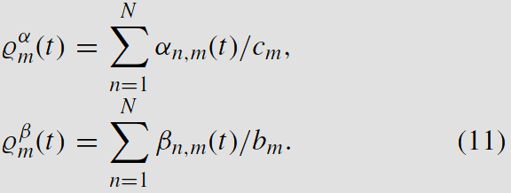
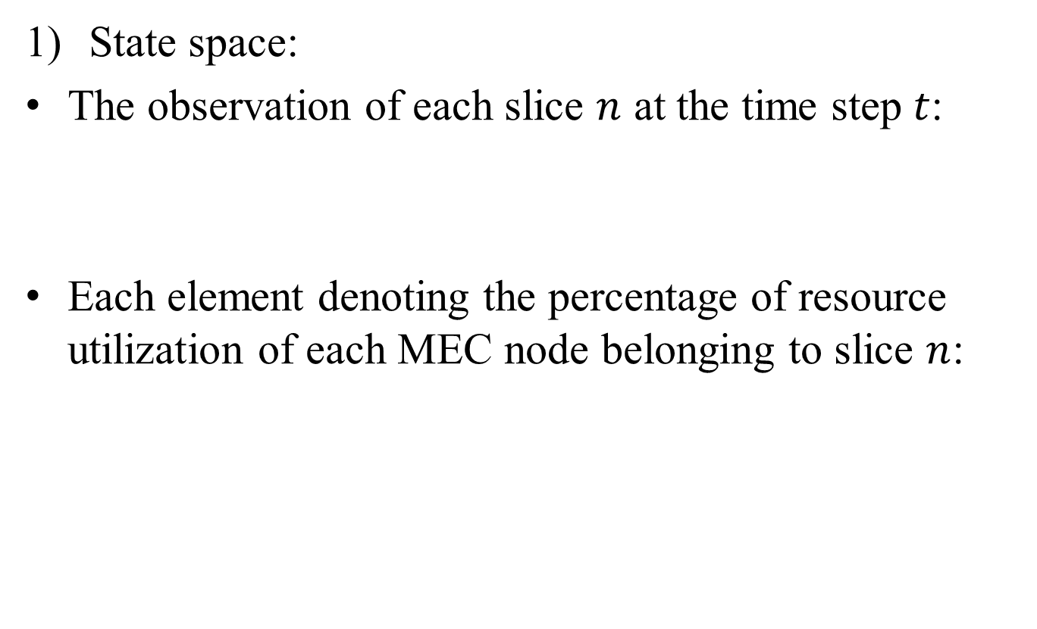
MDP Model
State space:
The observation of each slice $n$ at the time step $t$:
Each element denoting the percentage of resource utilization of each MEC node belonging to slice $n$:
Notes:
$k_{n}:$服務類型，決定延遲限制、封包大小、處理密度
$i_{n}:$切片n的路口節點
$ρ^{n}:$切片n的0資源利用率百分比
$c_{m}:$計算容量
$b_{m}:$ 輸出BW
$α_{n,m}(t):$分配給node的容量
$β_{n,m}(t):$ 分配給node m的BW

Slide 11
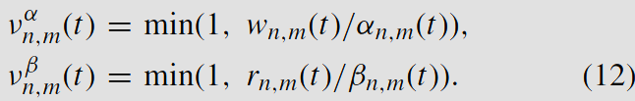

MDP Model
The utilization of the resource allocated from the MEC node m to slice $n$:
Notes:
$w_{n,m}\left(t\right):$工作量
$r_{n,m}(t):$ data rate
$ν_{n,m}(t):$ 分配給在切片 n 中node m 的資源利用率向量 ($α的是容量$，$β的是$BW)

Slide 12
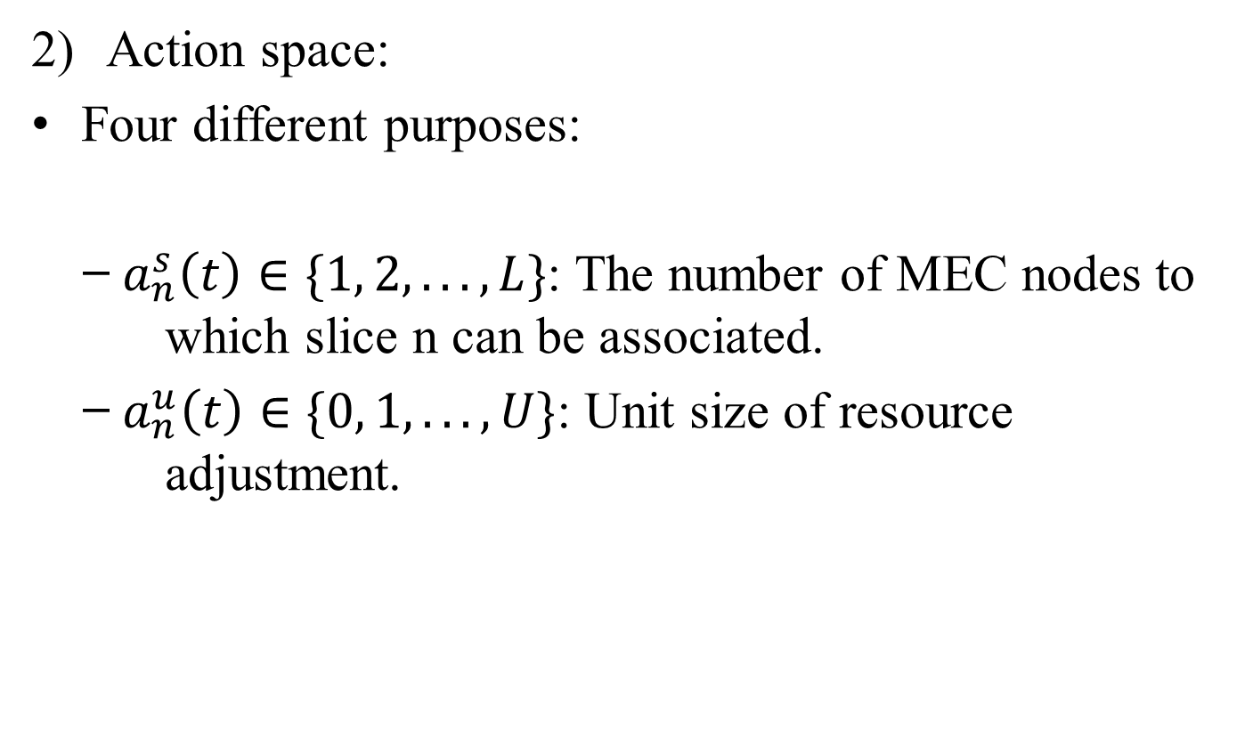
MDP Model
Action space:
Four different purposes:
̶ $a_{n}^{s}\left(t\right)∈\{1, 2, . . . , L\}$: The number of MEC nodes to which slice n can be associated.
̶ $a_{n}^{u}\left(t\right)∈\{0, 1, . . . , U\}$: Unit size of resource adjustment.
Notes:
Four different purposes:
(1)選擇調整資源的節點，(2)決定調整大小，(3、4)決定增加或減少CPU和頻寬資源。
$a_{t}^{n}:$action space of slice n
$a_{n}^{α}(t)$: 調整計算量 $α:$capability
$a_{n}^{β}(t)$: 調整BW資源 $β:$ BW

Slide 13
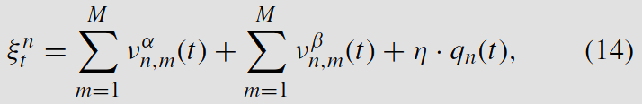
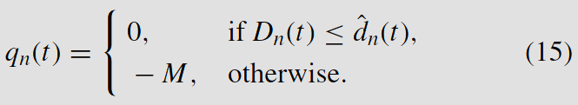

MDP Model
Reward function:
To maximize QoS, an effective solution to avoid QoS violation is increasing resource utilization and decreasing the resource wastage simultaneously
Notes:
$ξ^{n}$: reward of slice n
$q_{n}\left(t\right):$ 違反切片 n 的 Qos 懲罰
$η$: 權重因子 (平衡資源效率和服務品質之間的權衡)
$dˆ_{n}(t):$ 可忍受的延遲上限(自己定義)

Slide 14
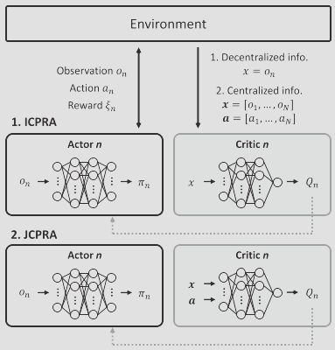
RL for End-to-End Network Slicing

Slide 15
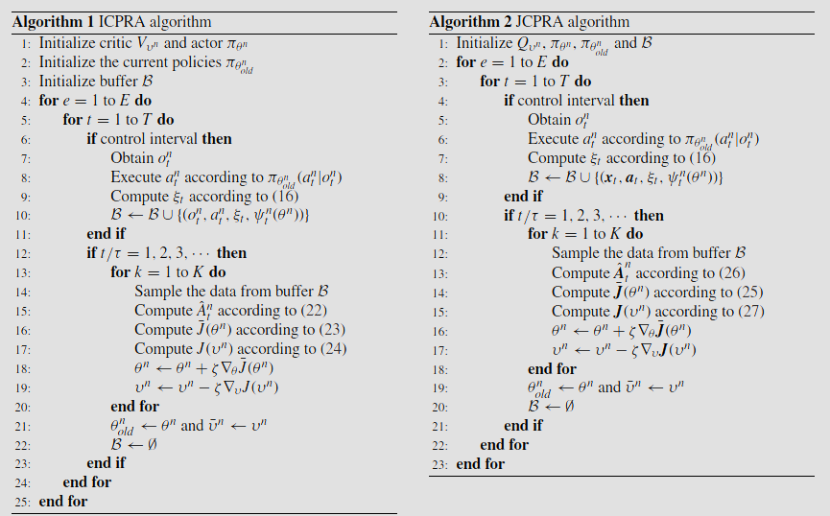
RL for End-to-End Network Slicing

Slide 16
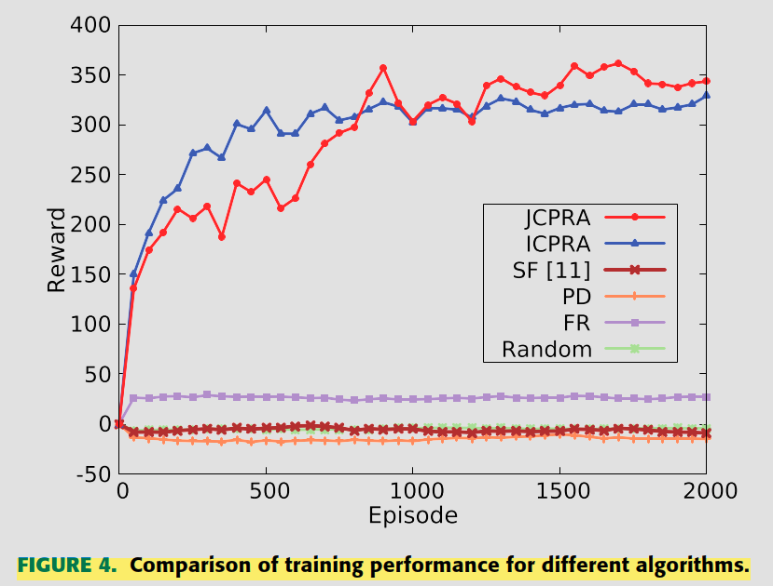
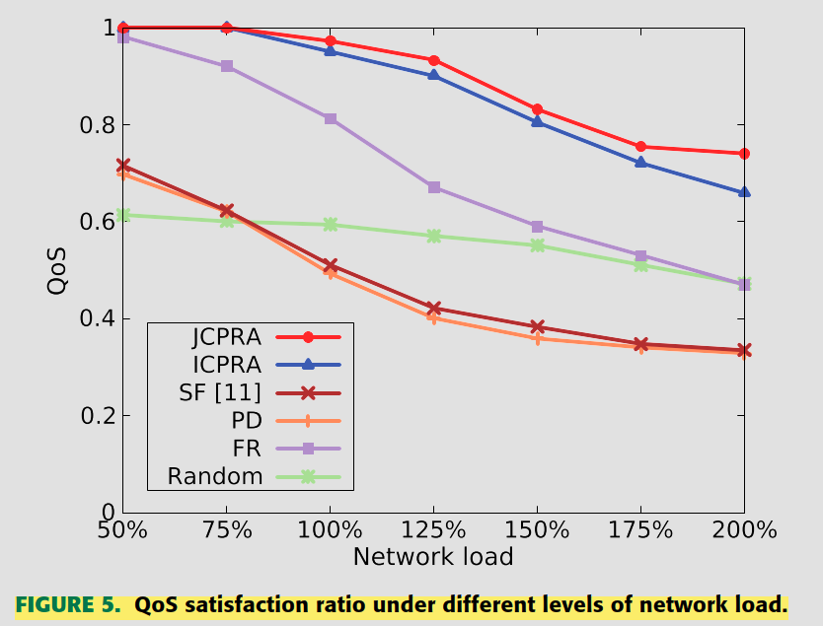
Performance Evaluation

Slide 17
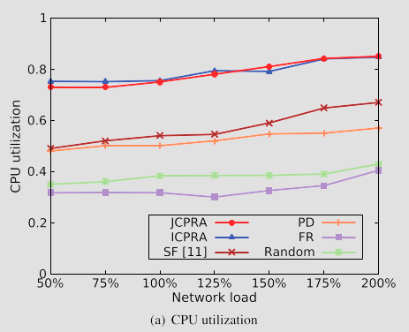
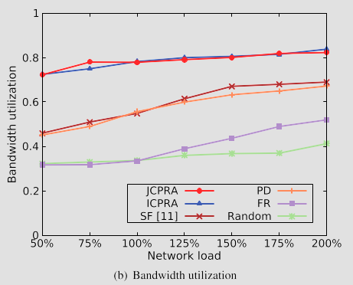
Performance Evaluation

Slide 18
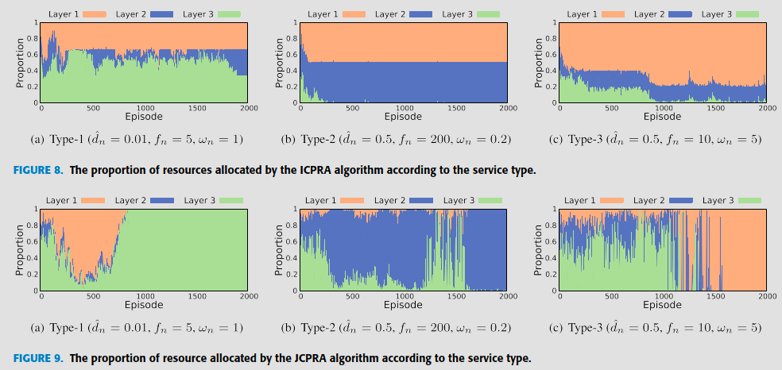
Performance Evaluation
Notes:
a.
delay-sensitive service
large-bandwidth service
computation-intensive service

Slide 19
Intelligent Joint Network Slicing and Routing via GCN-Powered Multi-Task Deep Reinforcement Learning
Published in: IEEE TRANSACTIONS ON COGNITIVE COMMUNICATIONS AND NETWORKING
Date of Publication: 2, JUNE 2022
Author: Tianjian Dong, Zirui Zhuang, Qi Qi, Jingyu Wang, Haifeng Sun, F. Richard Yu, Tao Sun, Cheng Zhou, Jianxin Liao
Speaker: Zhun-Sheng Chen, Zi-Jun Wei
Advisor: Yi-Huai Hsu
2024/04/03

Slide 20
Outline
Introduce
System Model
MDP Framework
GCN-powered MTDRL
Performance Evaluation

Slide 21
Introduction
In prior network resource management works, the network management and control are isolated, which has restricted the uniﬁed controls of 6G.
Integrate the network management (i.e., network slicing) and network control (i.e., routing) to realize the uniﬁed control in 6G networks to meet the growing stringent service requirements.
Notes:
在先前的網絡資源管理工作中，網絡管理和控制是孤立的，這限制了6G網絡的統一控制，並且幾乎無法根據6G網絡的高動態變化安排資源，以滿足新興用例的嚴格要求。
融合網路管理（即網路切片）與網路控制（即路由），實現6G網路的統一控制，滿足日益嚴格的業務需求。
因為許多新興用例的需求，網絡管理的周期變得更短。例如，在6G網絡中，因為它的突發特性，進行數據傳輸時，需要極低的延遲和極高的可靠性，以滿足對於即時性和可信賴性的極端需求。因此，網絡管理和網絡控制之間的界限變得更加模糊。因為以往網絡管理主要是靜態的，周期長的，而網絡控制則是動態的。但是在6G網絡中，由於需求的變化和突發特性，兩者之間的界限變得更加模糊。

Slide 22
Introduction
Existing works still rely on rule-based or heuristic algorithms.
Utilize DRL to provide near-optimal performance in response to complex network status and traffic demand changes
Use MTDRL to improve issues in DRL.
Use GCN to capture the topological information of NSs from the common graph-structured network status.
Notes:
現有的研究仍然依賴於基於規則或啟發式算法。但前者無法很好地捕捉到流量需求和網絡狀態的動態特性，而後者具有更高的計算複雜度，導致巨大的控制成本。
適用於高度動態的6G環境中的聯合網絡分割和路由
如果將 DRL 算法直接應用於多任務分配，會因為action space的大小隨著任務數量的增加而呈指數級增長。因此在這篇paper中提出了一種多任務深度強化學習（MTDRL）方法來減少聯合網絡切片和路由的action space。
出了一種定制的圖形卷積網絡（GCN）來捕獲從常見的圖形結構的網絡狀態中的網絡切片的拓撲信息。

Slide 23
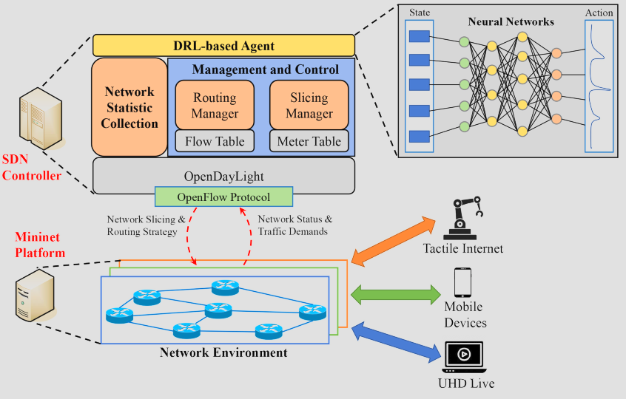
System Model

Slide 24
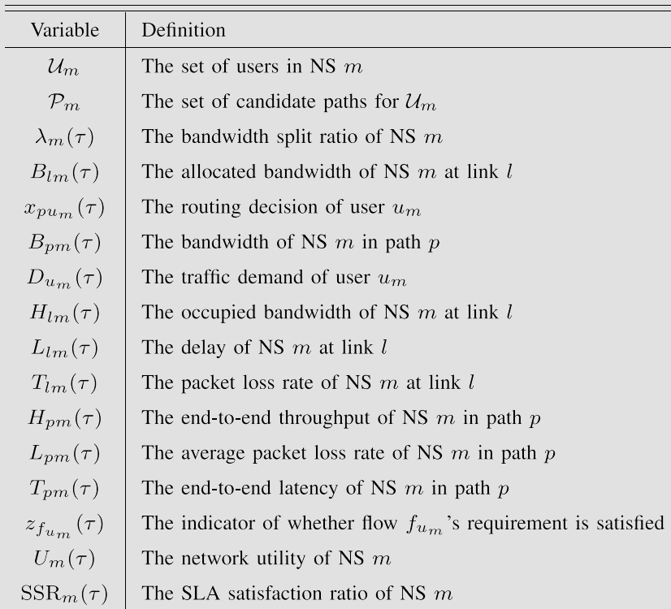
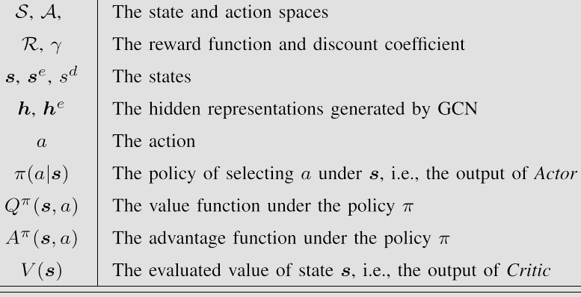
System Model

Slide 25
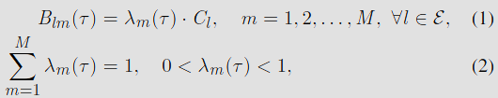
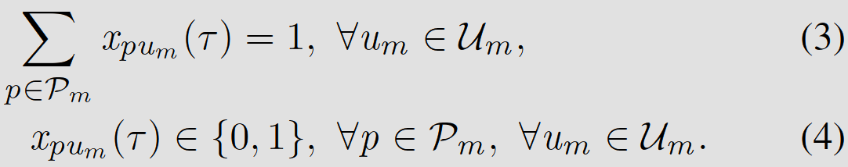
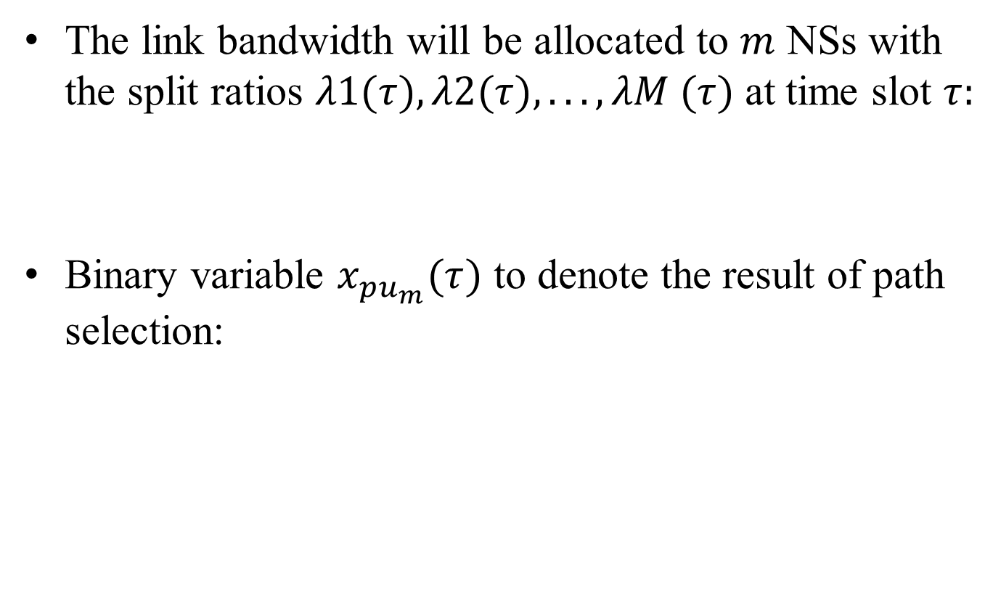
System Model
The link bandwidth will be allocated to $m$ NSs with the split ratios $λ1(τ), λ2(τ), . . . , λM (τ)$at time slot $τ:$
Binary variable $x_{pu_{m}}(τ)$ to denote the result of path selection:
Notes:
Network Slicing:
如何有效地利用網絡基礎設施來支持多個網絡切片，以滿足各個切片的需求。
$B_{lm}\left(τ\right):$分配給 NS m 上的鏈結 l 的 BW
$λ_{m} (τ)$: BW 分流比
$C_{l}:$ link 的 BW 容量
Routing:
$x_{pu_{m}}(τ)$: user 在第 m 個NS 的路徑選擇的結果 (1代表選擇次此路徑，0則相反)
每個用戶的流量在給定的時間槽中將僅通過一條路徑進行

Slide 26
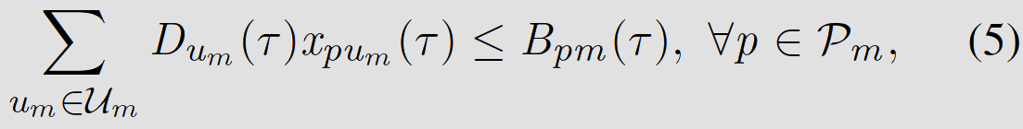
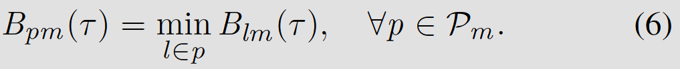

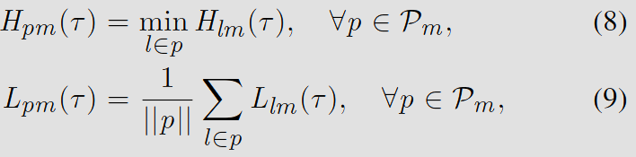

System Model
The trafﬁc demands of all users in $U_{m}$ cannot exceed the allocated bandwidth of NS m in the path $p$:
Maximize the utilization of network resources:
Notes:
$D_{u_{m}}(τ):$ user m 的傳輸需求量 * 走過路徑
The utility function aims to maximize the link bandwidth utilization and minimize the packet loss
$U_{p_{m}} \left(τ\right): 路徑$p 在 NS m 的效用
$α, β:$ 係數
$B_{pm}\left(τ\right):$分配給 NS m 上的路徑 p 的 BW
$H_{p_{m}}\left(τ\right):$ 路徑 p 上端到端的吞吐量
$L_{l_{m}}(τ)$: NS m 中 link l 的封包丟失率
$||p||$: link l 在 path p 中的數量
$L_{lm} \left(τ\right):$link l 的 delay

Slide 27
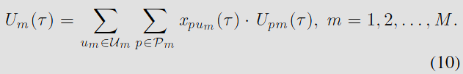
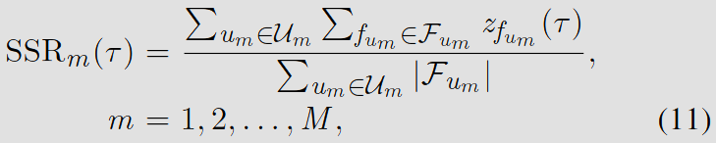



System Model
Utility of the NS in time slot $τ:$
SLA Satisfaction Ratio:
Notes:
$F_{u_{m}}:$ user 發送流量集
$f_{u_{m}}:$ user 發送
$z_{f_{um}}$: 當前的切片和路由選擇是否满足用 user's flow $f_{u_{m}}$ 的要求
$T_{pm}\left(τ\right):$ NS m 在路徑 p中的端對端延遲
$T_{l}(τ)$: link l 的 延遲

Slide 28
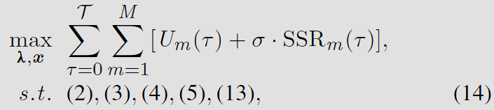
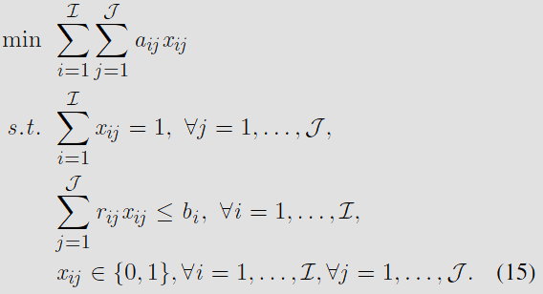
System Model
The network slicing and routing problem:
Notes:
$σ$: 係數
the network utility
$SSR_{m}$: 滿足終端user的SLA滿意比例
NP-hard

Slide 29



MDP Framework
State Space:
Network side state:
User side state:

Slide 30
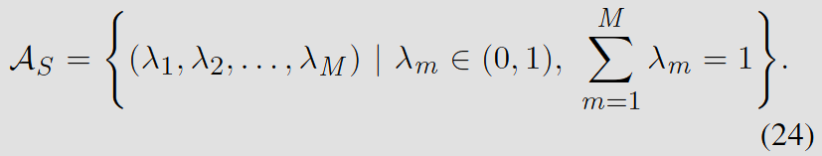
MDP Framework
2) Action Space
The overall routing approach is divided into M tasks, which have their own action space:
After integrating each action space, the split ratio of each slicing is obtained.

Slide 31
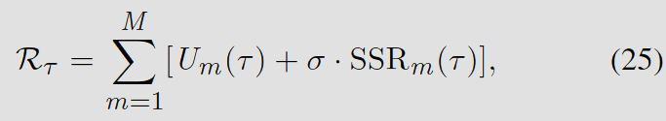
MDP Framework
3) Reword Function:
The feedback given to the DRL agent according to the decision of network slicing and routing.

Slide 32
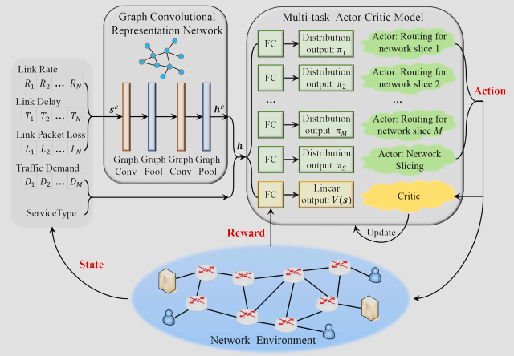
MDP Framework

Slide 33
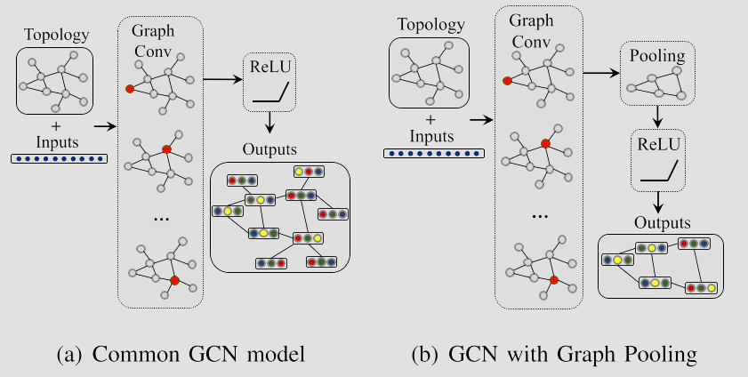
GCN-powered MTDRL
Notes:
Pooling通常指的是將一個卷積層的輸出縮減為更小的形狀，以減少計算量和參數數量，同時保留重要特徵。
池化層會掃過輸入數據的各個區域，將每個區域的特徵值（如最大值或平均值）提取出來，形成輸出的特徵圖。這有助於減少輸出的尺寸，同時保留重要的特徵信息，從而有助於提高模型的效能和效率。
利用GCN node-level 轉為 graph-level

Slide 34
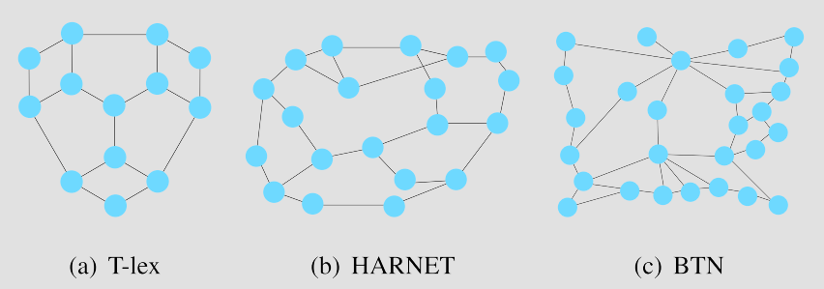
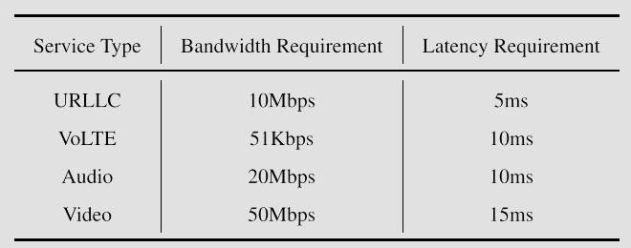
Performance Evaluation

Slide 35
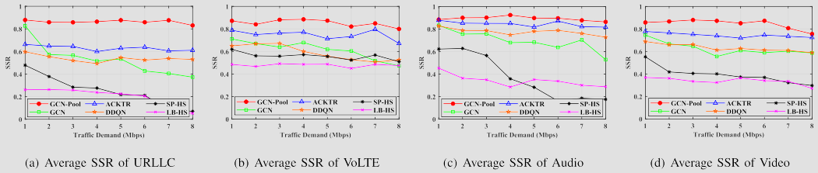
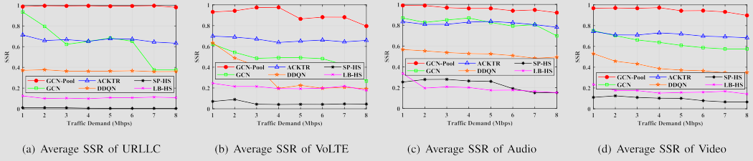

Performance Evaluation
Notes:
T-lex topology (Tokyo, Japan)
HARNET topology (Hong Kong, China)
BTN topology (USA)

Slide 36


Performance Evaluation

Slide 37
END

