Slide 1
hw13_ppt

Slide 2
Intro
Cancer remains a significant health concern in the United States.
This is because: - Cancer cost is rising - Survival rate has been improved - Distressing symptoms have been reported

Slide 3
Cancer cost graph

Slide 4
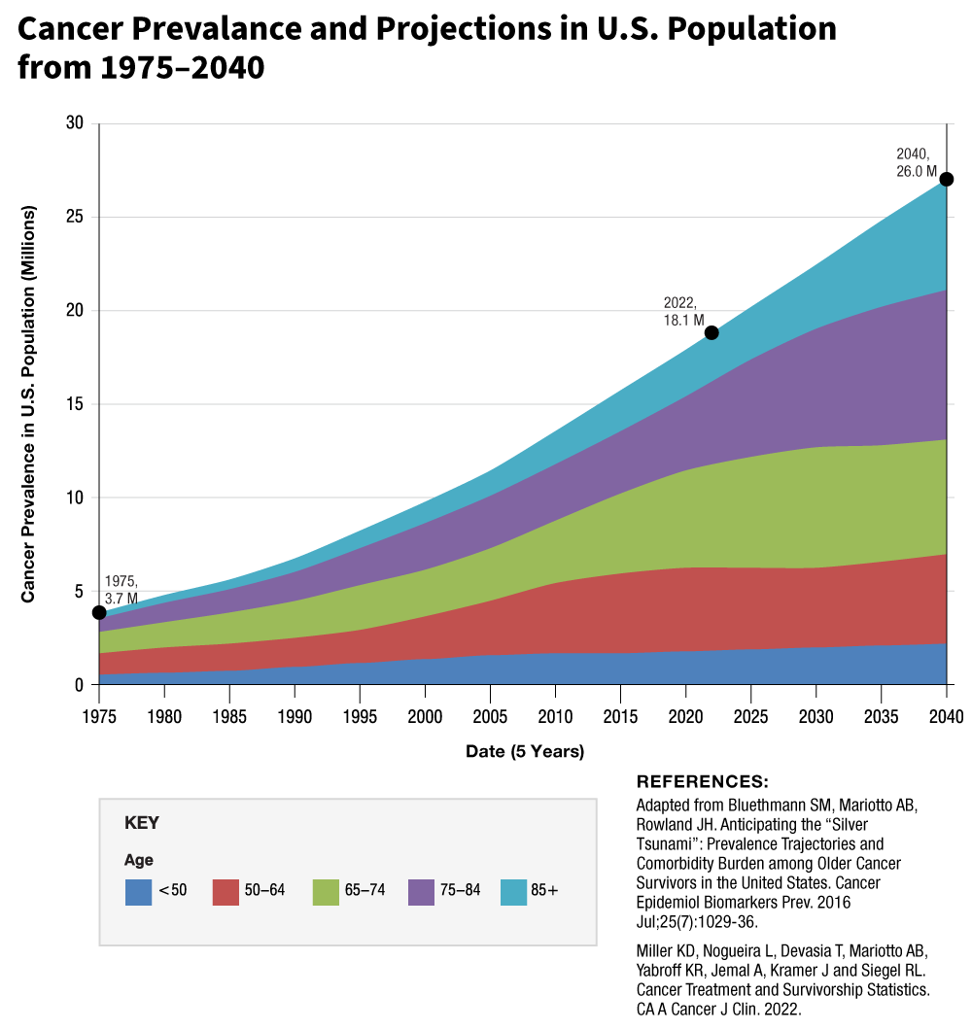
cancer prevalence graph

Slide 5
Symptom Science
The National Institute of Nursing Research (NINR) has integrated the precision health approach into its symptom-science model to guide nursing research in symptom science

Slide 6
Reference
Siegel, R.L., et al., Colorectal cancer statistics, 2023. CA: A Cancer Journal for Clinicians, 2023.
Cashion, A.K., et al., National Institutes of Health Symptom Science Model sheds light on patient symptoms. Nurs Outlook, 2016. 64(5): p. 499-506.
Hickey, K.T., et al., Precision health: Advancing symptom and self-management science. Nurs Outlook, 2019. 67(4): p. 462-475.

