Slide 1
KPED Kitt Peak EMCCD Demonstrator
A sensitive, flexible, multi-spectral optical imaging capability for high-cadence follow-up of the transient universe.
Instrument
Science
1. EMCCD – Andor iXon 888
2. Filter Wheel – Finger Lakes (10 slot)
3. Filters – Johnson UBVRI, Sloan g and r
4. Corrector Lens
5. Mounting plates
6. Computer
Hardware
ZTF transient follow-up (GWs, SGRBs, TNOs)
Ahumada/Coughlin/Dekany/Kulkarni
WD Binaries – PTF and ZTF
Feeney/Riddle/Dekany/Coughlin
Burdge/Coughlin/Prince/van Roestel
Software
1. EMCCD – Andor SDK + Python wrapper
2. Filter Wheel – FLI SDK + Python wrapper
3. Telescope Control – Robo-AO
4. Reductions – Robo-AO + Chimera
Gravitational Lens Time Delays
Coughlin
Astroseismology
Riddle/Duev/Coughlin
Telescope/Camera
Fuller
1. F/# = 4.864
2. FOV = 4.4 x 4.4 arcmin
3. 2.1 meter primary
Calibration/Technical
Feeney/Riddle/Dekany/Coughlin
Coughlin
Instrument: Coughlin, Dekany, Feeney, Kulkarni, Riddle
Science: Ahumada, Burdge, Coughlin, Dekany, Fuller, Kulkarni, Prince, Riddle

Slide 2
KPED Kitt Peak EMCCD Demonstrator
Science
WD Binaries - PTF, ZTF and ATLAS
Asteroseismology
Low-mass pulsating white dwarfs
Monitoring of the WD binary systems identified in the original PTF data.
Follow-up of potential ZTF WD binary systems
Follow-up of potential ATLAS WD binary systems
Gravitational Lens Time Delays
Time delay measurement for GAIA + PS1 lens systems
https://arxiv.org/abs/1803.07601
ZTF transient follow-up (GWs, SGRBs)
Monitoring of the ZTF transients identified in the SGRB follow-up work.
ZTF transients, especially those identified as fast fading, in preparation for SGRB and GW follow-up, is important.
Calibration/Technical
Photometric stability and performance of EMCCDs as a function of EM gain.
Multiband colors in UBVRI of hot DA white dwarf stars from Gaia.

Slide 3
KPED Kitt Peak EMCCD Demonstrator
Objects
Papers
Known Objects
ZTF transient follow-up – GRB180523
1. ZTF18aalrxas – 1a?
2. 1821i - ZZ Ceti pulsator with a 4.8 minute period
3. PG-1336 - Eclipsing binary with an orbital period of ~2.4h and also shows pulsations.
Coughlin/Ahumada
ATLAS18qqn early photometry/spectra
Perley/Coughlin/Ahumada
1815f – 7 minute eclipsing binary
PTF/ZTF Periodic Objects
Burdge/Prince/Coughlin/Kulkarni
We have confirmed many periodic objects at this point.
AMCvn SDSS J141118.31+481257.6
Kupfer/Burdge/Prince/Coughlin
External Objects
Instrument/Technical
Coughlin/Ahumada/Burdge/Feeney
ATLAS18qqn – About a week of photometry in UgrI
D6-2 – Hypervelocity white dwarf from Gaia, a few nights of a few hours each
Maxi-J1820+070 – 17 hour period, 0.4 mag
PTF Periodic Objects
Burdge/Prince
Riddle/Duev/Coughlin
ZTF Periodic Objects
Coughlin/Burdge/Prince

Slide 4
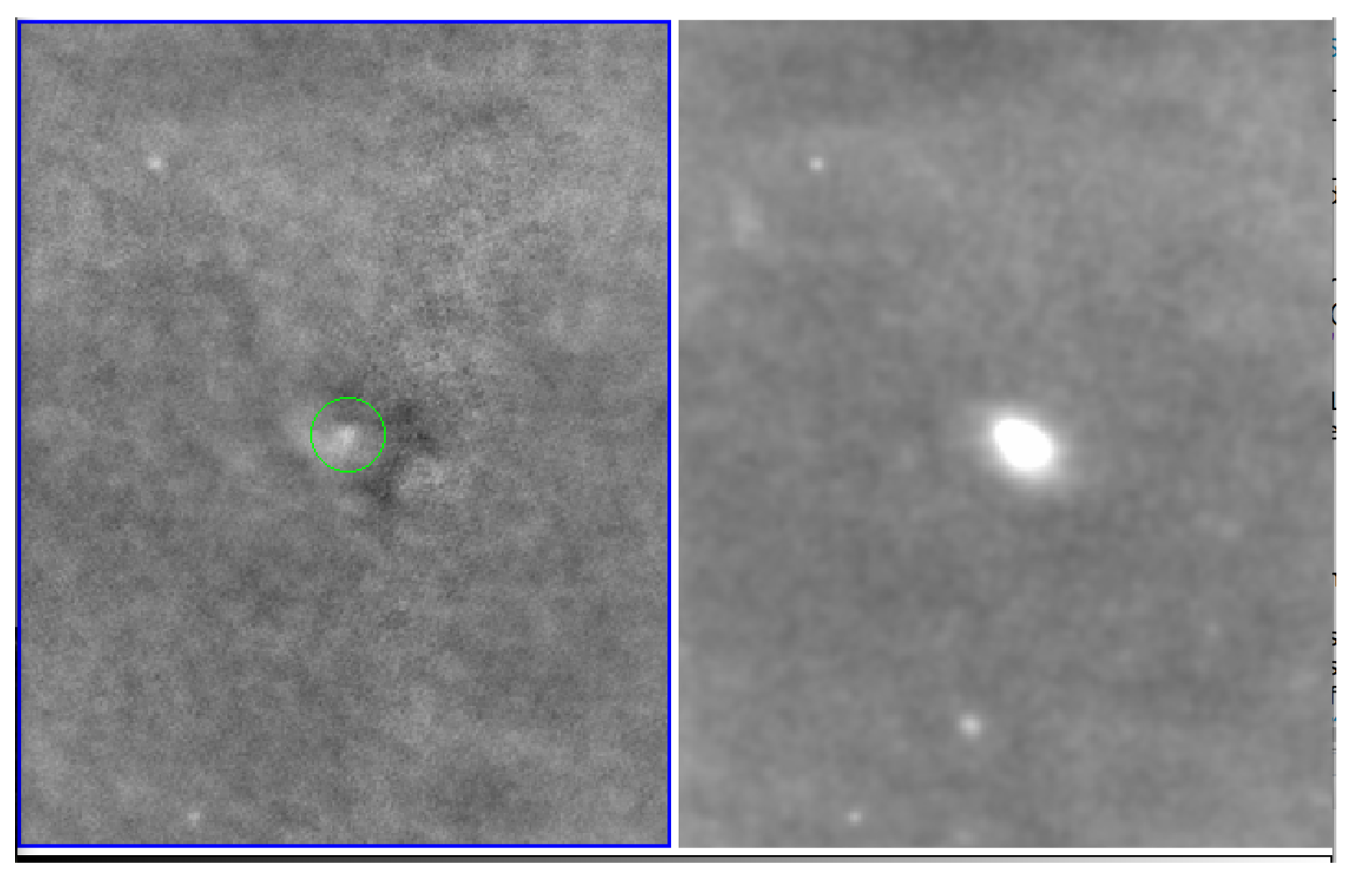
KPED Kitt Peak EMCCD Demonstrator
ZTF Transients (ZTF18aalrxas)

Slide 5
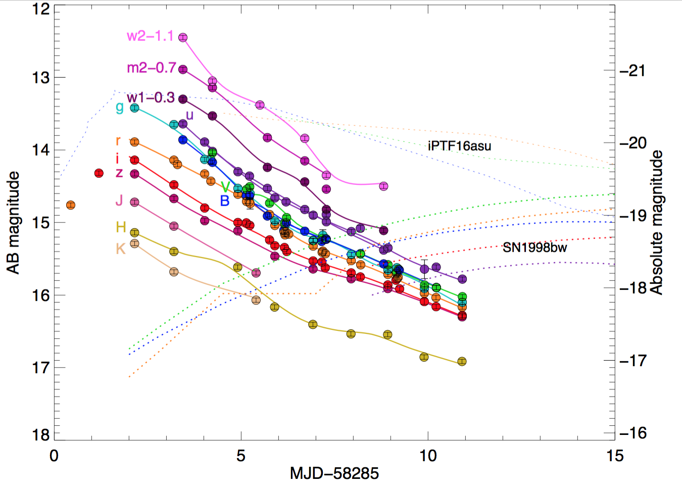
KPED Kitt Peak EMCCD Demonstrator
AT2018cow

Slide 6
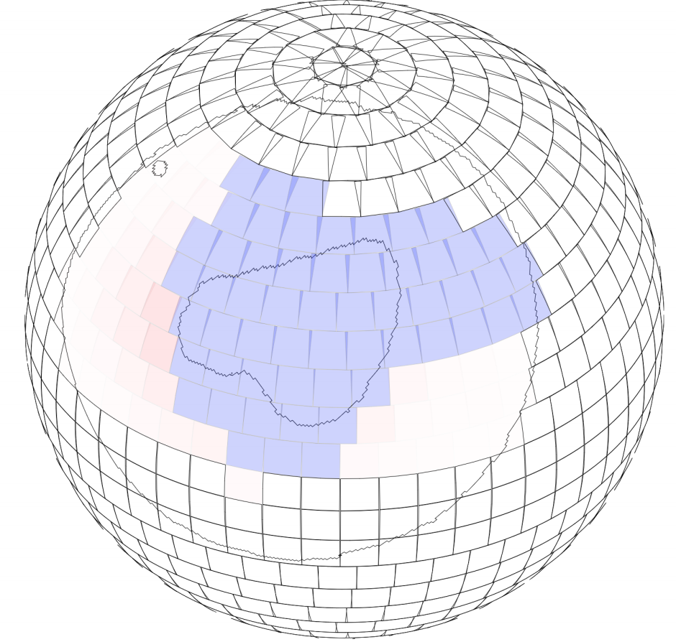
KPED Kitt Peak EMCCD Demonstrator
ZTF ToO Follow-up

Slide 7
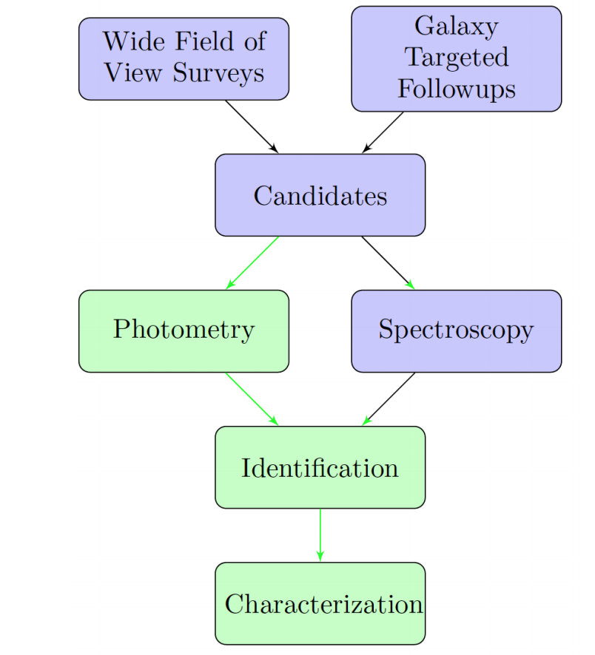
KPED Kitt Peak EMCCD Demonstrator
Needle in a haystack

