Slide 1

Analyzing robustness of end-to-end neural models for automatic speech recognition
Goutham Rajendran*, Wei Zou*

Slide 2
Motivation – what is robustness?
Robust machine learning - Design models that handle noisy data
Noisy data - random noise, outliers, corrupted data, etc
Important applications, for example
Computer vision – Autonomous driving
Speech – ASR in noisy environments
Speech data always has background noise
Other possible sources of noise
Hardware issues – poor quality microphones, transmission errors
Software issues – dropped/corrupted frames

Slide 3
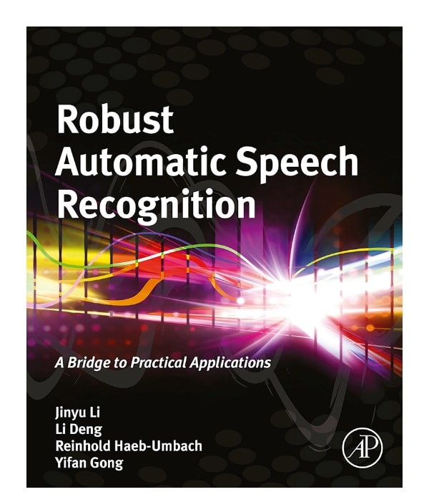
Prior work
Reducing noise both in hardware/software
Improve model using data augmentation
Add noisy data to dataset
Then fine-tune
Sample references
Hsu et al., 2021
Wang et al., 2022
The book on the right, 2015

Slide 4
Part 1 Noisy waveform data

Slide 5

Experiments
Model takes input x’ instead of x
x’ is “noisy” version of x
Example: “We are international businessmen”
Original
White noise
Speed Perturb
Dropped chunks
Experiments on wav2vec2 vs HuBERT on LibriSpeech

Slide 6
White noise

Slide 7
Speed Perturb

Slide 8
Dropped chunks – varying length

Slide 9
Dropped chunks – varying count

Slide 10
Main observations
HuBERT is slower than wav2vec2
But on simulated noise, it’s more robust
For noise of small magnitude, they are roughly similar

Slide 11
Part 2 A layerwise robustness analysis of wav2vec2

Slide 12
Injecting noise into layers
Goal: Explore how noise affects wav2vec2 on a layer-by-layer level
Experiment 1: Manually inject noise in layer i and observe behavior
Experiment 2: Compare layer activations on original sample and corrupted sample

Slide 13
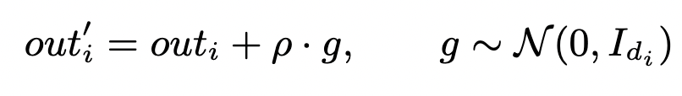
Experiment 1 – Additive noise
Let output of i-th layer be out_i of dimension d_i.
Intervene and modify the output via
Intuition:
Noise-sensitive layers – Possibly learn “higher level” content such as context, meaning, etc.
Noise-robust layers – Possibly learn “lower level” content such as local information, phones, etc.

Slide 14
Experiment 1 – additive noise

Slide 15
Experiment 1 – additive noise

Slide 16
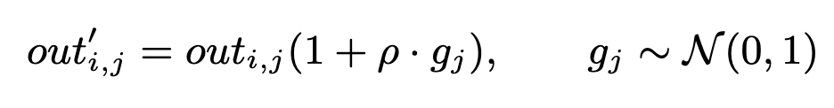
Experiment 1 – multiplicative noise
Additive noise doesn’t take scaling into account
To incorporate scaling, we use multiplicative noise

Slide 17
Experiment 1 – multiplicative noise

Slide 18
Experiment 1 – multiplicative noise

Slide 19
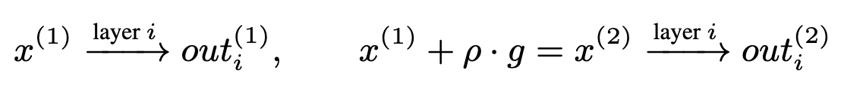
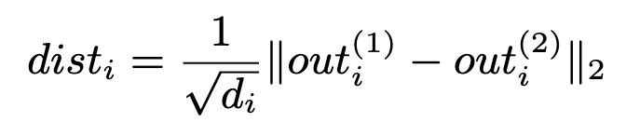
Experiment 2
Take an input and its corrupted version
Run them through the model
Question – How does the error propagate through the layers?
Quantifying error of layer i:

Slide 20
Experiment 2

Slide 21
Experiment 2

Slide 22
Main observations
Wav2vec2 gradually seems to “kill off” the noise as we go up the layers
What’s going on in layer 11?
Unusual behavior also observed in Pasad et al., 2021
Maybe related, requires further investigation

Slide 23
Conclusion
We saw
Robustness of wav2vec2 vs Hubert
Analyses of wav2vec2 layers
Potential future directions:
Explain layer 11
Realistic background noise
Adversarial noise
Seems fascinating - Alzantot et al., Neekhara et al., Olivier et al., etc.

Slide 24
Thank you

