Slide 1

Data Analysis for :
Customer Shopping Behavior
A strategic analysis project to uncover what drives customer decisions — and how to act on it.

Slide 2



The Business Challenge
Shifting Patterns
Purchasing behavior is evolving across demographics, product categories, and sales channels — faster than intuition alone can track.
Unknown Drivers
We lack a clear picture of what motivates customer decisions and what turns a first purchase into repeat loyalty.
Strategic Opportunity
With the right data, we can improve sales performance, elevate customer satisfaction, and build long-term loyalty at scale.

Slide 3
The Core Question
How can we leverage consumer shopping data to identify trends, improve customer engagement, and optimize marketing and product strategies?
This project transforms raw transaction data into strategic direction — giving leadership the clarity to act with confidence.
What truly drives the customer?

Slide 4



What We'll Analyze
Customer Segments
Purchase Drivers
Channel Performance
Demographics, purchase frequency, and lifetime value to identify who our most valuable customers are.
Discounts, reviews, seasonality, and payment preferences — the factors that convert browsers into buyers.
Online vs. offline behavior, conversion rates, and where customers are most likely to engage and transact.

Slide 5
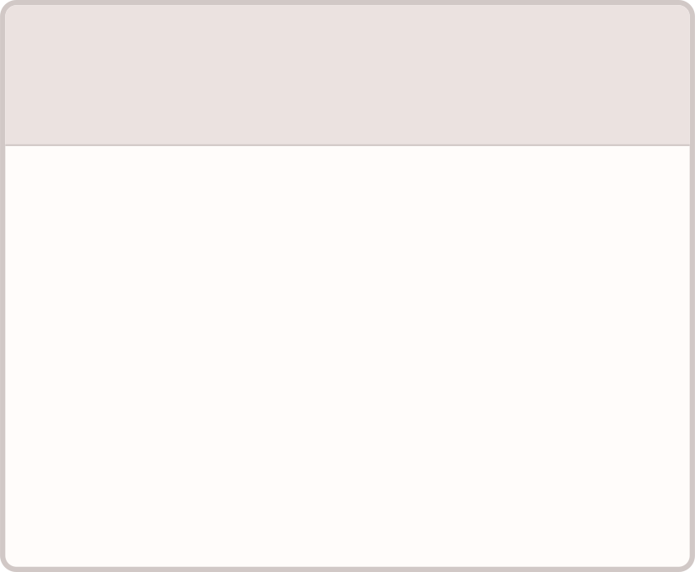
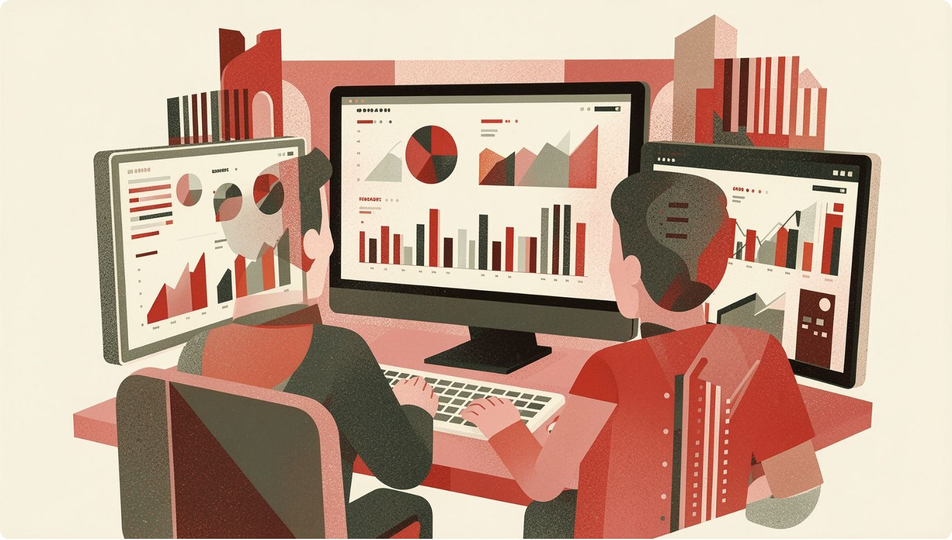
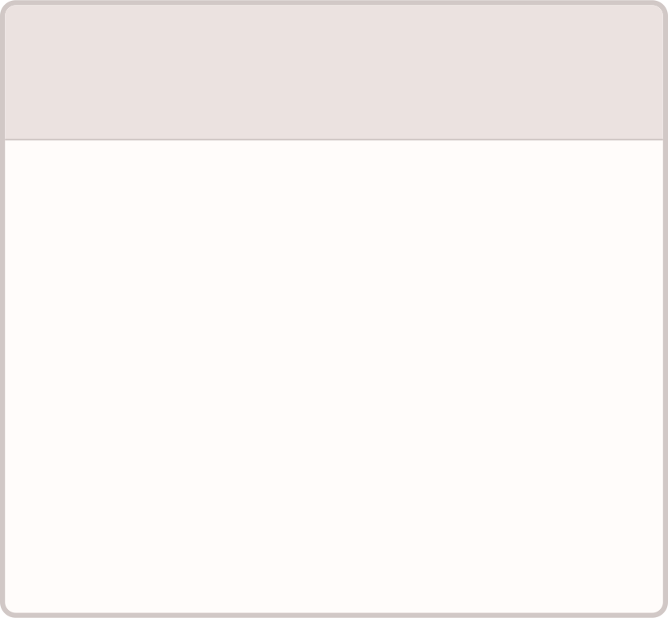
Project Deliverables
1
2
Clean Dataset
SQL Insights
Transformed and validated data prepared in Python, ready for analysis.
Structured queries surfacing key patterns and business-relevant findings.
3
4
Power BI Dashboard
Findings Report
Interactive, executive-ready visualization of all core metrics.
A full stakeholder presentation with actionable recommendations.

Slide 6
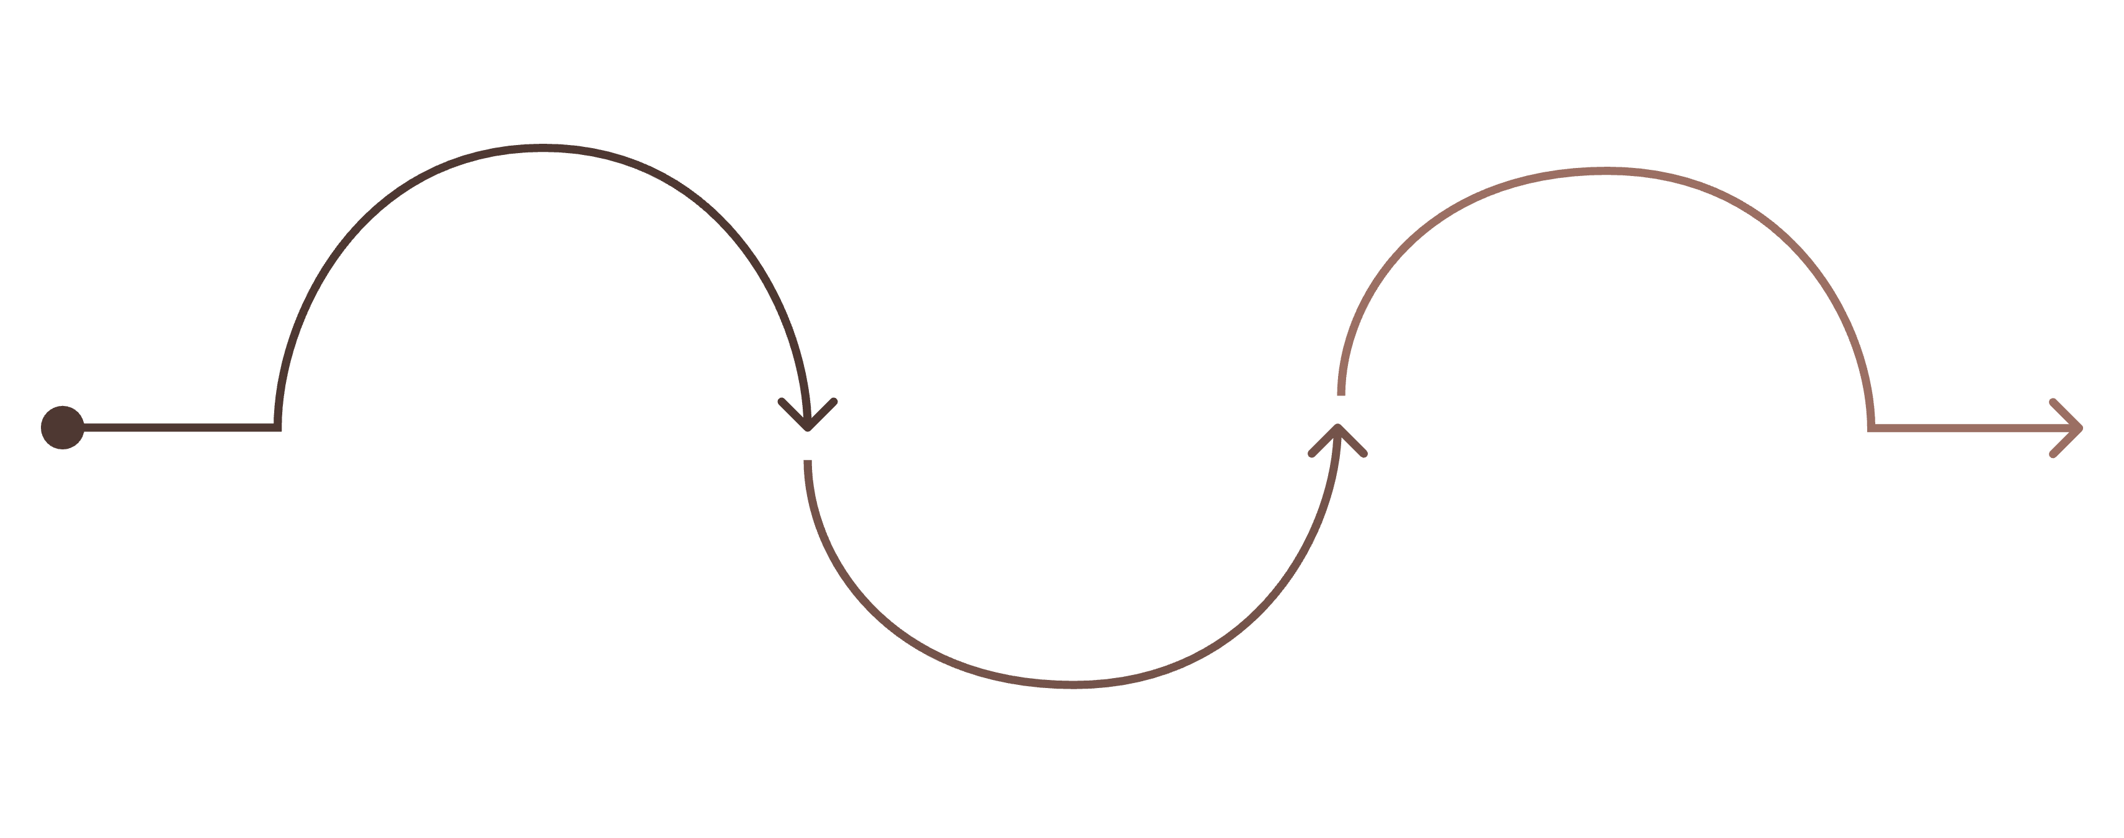
Our Approach: Three Phases
Data Preparation
Visualization & Recommendations
Clean and model raw data
Analysis & Insights
Extract patterns on segments, loyalty, drivers
Build dashboards and deliver strategies
Each phase builds on the last — ensuring that every recommendation delivered to leadership is grounded in clean data and rigorous analysis.

Slide 7

Expected Business Impact
🎯 Targeted Marketing
📦 Optimized Product Mix
Identify high-value customer segments to focus acquisition and retention spend where it matters most.
Refine pricing strategies and product assortment based on what customers actually want to buy.
❤️ Stronger Retention
Drive loyalty through personalized engagement powered by behavioral data, not guesswork.

Slide 8
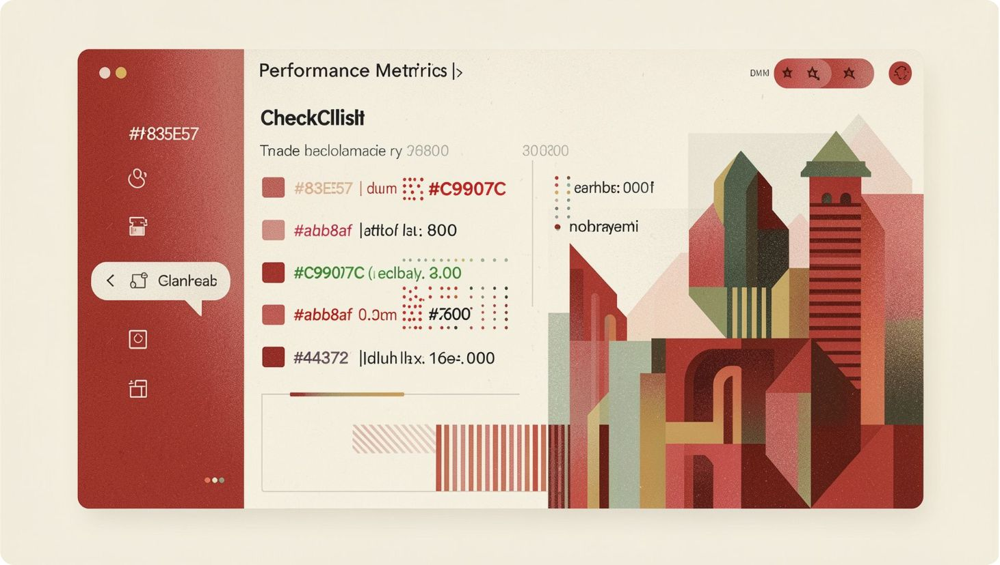
Key Success Metrics
Segment Clarity
Well-defined customer personas with distinct, actionable behavioral traits that marketing can act on immediately.
Driver Identification
The top 3–5 factors that most influence purchasing decisions, ranked by business impact.
Actionability
Every recommendation is tied directly to a measurable revenue or retention outcome — no abstract findings.

Slide 9




Next Steps
Confirm Access
Kick Off Prep
Weekly Reviews
Finalize data access permissions and agree on project timeline with all stakeholders.
Begin the data preparation phase — cleaning, transforming, and modeling raw datasets for analysis.
Schedule recurring stakeholder check-ins to share insights and align on evolving priorities throughout the project.
Your input shapes the output. Early alignment on data access and cadence is the single biggest driver of project success.

