Slide 1
Case Study​
Rework on Salaries​
1
Gender Equality​
2
Covid​-19
3
Bonus raise​

Slide 2
Agenda
01
Gender Equality
A company want to assess its gender equality employment policy
02
COVID-2019
Due to COVID-19 a company wants to down size its employees to save 20% of the total salaries
03
Bonus Raise​
A company wants to offer bonuses as a reward to its senior employees, and convince their soon reitiring contracters to stay.

Slide 3
Gender Equality
First Case

Slide 4
Number of male and female employees in the company
In Percentage
60%
40%

Slide 5
Numbers of males and females in each department
5 years plan to resolve this difference. Assuming that the organization is hiring 5000 males in the upcoming 5 years, so the number of females should be.
Number of Females = number of males + Difference
Then
12602 = 5000 + 7602
Based on that than for every year we need to hire
2520 females for every 1000 males.

Slide 6
Average Salaries for Male and Female in the past 5 years
There Is No Real Gap Between
The Average Salaries Of Male And Female Employees.
Therefore, No Further Action Is Required.

Slide 7
Covid-19
Second case

Slide 8
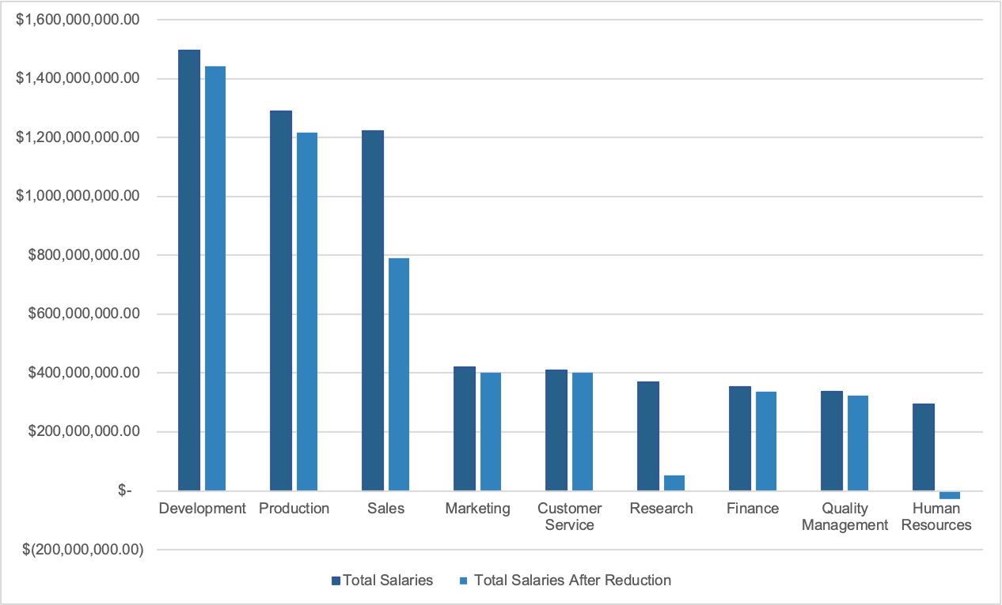
CHARTS

Slide 9
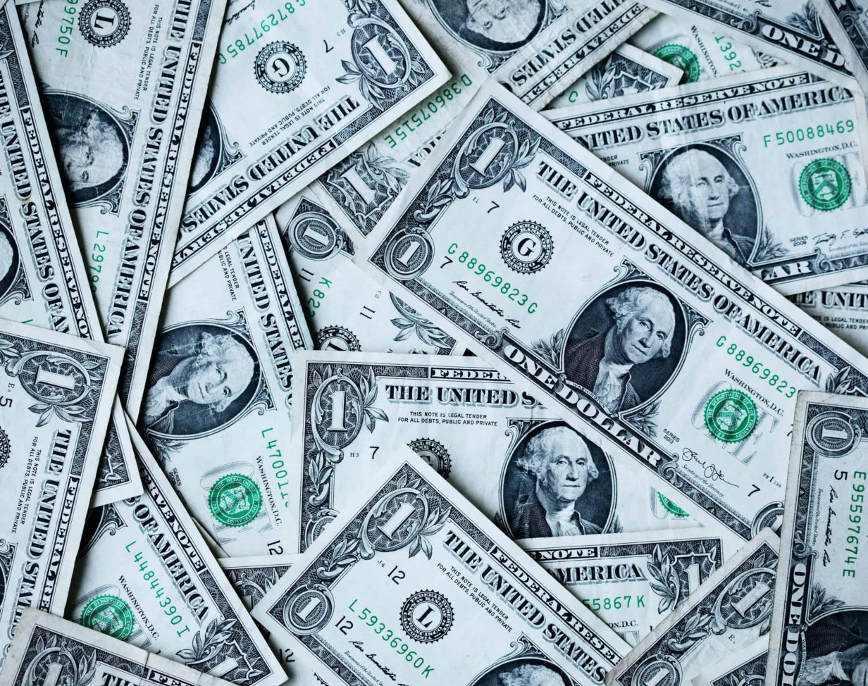
Total Savings:
$ 1,249,051,151.53

Slide 10
Bonus Raise
Third Case

Slide 11
$50 Million Budget Plan

Slide 12
Approach 1 – 1.5% Increase
15 years
In this approach we increase all employees who have been with us for 10 years or more by 1.5%. For a total of $39 million dollars.
14 Years
13 Years
10-13 Years

Slide 13
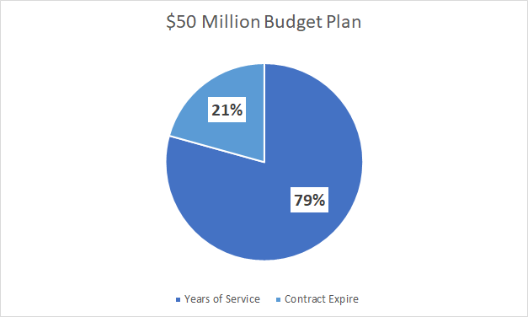
Approach 1 – 0.155% Increase
As stated in the pie chart above the remainder $10 million of the original $50 goes to those whose contracts expire soon at a 0.155% for each employee

Slide 14
Approach 2 - % on YOS
1. 15 Years of Service
15 Years
Increase by 1.5%
2. 14 Years of Service
Increase by 2.0%
14 Years
3. 13 Years of Service
Increase by 1.0%
13 Years
For a total of $24.5 Million allocated to years of service raises.

Slide 15
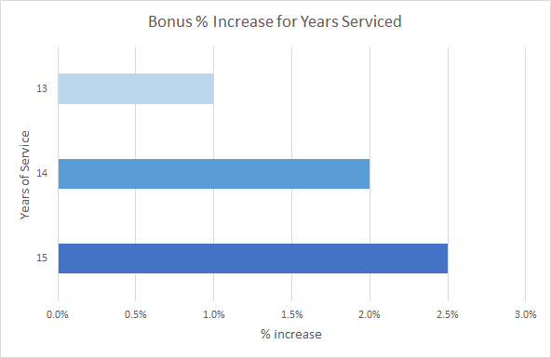
Approach 2 - % on YOS

Slide 16
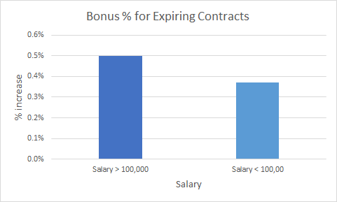
Approach 2 – 0.37-0.5% Increase
As stated in the column chart above those whose contracts expire soon will get a raise of either 0.37% to 0.5% based on their max salary if its above or below $100k. For a total of $24.5 million allocated.

Slide 17
Our Team
Sara Aldubaie
Norah Al-Harthi
Fadak Aldar
Wejdan Al-Ahmadi

Slide 18
Thank You
Any questions ?

