Slide 1
Student Performance EDA
Mathematics Course
GO!

Slide 2
The dataset we chose to do our analysis on is a student performance dataset for Mathematics course.

Slide 3
Table of Contents
Plots
Issues
Solutions
EDA
We have 12 plots.
We have one major issue!
We have many solutions.

Slide 4
01
Mother and Fathers Job Plot
01
02
03

Slide 5
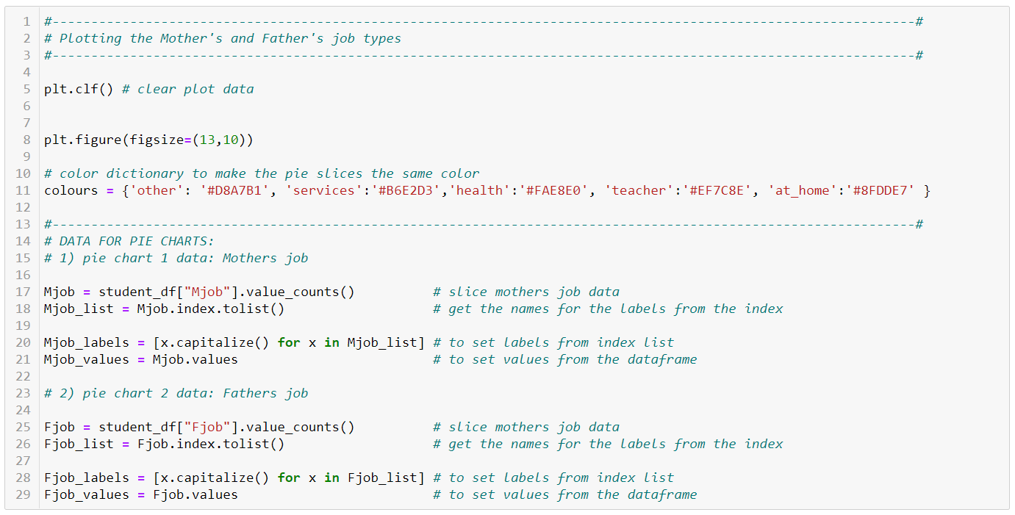

Slide 6
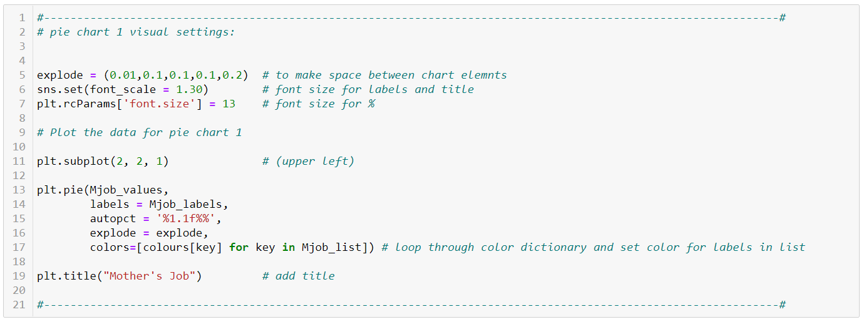

Slide 7
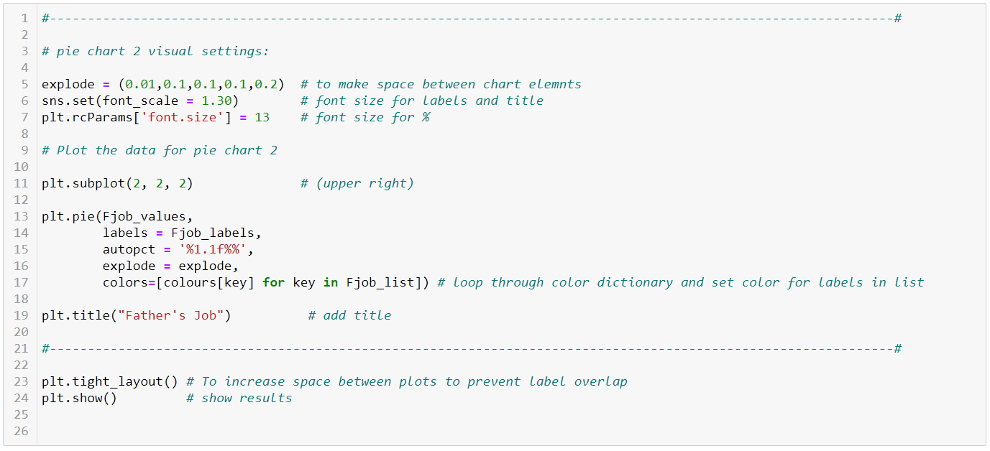

Slide 8
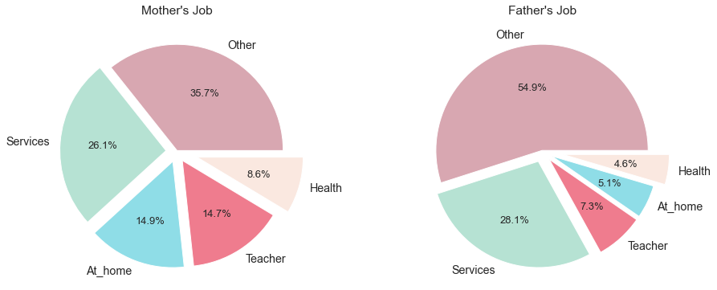
Insights:
•Fathers are more likely to work in the "other" category.
• There’s a higher percentage of stay at home moms than dads by 10%.
• Mothers are more likely to work in the Teaching and Health sectors compared to Fathers.

Slide 9
02
Students Alcohol Consumption
01
02
03

Slide 10
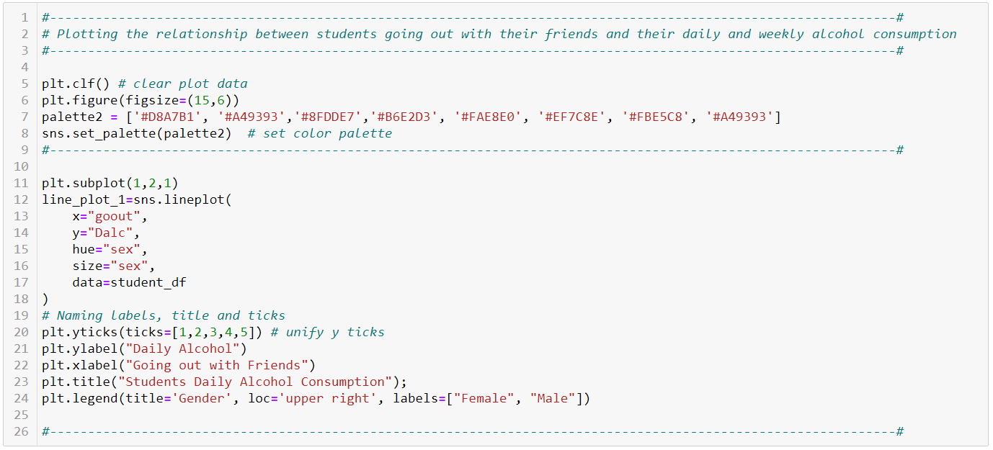

Slide 11
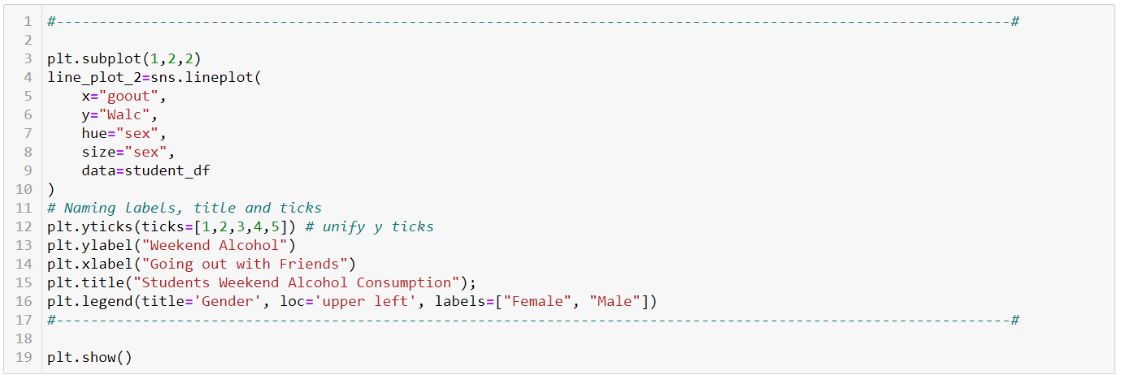

Slide 12
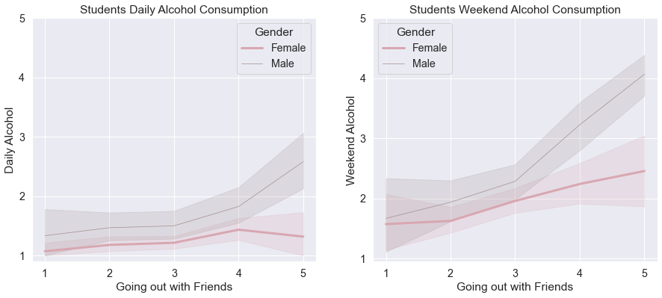
Insights: •Students are more likely to consume more alcohol during the weekend. •The number of females that drink is higher than males, but when the males drink, they drink more (quantity) than females. •The more the students go out with friends the more likely they are to drink, we can see this as a positive linear progression in the second chart.
01
Alcohol
Consumption
Plot
02
03

Slide 13
03
Family’s support and students absence
01
02
03

Slide 14
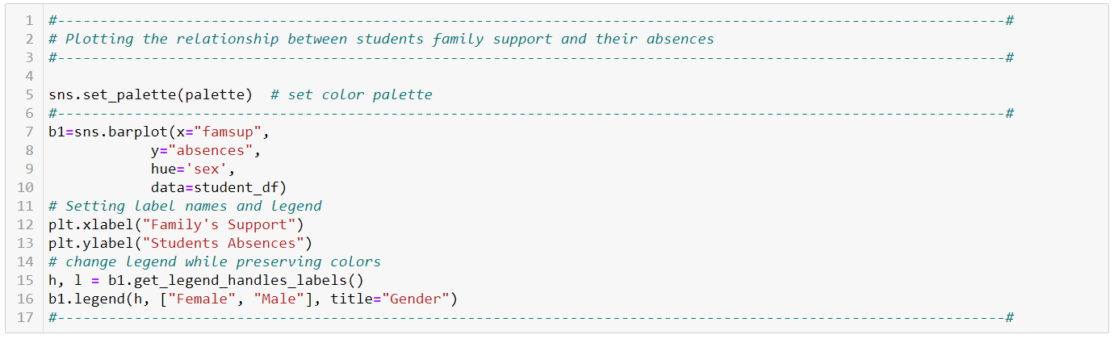
01
Code
02
03

Slide 15
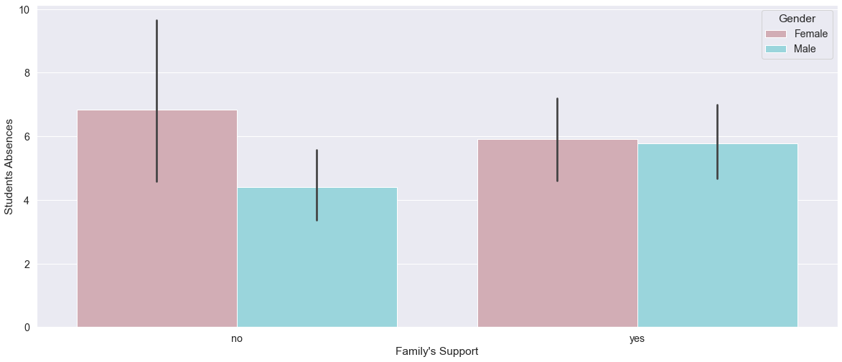
01
Insights:
•Females who lack their families support tend to be absent more. •Males who lack family support tend to have better attendance than their peers who have family support. •The attendance for students of both genders tend to be the same with the families support.
Absence
Plot
02
03

Slide 16
04
Family Status
Family Status Effects On Student's Grades

Slide 17
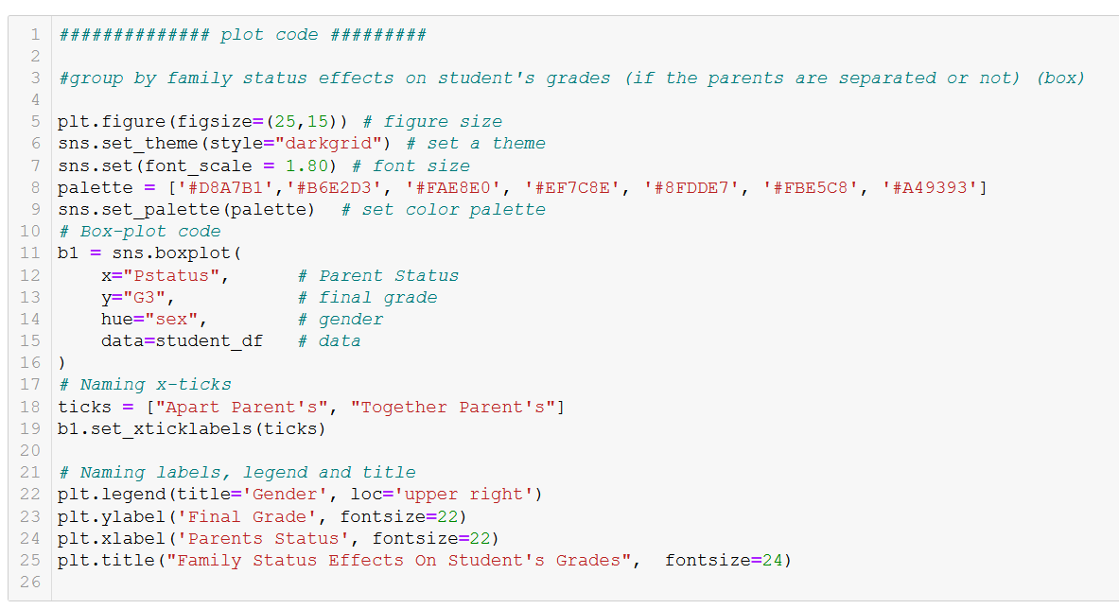

Slide 18
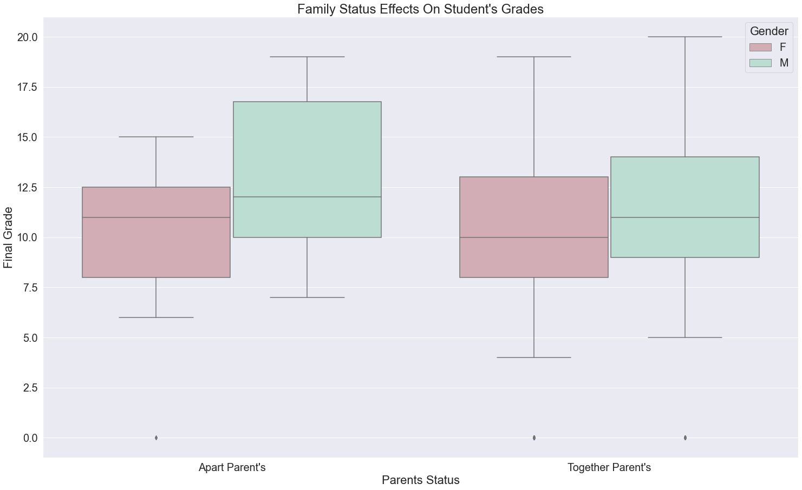
Insights
• Males minimum grade is higher than females for overall in math course.
• The apart parents have a more negative impact on females than males.
• The maximum grade was in students with parents who lives together.
• Males tend to have higher grades than female

Slide 19
05
Students Past Failures
Past failures Effects On Student's Grades

Slide 20
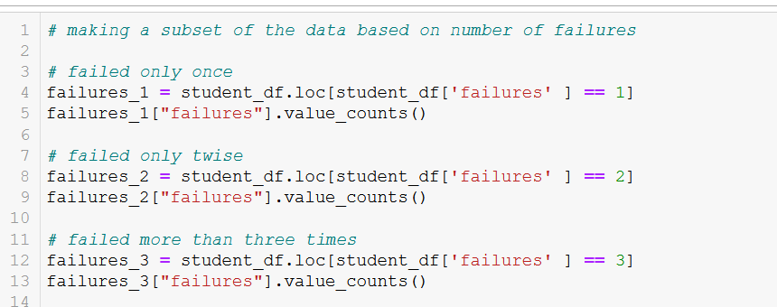
code

Slide 21
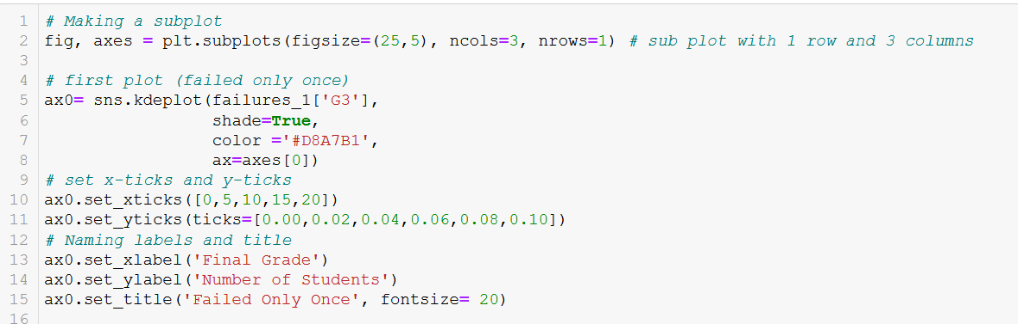
code

Slide 22
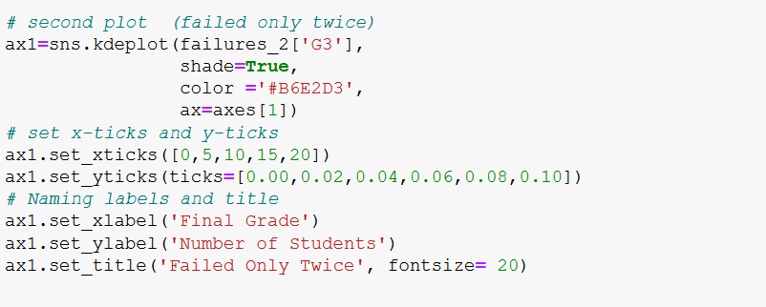
code

Slide 23
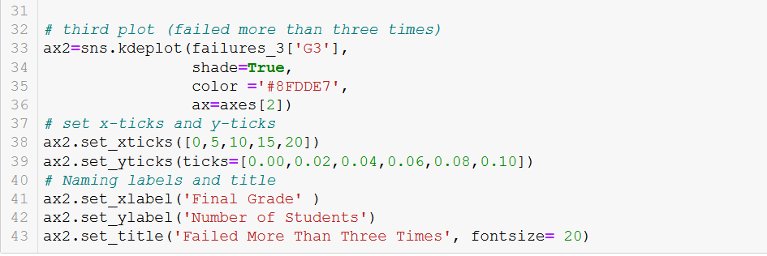
code

Slide 24
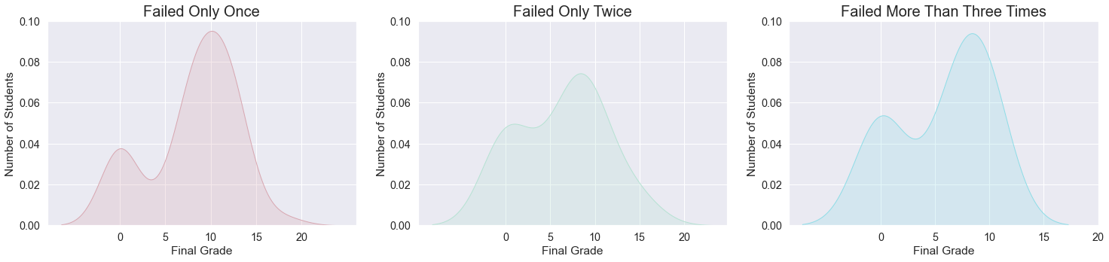
Insights
• Most of the students that only failed once got a score of 10 on the final grade.
• Most of the students that failed twice got a score between 0 and 8 on the final grade.
• Most of the students that failed more than three times got a score between 0 and 7 on the final grade.
• Students who only failed once have an overall better performance than those who failed more than twice.
• There is a dip that starts from 1 until 3 in all chart

Slide 25
06
Final grades
Final grades based on gender

Slide 26
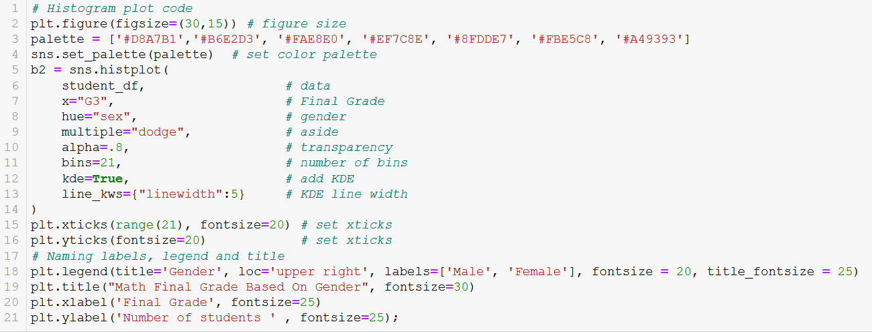

Slide 27
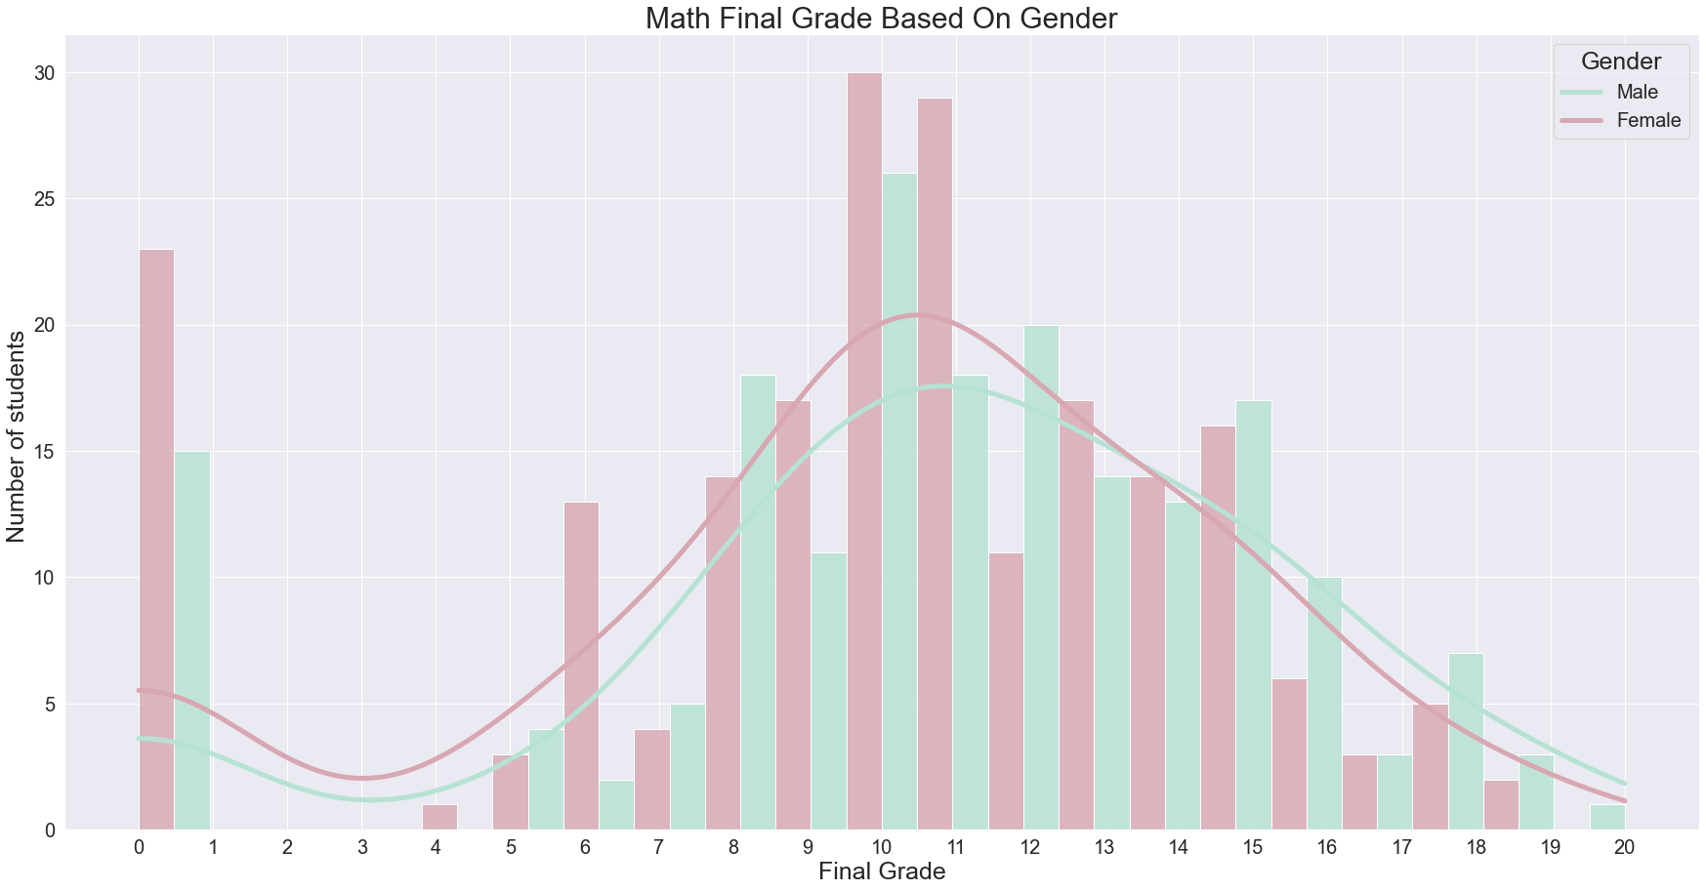
Final Grade Plot
Insights:
•Only one male student succeed in getting a full mark.
•For grades higher than 15 males got higher grading than females.
•Most of the students got grades between 8 and 12.
•Huge number of students got zero for final grades.
•The dip insight from the previous charts is explained here in more detail, it was caused by no students having a score between 1 and

Slide 28
07
Students Who got zero
01
02
03

Slide 29
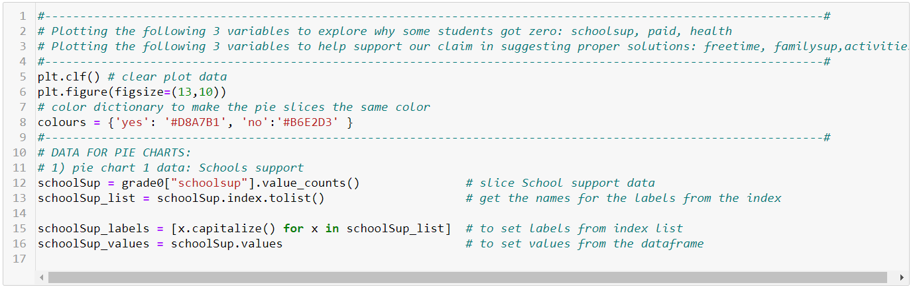

Slide 30
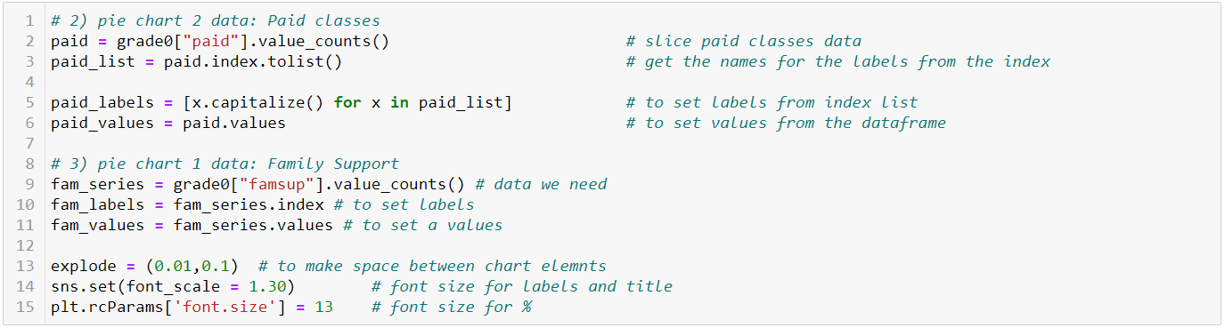

Slide 31
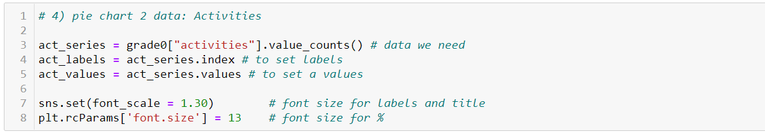

Slide 32
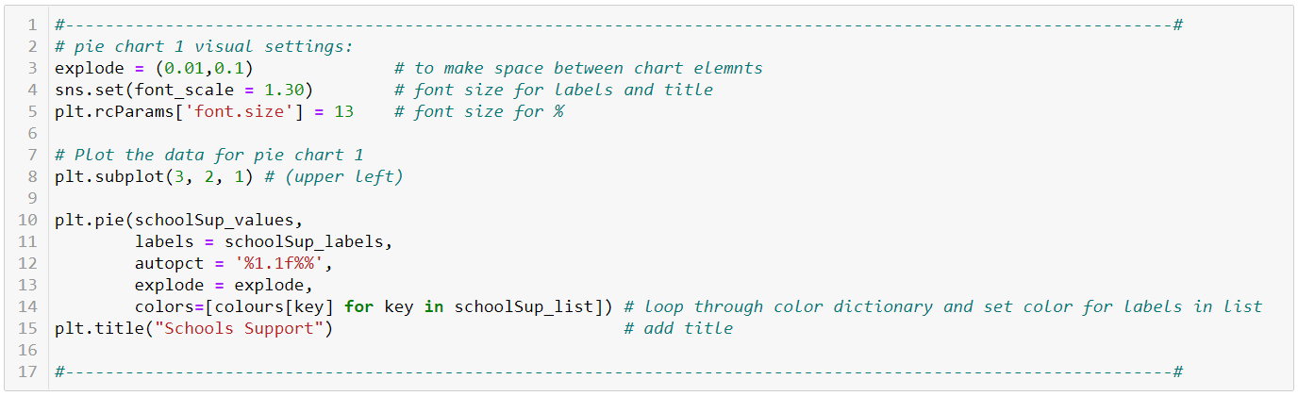

Slide 33
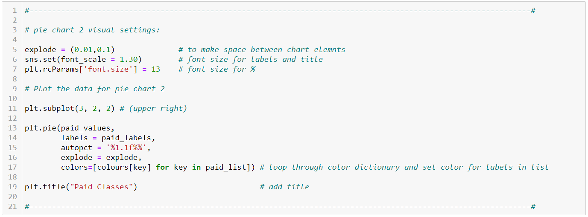

Slide 34
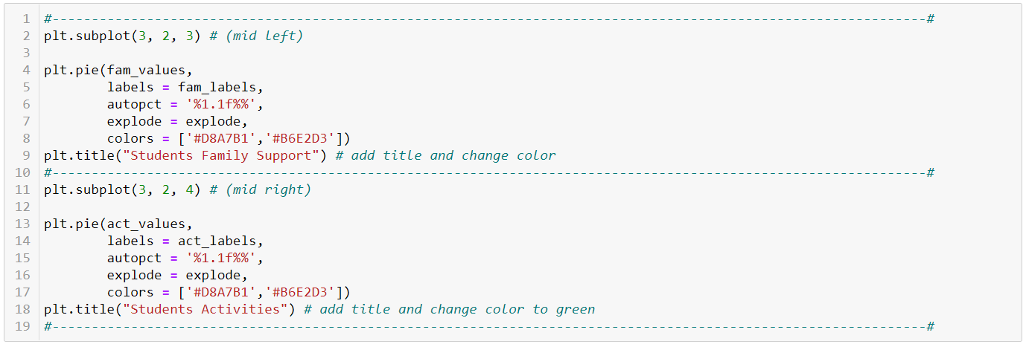

Slide 35
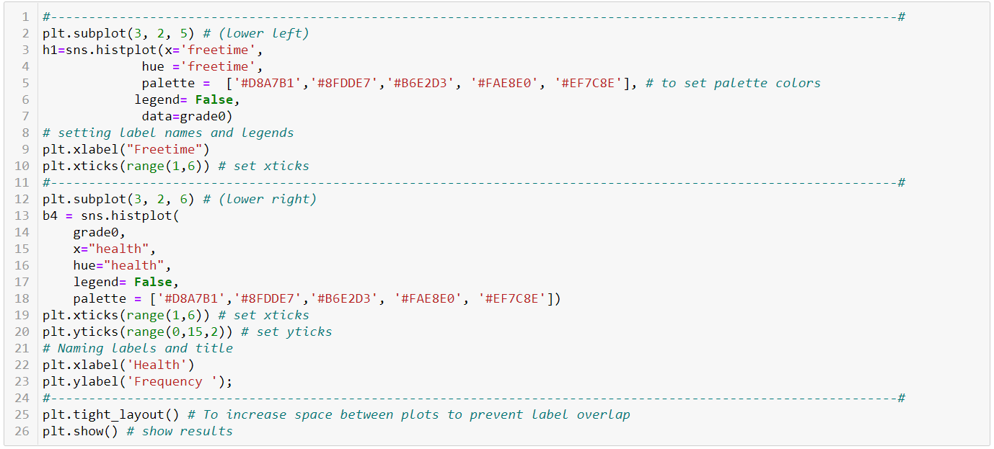

Slide 36
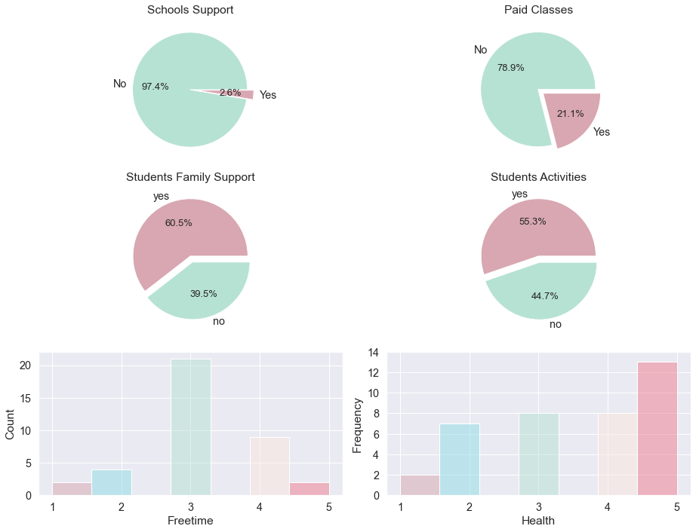

Slide 37
Issues
01
Issues
02
03
School Support Pie chart: The overwhelming majority of students who got zero on their final grade do not have the Schools support.
Paid Classes Pie chart: 80% of the students who got zero on their final grade did not have extra paid classes.
Student Free-time Histogram: Most of the students who got zero on their final grade do have sufficient free-time.
Family Support Pie chart: 39.5% of the students that got zero on the finales don't have a supportive family.
Extracurricular Activity Pie chart: 44.7% of the students that got zero on the finales don't have extracurricular activities.
Student Health Histogram: Most of the students lie between 2 and 4, with 4 being the healthiest and 2 being the least healthy.

Slide 38
From the free-time histogram chart we can see that the students have an ample amount of free-time to implement these following solutions:
01
Solutions
02
03
An after-school program that includes tutoring and one-on-one mentoring to help the students who are behind. To decrease the load on the school’s teachers, this can be done by volunteers or people who need extra work experience on their resumes.
Establish a reward system for all students to increase overall performance, this can include coupons, movie tickets, gift cards or sending a survey to the students to see their preferred rewards.
Create a summer school program, where students can take extra classes.

Slide 39
From the free-time histogram chart we can see that the students have an ample amount of free-time to implement these following solutions:
01
Solutions
02
03
Give extra support to the students who lack family support.
Create a paid classes scholarship program for students who scored zero on their exams.
Students with health issues could take the exams online, or have a re-take chance.
More monitoring of the students’ performance.

Slide 40


Our Team
01
Thanks! Any Questions?
Power
Puff
Girls
02
03
Sara Aldubaie
Wejdan Al-Ahmadi

