Slide 1
Decision Tree

Slide 2
Decision Tree
INTRODUCTION

Slide 3
Important Terminology Related To Decision Trees
Leaf / Terminal Node
Root Node
Nodes do not split is called Leaf or Terminal node.
is at the beginning of a tree.
Pruning
When we remove sub-nodes of a decision node. You can say the opposite process of splitting.
Splitting
It is a process of dividing a node into two or more sub-nodes.
Branch / Sub-Tree
A subsection of the entire tree is called branch or sub-tree
Decision Node
When a sub-node splits into further sub-nodes, then it is called the decision node.
Parent and Child Node
A node, which is divided into sub-nodes is called a parent node of sub-nodes.

Slide 4
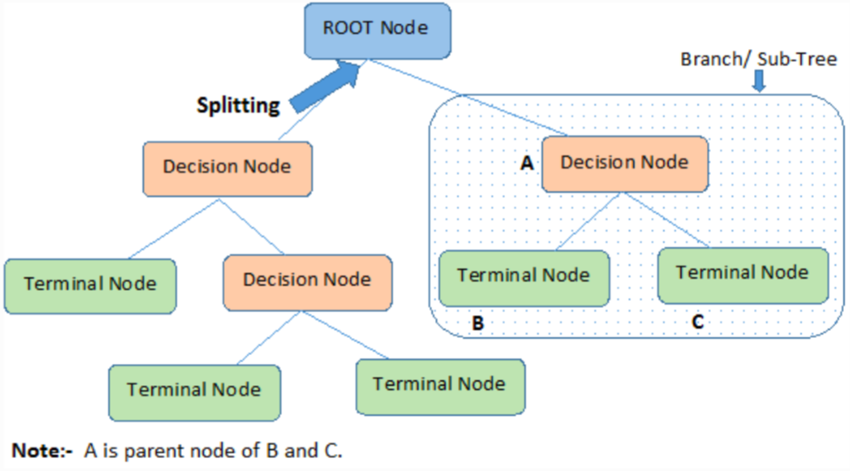
Important Terminology Related To Decision Trees

Slide 5
Decision tree characteristic
Usage
Decision Tree
People use decision trees in a variety of situations, such as determining a course of action for a complex finance or business decision.
s a diagram or chart that helps determine a course of action or show a statistical probability.
3
1
Result
Branch
4
each end result has an assigned risk and reward weight or number. If a person uses a decision tree to make a decision, they can look at each final outcome and assess the benefits and drawbacks.
Each branch of the decision tree represents a possible decision, outcome, or reaction. The furthest branches on the tree represent the end results of a certain decision pathway.
2

Slide 6
Types of Decision Trees
Continuous variable
Categorical variable
Includes categorical target variables that are divided into categories.
Every stage of the decision process falls into one of the categories
Categories can be yes or no
Decision tree with a continuous target variable
Unknown data that can be predicted based on available information
Like someone's income based on their age, occupation.

Slide 7
Decision Tree Algorithms
CHAID
Categorical, tools: SPSS Answer Tree
ID3
Categorical, no restriction in data splitting method, tools: WEKA
C4.5
Categorial, Numerical, no restrictions in data splitting method, tools: WEKA
CART
Categorial, Numerical, binary in data splitting method, tools: CART 5.0

Slide 8






Platforms for making Decision Trees
Applications
1
2
3
4
5
6
Excel
Scikit-Learn
Knime
Google Docs
WEKA
R

Slide 9
Decision Tree Applications
Business Management
Marketing
Decision trees are a possible way to extract useful information from databases and have been used in many applications in business and management.
Decision trees can be used to enhance the accuracy of their promotional campaigns by observing the performance of their competitors’ products and services.
Customer
Relationship Management
Fraudulent Statement Detection
Decision trees used to investigate the relationships between the customers’ needs and preferences and the success of online shopping.
Such an application is particularly important because the existence of FFS may result in reducing the government’s tax income.

Slide 10
Decision Tree Applications
Serving as support
tool in several fields
Healthcare Management
In operations research in planning logistics and strategic management.
In determining appropriate strategies that will help a company achieve its intended goals.
Decision tree can be used for making predictions.
Diagnosis of Diseases and Ailments
Engineering
Decision trees can help physicians and medical professionals in identifying patients that are at a higher risk of developing serious ( or preventable).
Decision trees are widely used in energy consumption and fault diagnosis.

Slide 11
Decision Trees Advantages
1
2
Easy to understand
Useful with or without hard data
3
4
Easy to build upon, you can always add more options
High value in picking out the best of several options
5
6
Possibility of working with missing values; they push them all in a category
Outliers can be isolated in a small node so that they do not affect the entire classification

Slide 12
Decision Trees Disadvantages
1
2
Can be excessively complex
Unstable; a small change in the data can result in major changes in the tree’s structure
3
4
Decision Trees do not analyze all the independent variables simultaneously. Instead, they evaluate them sequentially which can create bias in the tree’s choice
Less effective in predicting outcomes of continuous variables

Slide 13

Previse Work
Which ‘Simpsons’ Character Are You?

Slide 14
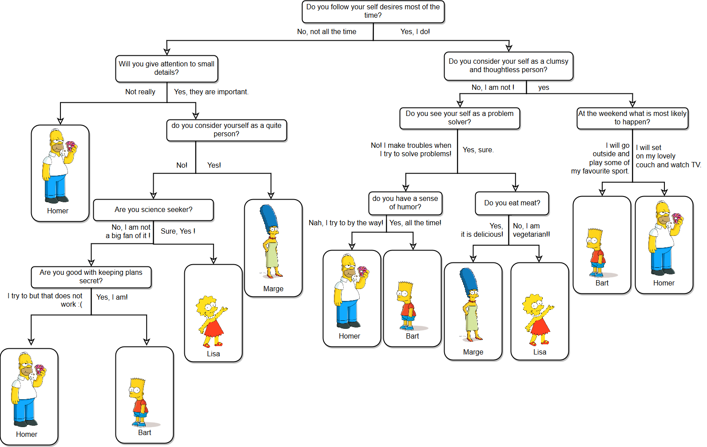
Previse Work

Slide 15
Power Puff Girls
Wejdan Al-Ahmadi
Norah AlHarthi
Members
Sara Aldubaie

