Slide 1
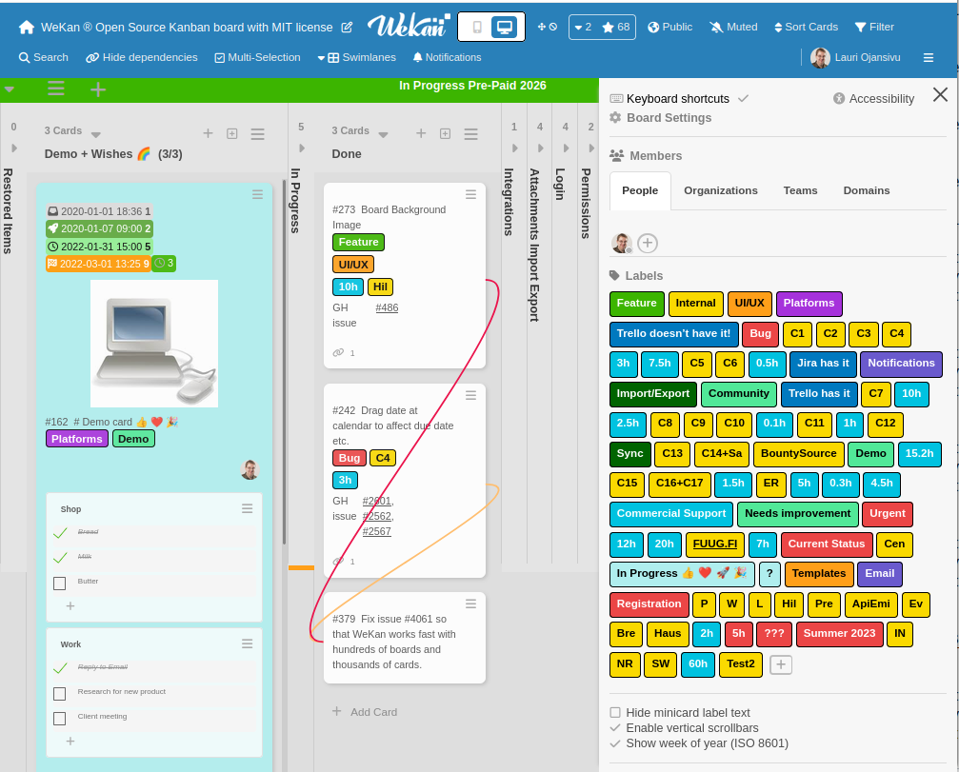

10 years of WeKan ® FOSS kanban
- Maintainer: Lauri Ojansivu (xet7) ,Cross-Platform FOSS Developer, https://github.com/xet7
- WeKan source code: https://github.com/wekan/wekan
https://wekan.fi

Slide 2
What is WeKan 10 ?
Before 0.20, numbering was whatever
Every release version number adds 0.01
10.00 = 1000 releases of WeKan
New release every 3rd day for 10 years
Newest dependencies! Party year !

Slide 3
What happened in 10 years?
2017: Just for fun.
2018: Bounties and Commercial Support
2019-2025: 4 million lines of code changes
2026: Meteor 3. Translation to all languages.
Back to Sandstorm and Snap Stable.

Slide 4
WeKan now at Meteor 3, huge thanks harryadel !
Previous Conference Ukraine 2025-05-18 | Now 2026-07-19
WeKan 7.90 | WeKan 10.02
Meteor 2.14 | Meteor 3.5
Node.js 14.21.4 | Node.js 24.18.0
NPM 6.14.17 | NPM 11.16.0
MongoDB 6.0.23 | FerretDB v1 fork / SQLite
 | (or MongoDB 7.x, 6.x. Or FerretDB 2/PostgreSQL)
Fibers 4.0.1 | Async/Await
 | Many old dependencies removed, code modernized

Slide 5
WeKan: Standard for Public Code
Now: FerretDB v1 SQLite Server fork by default
No MongoDB Server required
Snap Stable upgrade from WeKan 6.09 to WeKan 10 happened at 15k Snap servers worldwide 2 days ago. It migrated automatically all MongoDB to FerretDB.
FerretDB Server v1 fork by xet7 at:
https://github.com/wekan/FerretDB

Slide 6
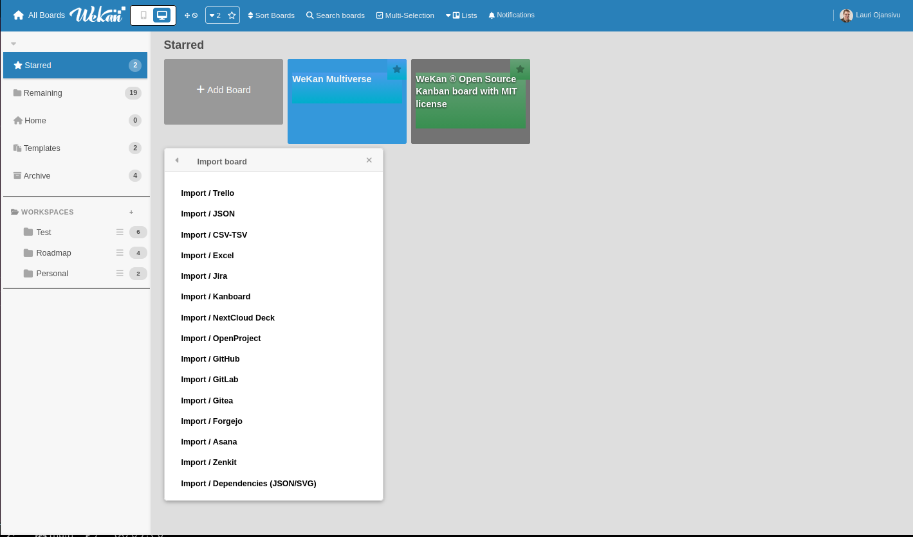

Slide 7
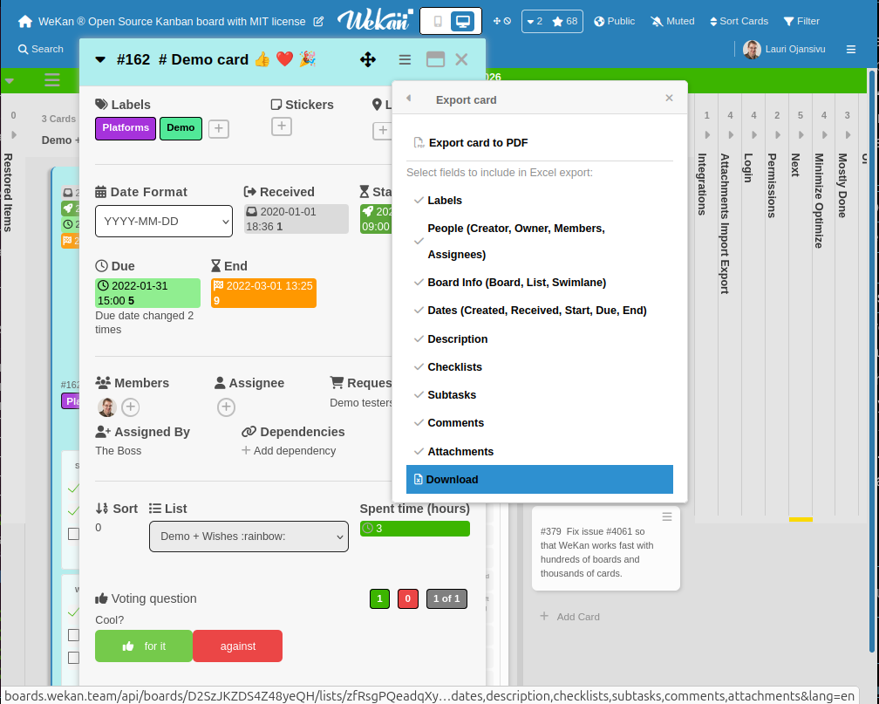
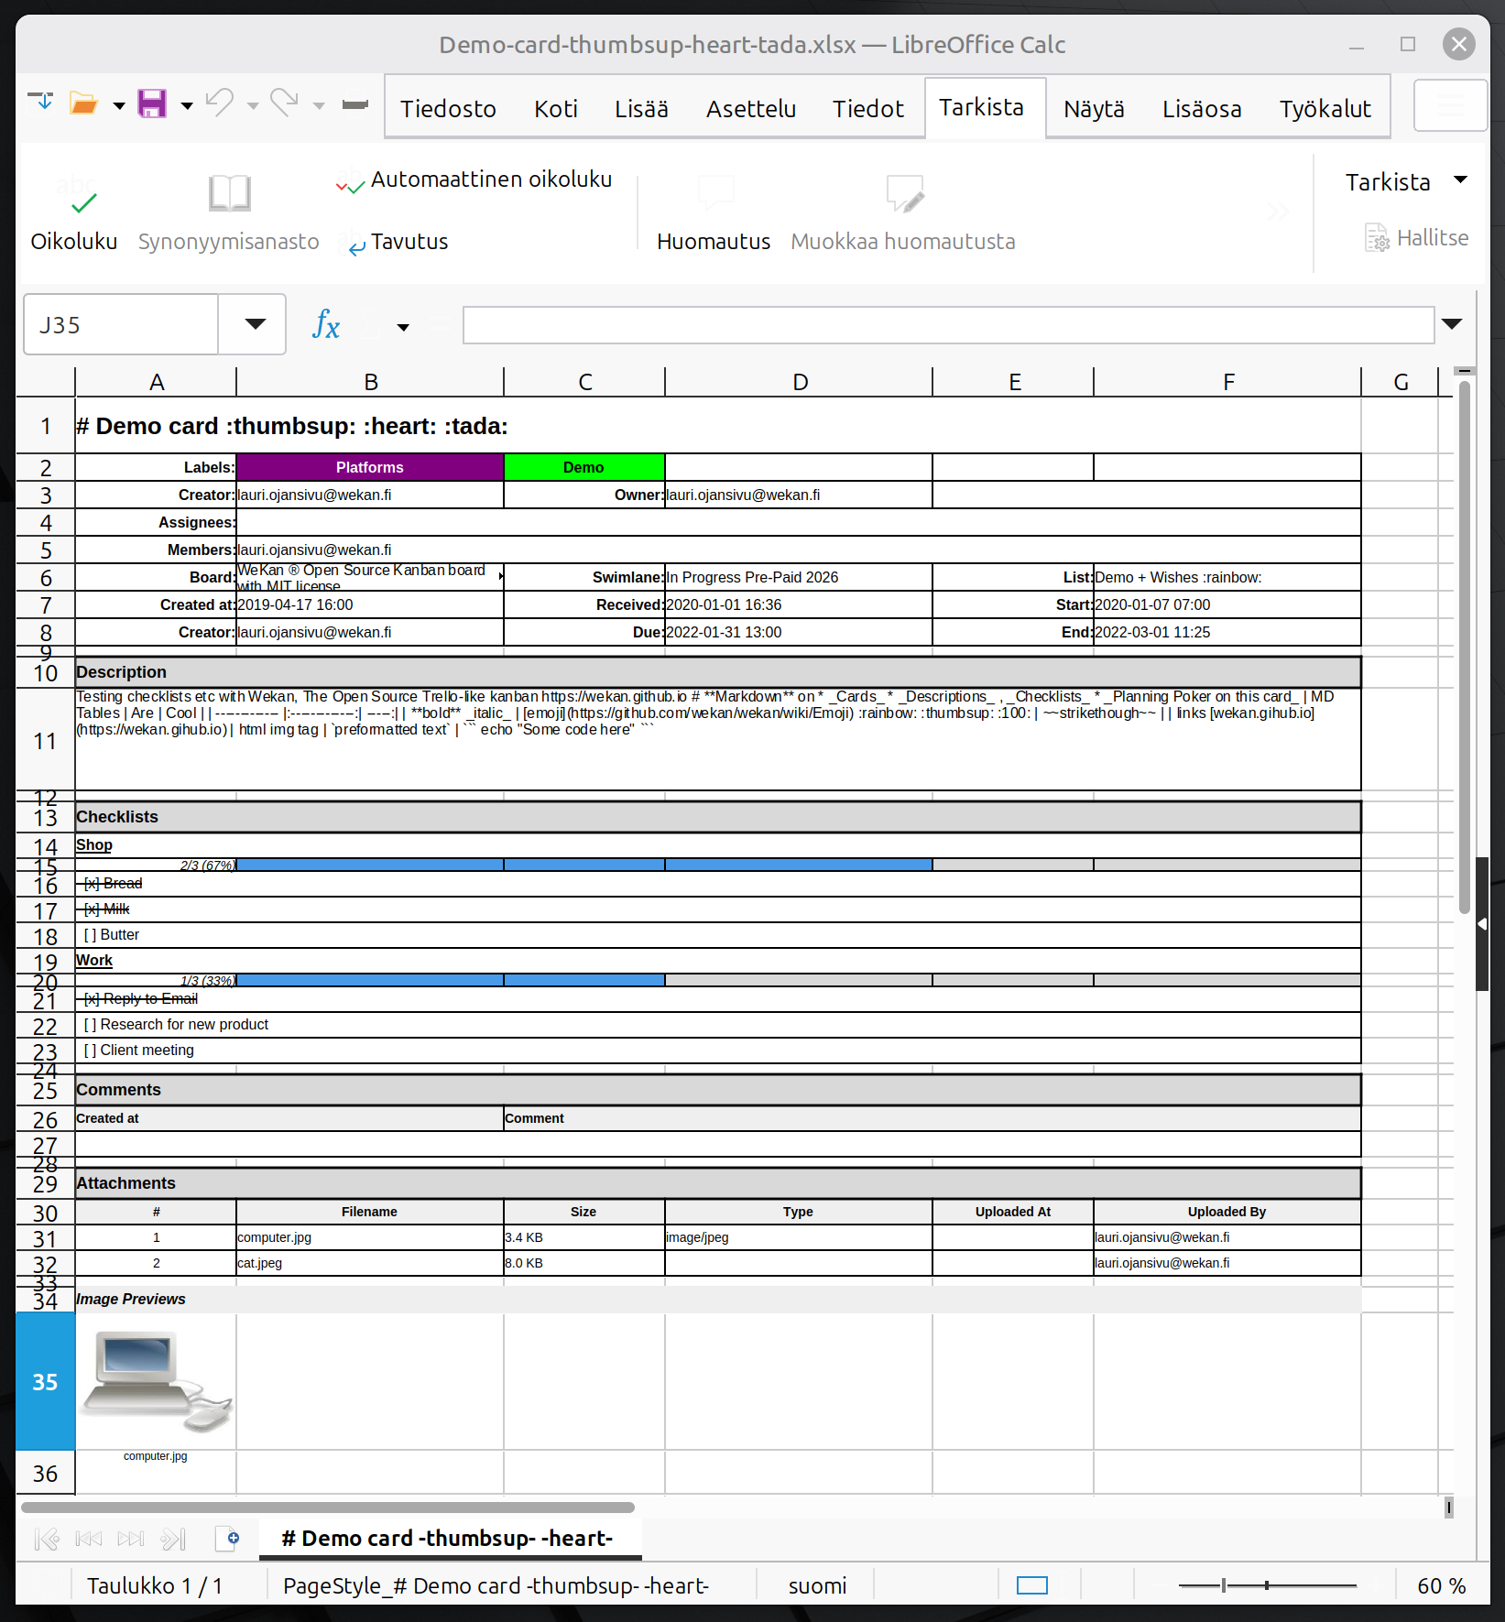
Export Card to Excel with Images

Slide 8
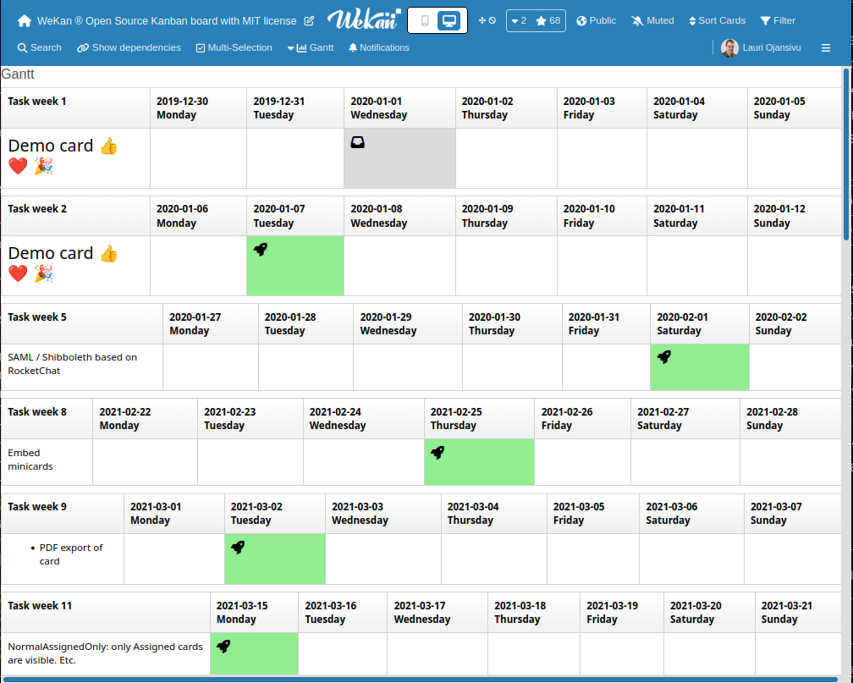
Gantt Chart: All Card Dates Visible

Slide 9
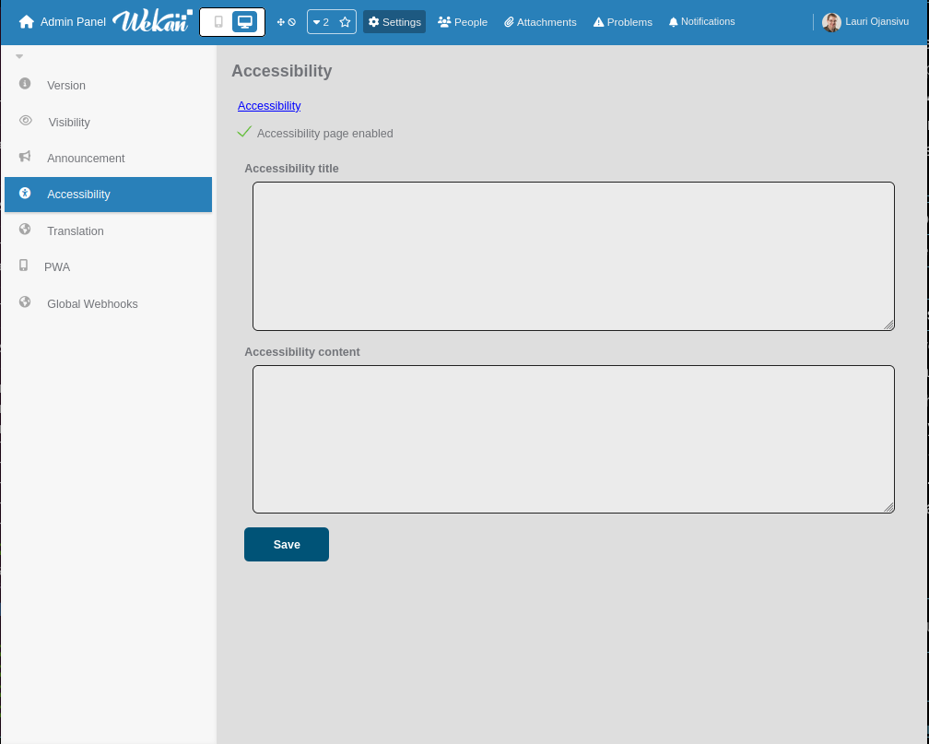
Accessibility fixes and enabling /accessibility page required by law

Slide 10
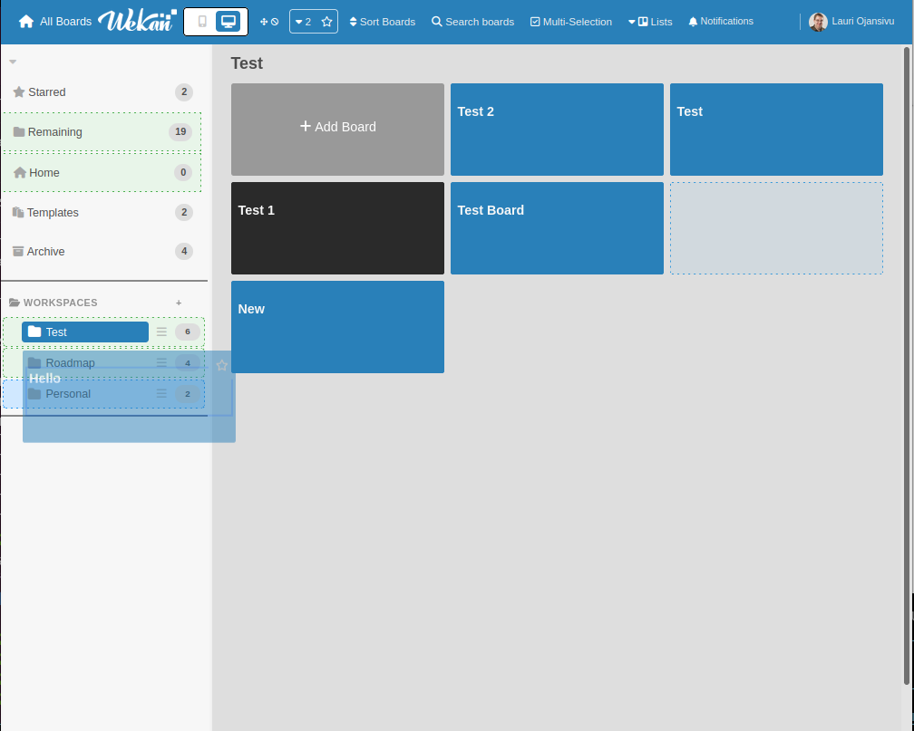
All Boards page: Drag from Remaining to Per-User Workspaces

Slide 11
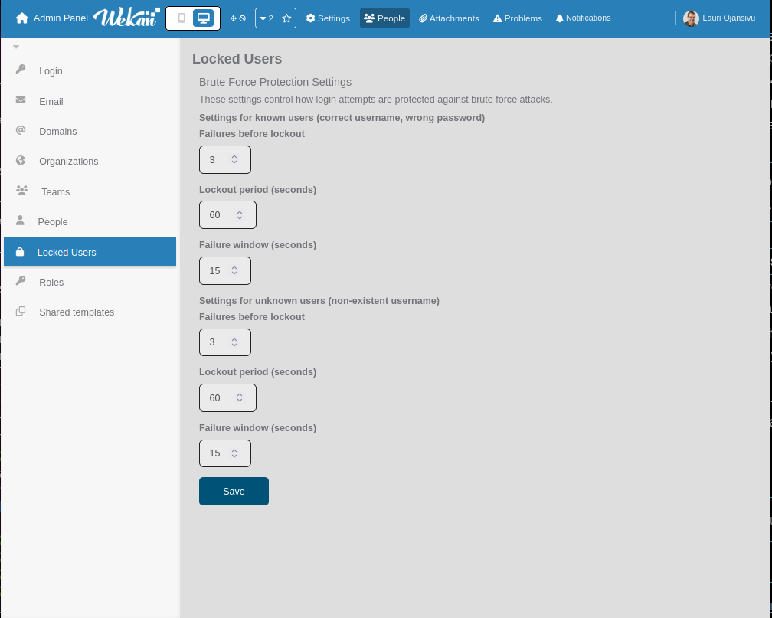
Brute Force Protection Settings and Unlocking at Admin Panel

Slide 12
What is NOT next?
NO help to downgrade to old vulnerable WeKan. Because WeKan takes security seriously. All known security issues have been fixed.
NO old WeKan 6.09 UI back, because new WeKan looks ugly. Show screenshots with arrows where it is ugly. I have now fixed all of those that were at first screenshots.

Slide 13
What is next?
Back to more platforms. Add new platforms.
More UI fixes. WeKan takes UI seriously.
https://github.com/wekan/wekan/issues: Previously 700. Now 300. More to be fixed and closed ASAP !
More Party of 10 years of WeKan !
Summer: Walking, Sunshine, Ice Cream and Strawberries

Slide 14
Funding ? Sponsors?
I moved to new rent apartment. I also moved 1 year ago, because rent price increased too much. There is still debt from previous year moving that is not paid yet.
If some customer can pay for yearly support, please contact.
Yearly support does not renew automatically. Most paid features have been already added. More will be added soon.
Help welcome, how to apply for FOSS funding.
Please contact https://wekan.fi/commercial-support/

Slide 15
WeKan kanban with MIT license website: https://wekan.fi
All code at: https://github.com/wekan/wekan
FOSS Feature Requests and Bugs:
https://github.com/wekan/wekan/issues
Pull Requests to: https://github.com/wekan/wekan/pulls
WeKan App at https://wekan.fi/app/
WeKan Private Paid Wordwide Commercial Support,
Support/Features/Fixes/Hosting: https://wekan.fi
Email: support@wekan.fi
IRC Libera.Chat #wekan . THANKS ! NOW: ANY QUESTIONS ?

