Slide 1
Fork-Join Framework
Parallelism
Goal: Taking advantage of multicore CPUs
How: Divide and conquer
Some problems can be difficult to execute as parallel tasks
Some problems are easier, e.g., servers that support multiple clients can use a separate task to handle each client
Scheduling too many parallel tasks can negatively impact performance

Slide 2
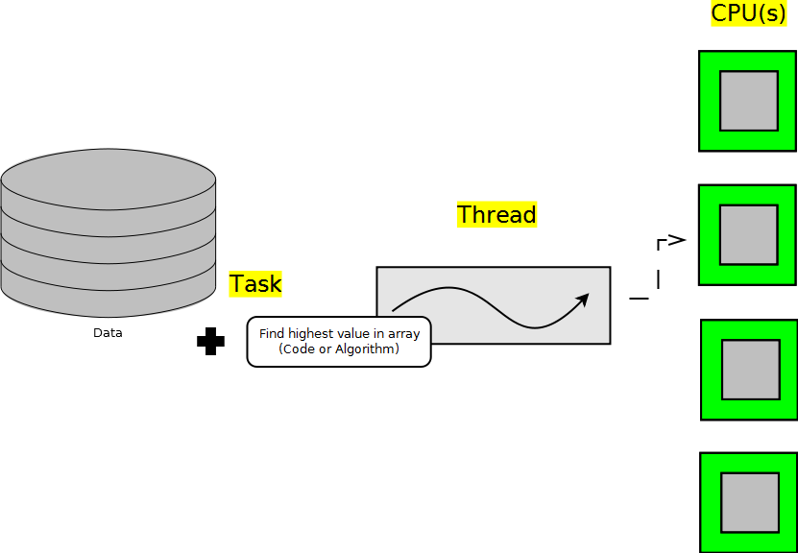
Without Parallelism
Utilizes only a portion of the system's processing power

Slide 3
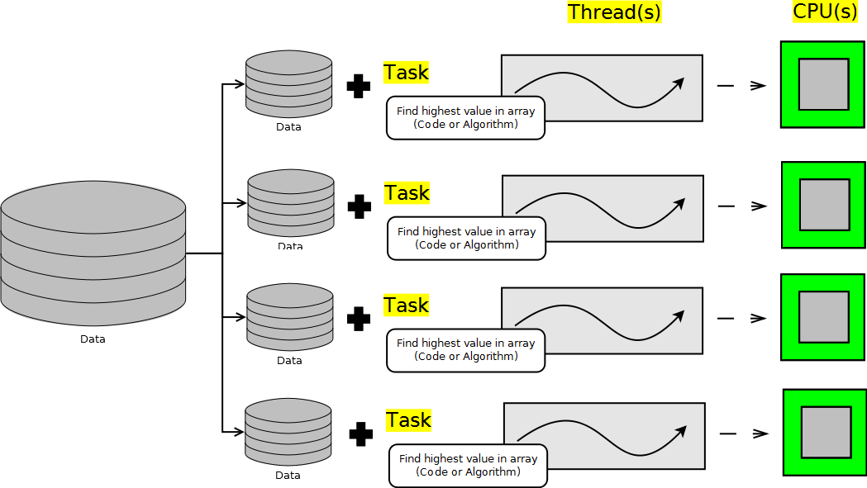
Naive Parallelism
Simple parallel solution breaks the data into multiple sets: one dataset per CPU and a thread to process each dataset

Slide 4
Need for Fork-Join Framework
Ideally all cores should be fully utilized until the task is complete, but:
CPU cores may run at different speeds
Non-Java tasks require CPU time themselves
The datasets being analyzed may require varying amounts of time to process

Slide 5
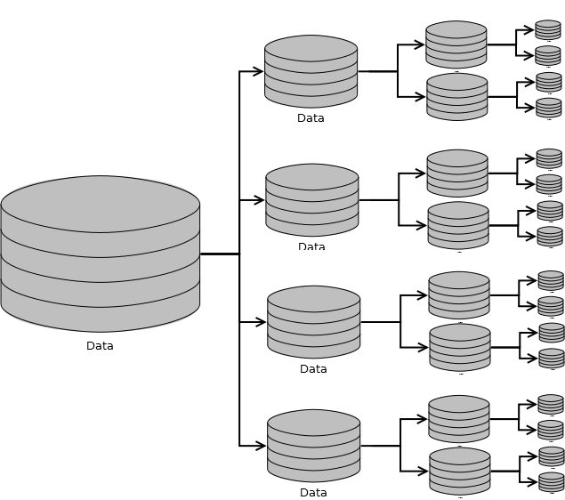
"Work-Stealing" Approach
To keep multiple threads busy:
Divide the data to be processed into a sufficiently large number of subsets
Place the data subsets to threads' processing queues
Each thread will have multiple subsets enqueued
If a thread finishes all its tasks early, it can “steal” subsets from another thread

Slide 6
java.util.concurrent.ForkJoinTask<V>
Abstract class that implements Future<V>
A ForkJoinTask object represents a task to be executed
A task contains the code and data to be processed; similar to a Runnable or Callable
A ForkJoinTask continuously creates ForkJoinTask instances until the data to be processed has been subdivided adequately
Developers typically use the following concrete subclasses:
RecursiveAction<Void>: When the task does not need to return a result
RecursiveTask<V>: When the task needs to return a result

Slide 7
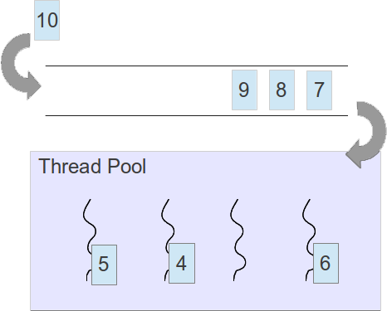
ForkJoinPool
As tasks arrive, they are enqueued
Threads in the thread pool grab the next available task
Task Queue
A ForkJoinPool is used to execute a ForkJoinTask
By default, it creates a thread for each CPU in the system

Slide 8
Fork-Join Recommendations
Avoid I/O or other blocking operations
Only one thread per CPU is created by default. Blocking ops keep from utilizing all CPU resources
Know your hardware
A Fork-Join solution will perform slower on a single core system than a standard sequential solution
Some CPUs increase in speed when only using a single core, potentially offsetting any performance gain provided by Fork-Join
Know your problem
Many problems have additional overhead if executed in parallel (e.g., parallel sorting)

Slide 9
ForkJoinPool_Simplified
ForkJoinSum

