Slide 1
Java 8 Lambda expressions

Slide 2
Module Outline
Introduction to the “Lambda Expressions”
The lambda syntax
Functional interfaces
Method references
Constructor references
How to process data from the Collection API?
4-2
Notes:
2

Slide 3
What is a Lambda Expression for?
A simple example:
public interface FileFilter {
boolean accept(File file);
}
4-3
Notes:
3

Slide 4
What is a Lambda Expression for?
Let’s implement this interface and use it:
public class JavaFileFilter implements FileFilter {
public boolean accept(File file) {
return file.getName().endsWith(".java"); }
}
JavaFileFilter fileFilter = new JavaFileFilter();
File dir = new File("d:/tmp");
File[] javaFiles = dir.listFiles(fileFilter);
4-4
Notes:
4

Slide 5
What is a Lambda Expression for?
FileFilter fileFilter = new FileFilter() {
@Override
public boolean accept(File file) {
return file.getName().endsWith(".java"); }
};
File dir = new File("d:/tmp");
File[] javaFiles = dir.listFiles(fileFilter);

Slide 6
A First Lambda Expression
Let’s use an anonymous class
FileFilter fileFilter = new FileFilter() {
@Override
public boolean accept(File file) {
return file.getName().endsWith(".java"); }
};
We take the parameters and return:
FileFilter filter = (File file) -> file.getName().endsWith(".java");
This is a Java 8 lambda expression.

Slide 7
What is a Lambda Expression for?
The first answer is:
To make instances of anonymous classes easier to
write
and read!

Slide 8
So what is a Java 8 Lambda Expression?
Answer: another way of writing instances of anonymous classes

Slide 9
Several ways of writing a Lambda Expression
The simplest way:
FileFilter filter = (File file) -> file.getName().endsWith(".java");
If you have more than one line of code:
Runnable r = () -> {
for (int i = 0; i < 5; i++) {
System.out.println("Hello world!"); }
};
If you have more than one argument:
Comparator<String> c =
(String s1, String s2) -> Integer.compare(s1.length(), s2.length());

Slide 10
Lambda example
Example:
FirstLambda
FirstLambda1

Slide 11
Lambda example
Example:
RunnableLambda
RunnableLambda1

Slide 12
Three Questions about Lambdas
What is the type of a lambda expression?
Can a lambda be put in a variable?
Is a lambda expression an object?

Slide 13
What is the type of a lambda expression?
Answer: a functional interface
What is a functional interface?
A functional interface is an interface with only one abstract method (methods from class Object do not count)
public interface Runnable {
run();
}
public interface Comparator<T> {
int compareTo(T t1, T t2); }
public interface FileFilter {
boolean accept(File pathname);
}

Slide 14
Functional interface
A functional interface can be annotated:
@FunctionalInterface
public interface MyFunctionalInterface {
someMethod();
/**
* Some more documentation
*/
equals(Object o);
};
The annotation is here just for convenience, the compiler can tell me whether the interface is functional or not

Slide 15
Can I put a Lambda Expression into a variable?
Answer is yes!
Comparator<String> c =
(String s1, String s2) -> Integer.compare(s1.length(), s2.length());
Consequences: a lambda can be taken as a method parameter, and can be returned by a method

Slide 16
Is Lambda an Object?
Let’s compare the following:
Comparator<String> c =
(String s1, String s2) -> Integer.compare(s1.length(), s2.length());
Comparator<String> c =
new Comparator<String>(String s1, String s2) {
public boolean compareTo(String s1, String s2) { Integer.compare(s1.length(), s2.length()); }
}
A lambda expression is created without using new

Slide 17
Three Questions about Lambdas
What is the type of a lambda expression?
Answer: a functional interface
Can a lambda be put in a variable?
Answer: yes
Is a lambda expression an object?
The answer is complex, but no
Exact answer: a lambda is an object without an identity

Slide 18
Lambda example
Example:
ComparatorLambda
ComparatorLambda1

Slide 19
Functional interfaces toolbox
New package : java.util.function
It contains a rich set of functional interfaces

Slide 20
Package java.util.function
Categories:
Supplier
@FunctionalInterface
public interface Supplier<T> {
T get();
}
Consumer / BiConsumer
@FunctionalInterface
public interface Consumer<T> {
void accept(T t);
}
@FunctionalInterface
public interface BiConsumer<T, U> {
void accept(T t, U u);
}
Notes:
These are functional interfaces and can therefore be used as the assignment target for a lambda expression or method reference.

Slide 21
Package java.util.function
Predicate
@FunctionalInterface
public interface Predicate<T> {
boolean test(T t);
}
BiPredicate
@FunctionalInterface
public interface BiPredicate<T, U> {
boolean test(T t, U u);
}
Notes:
These are functional interfaces and can therefore be used as the assignment target for a lambda expression or method reference.

Slide 22
Package java.util.function
Function
@FunctionalInterface
public interface Function<T, R> {
R apply(T t);
}
Unary operator
@FunctionalInterface
public interface UnaryOperator<T> extends Function<T, T> {
}
Notes:
These are functional interfaces and can therefore be used as the assignment target for a lambda expression or method reference.

Slide 23
Package java.util.function
BiFunction
@FunctionalInterface
public interface BiFunction<T, U, R> {
R apply(T t, U u);
}
Binary operator
@FunctionalInterface
public interface BinaryOperator<T> extends BiFunction<T, T, T> {
}
Notes:
These are functional interfaces and can therefore be used as the assignment target for a lambda expression or method reference.

Slide 24
More on Lambda expression syntax
Most of the time, parameter types can be omitted:
Comparator<String> c =
(String s1, String s2) -> Integer.compare(s1.length(), s2.length());
Becomes:
Comparator<String> c =
(s1, s2) -> Integer.compare(s1.length(), s2.length());

Slide 25
Method references
This lambda expression:
Function<String, String> f = s -> s.toLowerCase();
Can be written like that:
Function<String , String> f = String::toLowerCase;
This lambda expression:
Consumer<String> c = s -> System.out.println(s);
Can be written like that:
Consumer<String> c = System.out::println;
This lambda expression:
Comparator<Integer> c = (i1, i2) -> Integer.compare(i1, i2);
Can be written like that:
Comparator<Integer> c = Integer::compare;

Slide 26
Method references example
Example:
LambdaTest

Slide 27
Method references
public class Person {
public enum Sex {
MALE, FEMALE
}
String name;
Date birthday;
Sex gender;
String emailAddress;
public static int compareByAge(Person a, Person b) {
return a.birthday.compareTo(b.birthday);
}
}

Slide 28
Method references
Arrays.sort(rosterAsArray,
(Person a, Person b) -> {
return a.getBirthday().compareTo(b.getBirthday());
}
);
However, this method to compare the birth dates of two Person instances already exists as Person.compareByAge. You can invoke this method instead in the body of the lambda expression:
Arrays.sort(rosterAsArray, (a, b) -> Person.compareByAge(a, b));
Because this lambda expression invokes an existing method, you can use a method reference instead of a lambda expression:
Arrays.sort(rosterAsArray, Person::compareByAge);

Slide 29
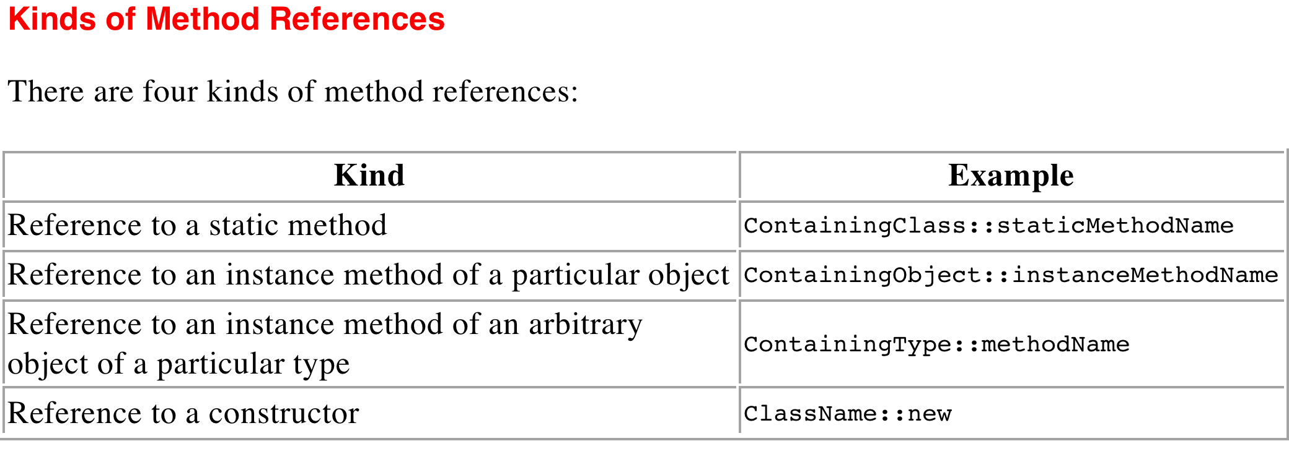
Method references
Arrays.sort(rosterAsArray, Person::compareByAge);
The method reference Person::compareByAge is semantically the same as the lambda expression (a, b) -> Person.compareByAge(a, b). Each has the following characteristics:
Its formal parameter list is copied from Comparator<Person>.compare, which is (Person, Person).
Its body calls the method Person.compareByAge.

Slide 30
Reference to an Instance Method of an Arbitrary Object of a Particular Type
String[] stringArray = { "Barbara", "James", "Mary", "John",
"Patricia", "Robert", "Michael", "Linda" };
Arrays.sort(stringArray, String::compareToIgnoreCase);
The equivalent lambda expression for the method reference String::compareToIgnoreCase would have the formal parameter list (String a, String b), where a and b are arbitrary names used to better describe this example.
The method reference would invoke the method a.compareToIgnoreCase(b).

Slide 31
Reference to a constructor
public static <T, SOURCE extends Collection<T>, DEST extends Collection<T>>
DEST transferElements(SOURCE sourceCollection,
Supplier<DEST> collectionFactory) {
DEST result = collectionFactory.get();
for (T t : sourceCollection) {
result.add(t);
}
return result;
}
The functional interface Supplier contains one method get that takes no arguments and returns an object. Consequently, you can invoke the method transferElements with a lambda expression as follows:
Set<Person> rosterSetLambda =
transferElements(roster, () -> { return new HashSet<>(); });
You can use a constructor reference in place of the lambda expression as follows:
Set<Person> rosterSet = transferElements(roster, HashSet::new);
The Java compiler infers that you want to create a HashSet collection that contains elements of type Person. Alternatively, you can specify this as follows:
Set<Person> rosterSet = transferElements(roster, HashSet<Person>::new);

Slide 32
Method references example
Example:
FuncInterfaceTutor
FuncInterfaceTask

Slide 33
How do we process data in Java?
Where are our objects?
Most of the time: in a Collection (it may be a List, a Set or a Map)
Can I process this data with lambdas?
List<Customer> list = ...;
list.forEach(customer -> System.out.println(customer));
Or:
List<Customer> list = ...;
list.forEach(System.out::println);

Slide 34
Can I process this data with lambdas?
The good news is: yes!
We can write:
List<Customer> list = ...;
list.forEach(customer -> System.out.println(customer));
But… where does this forEach method come from?
Adding a forEach method on the Collection interface breaks the compatibility: all the implementations have to be refactored!

Slide 35
How to add methods to Iterable?
Without breaking all the existing implementations?
public interface Iterable<E> {
// the usual methods
void forEach(Consumer<E> consumer);
}
Refactoring these implementations is not an option
If we can’t put the implementation in ArrayList, then…
public interface Iterable<E> {
// the usual methods
default void forEach(Consumer<E> consumer) {
for (E e : this) {
consumer.accept(e); }
}
}

Slide 36
forEach example
Example:
ChainConsumers

Slide 37
Default methods
This is a new Java 8 concept
It allows to change the old interfaces without breaking the existing implementations
It also allows new patterns!
Static methods are also allowed in Java 8 interfaces!

Slide 38
Static methods
In addition to default methods, you can define static methods in interfaces.
A static method is a method that is associated with the class in which it is defined rather than with any object. Every instance of the class shares its static methods.
This makes it easier for you to organize helper methods in your libraries; you can keep static methods specific to an interface in the same interface rather than in a separate class.
All static methods inside an interface need to provide an implementation.

Slide 39
Default and static methods
public interface TimeClient {
void setTime(int hour, int minute, int second);
void setDate(int day, int month, int year);
void setDateAndTime(int day, int month, int year,
int hour, int minute, int second);
LocalDateTime getLocalDateTime();
ZonedDateTime getZonedDateTime(String zoneString);
}
public class SimpleTimeClient implements TimeClient {
...
}
Following a modification to the TimeClient interface, you would also have to modify the class SimpleTimeClient and implement the new method getZonedDateTime.
You can instead define a default implementation.

Slide 40
Default and static methods
public interface TimeClient {
void setTime(int hour, int minute, int second);
void setDate(int day, int month, int year);
void setDateAndTime(int day, int month, int year, int hour,
int minute, int second);
LocalDateTime getLocalDateTime();
static ZoneId getZoneId (String zoneString) {
try {
return ZoneId.of(zoneString);
} catch (DateTimeException e) {
System.err.println("Invalid time zone: " + zoneString);
return ZoneId.systemDefault();
}
}
default ZonedDateTime getZonedDateTime(String zoneString) {
return ZonedDateTime.of(getLocalDateTime(), getZoneId(zoneString));
}
}

Slide 41
Default methods example
Example:
TimeClient
SimpleTimeClient

Slide 42
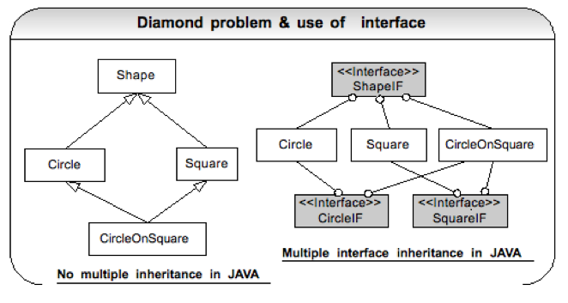
Default methods and the diamond problem
Notes:
Prior to Java 8, Java was not subject to the Diamond problem risk, as Java does not support multiple inheritance. The default interface method capability added with Java 8 introduced a type of multiple inheritance since classes can implement more than one interface, which can contain default methods that have the same name. However, the Java compiler provides rules to determine which default method a particular class uses, which prevents the Diamond problem.

Slide 43
Default methods and the diamond problem
Prior to Java 8, Java was not subject to the Diamond problem risk, as Java does not support multiple inheritance.
The default interface method capability added with Java 8 introduced a type of multiple inheritance since classes can implement more than one interface, which can contain default methods that have the same name.
The Java compiler provides rules to determine which default method a particular class uses, which prevents the Diamond problem.

Slide 44
Default methods and the diamond problem
public interface Bar {
default void someMethod(){
System.out.println("Bar#someMethod");
}
}
public interface Foo {
default void someMethod(){
System.out.println("Foo#someMethod");
}
default void someOtherMethod(){
System.out.println("Foo#someOtherMethod");
}
}

Slide 45
Default methods and the diamond problem
public class FooBar implements Foo, Bar {
public static void main(String [] args) {
System.out.println("FooBar#main");
FooBar fooBar = new FooBar();
fooBar.someMethod();
fooBar.someOtherMethod();
}
}
Compile error:
Duplicate default methods named someMethod with the parameters () and () are inherited from the types Bar and Foo

Slide 46
Default methods and the diamond problem
public class FooBar implements Foo, Bar {
@Override
public void someMethod(){
System.out.println("FooBar#someMethod");
}
public static void main(String [] args) {
System.out.println("FooBar#main");
FooBar fooBar = new FooBar();
fooBar.someMethod();
fooBar.someOtherMethod();
}
}
Code compiles and executes.
FooBar#main
FooBar#someMethod
Foo#someOtherMethod

Slide 47
Default methods example
Example:
Foo
Bar
FooBar

Slide 48
Examples of new patterns
Predicates
Predicate<String> p1 = s -> s.length() < 20; Predicate<String> p2 = s -> s.length() > 10;
Predicate<String> p3 = p1.and(p2);
@FunctionalInterface
public interface Predicate<T> {
boolean test(T t);
default Predicate<T> and(Predicate<? super T> other) { Objects.requireNonNull(other);
return (t) -> test(t) && other.test(t); }
}

Slide 49
Examples of new patterns
Predicates
Predicate<String> id = Predicate.isEqual(target);
@FunctionalInterface
public interface Predicate<T> {
boolean test(T t);
static <T> Predicate<T> isEqual(Object targetRef) { return (null == targetRef)
? Objects::isNull
: object -> targetRef.equals(object); }
}

Slide 50
Summary
The new « lambda expression » syntax
A lambda expression has a type: a functional interface
Definition of a functional interface, examples
Method and constructor references
Iterable.forEach method
Default and static methods in interfaces, examples

