Slide 1
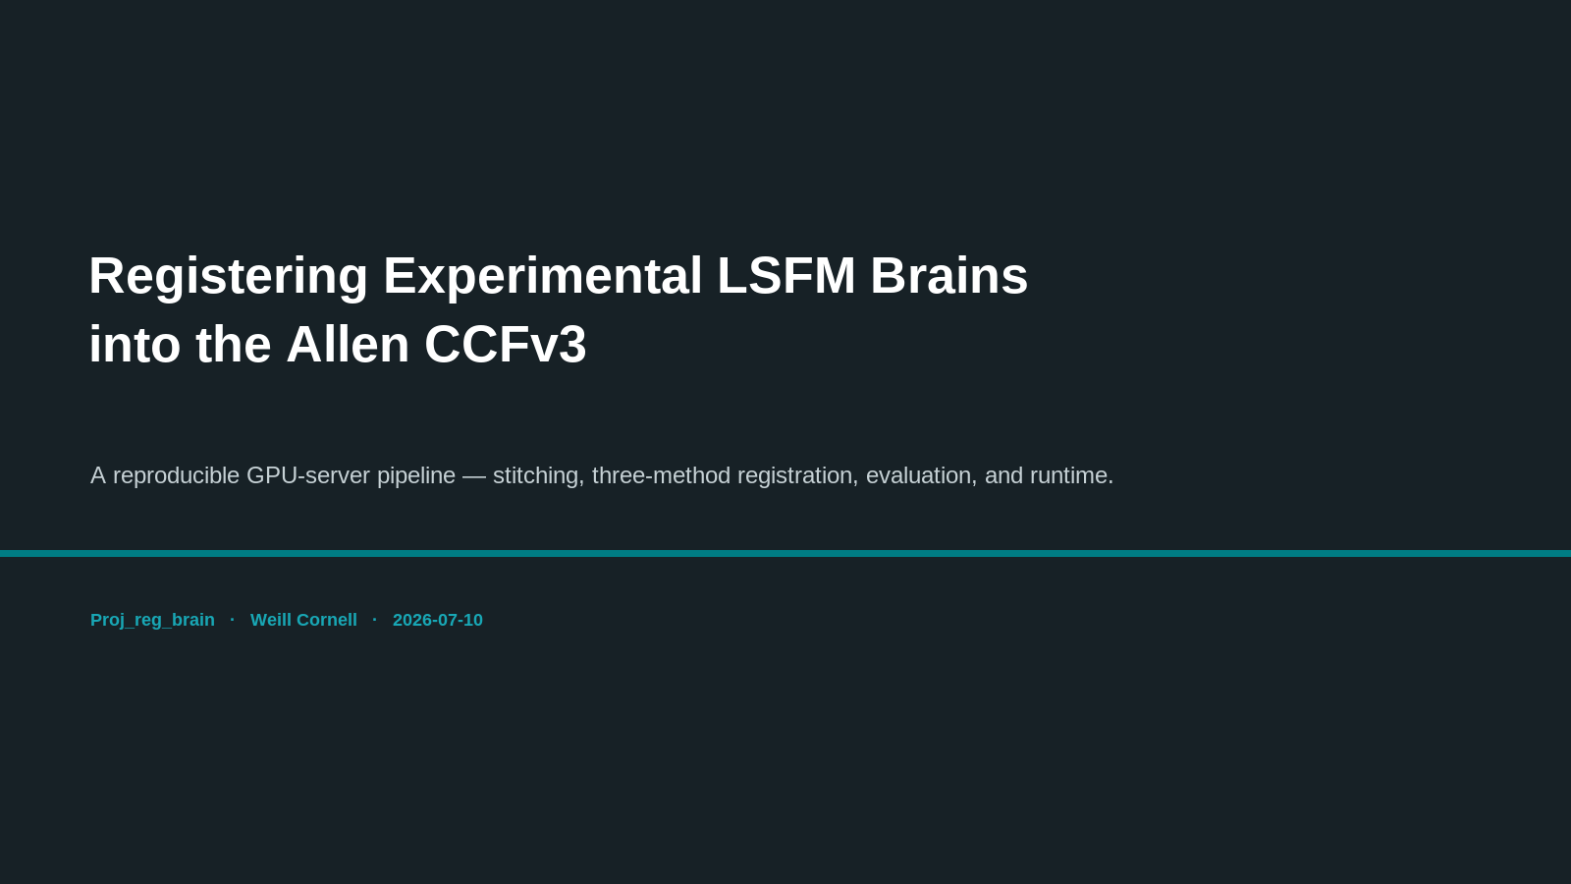
Notes:
SLIDE 1 — TITLE (brief)
This talk: a reproducible pipeline that registers experimental light-sheet (LSFM) mouse brains into the Allen Common Coordinate Framework (CCFv3), and benchmarks the registration methods on accuracy and runtime.

Slide 2
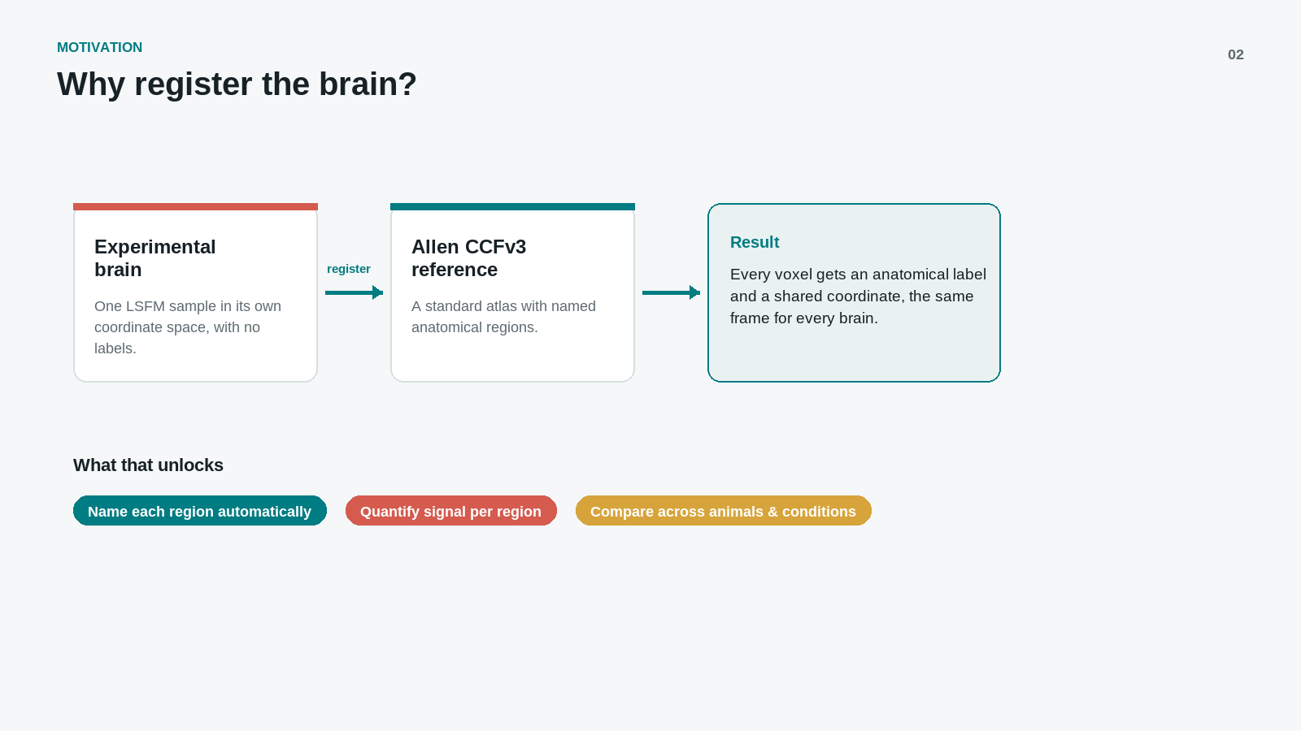
Notes:
SLIDE 2 — WHY REGISTER (brief)
Registration warps a standard atlas (Allen CCFv3, which has named regions) onto our experimental brain. Payoff: every voxel gets an anatomical label and a shared coordinate frame — so we can automatically name regions, quantify signal per region, and compare across animals and conditions.

Slide 3
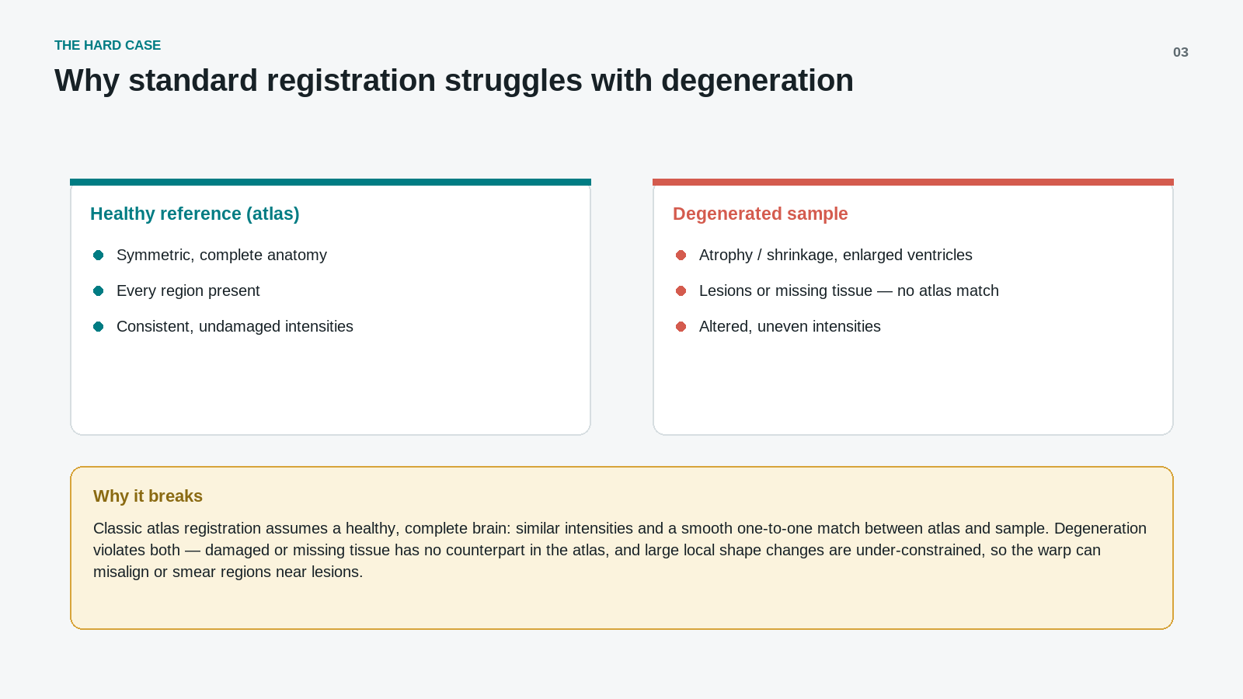
Notes:
SLIDE 3 — THE HARD CASE (brief)
Standard atlas registration assumes a healthy, complete brain: similar intensities, every region present, a smooth one-to-one match. Degenerated samples break all three (atrophy/shrinkage, lesions or missing tissue, altered intensities), so the warp can misalign or smear regions near damage. This motivates benchmarking methods and, later, GPU/learned approaches.

Slide 4
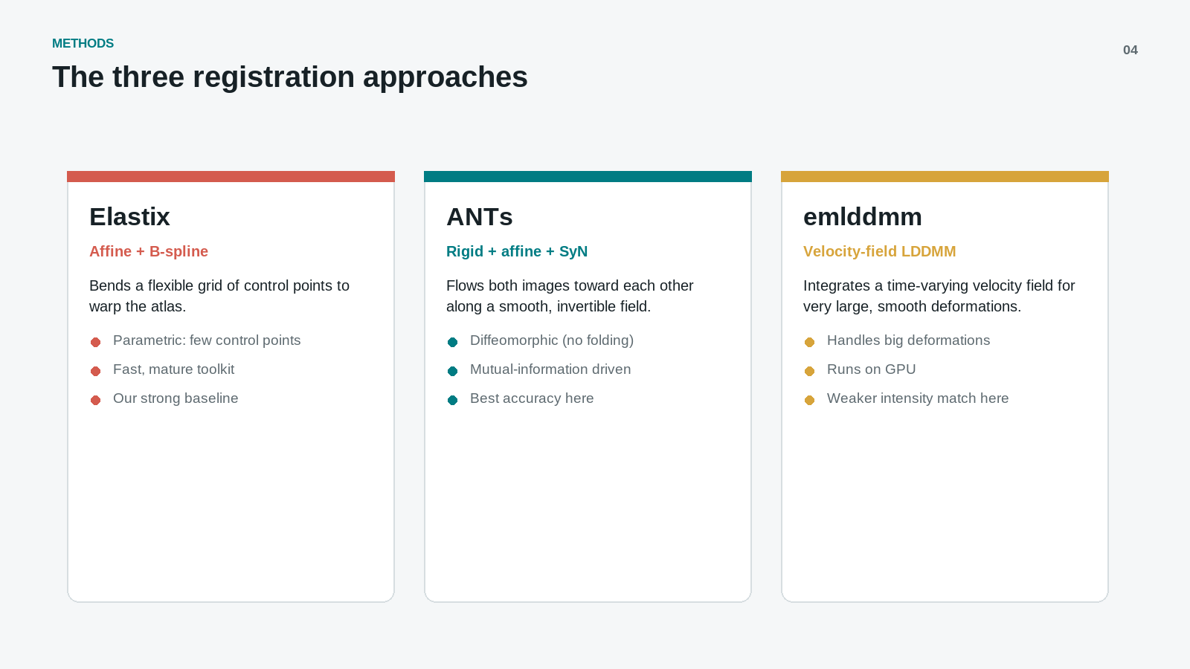
Notes:
SLIDE 4 — THE THREE REGISTRATION APPROACHES (a bit more detail)
Three methods, from the simplest to the most flexible deformation model. The key is HOW each one bends the atlas:
- elastix (Affine + B-spline): warps the atlas by bending a grid of control points. "Parametric" = the warp is defined by relatively few control points. Fast, mature toolkit — our strong baseline.
- ANTs (Rigid + affine + SyN): "flows" the two images toward each other along a smooth, INVERTIBLE deformation field (diffeomorphic = no folding/tearing), driven by a mutual-information similarity metric. Best accuracy in our benchmark.
- emlddmm (velocity-field LDDMM): builds the deformation by integrating a time-varying velocity field — designed for very large, smooth deformations. Runs on GPU; weaker intensity match on this data.
One-line difference: elastix bends a control-point grid; ANTs and emlddmm both produce dense, invertible (diffeomorphic) deformation fields, with emlddmm using a velocity-field formulation for bigger deformations. All three do global alignment first, then nonlinear refinement.
(FireANTs, a GPU-accelerated ANTs, is added later in the deck.)

Slide 5
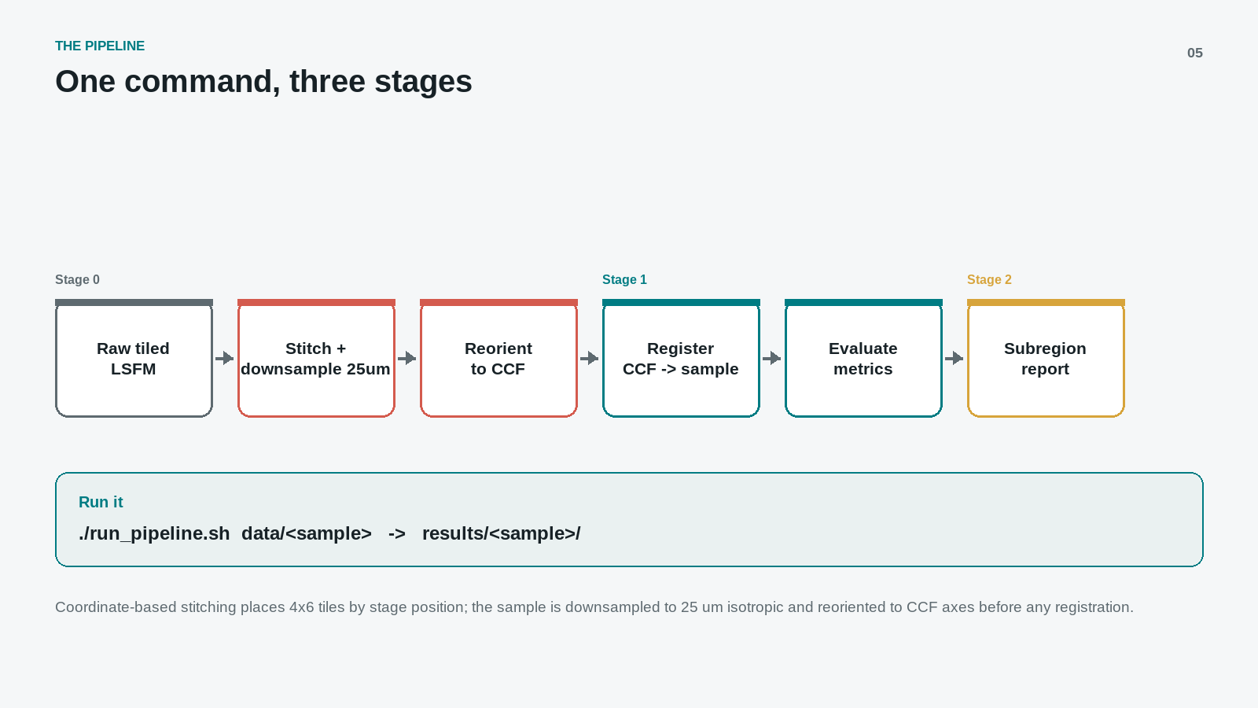
Notes:
SLIDE 5 — ONE COMMAND, THREE STAGES (+ evaluation metrics & how they are computed)
One command runs everything: ./run_pipeline.sh data/<sample> writes all outputs to results/<sample>/.
Stage 0 (preprocessing): stitch the raw 4x6 LSFM tiles by stage position, downsample to 25 um isotropic, reorient to CCF axes — so the sample is roughly aligned before any registration.
Stage 1 (register + evaluate): warp the CCF template and its labels into the FIXED sample space with each method, then score.
Stage 2 (subregion report): per-region comparison tables.
BENCHMARK DESIGN (why it's fair):
- The experimental sample is always the FIXED reference — it is never resampled, so we never degrade the data; the smaller CCF template and labels MOVE into sample space.
- Every method is scored the same way at the same downsampling stride — apples-to-apples.
- Metrics are intensity-agreement PROXIES (there is no manual ground-truth segmentation of the sample). They show which method aligns best, not absolute anatomical correctness — so we also inspect overlays visually.
HOW THE METRICS ARE COMPUTED:
Whole-brain: after registration, compare the warped CCF template vs the fixed sample, voxel-by-voxel, inside the brain mask.
- NCC (normalized cross-correlation) and edge NCC — how well intensities / edges correlate (higher = better).
- Mutual information & NMI — statistical dependence between the two intensity patterns (higher = better).
- RMSE / MAE — intensity error after normalization (lower = better).
Per-subregion: use each warped atlas LABEL as a mask (a region of interest) and compute the same scores inside it — revealing which anatomical regions align well and which don't.

Slide 6
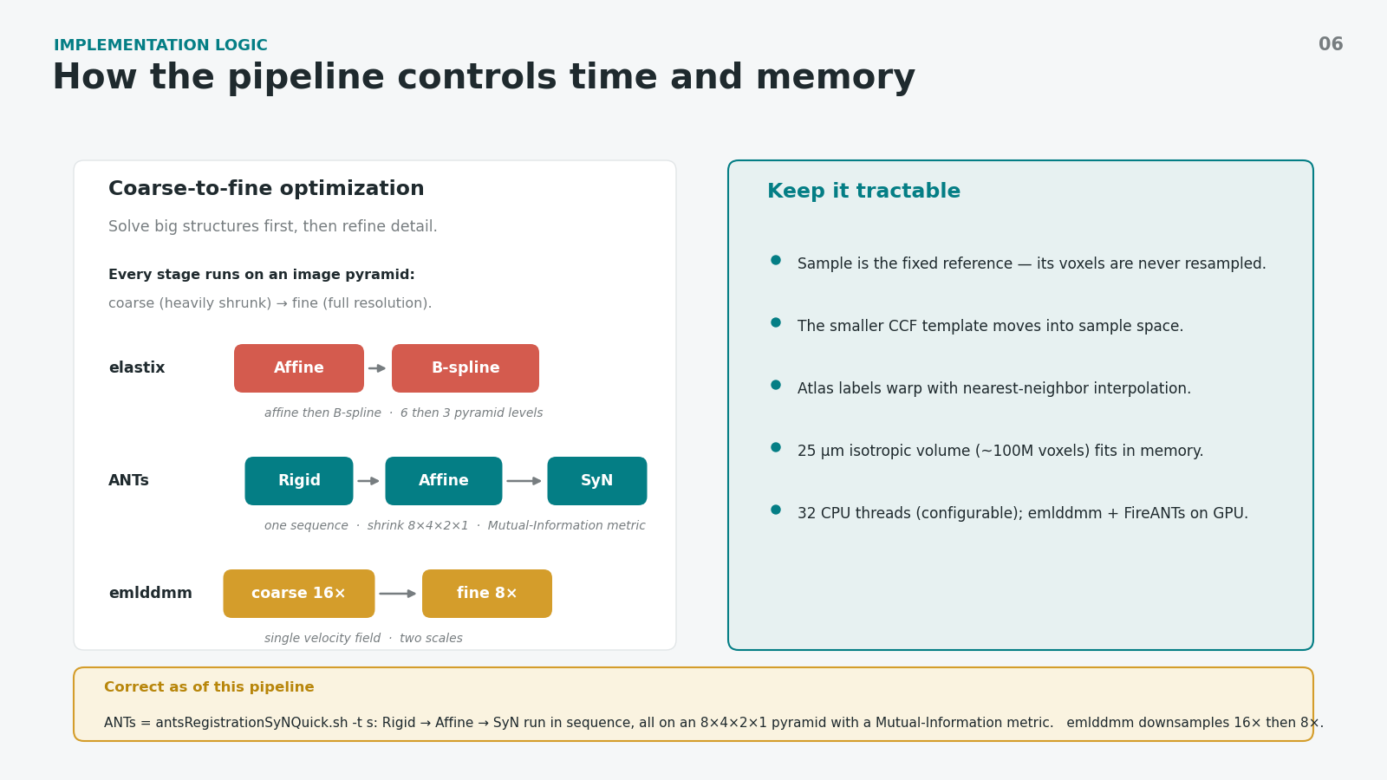
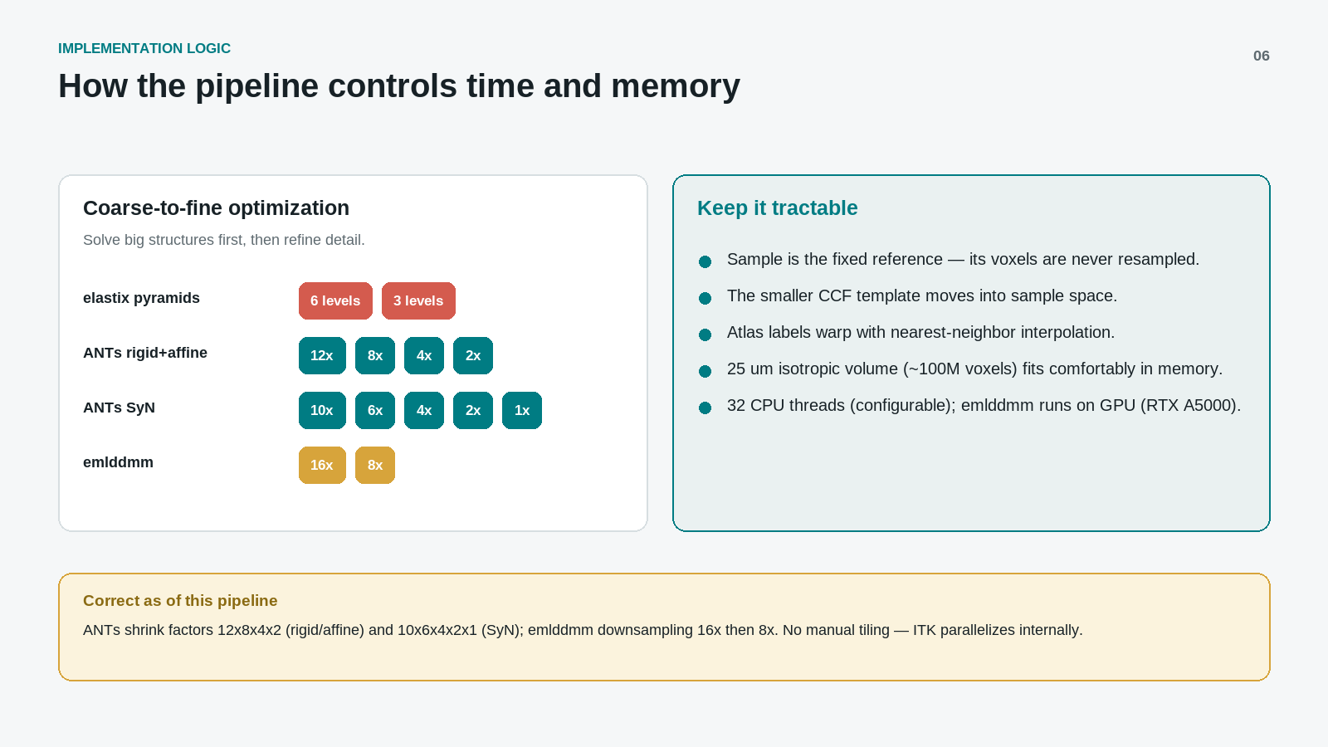
Notes:
SLIDE 6 - HOW THE PIPELINE CONTROLS TIME AND MEMORY (explicit)
The engineering behind the method: how we keep registration fast and within memory, and the exact ANTs settings we run with.
COARSE-TO-FINE OPTIMIZATION (left card)
Registration is a search for the transform that best lines up the atlas with our sample. If we searched at full resolution from the very start, it would be slow AND get trapped fitting tiny, noisy details before the brain is even globally aligned. So every method works on an image PYRAMID - the same picture at several resolutions:
- Start heavily shrunk (e.g. 8x smaller): only big shapes remain - overall outline, major lobes. Solve THAT alignment first; it's fast and hard to get wrong.
- Step to less shrinking (4x, then 2x, then full 1x), each level refining finer detail on top of the previous level's answer.
Analogy: sketch the rough outline first, then progressively add detail - you never start by drawing individual hairs. Coarse-to-fine is both faster and more robust (it avoids bad local solutions).
THE ANTs STAGES ARE A SEQUENCE, NOT A CHOICE (the key point)
ANTs aligns in three stages, each MORE flexible than the last, and each hands its result to the next as a starting point:
1) RIGID - slide and rotate the whole atlas as if it were a solid, unbendable block (only 6 knobs: 3 shifts + 3 rotations). Gets it roughly into the right position and orientation.
2) AFFINE - now also allow uniform stretch, scale and shear of the whole block (still ONE transform for the entire brain). Fixes overall size and proportion so the atlas roughly fills the sample.
3) SyN - the nonlinear step. Now each little region can move on its own along a smooth, invertible deformation field, bending the atlas LOCALLY to match folds, ventricles, hippocampus - things a single whole-brain transform can never capture.
Why all three: rigid/affine get you globally "in the ballpark," and SyN only succeeds if it STARTS from a good global alignment. SyN alone on unaligned images, or stopping at affine, both give poor results. Each stage itself runs coarse-to-fine on the 8x4x2x1 pyramid.
WHICH ANTs VERSION WE USE - AND WHY WE CHOSE THESE SETTINGS
Command: antsRegistrationSyNQuick.sh -t s -p f -n 32
- "-t s" (rigid + affine + SyN): chosen because our sample and the CCF differ in pose, size AND local shape, so we need the full stack. "-t a" (affine only) leaves anatomy locally misaligned; "-t so" (SyN only) wrongly assumes we are already globally aligned.
- SyNQuick vs full SyN: Quick uses fewer iterations (its SyN stage even skips the finest-resolution refinement) and Mutual Information throughout. We chose Quick because this is a multi-method, multi-sample BENCHMARK - we want fast, repeatable, good-quality runs to compare methods fairly, not one maximally hand-tuned result. Full antsRegistrationSyN.sh is our "turn up the quality" switch (adds finest-level refinement with a cross-correlation metric) for a final best-effort run, at higher runtime.
- Metric = Mutual Information (the SyNQuick default): chosen deliberately because the fixed sample (LSFM autofluorescence) and the moving CCF template are DIFFERENT modalities - their brightness does not correspond linearly. MI measures statistical dependence, so it stays robust across modalities; cross-correlation assumes a linear intensity relationship and is weaker here. (This is exactly why FireANTs, which uses CC, underperformed.)
- "-p f" (single-precision float): half the memory of double with negligible accuracy loss, so the ~100M-voxel volume stays comfortable in RAM.
- "-n 32" threads: half of the 64 cores - good speed with headroom; fully configurable.
Defaults we keep: the 8x4x2x1 pyramid and SyN regularization are sensible defaults, and because we pre-orient the sample we don't need an even coarser level.
Levers to push accuracy later: switch to full SyN; add histogram matching (-j) and a brain mask (-x) for this cross-modality pair; or drop to hand-rolled antsRegistration for full control of metric / iterations / shrink / smoothing.
KEEP IT TRACTABLE (right card)
Sample stays FIXED (never resampled, so the raw data is never degraded); the smaller CCF template moves into sample space; labels warp with nearest-neighbour so region IDs are not blended; the 25 um volume (~100M voxels) fits in memory; 32 CPU threads; emlddmm and FireANTs use the GPU.

Slide 7
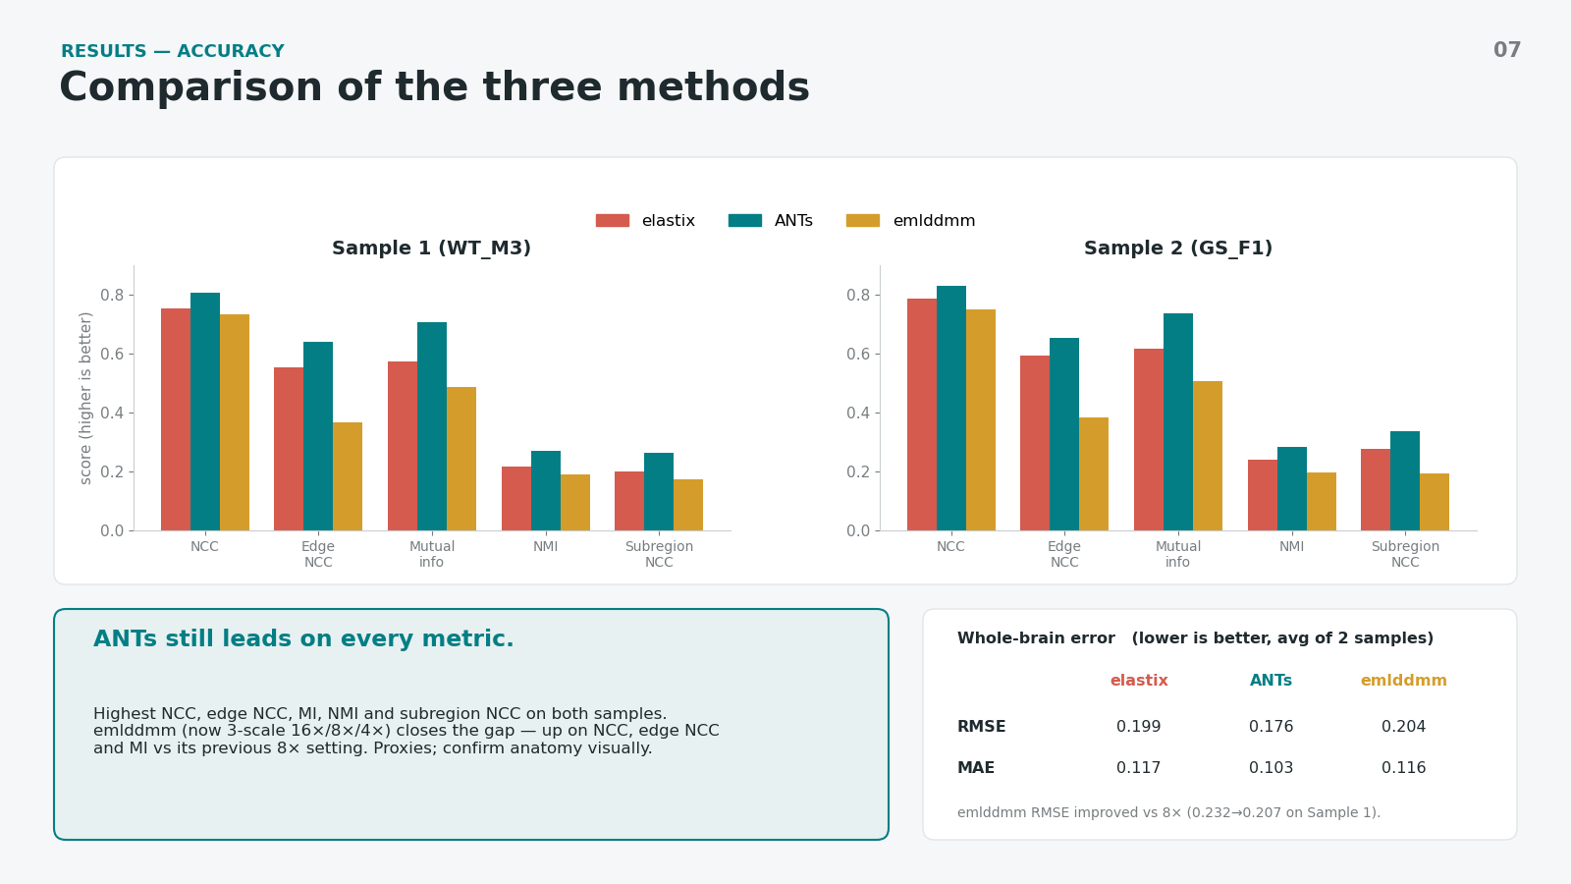
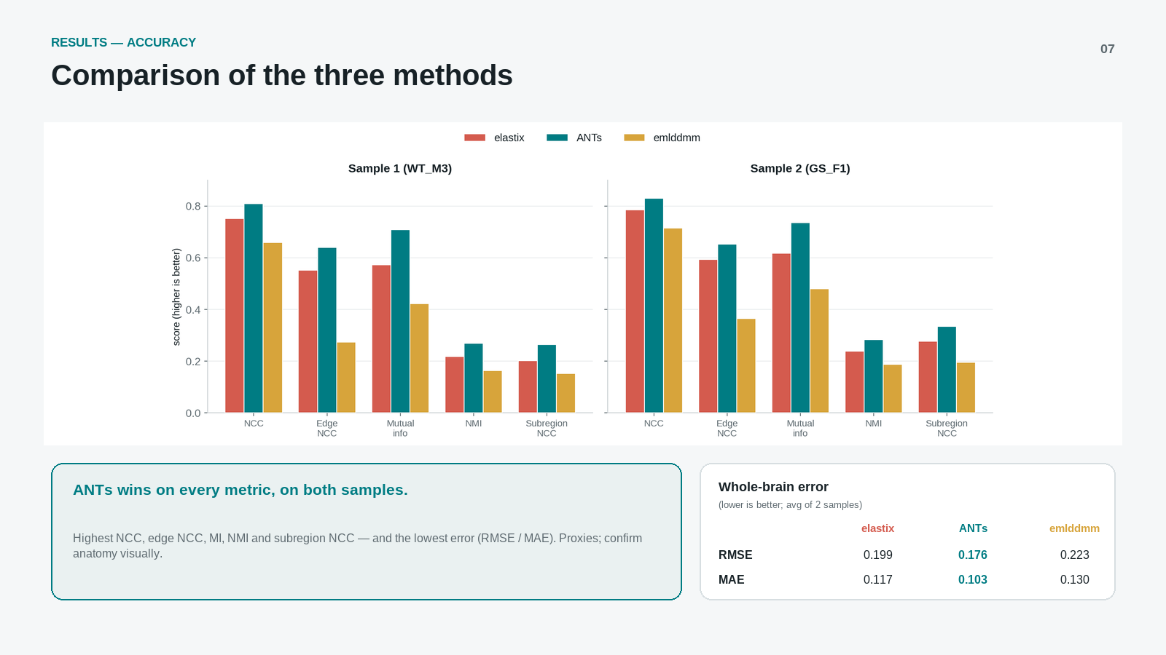

Slide 8
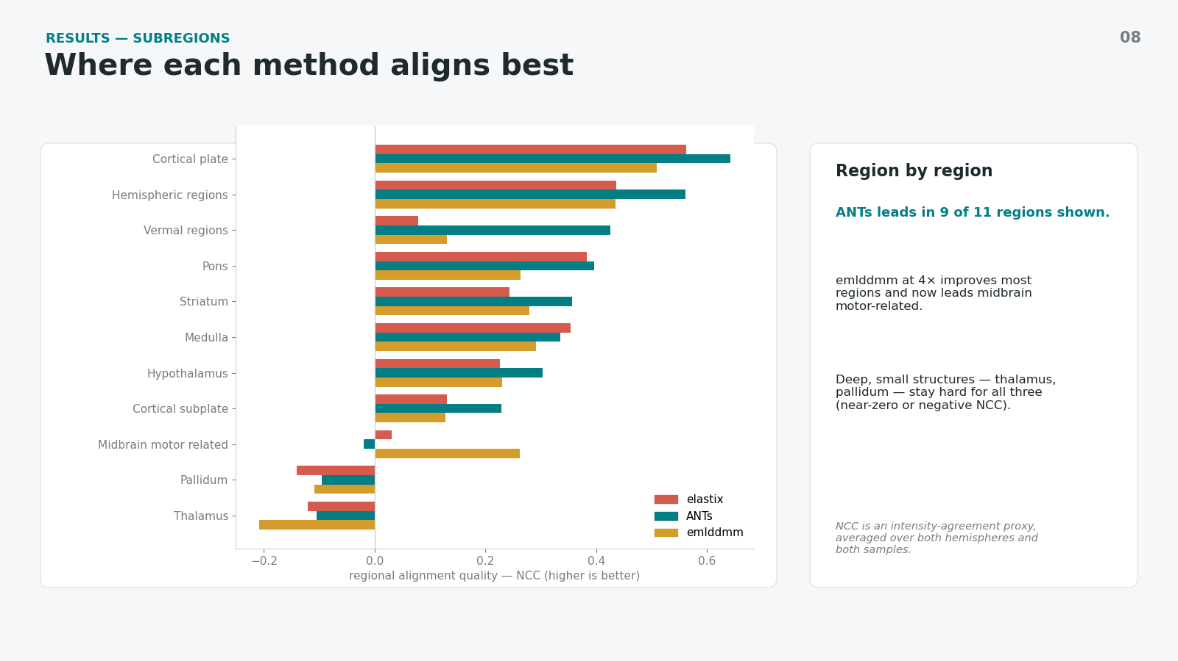
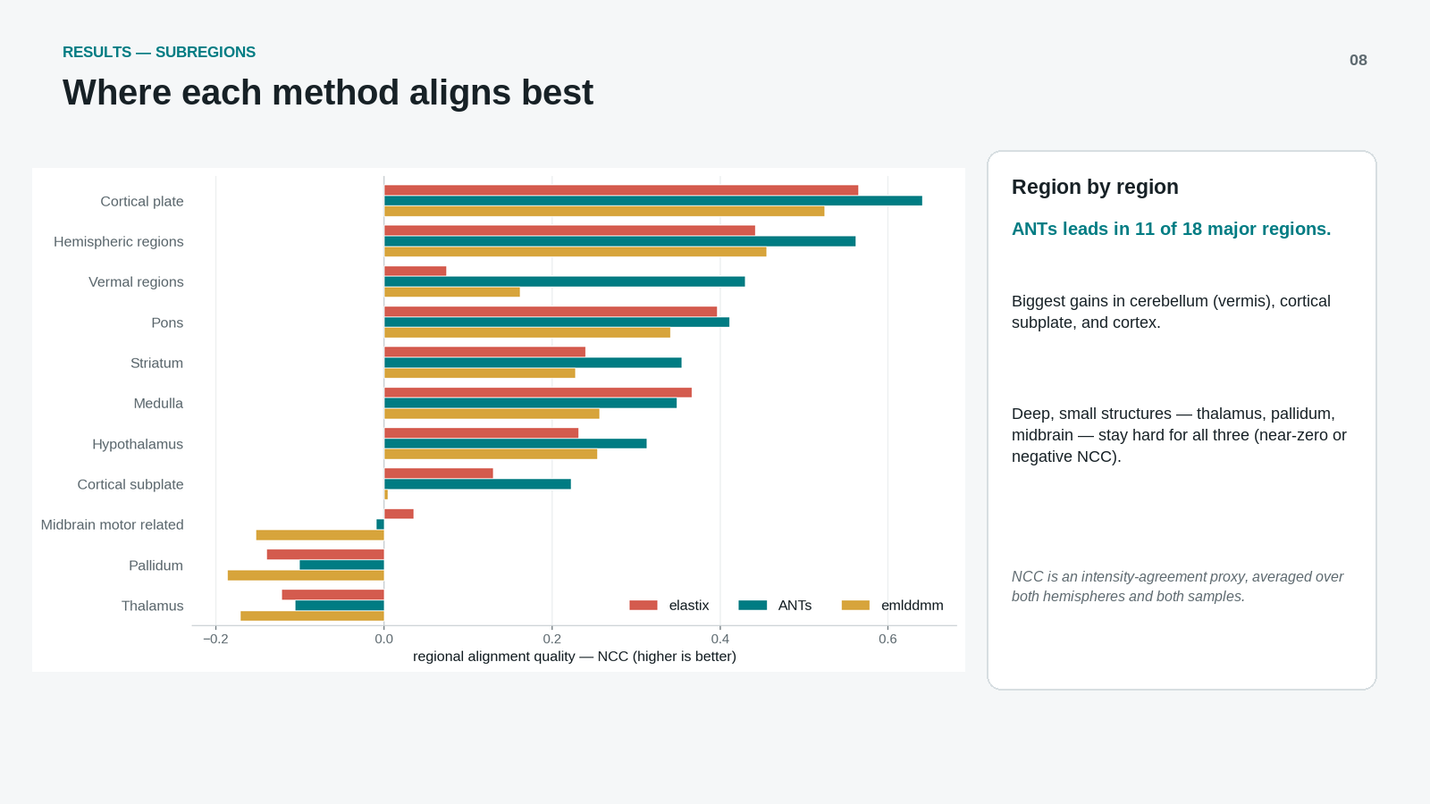

Slide 9
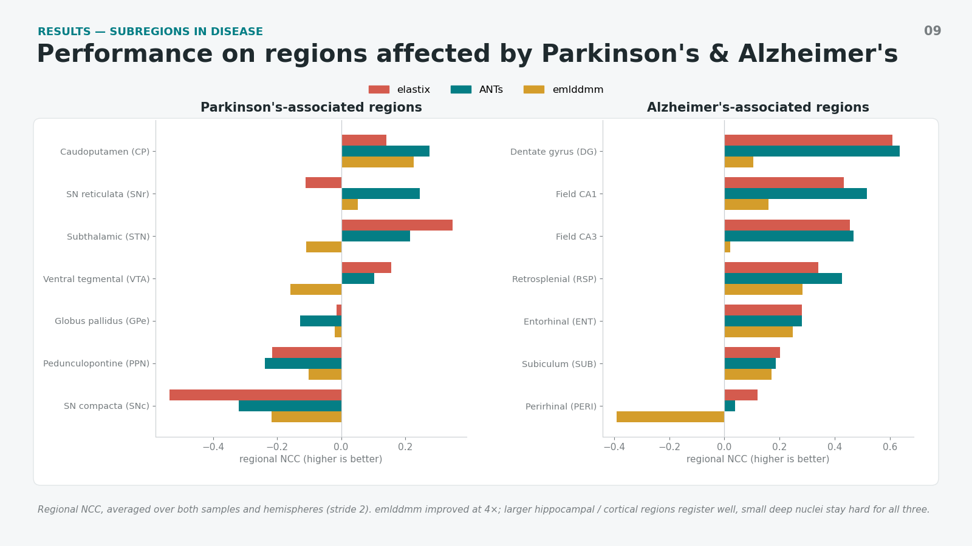
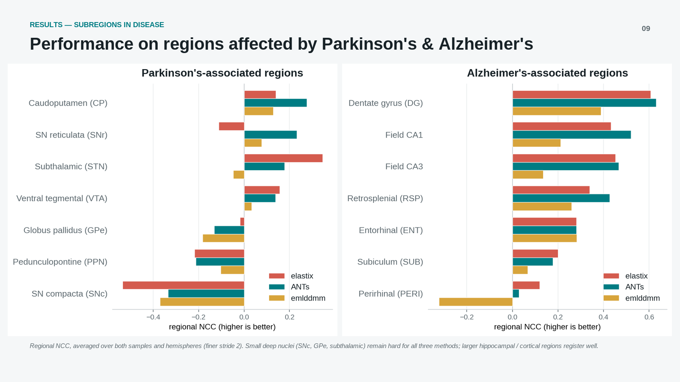

Slide 10
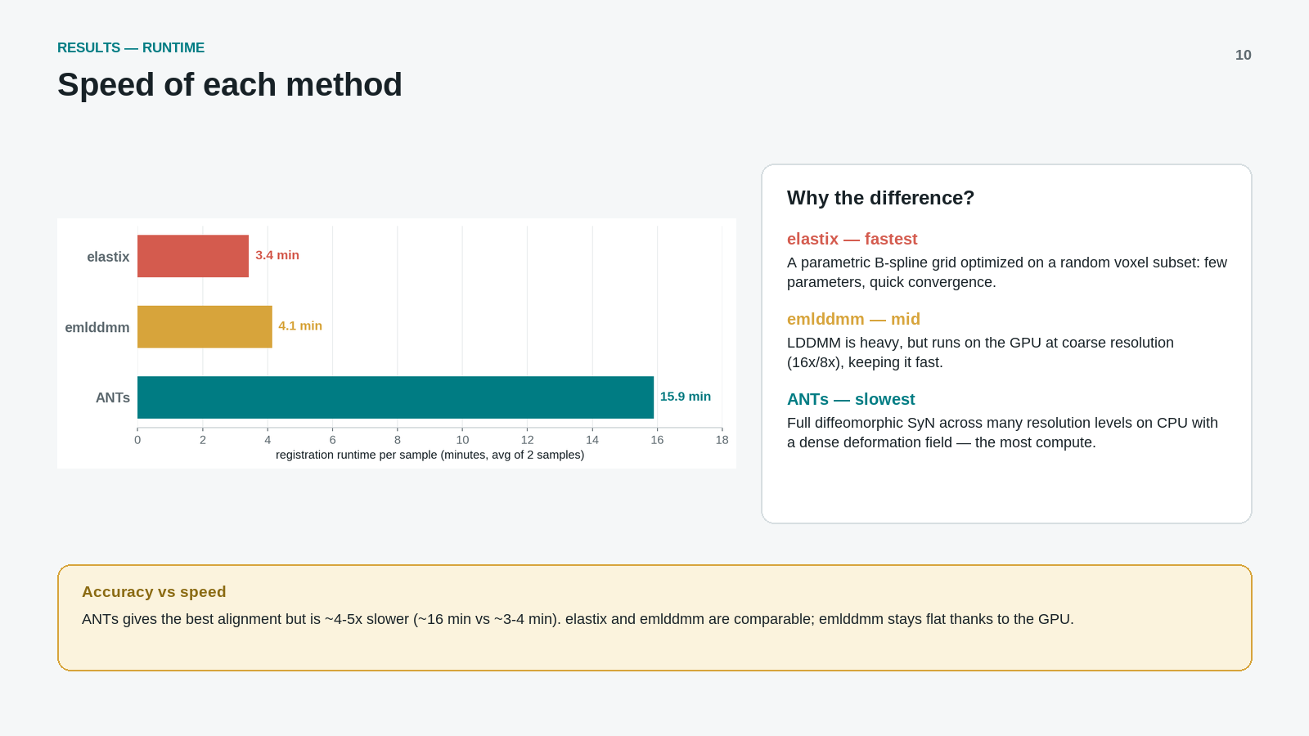

Slide 11
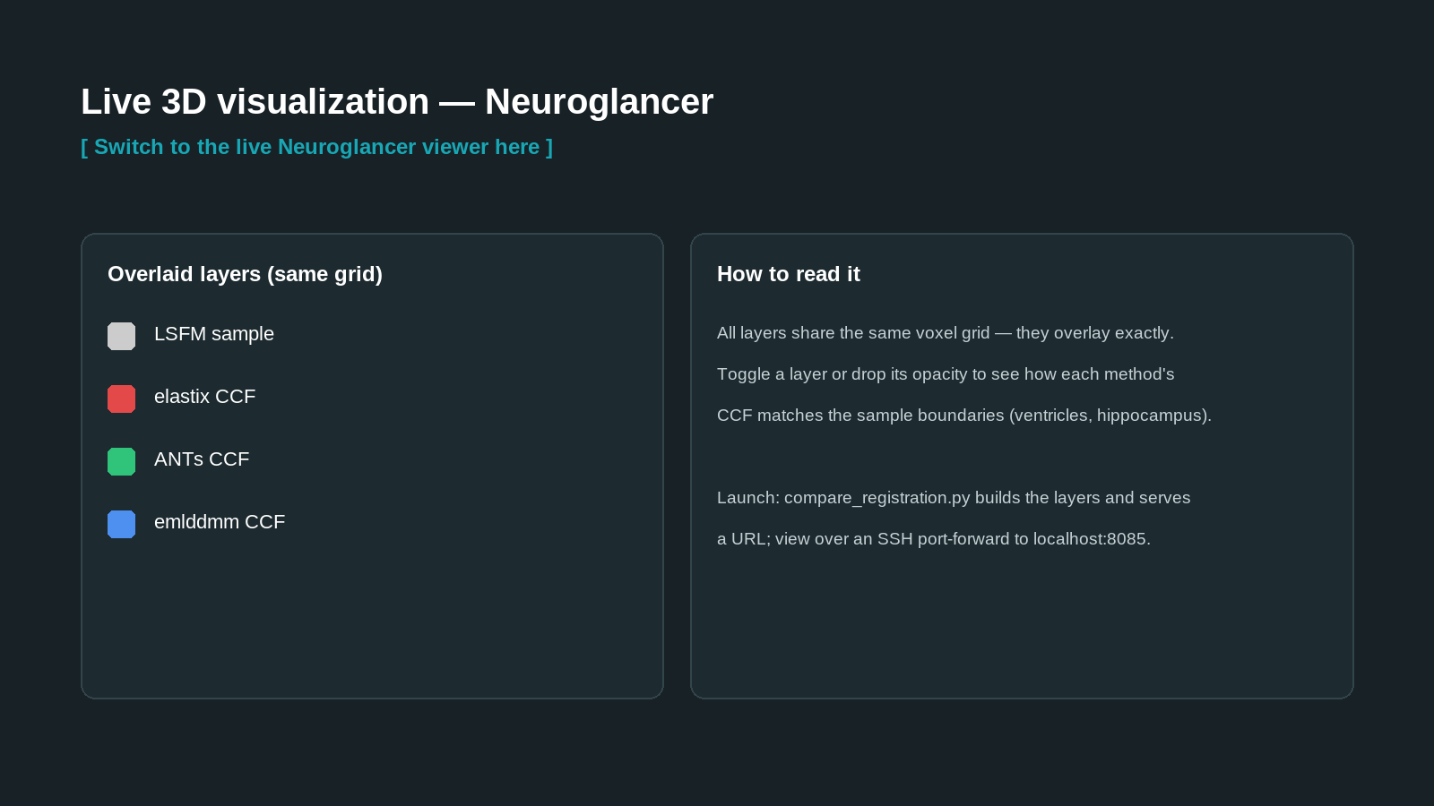

Slide 12
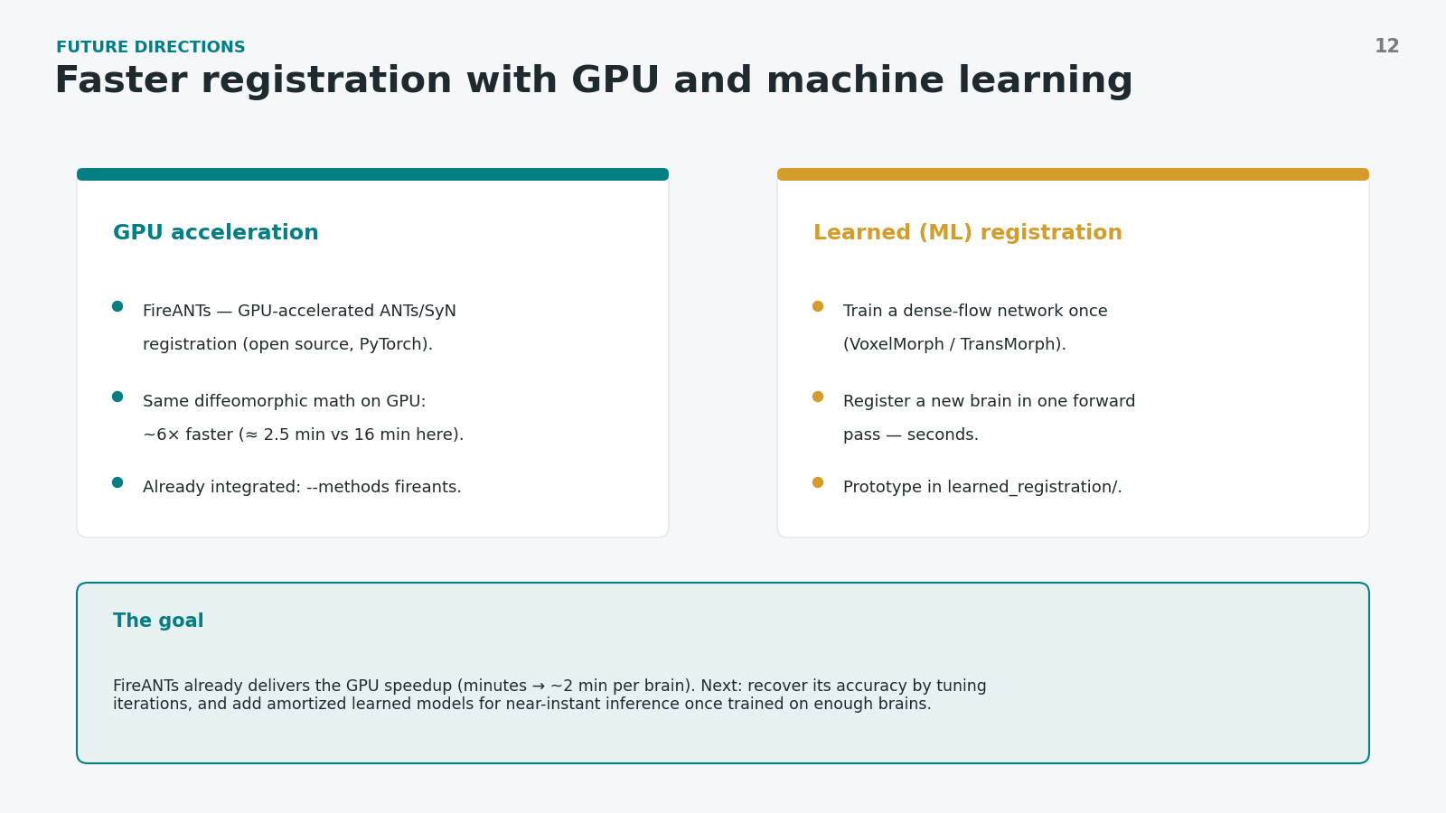
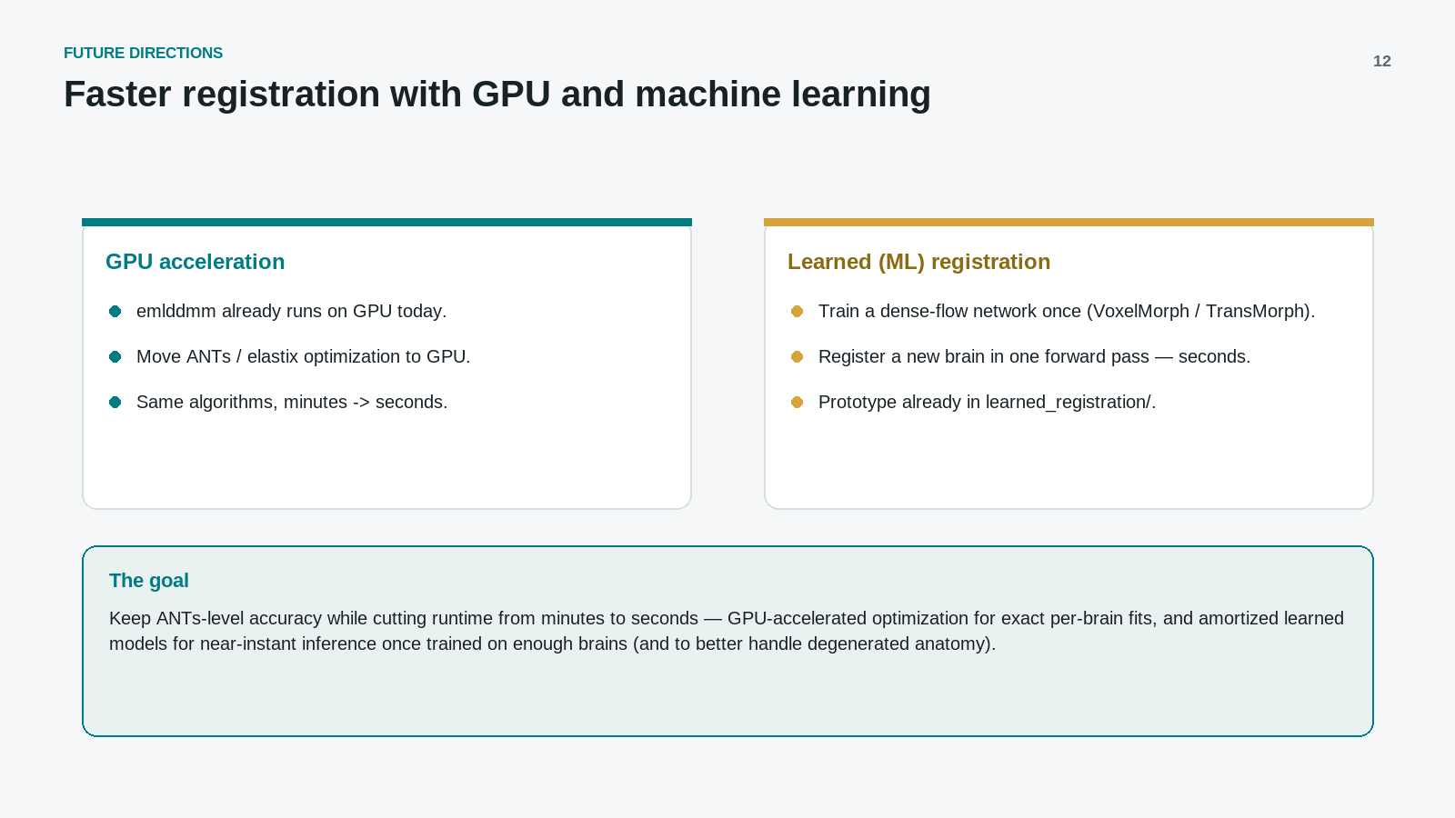

Slide 13
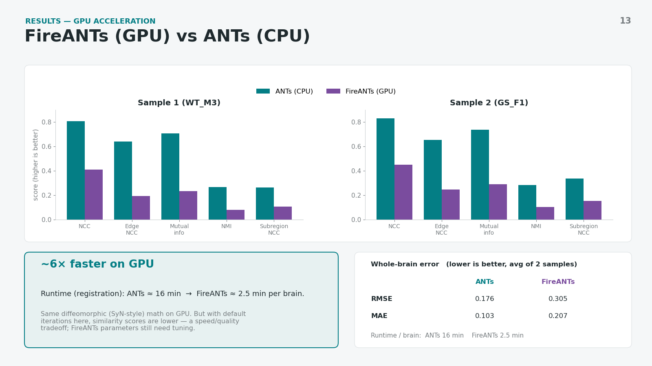

Slide 14
