Slide 1
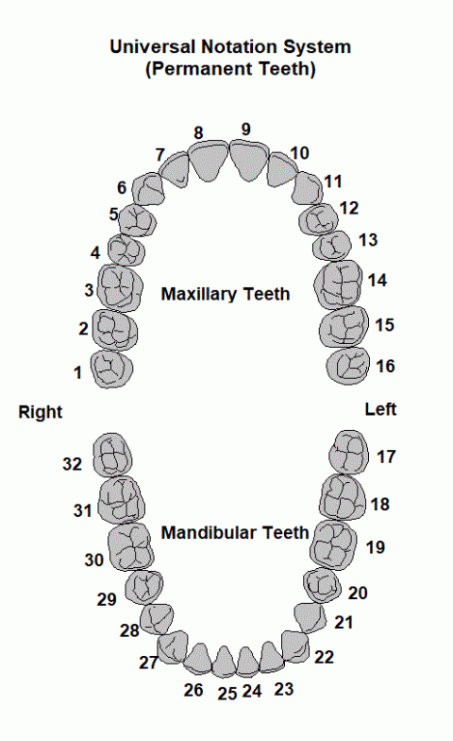
기존 : Maxillary
잇몸 : 255,255,255
150,150,150
150,255,150
150,150,255
100,255,255
255,150,150
255,100,255
255,255,150
255,255,100
255,100,100
255,150,255
100,100,255
150,255,255
100,255,100
170,170,170
170,255,170
100,100,100

Slide 2
기존 : mandibular
잇몸 : 255,255,255
130,130,130
200,255,200
200,200,200
130,255,130
180,255,255
130,130,255
255,180,255
255,130,130
255,255,180
255,255,130
255,180,180
255,130,255
180,180,255
130,255,255
180,180,180
180,255,180

Slide 3
변경 : Maxillary
잇몸 : 0,0,0
200,200,250
250,250,200
250,200,250
200,250,200
200,250,250
250,200,200
250,250,250
200,200,200
150,200,200
250,0,0
200,150,200
0,250,0
200,200,150
0,0,250
100,50,100
150,150,200

Slide 4
변경 : mandibular
잇몸 : 0,0,0
50,50,50
150,200,150
200,150,150
100,50,50
150,150,150
50,100,50
100,150,150
50,50,100
150,100,150
100,100,50
150,150,100
50,100,100
100,100,150
100,100,100
150,100,100
100,150,100

