Slide 1


Ember.js
Presented by
Mary Welcey Guillen
Advanced Topics - Web Dev
PROG1024I

Slide 2


Agenda
Brief overview of Ember.js
Setup & Project Structure
Strengths
Demo
Features
Exercise

Slide 3


What is Ember.js
Productive, battle-tested JavaScript framework for building modern web applications
Created in 2011 by Yehuda Katz (co-creator of jQuery & Ruby on Rails)
Designed for ambitious web applications with a focus on productivity
Uses modern tooling (Embroider, TypeScript support, CLI-driven development)
Notes:
1. It includes everything you need to build rich UIs that work on any device.
2. Ember is not just for small projects—it’s built to handle big, ambitious applications without compromising maintainability.
3. Provides a complete set of tools and features out of the box (routing, components, data management, testing)

Slide 4

Strengths of Ember.js
Convention over Configuration
Strong Backward Compatibility
Minimal configuration needed
Long-term stability. Great for growing projects.
Robust CLI
Robust Data Layer (Ember Data)
Best-in-class developer experience.
Standardized way to handle API interactions
Notes:
1. Strong Conventions – opinionated way of doing things, so you don’t have to constantly check if it’s the best practice
2. Ember CLI automates project setup, builds, and testing
3. Strong Backward Compatibility – New features are introduced without breaking old ones

Slide 5


Features
Components
Services
UI Building Blocks
Global State & Shared Logic
Routing
Ember Data
Manages URLs & Navigation
State Management & API Handling

Slide 6
Setup
requires node and npm
Install ember-cli locally and create project
npx -p ember-cli ember new <name-of-proj> --embroider
Optional Flags:
--embroider
-sg (--skip-git)
--no-welcome
Commands:
npx ember –h
npx ember g -h
npx ember g component <name> –gc
npx ember g route <name>
npx ember g model <name>
Notes:
We keep the command in one line so that we can install the ember-cli directly inside our project folder (no node_modules, and package.json outside the project directory)
-p ember-cli tells npx to temporarily install ember-cli and use it for this command.
npx is a Node.js package runner that allows you to run npm packages without installing them globally. It comes bundled with Node.js (since v5.2.0 of npm).

Slide 7
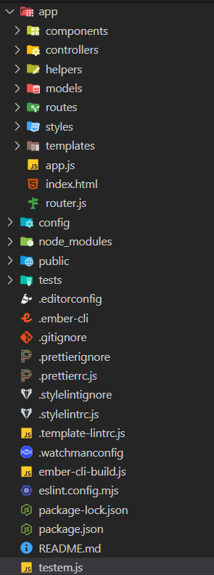

Project Structure
Notes:
App dir is where we focus on, contains all logic templates
Config is where configuration files are contained (environment vars)
Public dir is where you put all assets (images, fonts) = all files contained here will be included once we create a build
Vendor dir is where you put third party libraries

Slide 8

Demo
Second Point
Discuss the importance of government policies and regulations in driving green job creation and supporting sustainable industries.
Movies App
Routing System
Highlight examples of government incentives, subsidies, and regulations that promote green employment
and investment.

Slide 9
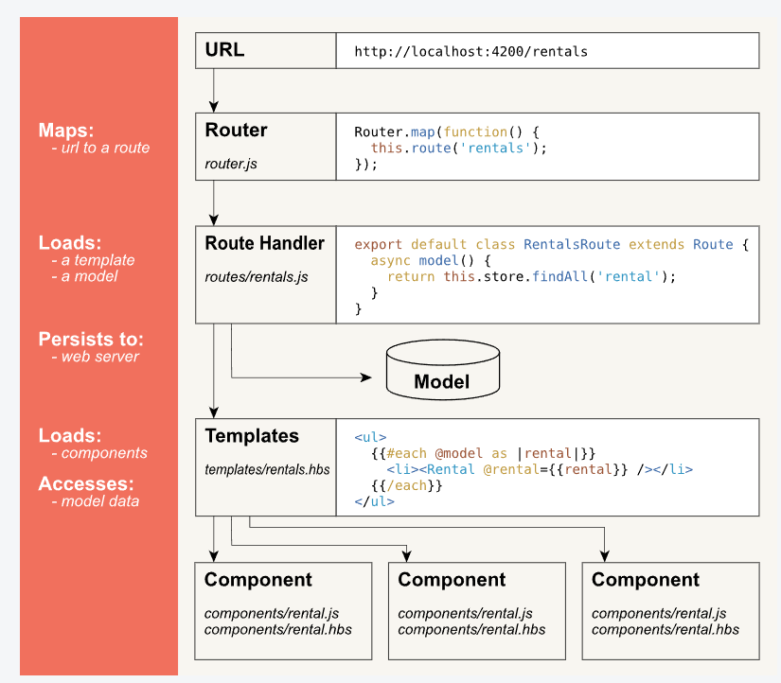
Anatomy of an Ember App
Notes:
Application.hbs – starting point of app
Kinds of routes
Basic route - /movies
Nested route - /movies/id

Slide 10

Resources
https://guides.emberjs.com/release/

Slide 11

Thank you!

