Slide 1
“make” & “snakemake” for Job Pipelines
Daniel Taliun
Matthew Flickinger
Ryan Welch
July 26th, 2017

Slide 2
Workflows/pipelines
Data analysis often consists of a graph of tasks:

Slide 3
Creating a pipeline
How do we specify this graph?
Input files required
Programs required to transform input to output
Output files that will be generated
How can we execute this graph to arrive at the final desired result(s)?

Slide 4
Reasons to use workflows/pipelines
Makes explicit each step of your pipeline
The exact input files, script, output files used
Ordering of steps
A well-commented Makefile/Snakefile can go a long way in serving as documentation of your workflow
Ease of re-running tasks if their dependencies (files) change and ensures no steps are missed

Slide 5
Two possible tools for the job
GNU make (Matthew)
Snakemake (Ryan)

Slide 6
(gnu)make
First used to help compile/build computer programs in 1977
Still primarily optimized for this use case
Can be used for data pipelines as well
Tracks dependencies between input and output
Rebuild only what's necessary
Looks at date/time on files
Recreates files if dependencies are newer than output

Slide 7
Makefile basics
target: dependency
<tab> recipe
Example:
out.txt: samples.txt sites.txt
prog --ind samples.txt --snp sites.txt > out.txt

Slide 8
"Traditional" script
wget ftp://ftp.sanger.ac.uk/pub/gencode.v19.gtf.gz
zcat gencode.v19.gtf.gz | awk '$3=="exon"' | cut –f1,4,5 > exon.bed
vcftools --bed exon.bed --code > exon.loci
ccpileup exon.loci samples.index --out pileup.txt

Slide 9
Make version
gencode.v19.gtf.gz:
wget ftp://ftp.sanger.ac.uk/pub/gencode.v19.gtf.gz
exon.bed: gencode.v19.gtf.gz
zcat gencode.v19.gtf.gz | awk '$$3=="exon"' | cut –f1,4,5 > exon.bed
exon.loci: exon.bed
vcftools --bed exon.bed --code > exon.loci
pileup.txt: exon.loci samples.index
ccpileup exon.loci samples.index --out pileup.txt

Slide 10
Running Make
Assumes your make file is called "Makefile"
"make" will build the first target in your make file
By convention this is often a target called "all"
"make pileup.txt" will build "pileup.txt"
"make –n pileup.txt" will show you what commands it will run without running them
"make –f recipes.make pileup.txt" will look for recipes in "recipes.make" rather than "Makefile"

Slide 11
Undesired duplication of file names
gencode.v19.gtf.gz:
wget ftp://ftp.sanger.ac.uk/pub/gencode.v19.gtf.gz
exon.bed: gencode.v19.gtf.gz
zcat gencode.v19.gtf.gz | awk '$$3=="exon"' | cut –f1,4,5 > exon.bed
exon.loci: exon.bed
vcftools --bed exon.bed --code > exon.loci
pileup.txt: exon.loci samples.index
ccpileup exon.loci samples.index --out pileup.txt

Slide 12
Make version (with variables)
gencode.v19.gtf.gz:
wget ftp://ftp.sanger.ac.uk/pub/gencode.v19.gtf.gz
exon.bed: gencode.v19.gtf.gz
zcat $^ | awk '$$3=="exon"' | cut –f1,4,5 > $@
exon.loci: exon.bed
vcftools --bed $^ --code > $@
pileup.txt: exon.loci samples.index
ccpileup $^ --out $@

Slide 13
Make variables
$@ target name
$^ all dependencies
$< first dependency
$* pattern match

Slide 14
Inefficient recipes
chr1.out: vcf/chr1.vcf.gz
prog --region chr1 vcf/chr1.vcf.gz > chr1.out
chr2.out: vcf/chr2.vcf.gz
prog --region chr2 vcf/chr2.vcf.gz > chr2.out
chr3.out: vcf/chr3.vcf.gz
prog --region chr3 vcf/chr3.vcf.gz > chr3.out
…

Slide 15
Patterned recipes
all: chr1.out chr2.out chr3.out
%.out: vcf/%.vcf.gz
prog --region $* $^ > $@

Slide 16
Variables and looping
CHRS = $(shell seq 1 22)
all: $(foreach chr, $(CHRS), $(chr).out)

Slide 17
Useful functions
$(shell) Returns result from shell command
$(basename) Takes off extension from file
$(foreach) Loops over list
$(word) Extracts word from list
$(addsuffix) Add suffix to file name
+ many more

Slide 18
Debugging make
make --n
See what commands will run without running them
make --d --r
Verbose debug mode
The --r ignores the implicit rules for executable building
make --p
Print variable and rule definitions
make --B
Remake everything (useful with --n to see how files were created)

Slide 19
Make pro/cons
Widely available
Very stable
Basic commands have very simple syntax
Very basic file matching patterns
Not cluster friendly
Assumes one output per command
No control flow options (if/for/while)
PRO
CON

Slide 20
Additional Reading
GNU Make for Reproducible Data Analysis by Zachary M Jones
http://zmjones.com/make/
Minimal Make by Karl Broman
http://kbroman.org/minimal_make/
GNU Make Manual
https://www.gnu.org/software/make/manual/

Slide 21
Snakemake
Recently developed tool that borrows concepts from Makefiles
A Snakefile is similar to a Makefile: it contains rules specifying input, output, and program to execute
Extends syntax beyond rules:
Any python code can be included in the same file
Support for wildcard rules that generalize over parameters
Documentation, examples, tutorial, FAQ can be found at:
https://snakemake.readthedocs.io/

Slide 22
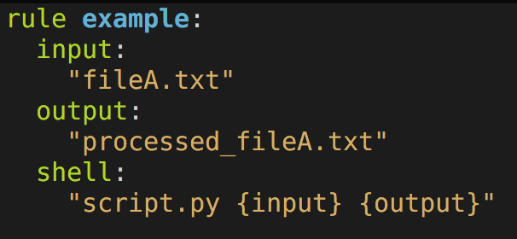
Snakemake rules
Specify input files required for the rule to run
Specify output files that will be created by the rule
Specify shell command (or could be python code) to generate the output files

Slide 23
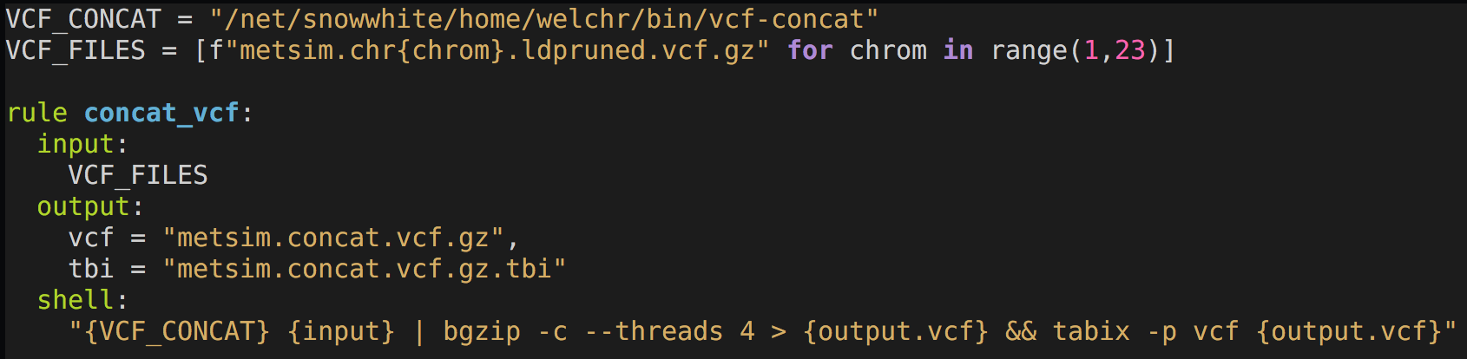
Snakemake rules
Python code
Specify input files required for the rule to run
Specify output files that will be created by the rule
Specify shell command (or could be python code) to generate the output files

Slide 24
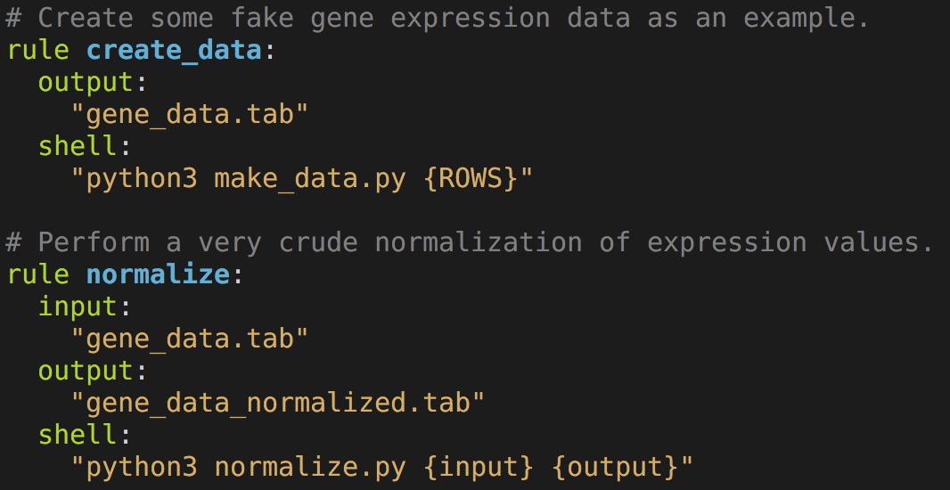
Snakemake rules - dependencies
Snakemake discovers automatically that the input for the normalize rule is the output for the create_data rule
It will run create_data first, and then execute normalize

Slide 25
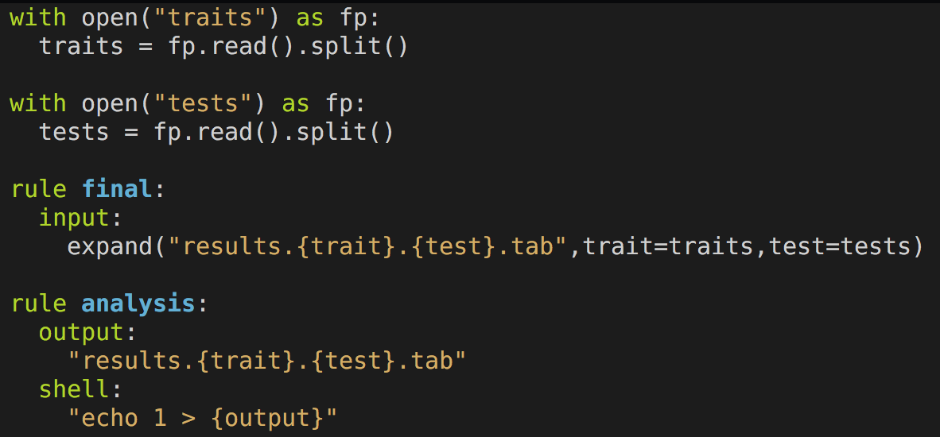
Snakemake rules - wildcards
At the top: simple python code to read in a list of traits and tests from files
In this example, trait and test are wildcards that Snakemake uses when generalizing the analysis rule
expand() is a function provided by Snakemake that takes the product of the set of traits and the set of tests

Slide 26
TUTORIAL

Slide 27
Snakemake
Other nice features we didn’t see today:
Rule priority: schedule some rules to execute preferentially before others
Force particular rules to execute
Flag file support (similar to .OK files used in Makefiles)
Automatic removal of output files from rules that fail to execute properly
Automatic deletion of temporary files (with temp() or shadow rules)
Dynamic rules (when # of input or output files is unknown until runtime)
Code and rule version tracking

Slide 28
Advantages of Snakemake
Excellent combination of rule syntax and python code
Snakefiles generally easier to read (especially for python users)
Rules can be generalized with multiple wildcards
Cluster support
Many features not available with Make

Slide 29
Drawbacks to Snakemake
Error messages for syntax errors in Snakefiles can be difficult to understand, often require some trial and error to correct problem
#1 mistake: forgetting to use {wildcards.XXX} instead of {XXX} in the shell section
Requires python 3.5 as of snakemake 4.0 (July 24th, 2017)
Not installed on our cluster by default
An older version of Snakemake IS however installed on our cluster (yuck!)
https://github.com/statgen/csg-python contains some instructions for setting up your own install of the latest python 3.x. I highly recommend setting up your own python instead of using the cluster’s!
Cluster support is not perfect - if SLURM cancels your job, Snakemake may wait endlessly for it to complete
GNU make is installed *everywhere* and it is well known by many programmers – getting help will be easier! Also used for compiling C/C++ code, and in R packages that include C/C++ code

