Slide 1
START
i, j
i = 0, j = 0
i = i + 1
j = j + i
YES
I < 100
NO
j
STOP
1+2+3+ … + 100

Slide 2
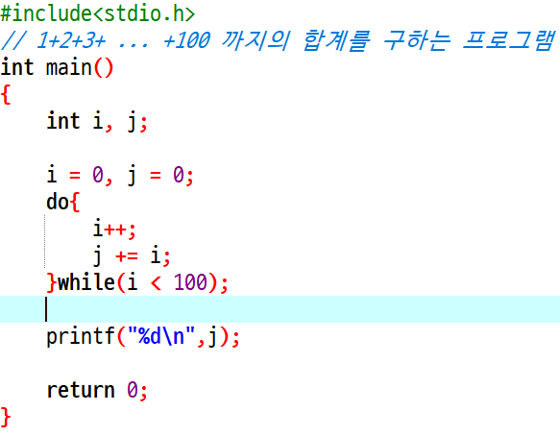
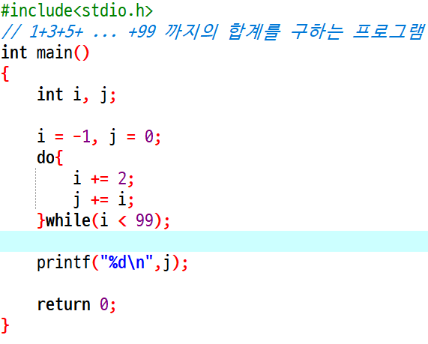

Slide 3
START
i, j, sw
i = 0, j = 0
sw = 0
i = i + 1
sw = 0
YES
NO
j = j + i
j = j - i
sw = 1
sw = 0
i < 100
j
STOP

Slide 4
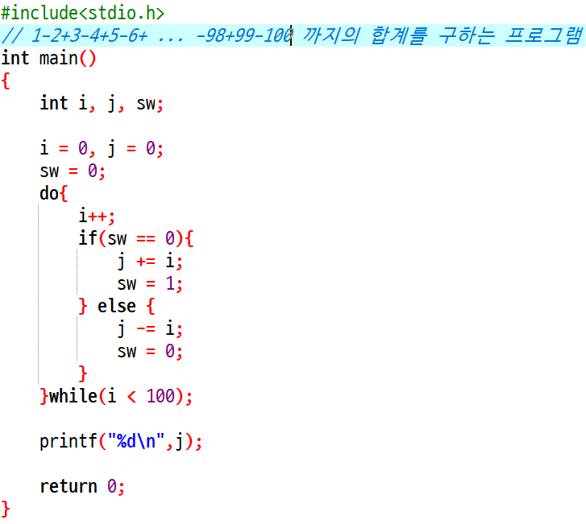

Slide 5
START
i = 0, j = 0
i = i + 1
J = j + i
>=
i : 99
<
i = i + i
J = j - i
j
STOP

Slide 6
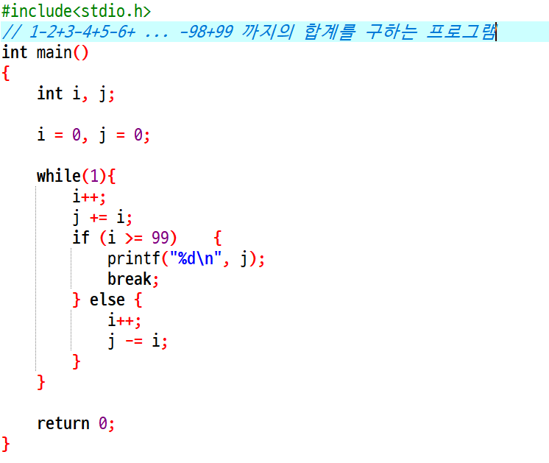

Slide 7
START
i, j
i = 0
j = 1
i = i + 1
MOD(i,2) = 0
YES
NO
j = j X i
J = j X i X (-1)
i < 100
j
STOP
(-1)x2x(-3)x4x(-5)x … x 100

Slide 8
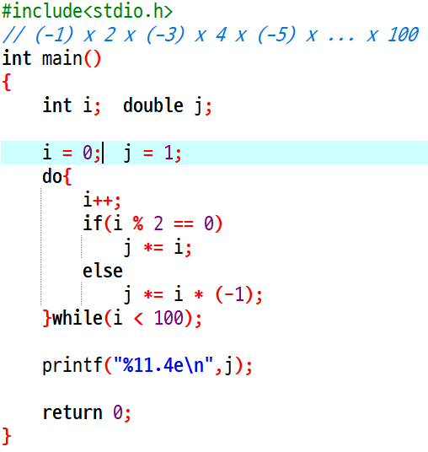

Slide 9
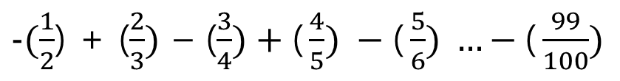
START
i = 0, j = 0
i = i + 1
INT(i/2) = i/2
YES
NO
j = j + (i/(i+1))
J = j - (i/(i+1))
i >= 99
NO
YES
j
STOP
$-(\frac{1}{2}$) + ($\frac{2}{3})$ – ($\frac{3}{4})+\text{(}\frac{4}{5}) −\text{(}\frac{5}{6}) …−\text{(}\frac{99}{100})$

Slide 10
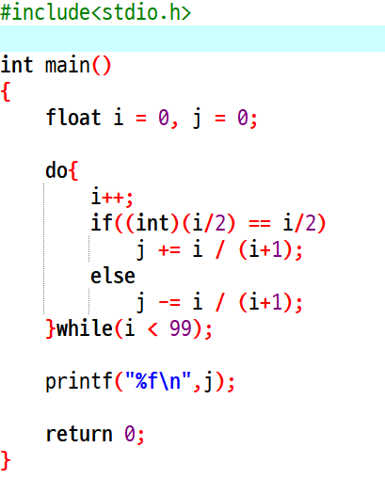
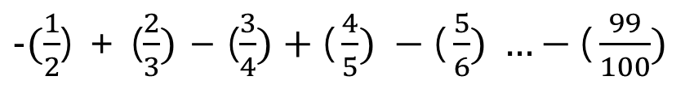
$-(\frac{1}{2}$) + ($\frac{2}{3})$ – ($\frac{3}{4})+\text{(}\frac{4}{5}) −\text{(}\frac{5}{6}) …−\text{(}\frac{99}{100})$

