Slide 1

FINAL YEAR MAJOR PROJECT
TAILORWALA
On-Demand Doorstep Custom Tailoring & Bespoke Couture Platform
A modern multi-tier web application connecting customers with master artisan tailors for home measurement visits, custom garment creation, live order tracking, and QR ID security verification.
PROJECT DEVELOPERS:
👤 Aryan Kumar
👤 Sushant Kumar
Full-Stack Architecture & Security
UI/UX Design & System Testing
React 19 • Node.js • Express • MongoDB • RBAC Security
✨ Master Artisan Tailoring & Doorstep Fit Assurance
TailorWala Project Presentation • Aryan Kumar & Sushant Kumar
Slide 1 / 10

Slide 2
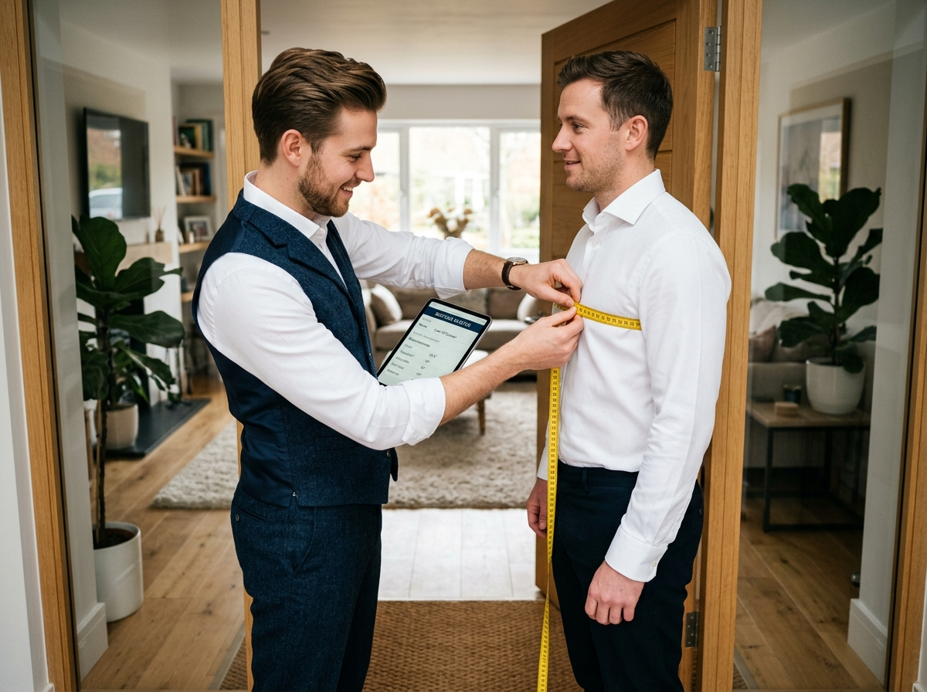
Introduction to TailorWala
✂️ TAILORWALA
Project Background, Purpose, Target Users, and Value Proposition
🏢 What is TailorWala?
🎯 Core Purpose
An end-to-end bespoke tailoring platform connecting customers with master tailoring artisans for home measurement visits, custom stitching, and delivery.
To digitize the unorganized tailoring sector, eliminating inconvenient shop trips, paper sizing errors, and delayed deliveries with modern automation.
👥 Target Audience
💡 Value Proposition
• Customers: Doorstep bookings & tracking
• Master Tailors: Order queue & digital portfolio
• Staff & Admins: RBAC governance & audit logs
Guarantees flawless custom fitting without leaving home, supports local tailor economies, and ensures safety with verified ID badges.
🚪 Doorstep Measurement Consultation: Master tailors visit clients with digital tablet measurement recording.
TailorWala Project Presentation • Aryan Kumar & Sushant Kumar
Slide 2 / 10

Slide 3
Problem Statement & Industry Gaps
✂️ TAILORWALA
Critical Challenges Plaguing Traditional Custom Tailoring
01
🚶‍♂️ Inconvenient Physical Store Visits
02
📏 Measurement & Sizing Errors
Customers must travel 3 to 4 times for measurement, fabric drop-off, trial fitting, and final pickup—wasting valuable time and fuel.
Manual paper notes and disorganized notebooks lead to ill-fitting garments, lost alterations instructions, and costly rework.
03
🔍 Limited Artisan Discovery
04
💸 Opaque Pricing & No Tracking
Highly skilled master tailors lack online visibility, digital portfolios, or booking tools, confining their earnings to walk-in footfall.
Zero real-time progress visibility, unpredictable delivery timelines, unstandardized pricing, and absence of formal digital receipts.
🚨 THE ROOT CAUSE: Lack of an organized digital platform connecting customer sizing, order tracking & master craftsmen.
TailorWala Project Presentation • Aryan Kumar & Sushant Kumar
Slide 3 / 10

Slide 4
Proposed Solution & Impact
✂️ TAILORWALA
How TailorWala Digitizes the End-to-End Tailoring Workflow
TRADITIONAL ISSUES
TAILORWALA SOLUTION
MEASURABLE IMPACT
Pain Points
Core Innovations
Proven Results
✓ Multiple store trips required
✓ Doorstep measurement visits
✓ 100% Doorstep convenience
✓ Lost paper measurement slips
✓ Cloud measurement profile vault
✓ Zero sizing & fit errors
✓ Unpredictable delivery dates
✓ Real-time order pipeline tracker
✓ Guaranteed 3-7 day turnaround
✓ No digital receipts or tracking
✓ Multi-channel payment gateway
✓ Safe payments & live receipts
✓ Tailors limited to footfall
✓ Artisan digital portfolios
✓ Sustainable artisan revenue growth
🏠 Zero Travel Needed
☁️ Cloud Sizing Vault
⚡ 3-7 Day Fast Turnaround
🛡️ Live QR ID Badges
TailorWala Project Presentation • Aryan Kumar & Sushant Kumar
Slide 4 / 10

Slide 5
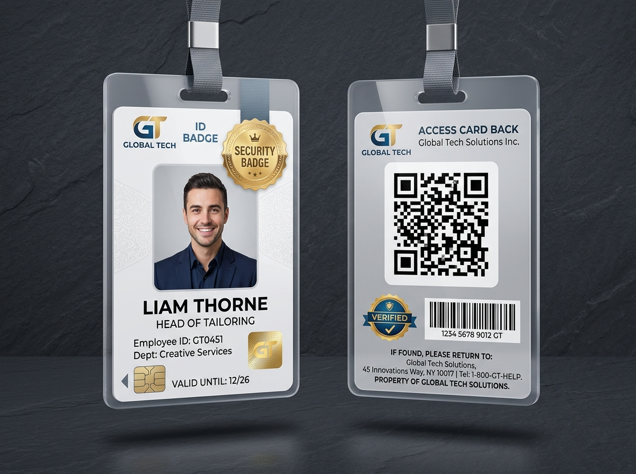
Core Features & Security Studio
✂️ TAILORWALA
High-Impact Capabilities for Customers, Tailors, and Staff
📍 Location-Based Search
📐 Cloud Measurements Vault
Find accredited tailors in Delhi NCR with distance radius filters & reviews.
Save male & female body profiles for 1-click doorstep reorders.
📦 Live Order Tracking
💳 Multi-Channel Payments
Real-time pipeline from fabric pickup to tailoring & delivery.
COD verification, UPI, Card, NetBanking, and Dynamic QR.
🔐 12-Module Staff RBAC
⭐ Public Live QR Verification
Granular permissions matrix with 1-click Select All/Clear All.
Anti-fraud staff validation via live QR scanner at /verify-id.
🪪 Enterprise ID Studio & Live QR Verification: Double-sided printable badges with holographic security seals and real-time public authenticity check.
TailorWala Project Presentation • Aryan Kumar & Sushant Kumar
Slide 5 / 10

Slide 6
Technologies & Languages Used
✂️ TAILORWALA
Enterprise Modern Web Architecture & Development Stack
🌐 FRONTEND STACK
⚙️ BACKEND ENGINE
🗄️ DATABASE & AUTH
🛠️ SERVICES & TESTS
React 19
Node.js (v18+)
MongoDB
In-Memory MongoDB
Component-driven Single Page UI
Event-driven server runtime
NoSQL document data store
Automated test suite fallback
JavaScript ES6+
Express.js 4
Mongoose 8 ODM
Dynamic QR Engine
Modern async logic & hooks
REST API routing & controllers
Schema validation & indexing
Badge verification QR builder
Tailwind CSS & Bootstrap
PDFKit
JWT Tokens
WhatsApp API
Responsive design tokens
Documentation & badge engine
Stateless Bearer token auth
Direct hotline integration
Vite 7
Dotenv & CORS
BcryptJS (10 Salt)
Node Test Runner
Ultra-fast HMR & bundler
Security & cross-origin pipeline
Salted password encryption
10/10 passing integration tests
TailorWala Project Presentation • Aryan Kumar & Sushant Kumar
Slide 6 / 10

Slide 7
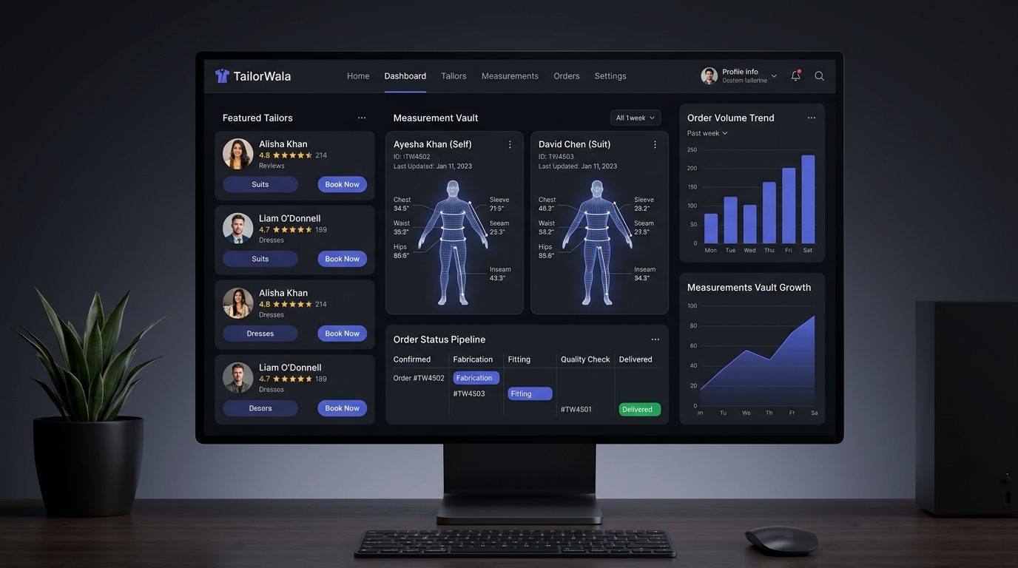
System Architecture & Interface
✂️ TAILORWALA
4-Tier Micro-Modular Architecture with Cloud Database & Dashboard
TIER 1: ACTORS & CLIENTS
👤 Customers • 👔 Master Tailors • 🔐 Staff & Admins • 🪪 QR Scanners
TIER 2: FRONTEND PRESENTATION (React 19)
AuthContext • Tailor Filters • Measurement Vault • RBAC Studio
TIER 3: BACKEND API LAYER (Express 4)
authController • bookingPipeline • adminRBAC • tailorPortfolio
TIER 4: DATABASE & INTEGRATIONS
MongoDB (Mongoose) • In-Memory Tests • QR Engine • WhatsApp API
🖥️ TailorWala Live SaaS Dashboard: Dynamic measurement vault, live order status pipelines, tailor directory, and business analytics.
TailorWala Project Presentation • Aryan Kumar & Sushant Kumar
Slide 7 / 10

Slide 8
End-to-End Operational Workflow
✂️ TAILORWALA
The 9-Stage Customer & Artisan Journey from Discovery to Doorstep Delivery
1
Register / Sign In
2
Discover Tailor
3
Select Garment
JWT login & profile setup
Filter by city, rating & skills
Custom suit, kurta, or dress
4
Measurements
5
Delivery & Address
6
Secure Payment
Doorstep visit or saved vault
Standard (7d) or Express (3d)
COD, UPI, Card, or QR code
7
Order Verified
8
Master Stitching
9
Doorstep Delivery
Live booking timeline tracking
Artisan crafts custom garment
Quality-checked final delivery
Discovery ➔ Measurement Visit ➔ Cloud Sizing ➔ Fabric Collection ➔ Artisan Stitching ➔ Quality Trial ➔ Doorstep Delivery
TailorWala Project Presentation • Aryan Kumar & Sushant Kumar
Slide 8 / 10

Slide 9
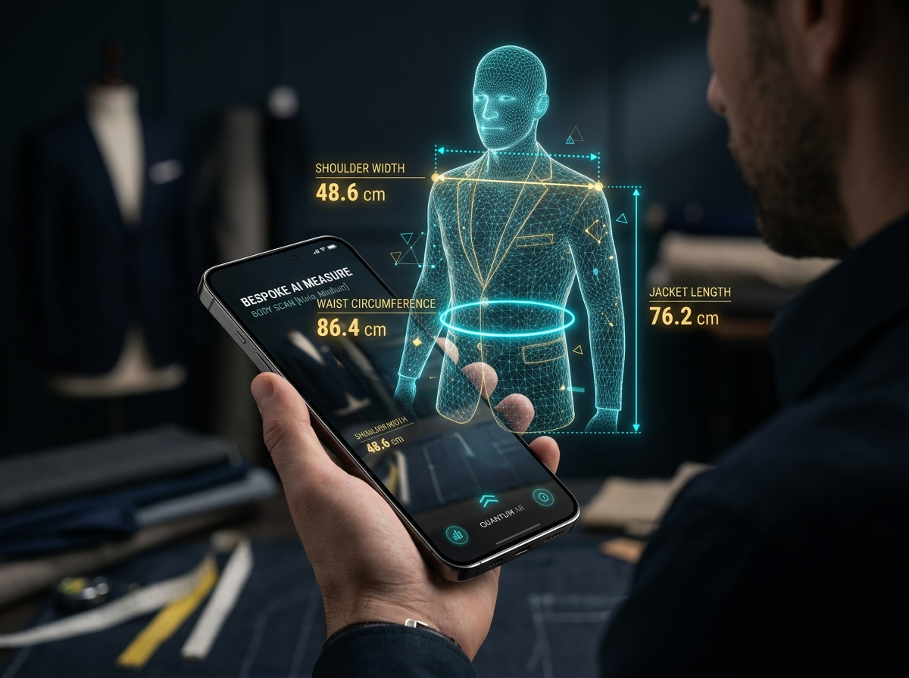
Benefits & Future Innovation
✂️ TAILORWALA
Platform Impact and Cutting-Edge Technological Horizon
🌟 KEY BENEFITS & IMPACT
✓ 100% Doorstep Convenience: No travel or waiting in shops.
✓ Accredited Master Tailors: Verified artisans with ratings.
✓ Cloud Measurement Vault: Eliminates paper note errors.
✓ Transparent Pricing: Fixed rates & clear delivery fees.
✓ Multi-Channel Payments: COD, UPI, Card & Dynamic QR.
✓ 12-Module Staff RBAC: Granular control & immutable logs.
🚀 FUTURE INNOVATION ROADMAP
➔ 📱 AI 3D Camera Body Scanning for instant smartphone sizing
✓ Live QR Authenticity: Anti-fraud official ID verification.
➔ 🗺️ Live GPS Agent Tracking for doorstep artisan visits
➔ 👗 3D Virtual AR Fabric Try-On & Multilingual Voice Booking
➔ 🤖 Automated WhatsApp AI Booking & Status Concierge Bot
TailorWala Project Presentation • Aryan Kumar & Sushant Kumar
Slide 9 / 10

Slide 10
THANK YOU
Reimagining the Bespoke Tailoring Experience for the Modern Digital Era
100%
12-Module
Live QR
Doorstep Convenience
Enterprise RBAC
Anti-Fraud ID Security
PROJECT CONTRIBUTORS & OFFICIAL CONTACT
👤 Aryan Kumar — Full-Stack Architecture & Backend Security
👤 Sushant Kumar — UI/UX Design & Quality Assurance
📞 WhatsApp Hotline: +91 87898682127 • 🌐 TailorWala Bespoke Services • Questions & Discussion Welcome
TailorWala Project Presentation • Aryan Kumar & Sushant Kumar
Slide 10 / 10

