Slide 1
The N-Body Problem
high performance computing
for gravitational physics
Erwan Le Dœuff

Slide 2
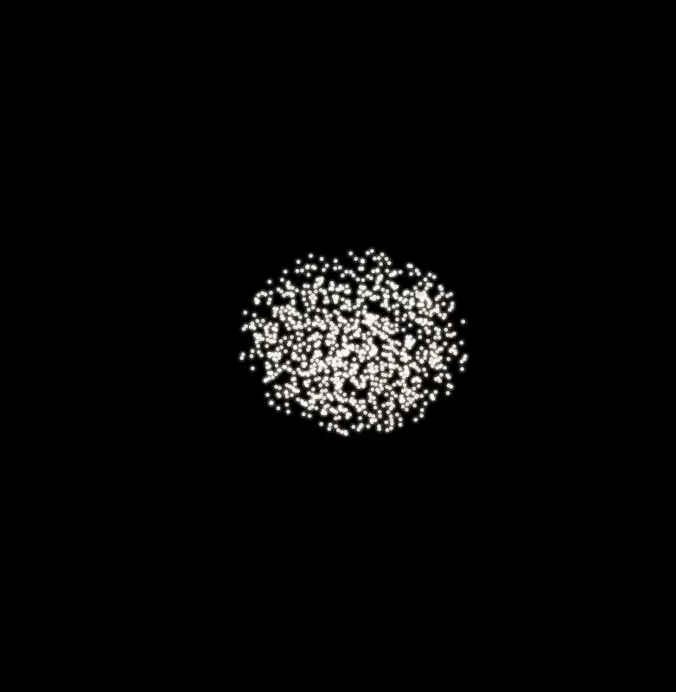

Slide 3
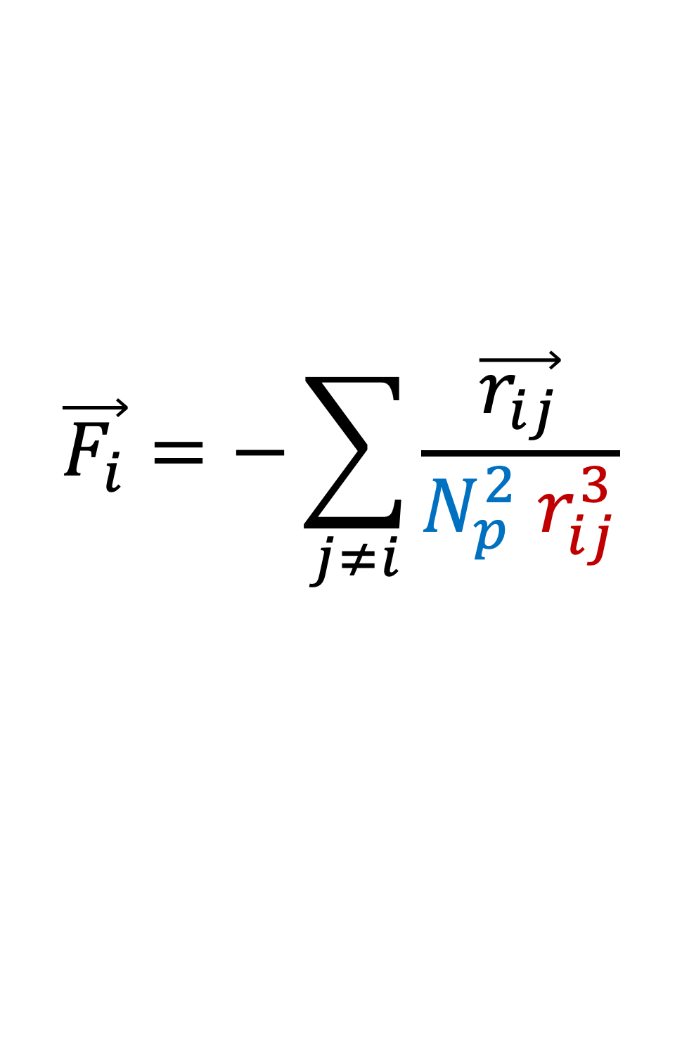
$$\vec{F_{i}}=−\sum_{j≠i}{\frac{\vec{r_{ij}}}{N_{p}^{2} r_{ij}^{3}}}$$
Distance between
i and j
Number of particles

Slide 4
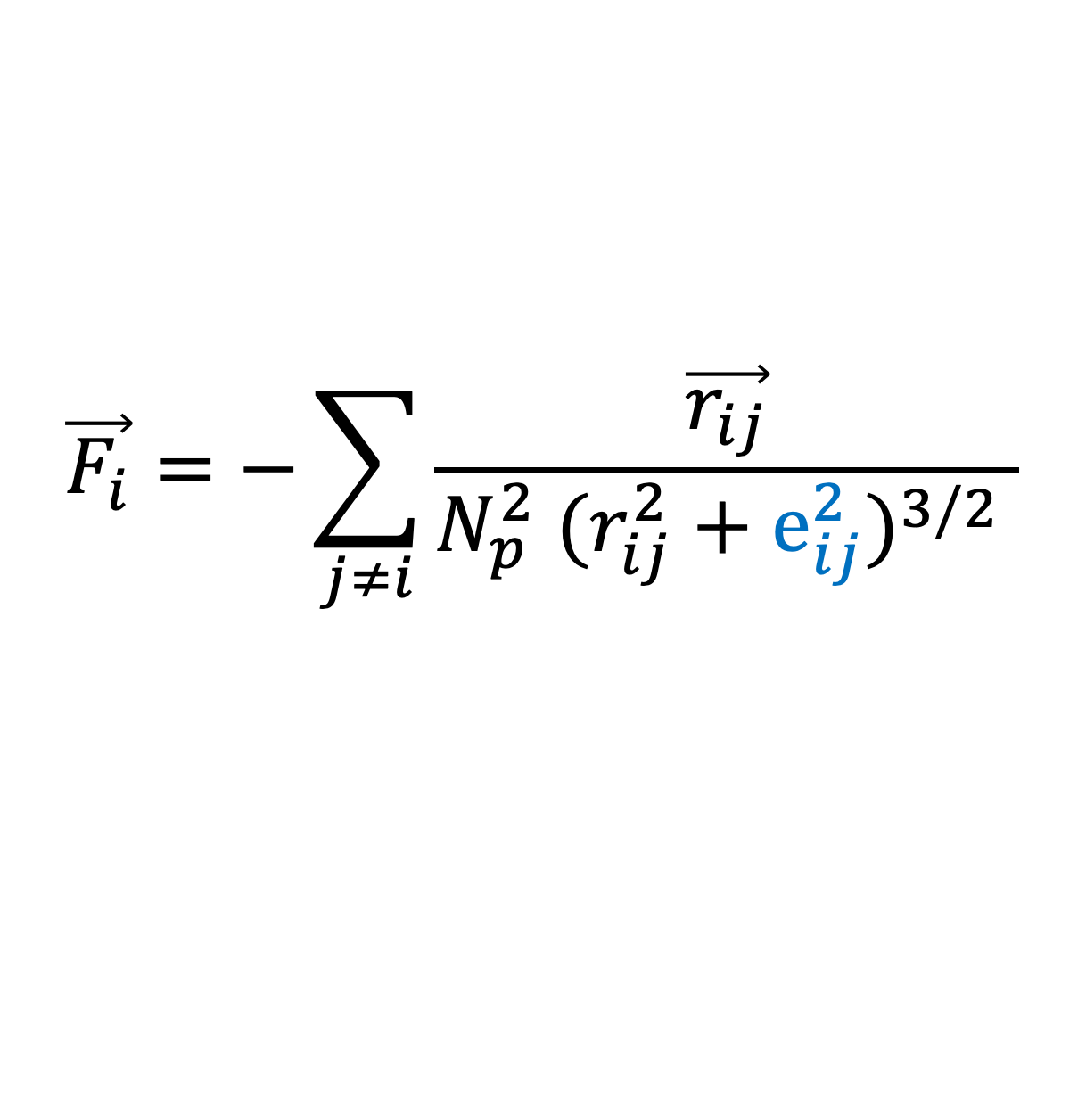
Diverges? Softening.
$$\vec{F_{i}}=−\sum_{j≠i}{\frac{\vec{r_{ij}}}{N_{p}^{2} (r_{ij}^{2}+e_{ij}^{2})^{3/2} }}$$
Softening parameter
This spreads the mass uniformly over an effective volume of length e.

Slide 5
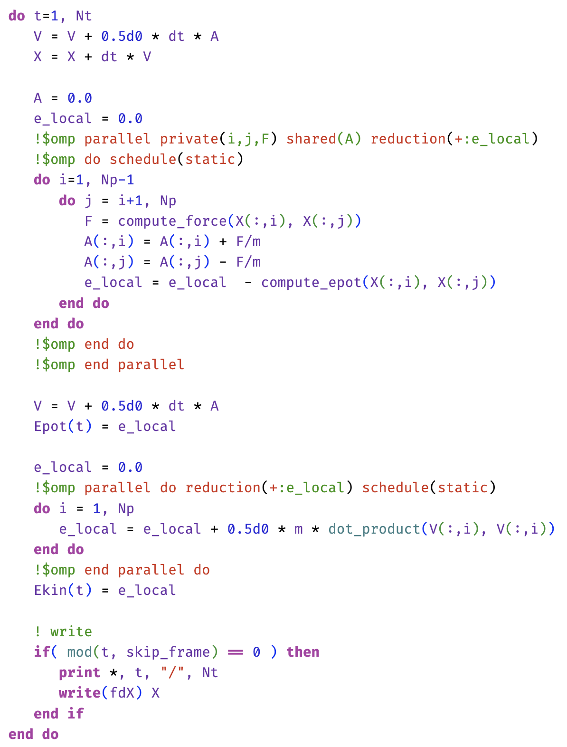
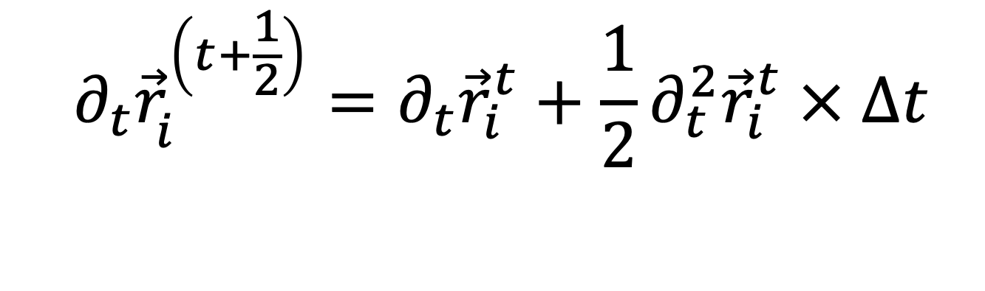
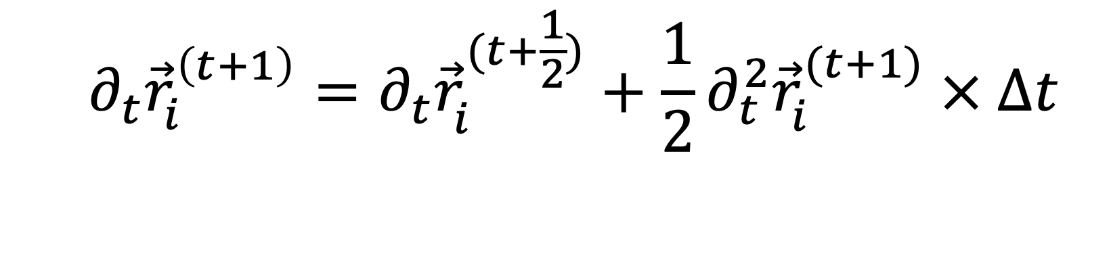
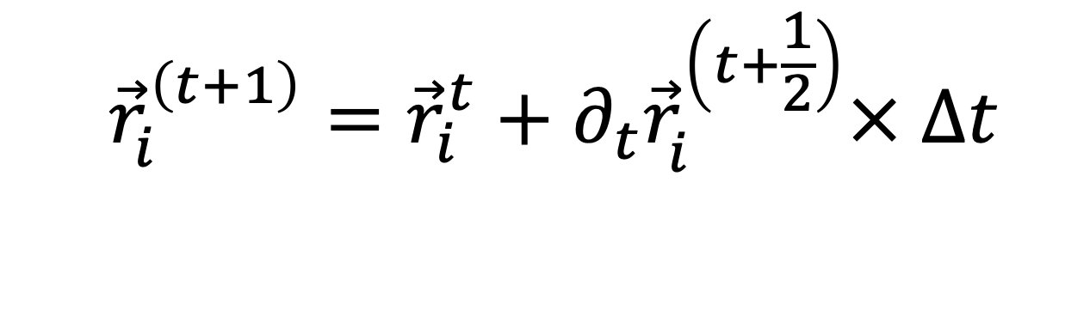
Leapfrog integrator
$$∂_{t}{\vec{r}}_{i}^{\left(t+\frac{1}{2}\right)}=∂_{t}{\vec{r}}_{i}^{t}+\frac{1}{2}∂_{t}^{2}{\vec{r}}_{i}^{t} × Δt$$
Kick
$${\vec{r}}_{i}^{\left(t+1\right)}={\vec{r}}_{i}^{t}+∂_{t}{\vec{r}}_{i}^{\left(t+\frac{1}{2}\right)}× Δt$$
Drift
$$∂_{t}{\vec{r}}_{i}^{\left(t+1\right)}=∂_{t}{\vec{r}}_{i}^{(t+\frac{1}{2})}+{\frac{1}{2}∂}_{t}^{2}{\vec{r}}_{i}^{(t+1)} × Δt$$
Kick

Slide 6
Implementation
Naive, sequential, version is straightforward to implement,
Few commonsense optimizations can be made
- column major order,
- heap vs stack
- upper triangular traversal,
- limit calls to I/O
- compile with (aggressive?) optimization flags

Slide 7
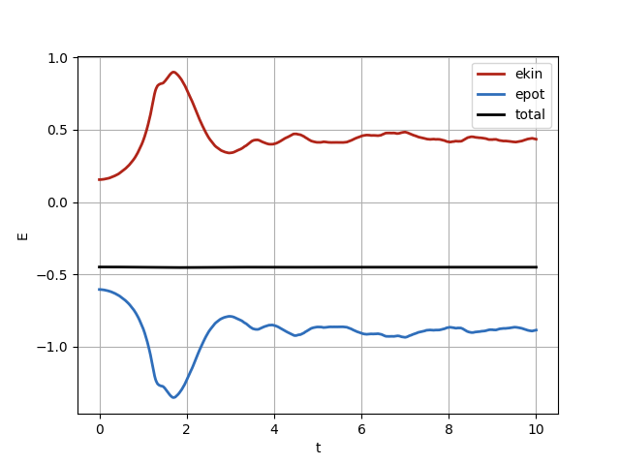

Slide 8

-O3 -march=native -ffast-math -funroll-loops -Accelerate
Main bottleneck remains: forces computation is$O(N_{p}^{2})$

Slide 9
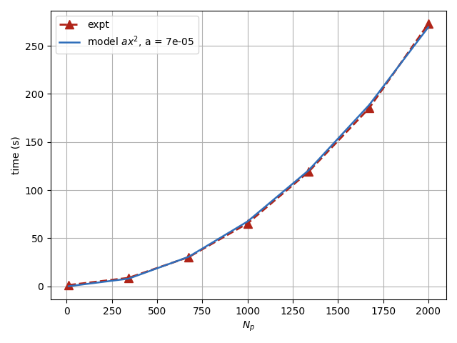

Slide 10
We need to introduce parallelization.

Slide 11
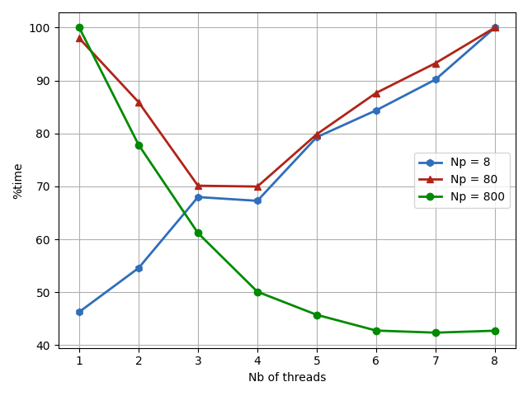

Slide 12
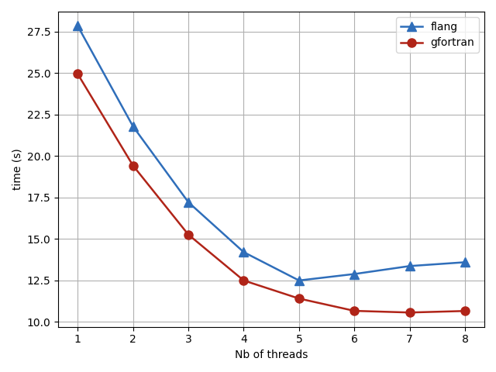
Can we test for another compiler?
flang (2020)
gfortran (2005)

Slide 13
Merci !

