Slide 1









$$h_{t−1}$$
$$σ$$
$$c$$
$$σ$$
$$h_{t}$$
+
◊
+
◊
+
$$i$$
$$x_{t}$$
feedback
+
$$f$$
◊
+
$$o$$

Slide 2
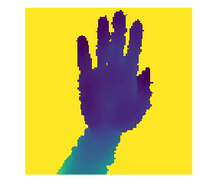

LSTM
.
.
LSTM
.
.
.
.
Image
sequence
Temporal Network
LSTM
.
.
Deeply-Fusion
Network
.
.
Prediction via mixture of experts
.
.
.
.
Spatial Network
.
.
.
.
.
.
.
.
split
.
.
Gate Network

