Slide 1
Apache JMeter
Web Application Performance Testing
By Rasika Weliwita

Slide 2
Introduction
Performance Testing Fundamentals
Http Overview
Apache JMeter
What is JMeter
Getting Started
JMeter Basics
JMeter Components
JMeter Examples

Slide 3
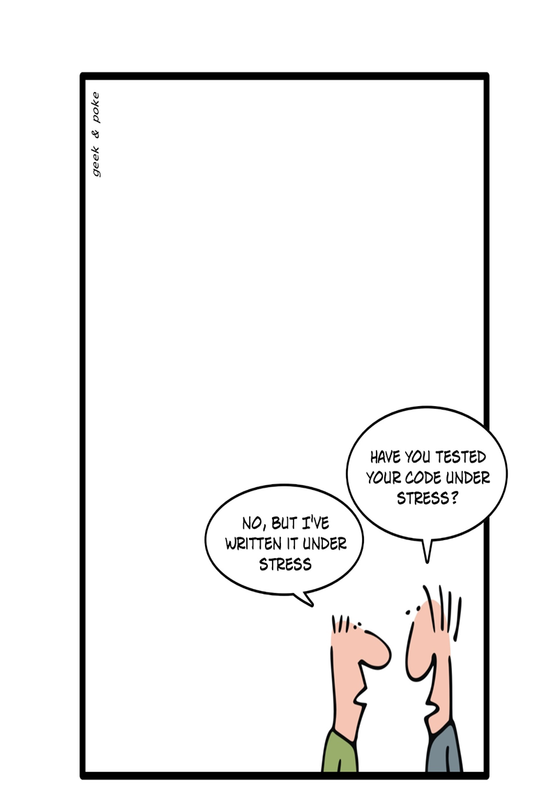
Performance Testing
Stress Tests
Load Tests
Peak Load Tests
Soak Tests or Endurance Tests
Scalability Tests
Capacity Tests
Spike Tests(Burst Capacity)
Performance Smoke Tests
High Availability Test/Fail-Over Tests
Notes:
Stress Tests: A stress test is a kind of performance test that tests the application beyond the normal limits. The application
is subjected to excess load and after that its stability and performance are noted. This type of test is used to
determine how the application responds to load spikes.
Load Tests: A load test is a kind of performance test that’s performed at the specified load level. So ideally, we would like to perform load tests at varying load levels to note the behavior of the application.
Peak Load Tests: A peak load test is performed at the load that the application is expected to handle. For example, e-commerce web sites experience their peak traffic during Black Friday, Cyber Monday, and the Christmas holidays. So a
peak load test in this case would test the application within the load specification but at the higher end.
Soak Tests: the application is subjected to a specified load that is within the
specified limit but for a long duration. It is performed for many hours at a time. This test determines if the
application is properly reusing its resources.
This test will surface problems like the following:
• Memory leaks in the application
• Database connections exhaustion
• Network connection exhaustion
• Log files becoming full and log rotation
• Other resource exhaustion
Scalability Tests: scalability test would increase the resources and test whether or not the application is providing
a corresponding increase in capacity. Ideally, we expect linear scalability (i.e., doubling the hardware
resources should result in double the application capacity).
Capacity Test: A capacity test is a load test that establishes the maximum load that the application can handle while
meeting the desired performance criteria. The resulting metric is called the maximum capacity. It is used in
scaling the application and to estimate costs for future growth
Spike Test: A spike test is a load test where the application is subjected to brief periods of sudden increment in load, a
small fraction beyond the maximum capacity. It is usually done to estimate the weakness/strength of an
application. The application is expected to be robust and continue to meet the performance criteria during
the spike. This metric is called the burst capacity
Performance Smoke test: few common and essential use-cases along with use-cases pertaining to the
code subject to change are together tested for performance. It is only when the smoke test succeeds that
the full suite of performance tests are conducted.
High Availability test : Modern web application infrastructure is designed to be highly available and resilient to hardware and software failures. Ideally, the architecture should ensure that there is no single point of failure and that there
are standby servers that can transparently take over without impacting the user experience. Hardware equipment and software failures simulated. Chaos monkey of Netflix.

Slide 4
Http Overview
Request Response
Cookies
Session Management
Https
Network Monitoring (Dev tools, Fiddler)
Creating Http Requests (PowerShell, curl)

Slide 5
Apache JMeter
A load testing tool for analyzing and measuring the performance of a variety of services, with a focus on web applications.
Test the performance of the web applications.
Industrial-strength performance testing tool.
Apache open source project.
Can be run in “distributed mode” in the cloud.
Can generate the load of thousands of users.
Has standard format for writing the performance test(JMX)
Supports Various protocols (HTTP,SOAP,FTP,LDAP,JDBC, etc)

Slide 6
Getting Started
JDK 1.8 (Download Link: http://www.oracle.com/technetwork/java/javase/downloads/jdk8-downloads-2133151.html )
JRE/JDK correctly installed and the JAVA_HOME environment variable set
JMeter 2.13 (Download Link: http://jmeter.apache.org/download_jmeter.cgi )
Extract to a folder
Run bin\jmeter.bat or bin\jmeter.sh

Slide 7
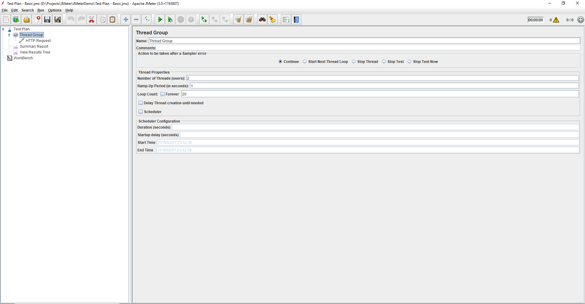
JMeter Basics
Test Plan
Thread Group
Sampler
Listener
Notes:
Test Plan – Entire Jmeter Script
Thread Group – simulate a user (user = thread)
Sampler – makes a request
Listeners – reporting, logging and debugging
Explain in Real JMeter and execute basic script – Example 1

Slide 8
JMeter Components
Assertions
Config Element
Pre-Processors
Post Processors
Workbench
Test Plan
Thread Group
Sampler
Listener
Controller
Timer
Notes:
Test Plan – Entire Jmeter Script
Thread Group – simulate a user (user = thread)
Sampler – makes a request
Config Element – configuration stuff
Timer – adding a delay
Listeners – reporting, logging and debugging
Assertions – error checking
Pre and post processor – modifies request and parse response
Logic Controller – repeating and conditional tasks
Workbench – temporary working space

Slide 9
JMeter Scripts
Create
Save
Import
Run GUI Mode
Run CommandLine Mode
jmeter -n -t [jmx file] -l [results file] -e -o [Path to output folder]
Simulate load with many users
JMX format
Notes:
http://jmeter.apache.org/usermanual/get-started.html#non_gui
-n This specifies JMeter is to run in non-gui mode
-e generate report dashboard after load test
-o output folder where to generate the report dashboard after load test. Folder must not exist or be empty

Slide 10
JMeter Examples
Creating Basic Test Script
Executing Test Scripting and Analyzing Test Results
Recording a script via Test Script Recorder
Using Timers
Managing Sessions
SPA and Ajax request performance
Response data extraction (Regular expressions, jQuery XPath extractors)
Handling JSON Responses
Controllers (Transaction, Foreach, Interleave and Random Controllers)
Testing Services(REST, SOAP, Database)
Using CSV data set to simulate multiple users
Notes:
Load each test script from Github
Use gausian random timer – delay execution of each thread

Slide 11
Resources
Presentation and Scripts
https://github.com/weliwita/JMeterDemo/archive/master.zip
Books
https://www.packtpub.com/application-development/jmeter-cookbook
https://www.apress.com/gp/book/9781484229606
http://jmeter.apache.org/usermanual/index.html

Slide 12
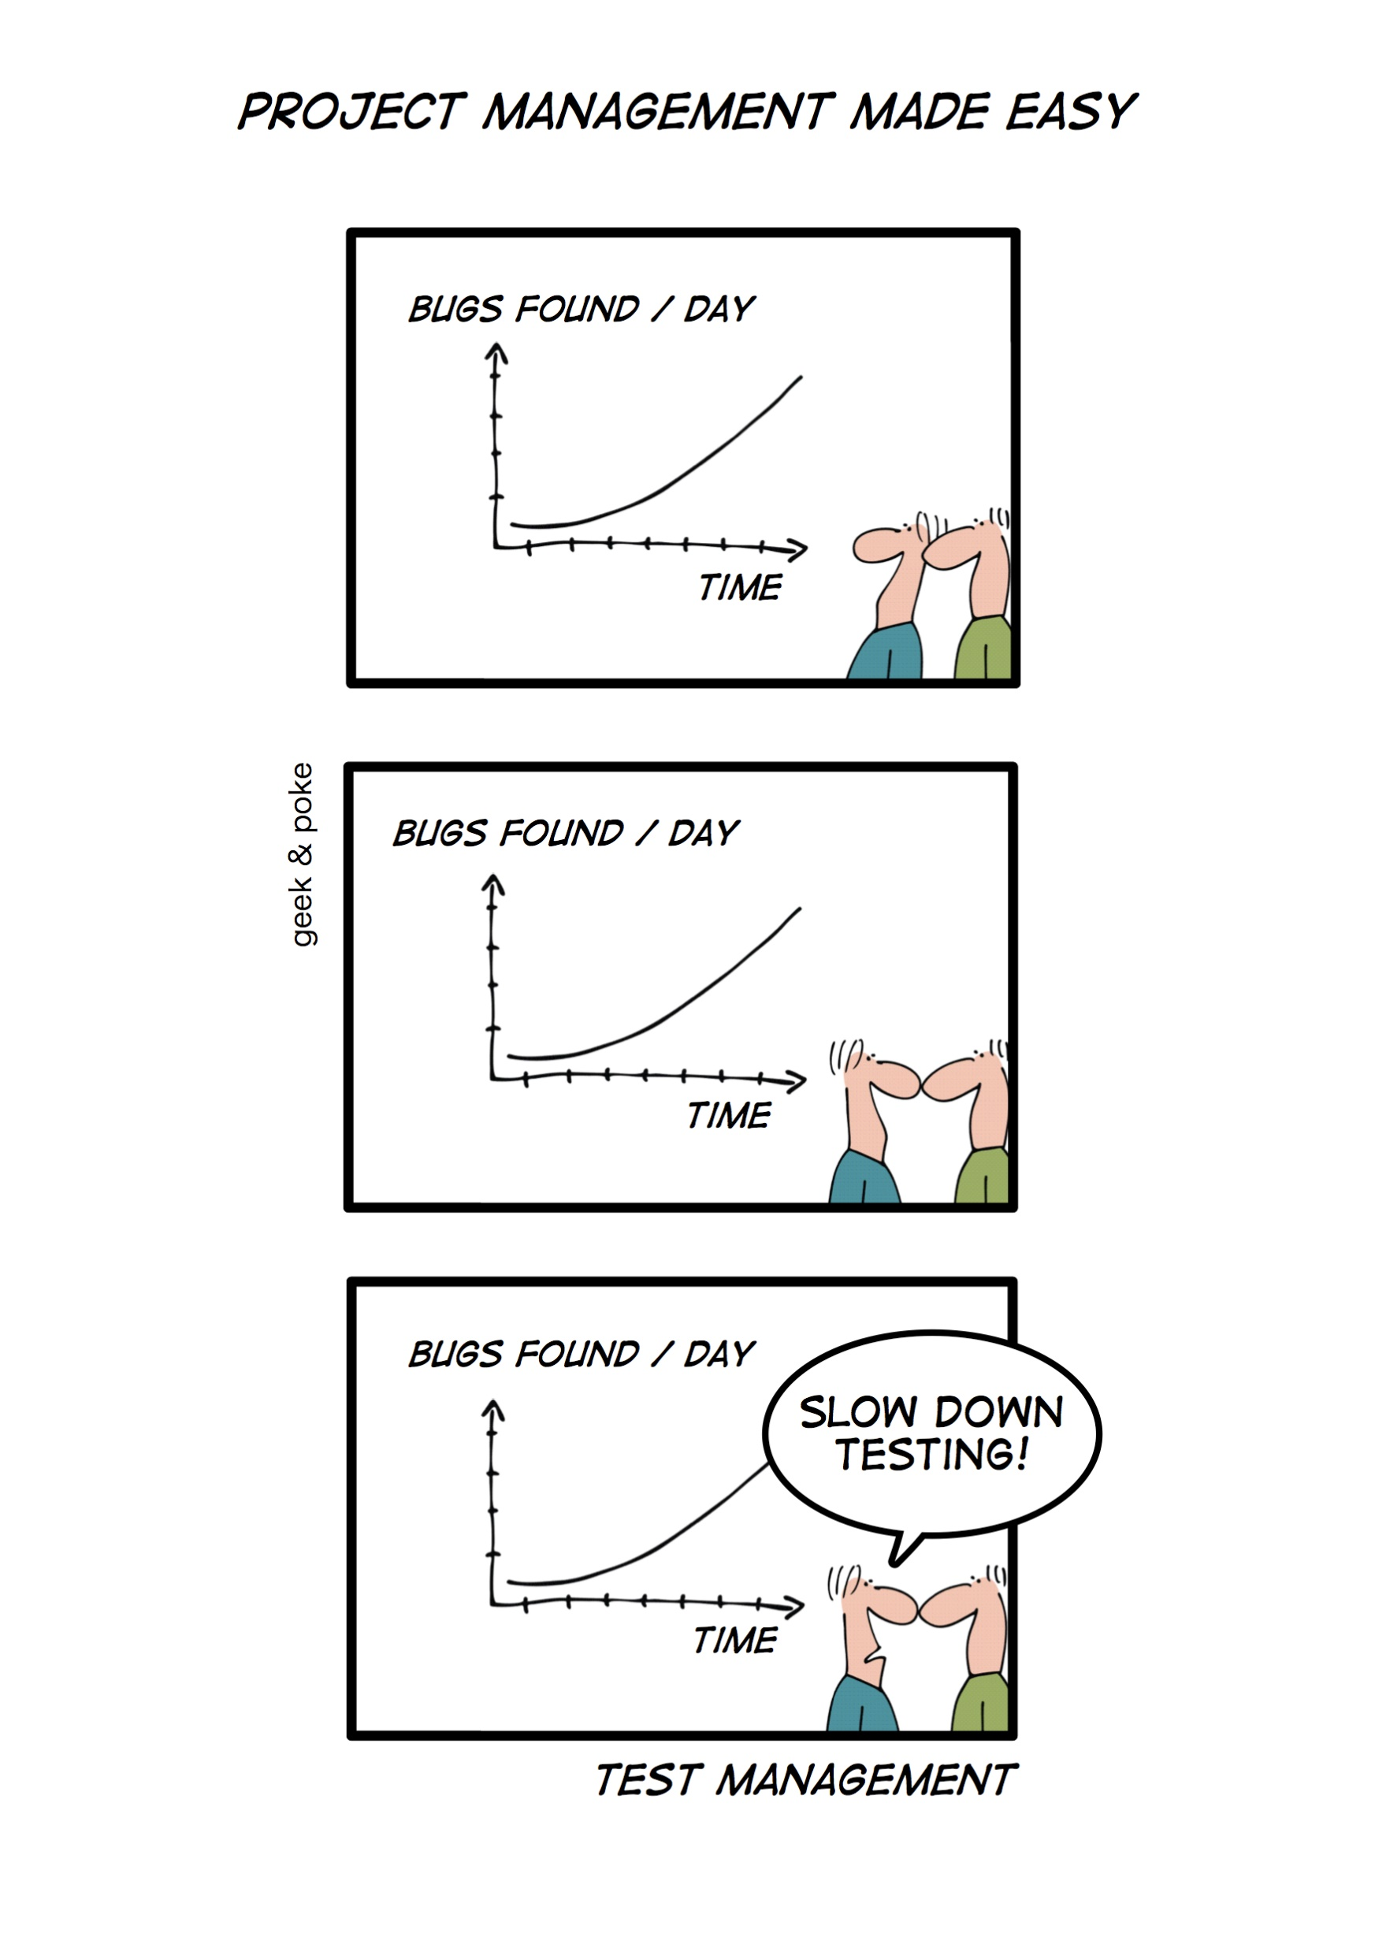
summary
Basics of performance testing
Http Basics
JMeter Test Plan Components
Creating and Running JMeter Test Scripts
Generate Load and Measuring performance
Not covered
Distributed Testing with multiple machines
Bean Shell Scripting

Slide 13
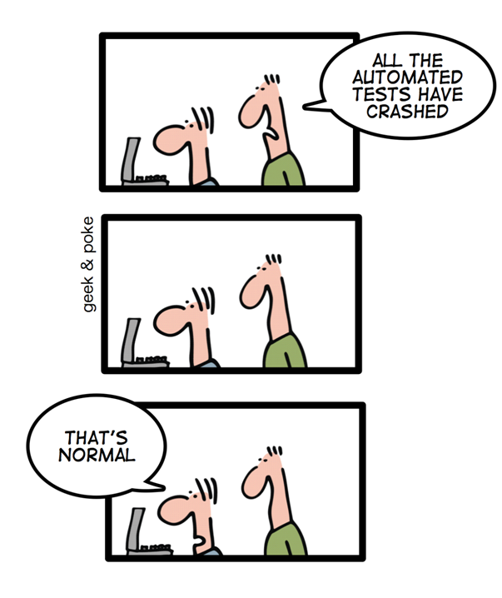
Q&A

Slide 14
Thank You

