Slide 1

Predicting COVID-19 Using Demographic Data
Caroline Clark, Feras Altwal, James Lee
October 30th, 2020
Notes:
Caroline

Slide 2
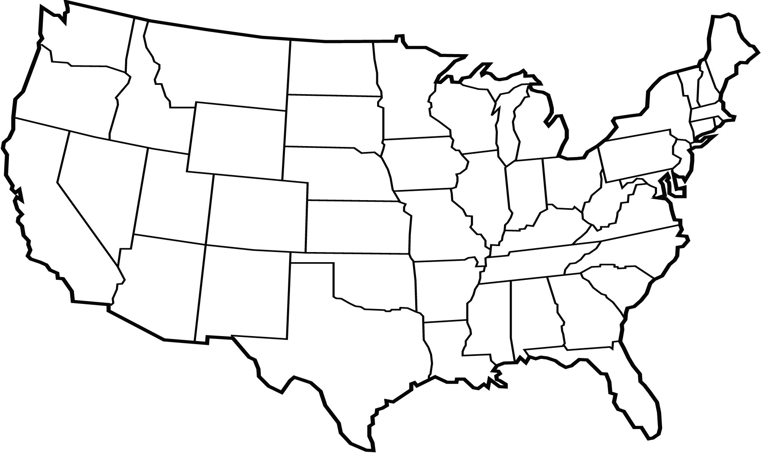
Can we predict COVID-19 severity using demographic data?
Notes:
Caroline

Slide 3
Project Pipeline
Data collection
Data pre-processing
Data visualization
Modeling
Making the data interactive
Notes:
Caroline

Slide 4


Data Collection
County-Level
Area |  | COVID-19
 | Population Density |  | Total Tests
Demographics |  |  | Total Cases
 | Age |  | Total Deaths
 | Gender | Health Indicators
 | Race |  | Obesity Rates
Economic Indicators
 | Income Per Capita
 | Health Insurance
 | Household Income
Notes:
Caroline

Slide 5
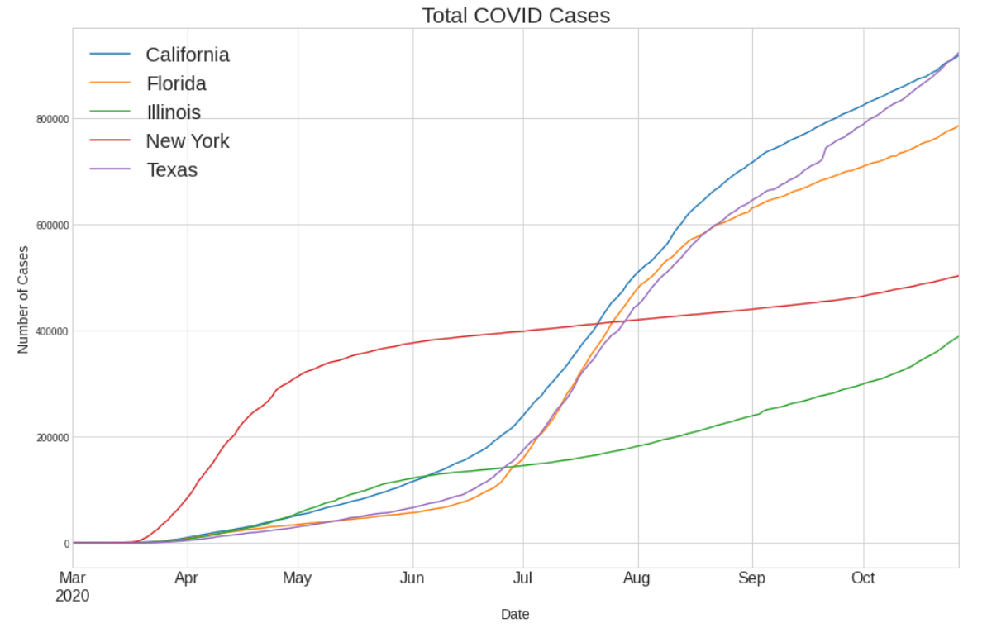
Five States with the Most COVID-19 Data
Notes:
Caroline

Slide 6
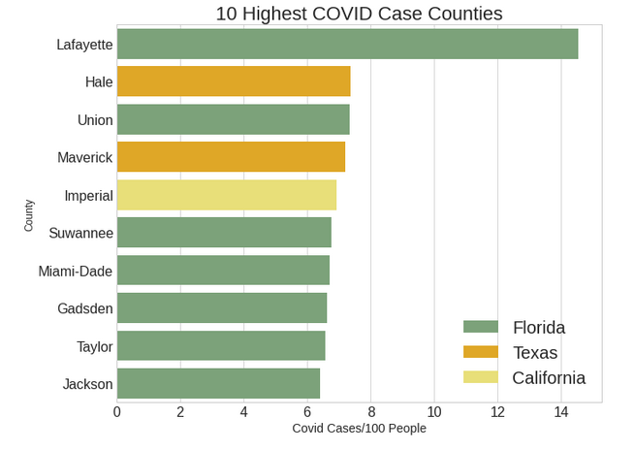
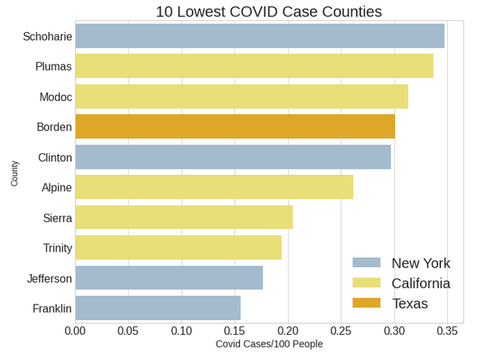
COVID-19 Statistics Vary Widely Among Counties
Notes:
Caroline

Slide 7
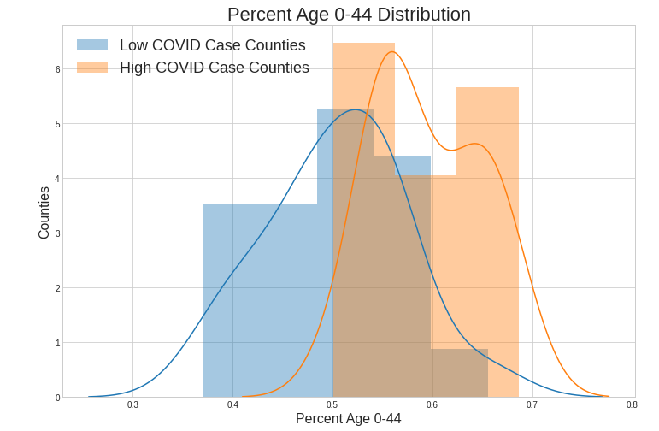
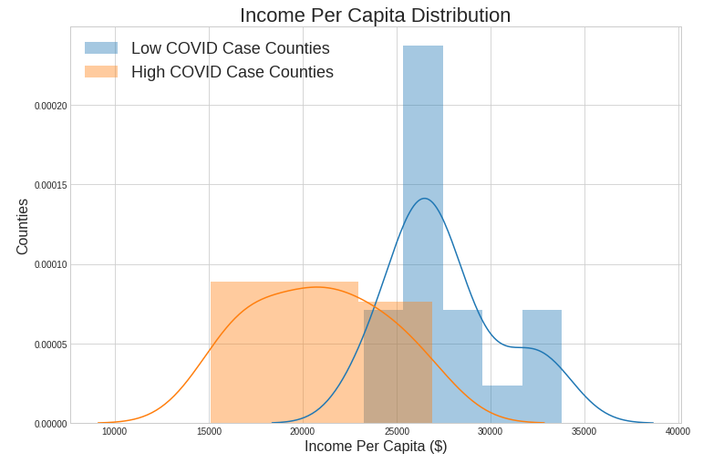
High COVID Counties Likely to be Younger, Have Lower Income Per Capita
Notes:
Caroline

Slide 8
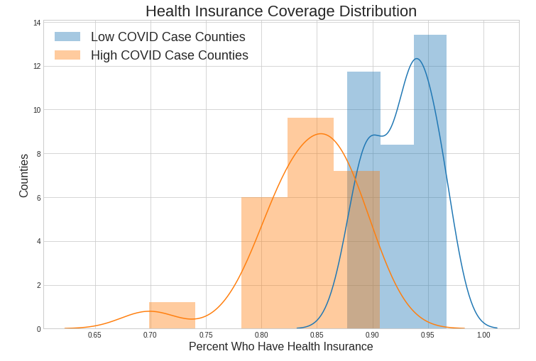
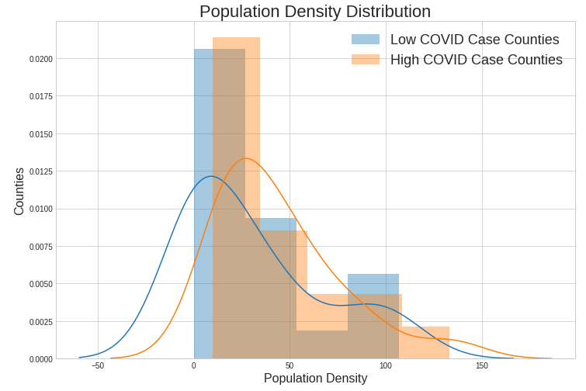
Low COVID Counties Likely to have Insurance Coverage, Lower Population Density
Notes:
Caroline

Slide 9
Modeling Successes and Challenges
Region | Best Regression R2 Score | Best Classification Accuracy Score | Classification Baseline
All Five States | 47% | 63% | 42%
California | 75% | 93% | 66%
Florida | 76% | 71% | 71%
Illinois | 32% | 73% | 54%
New York | 81% | 94% | 81%
Texas | 49% | 59% | 40%
Notes:
Feras

Slide 10
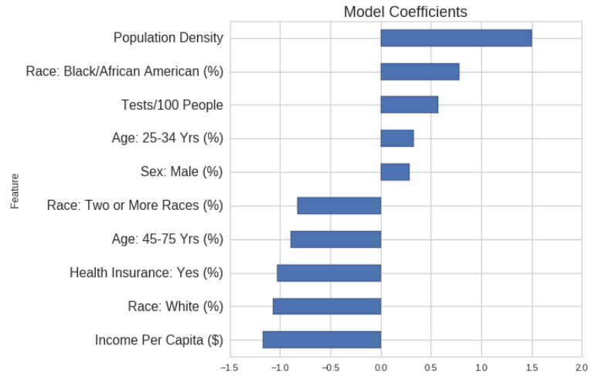
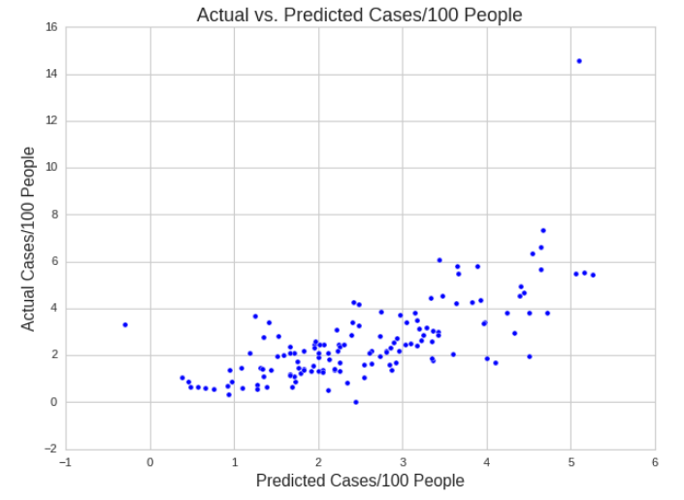
Population Density and Income Strongest Factors when Modeling All Five States
Notes:
Feras

Slide 11
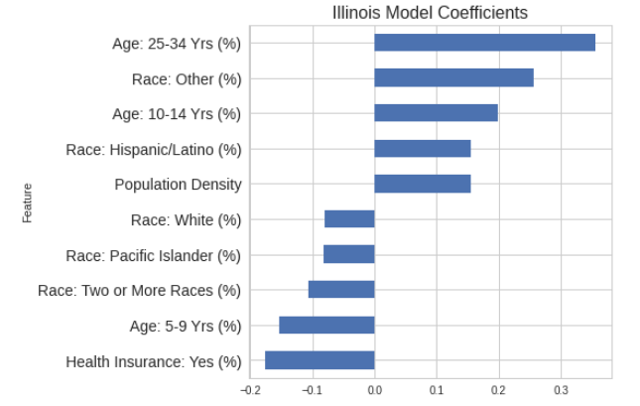
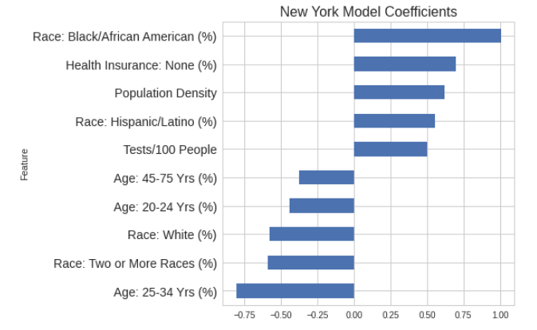
Predictors Varied in State-Level Models
Notes:
Feras

Slide 12
Conclusions and Key Challenges
Ongoing event
Widely varying data
More features
Notes:
Feras

Slide 13
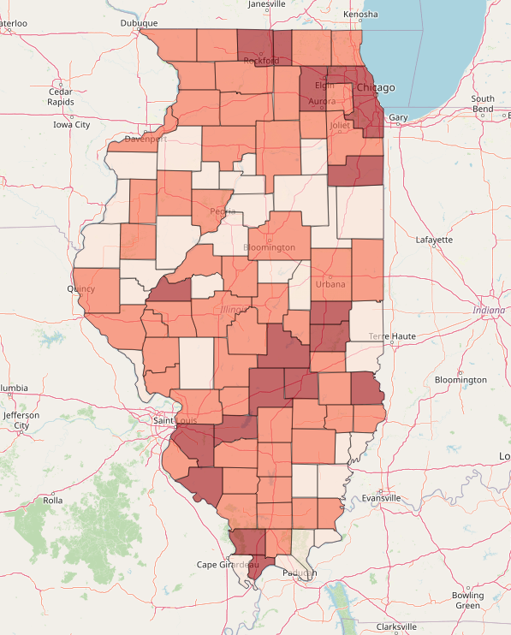
Demo: Interacting with Demographic Data and Classification Model
Notes:
James

Slide 14
Thank you

Slide 15
Appendix

Slide 16
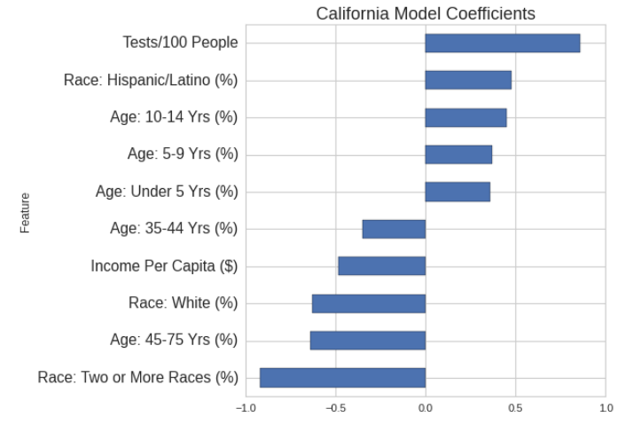
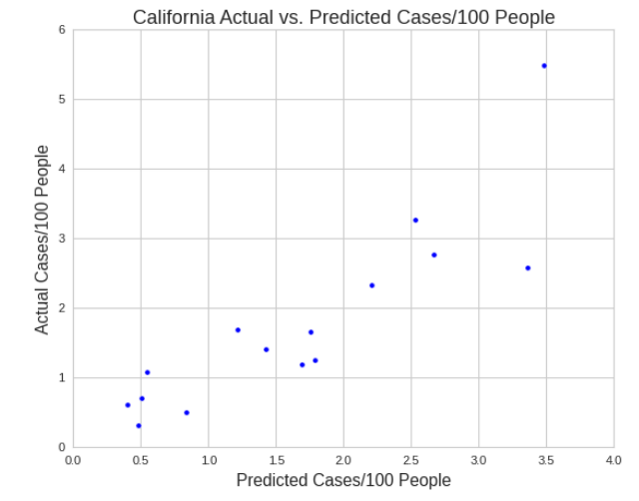
In California, Testing and Race Emerged as Strongest Predictors

Slide 17
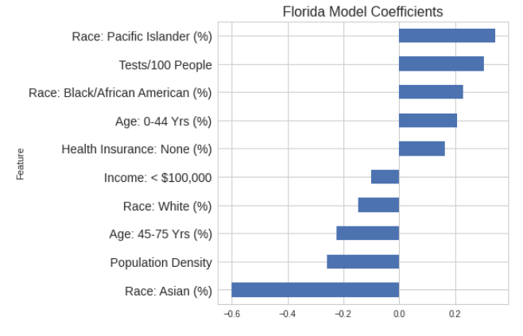
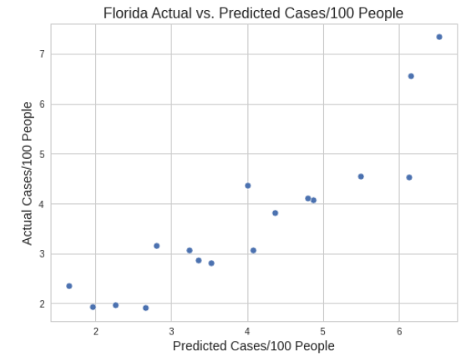
In Florida, Race Emerged as Strongest Predictors

Slide 18
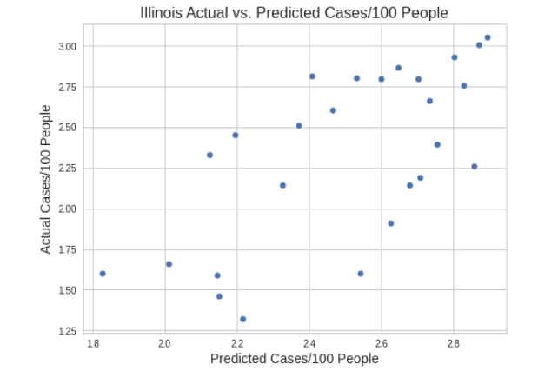
In Illinois, Age and Being Insured Emerged as Strongest Predictors

Slide 19
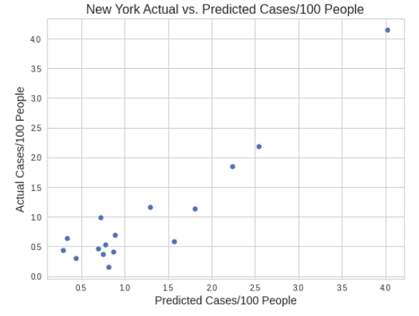
In New York, Race and Age Emerged as Strongest Predictors

Slide 20
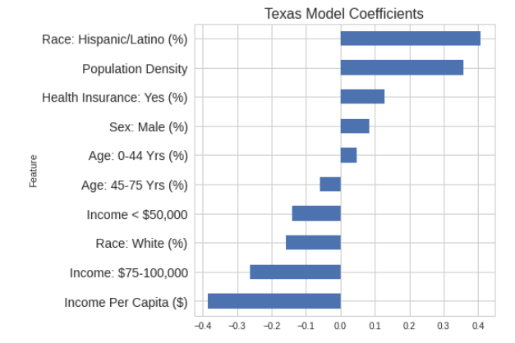
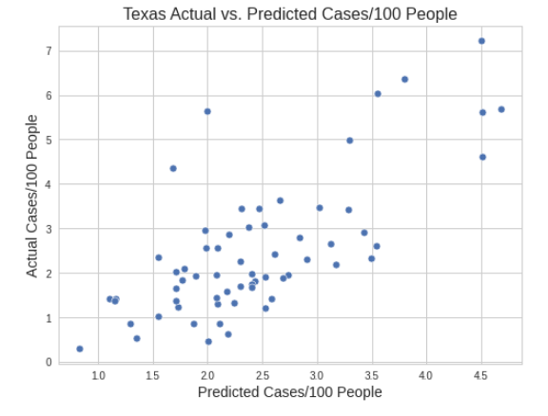
In Texas, Race and Income Emerged as Strongest Predictors

Slide 21
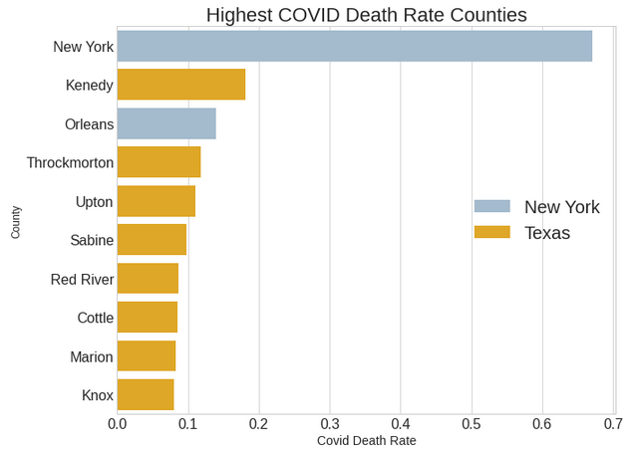
Highest Death Rate Counties

Slide 22
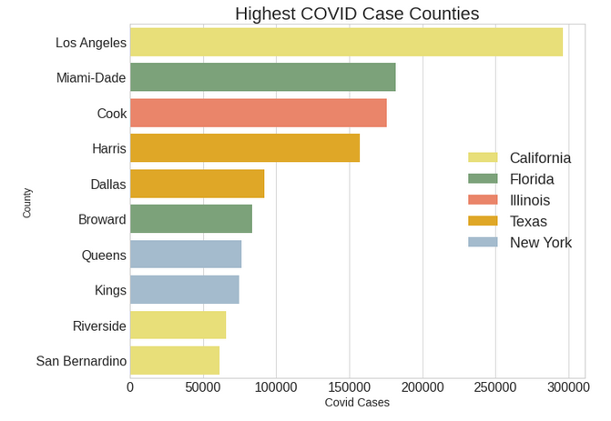
Highest COVID Case Counties Overall

Slide 23
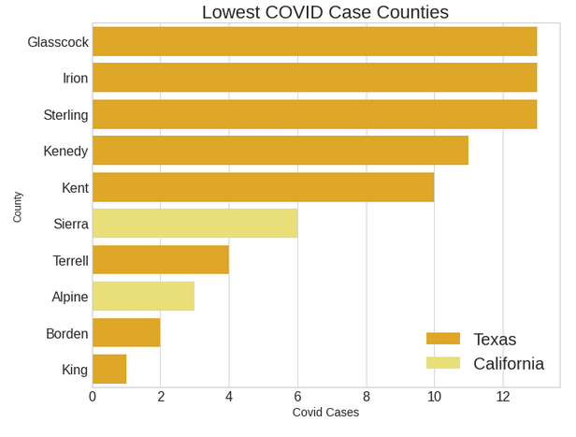
Lowest COVID Case Counties Overall

