Slide 2
Slot0
Slot1
Slot2
Slot3
 | Slot0 | Slot1 | Slot2 | Slot3

Slide 3
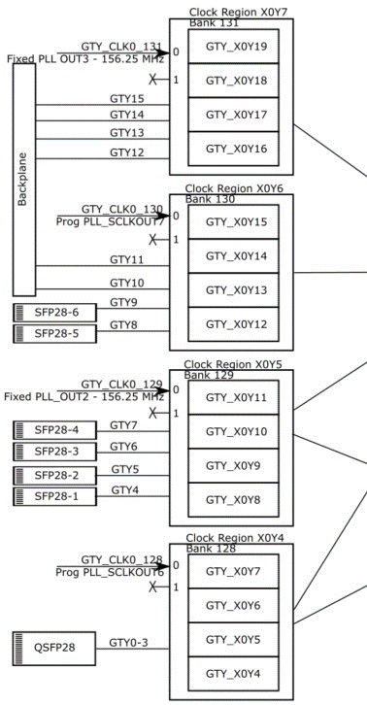

Slide 4
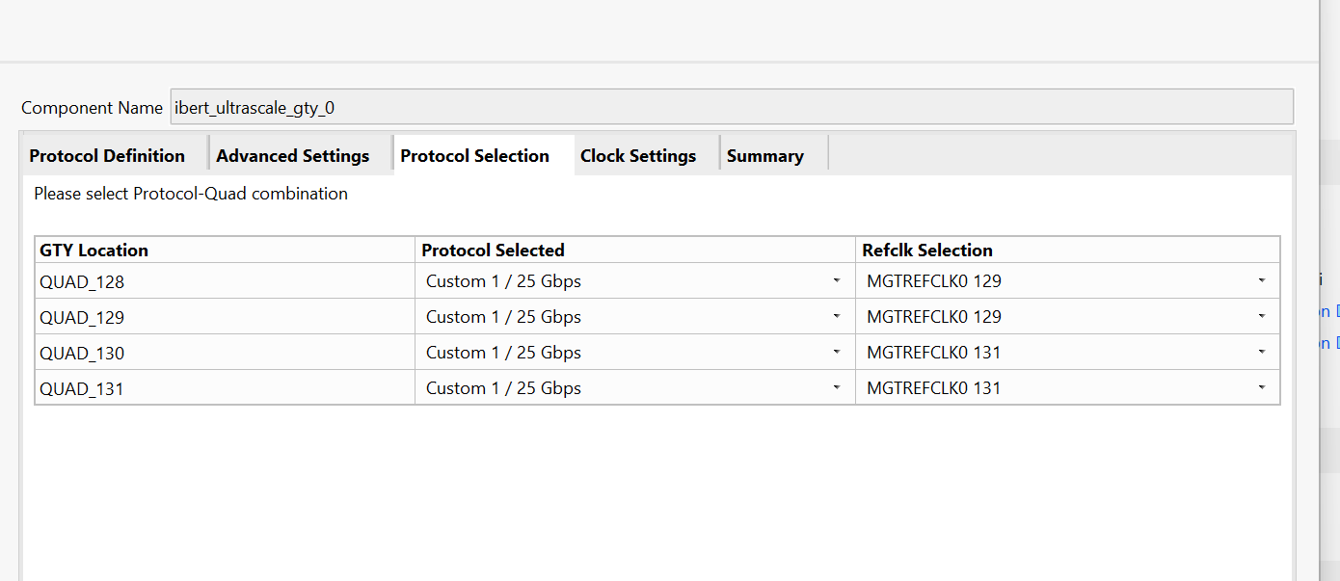
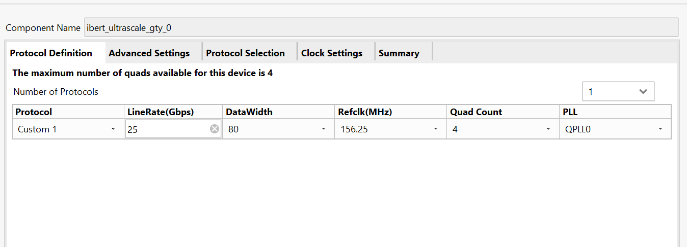
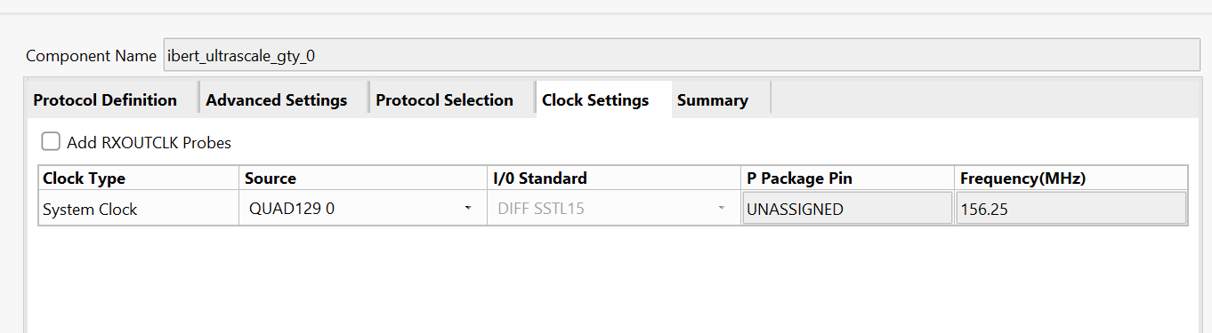
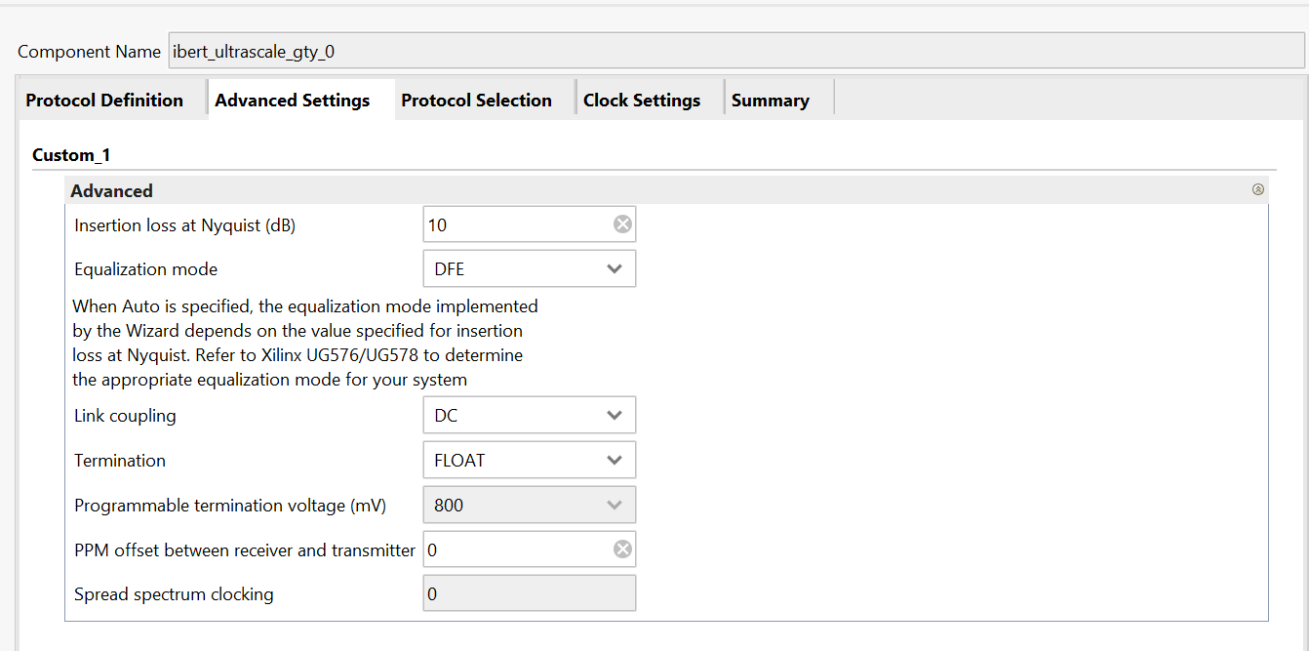
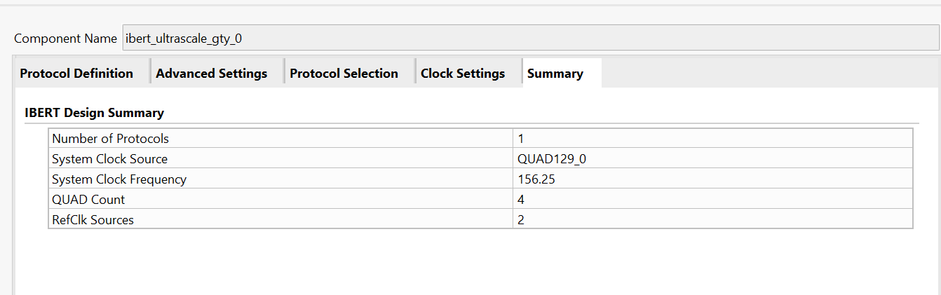

Slide 5
On-board Links – rev0

Slide 6
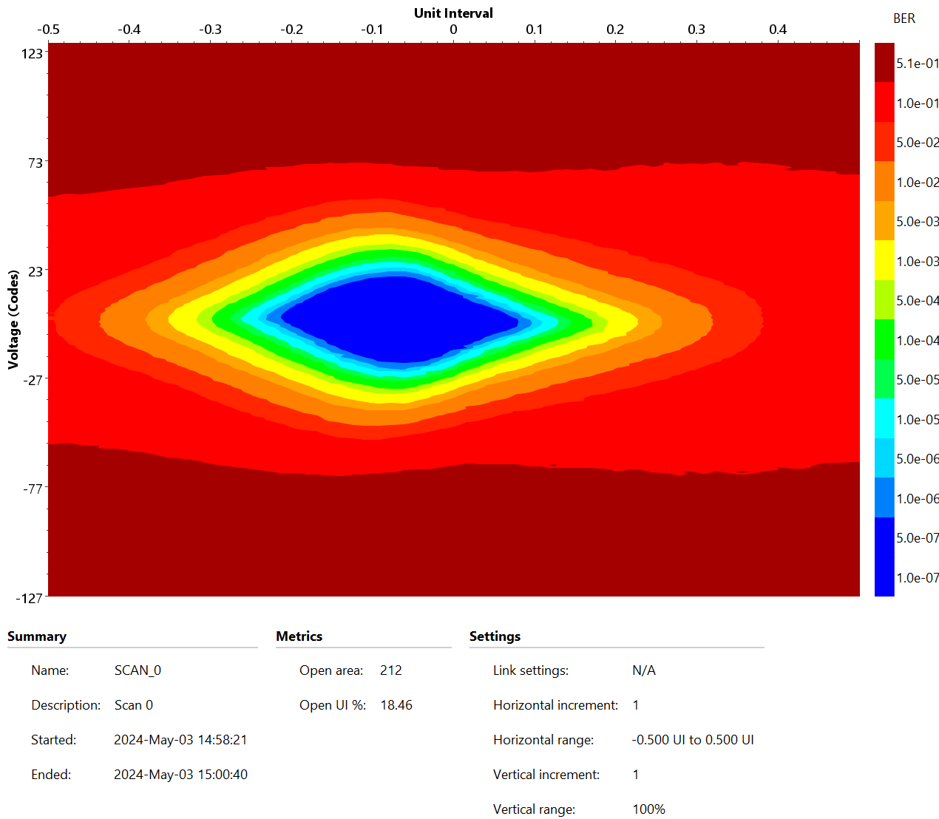
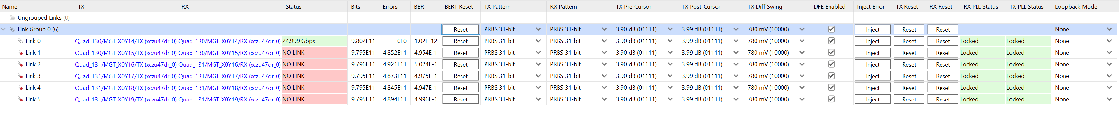
Slot 3 → Slot0
CRS-R3.0022
Slot0

Slide 7
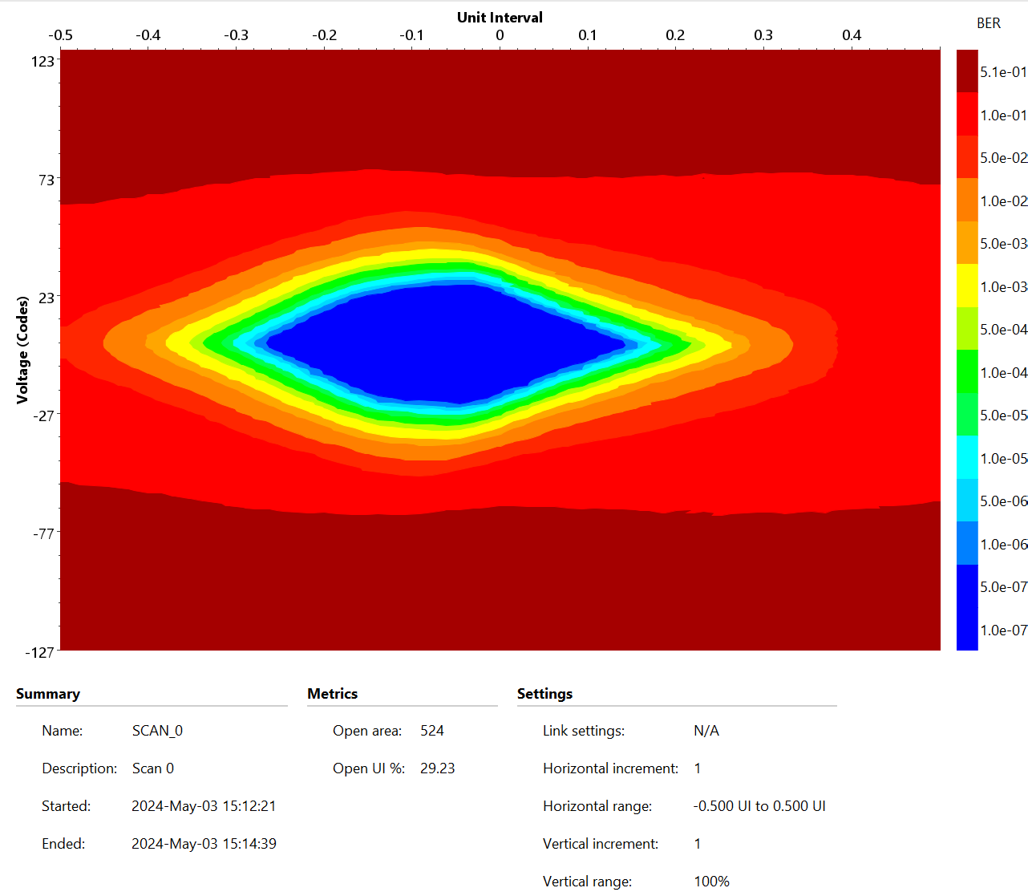
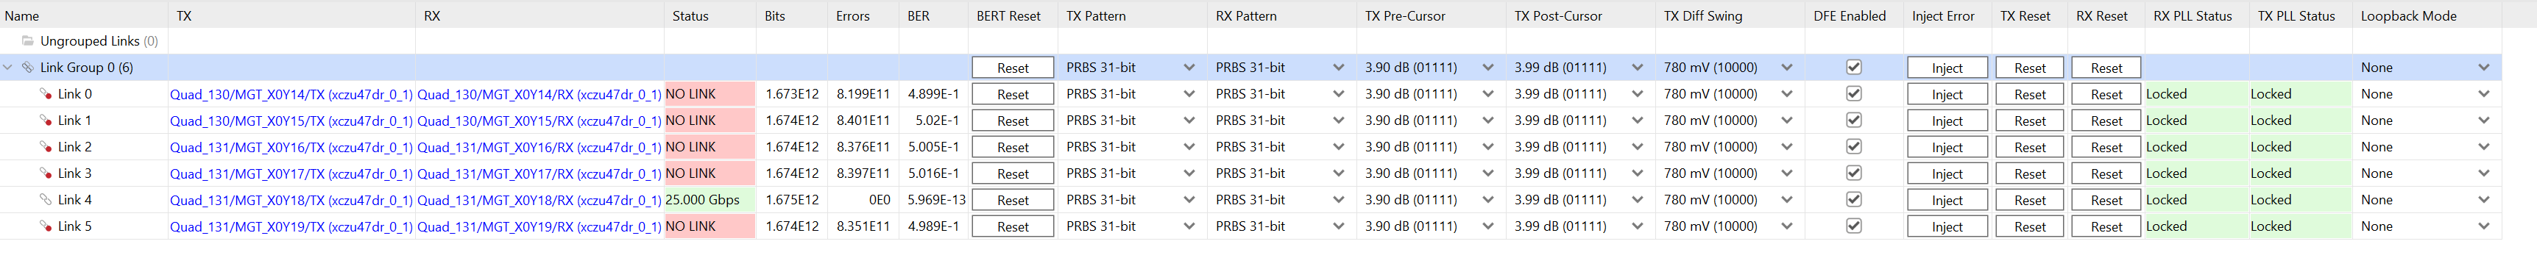
Slot 0 → Slot3
CRS-R3.0020
Slot3

Slide 8
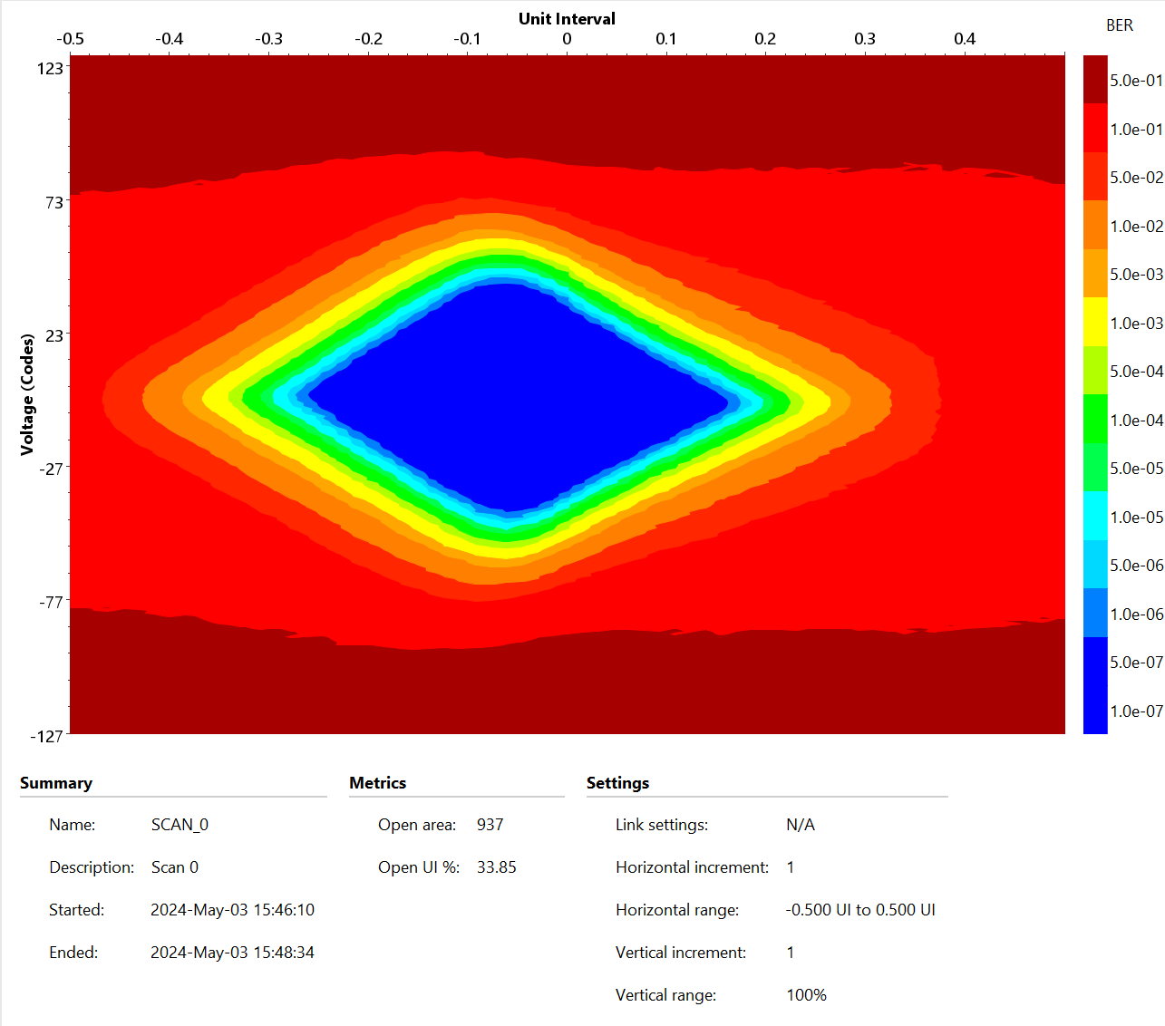
Slot 1 → Slot0
Slot0

Slide 9
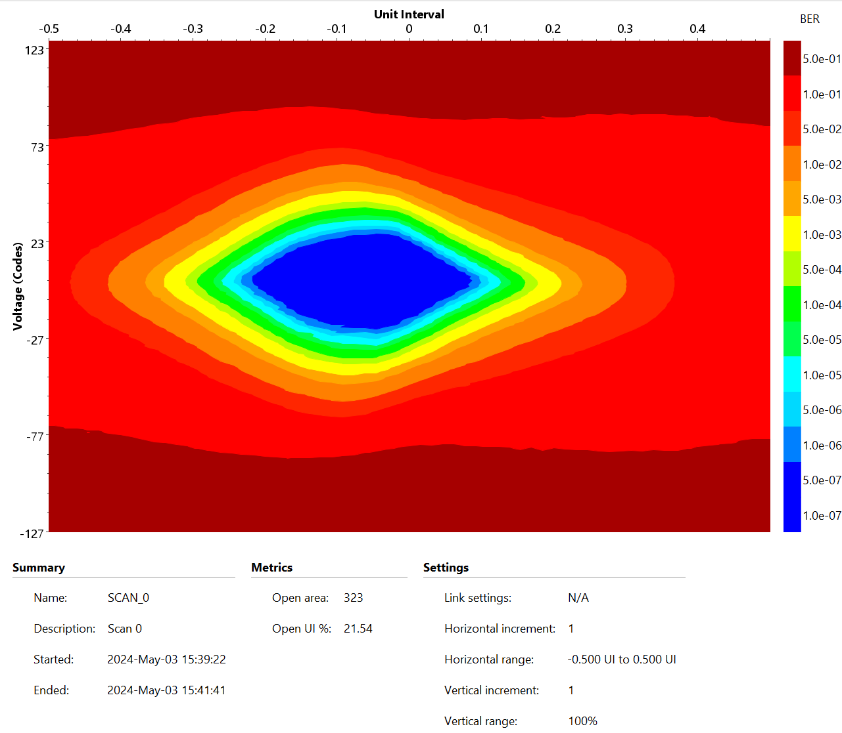
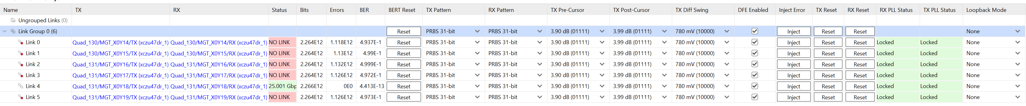
Slot 0 → Slot1
CRS-R3.020
Slot1

Slide 10
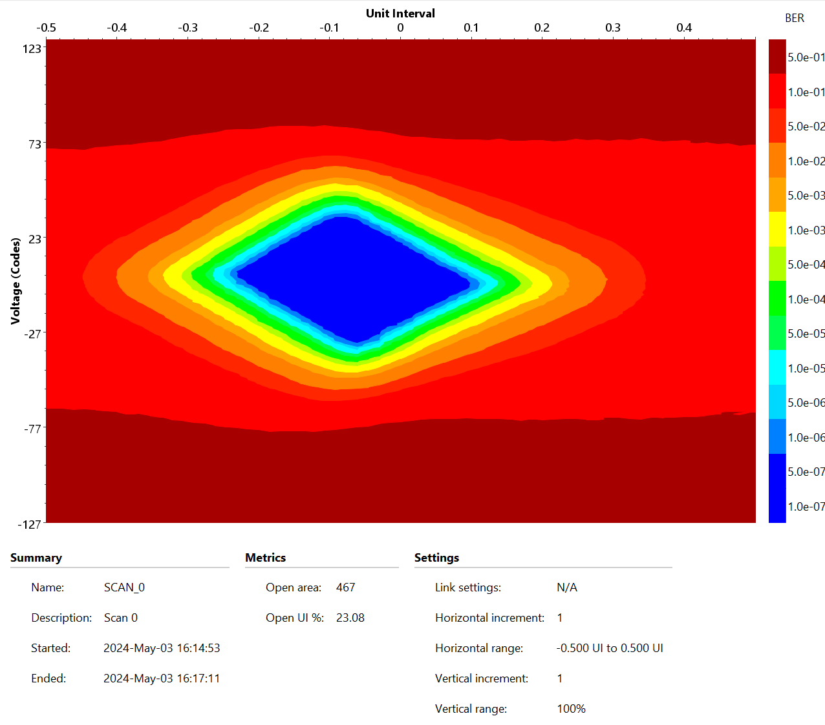
Slot 2 → Slot0
CRS-R3.0022
Slot0

Slide 11
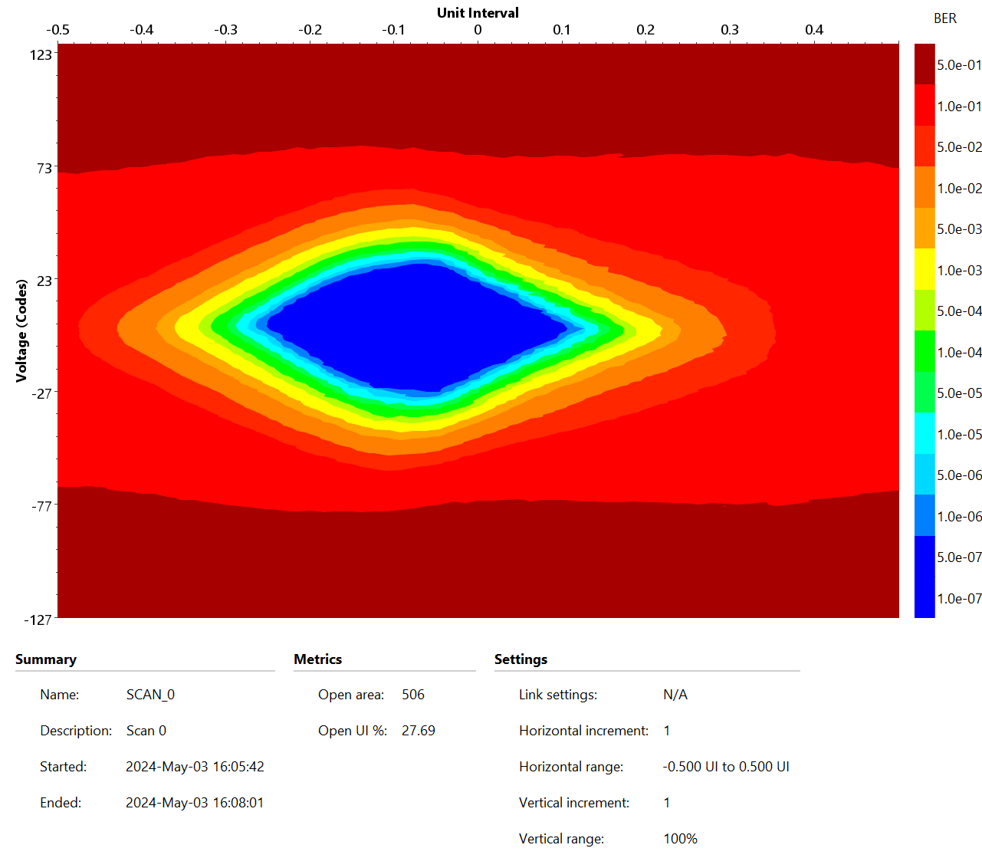
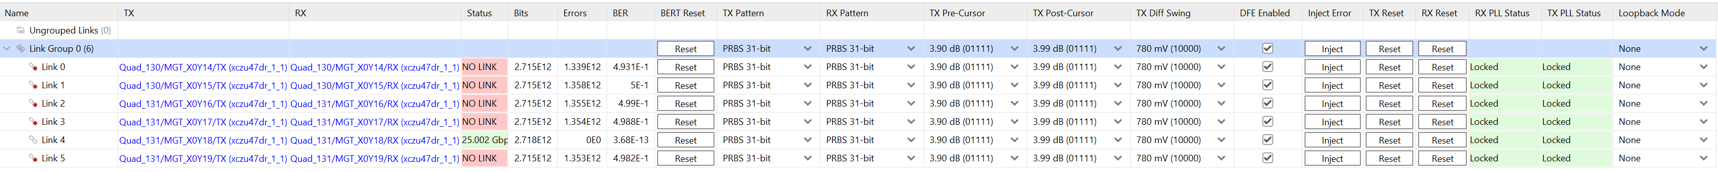
Slot 0 → Slot2
CRS-R3.020
Slot2

Slide 12
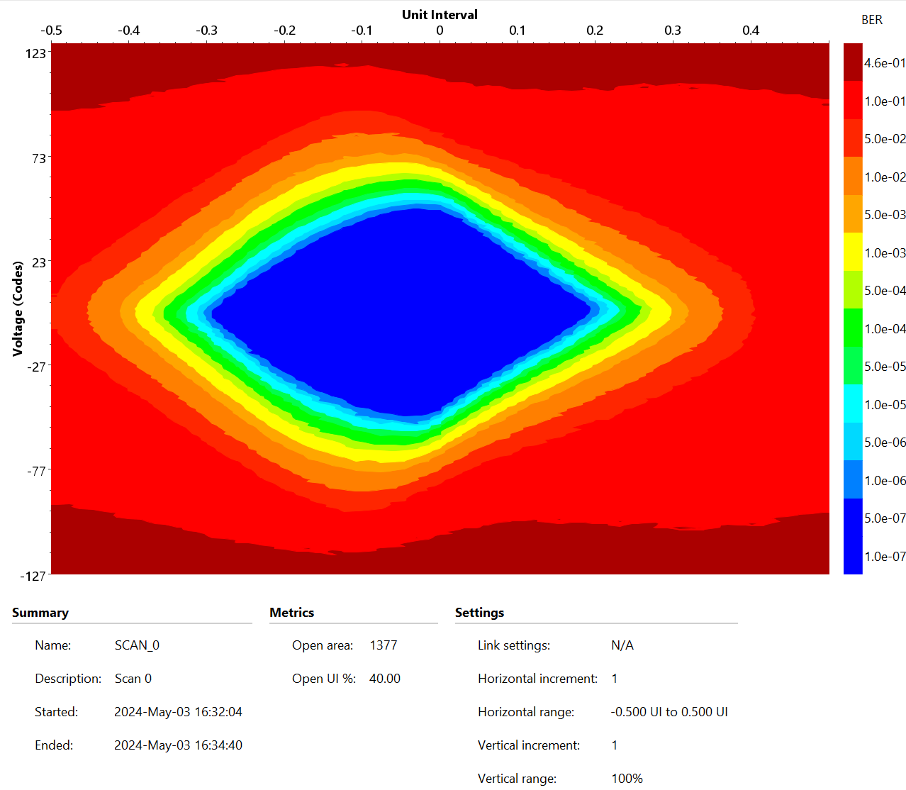
Slot 1 → Slot2
CRS-R3.0020
Slot2

Slide 13
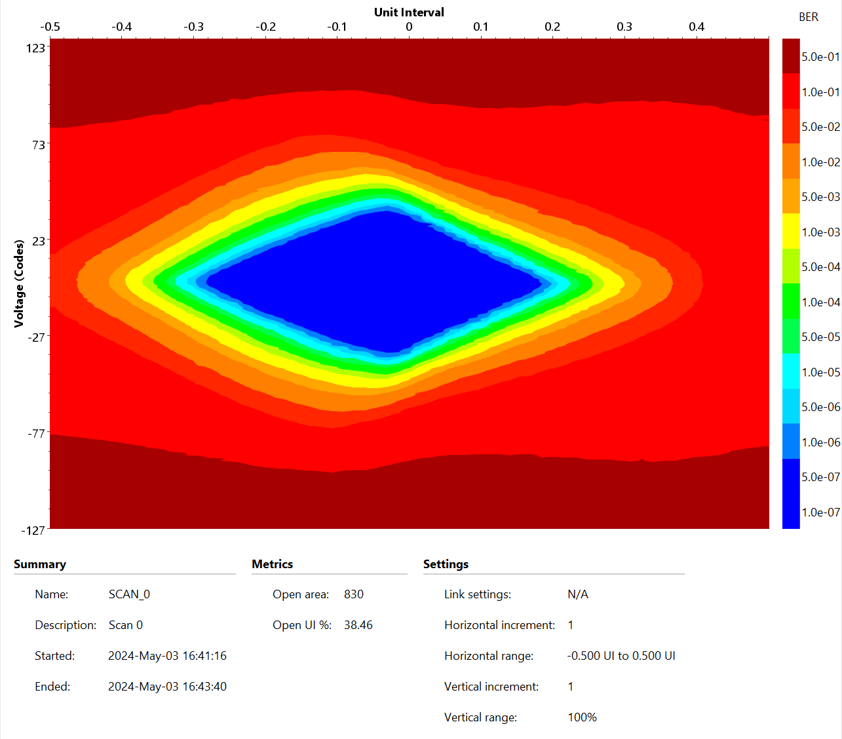
Slot 2 → Slot1
CRS-R3.0022
Slot1

Slide 14
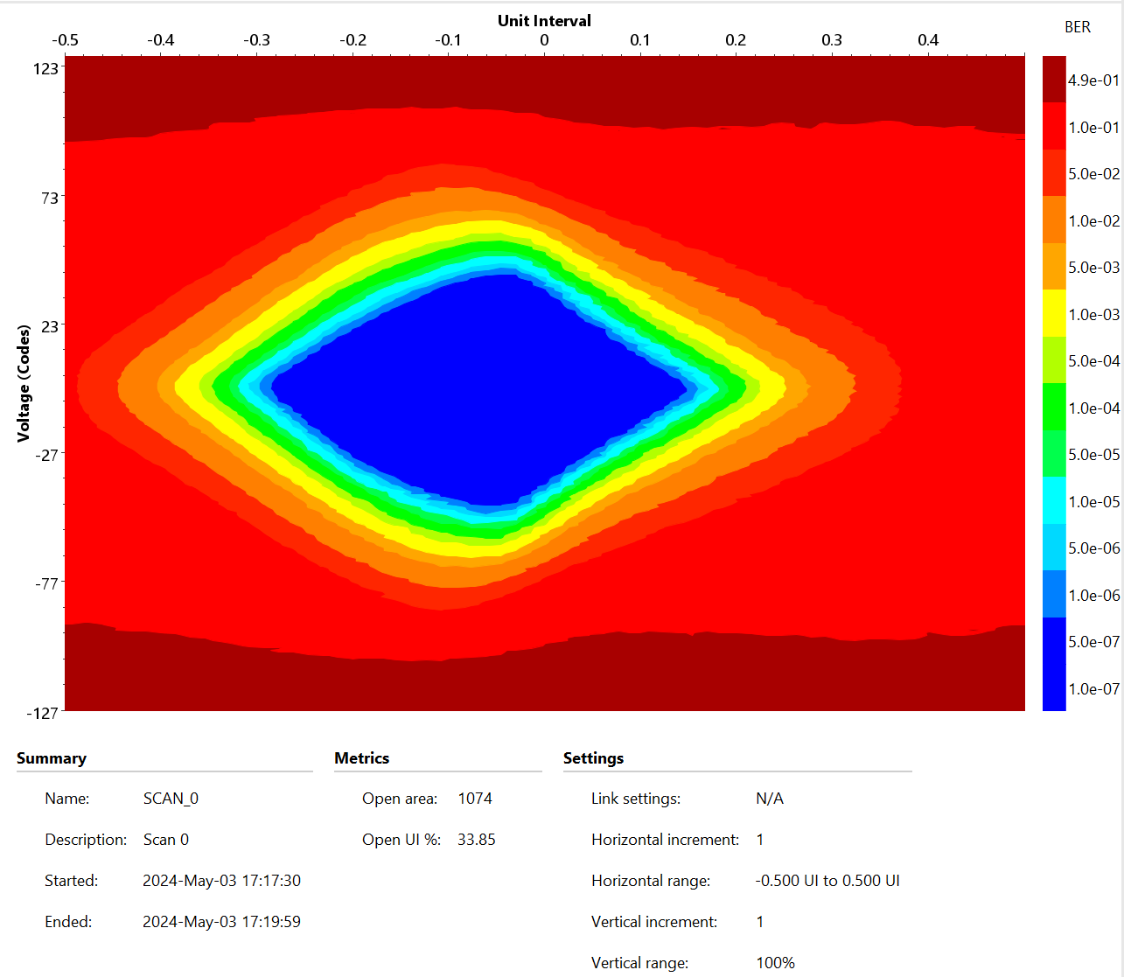
Slot 1 → Slot3
CRS-R3.0020
Slot3

Slide 15
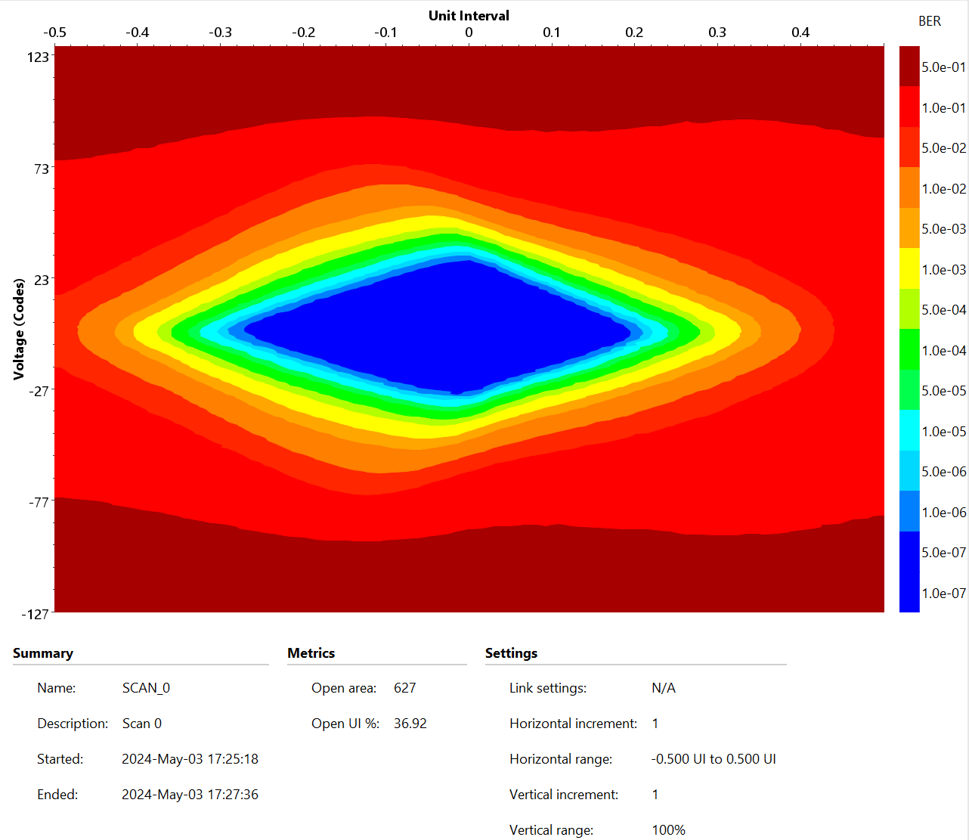
Slot 3 → Slot1
CRS-R3.0022
Slot1

Slide 16
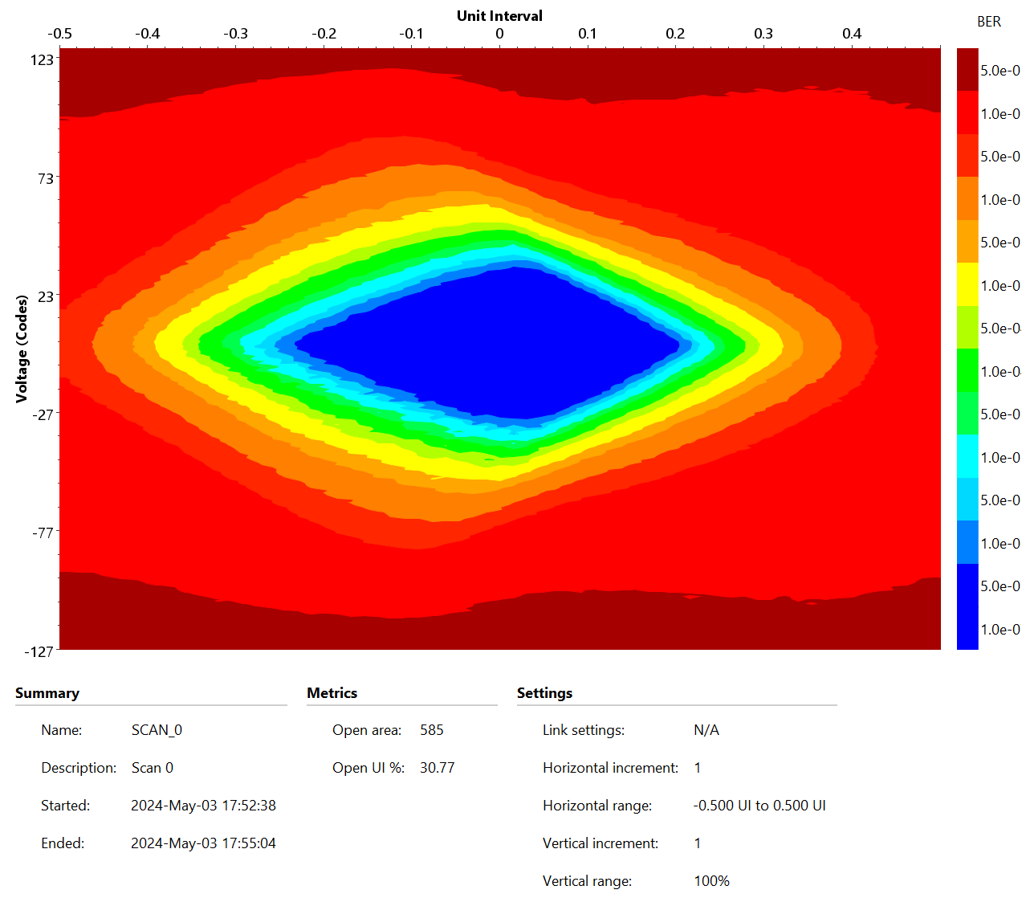
Slot 2 → Slot3
CRS-R3.0020
Slot3

Slide 17
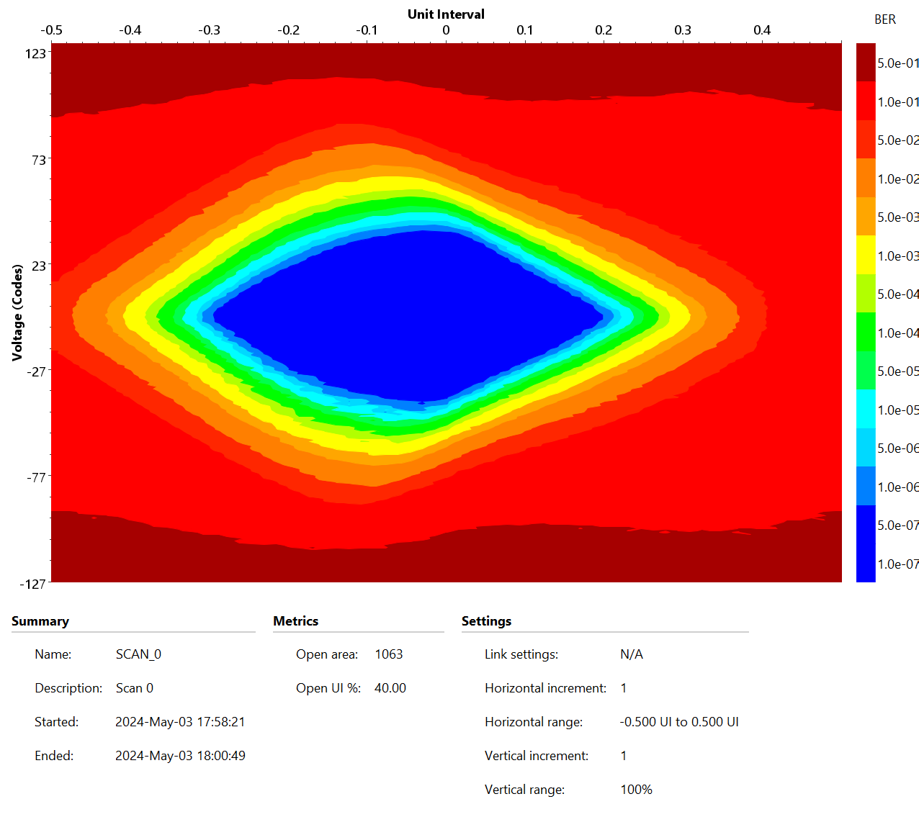
Slot 3 → Slot2
CRS-R3.0022
Slot2

Slide 18
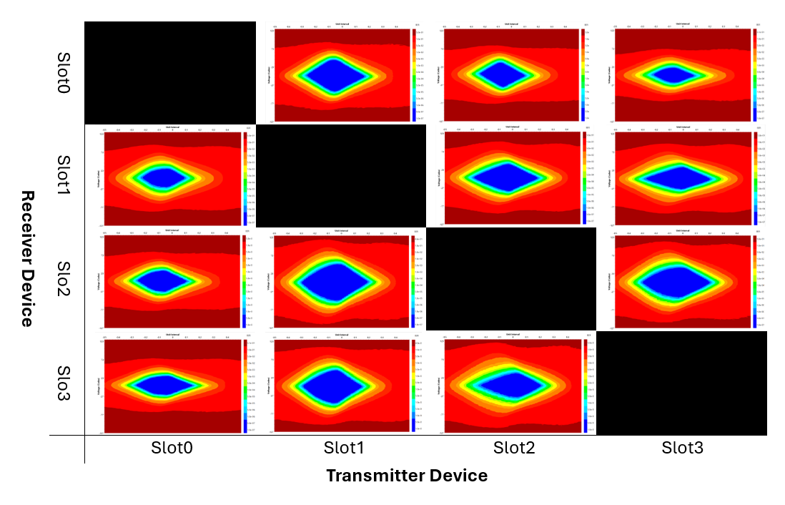
On-board Connections – Eye Diagram Matrix

Slide 19
QSFP loopback

Slide 20
SLOT0-QSFP+

Slide 21
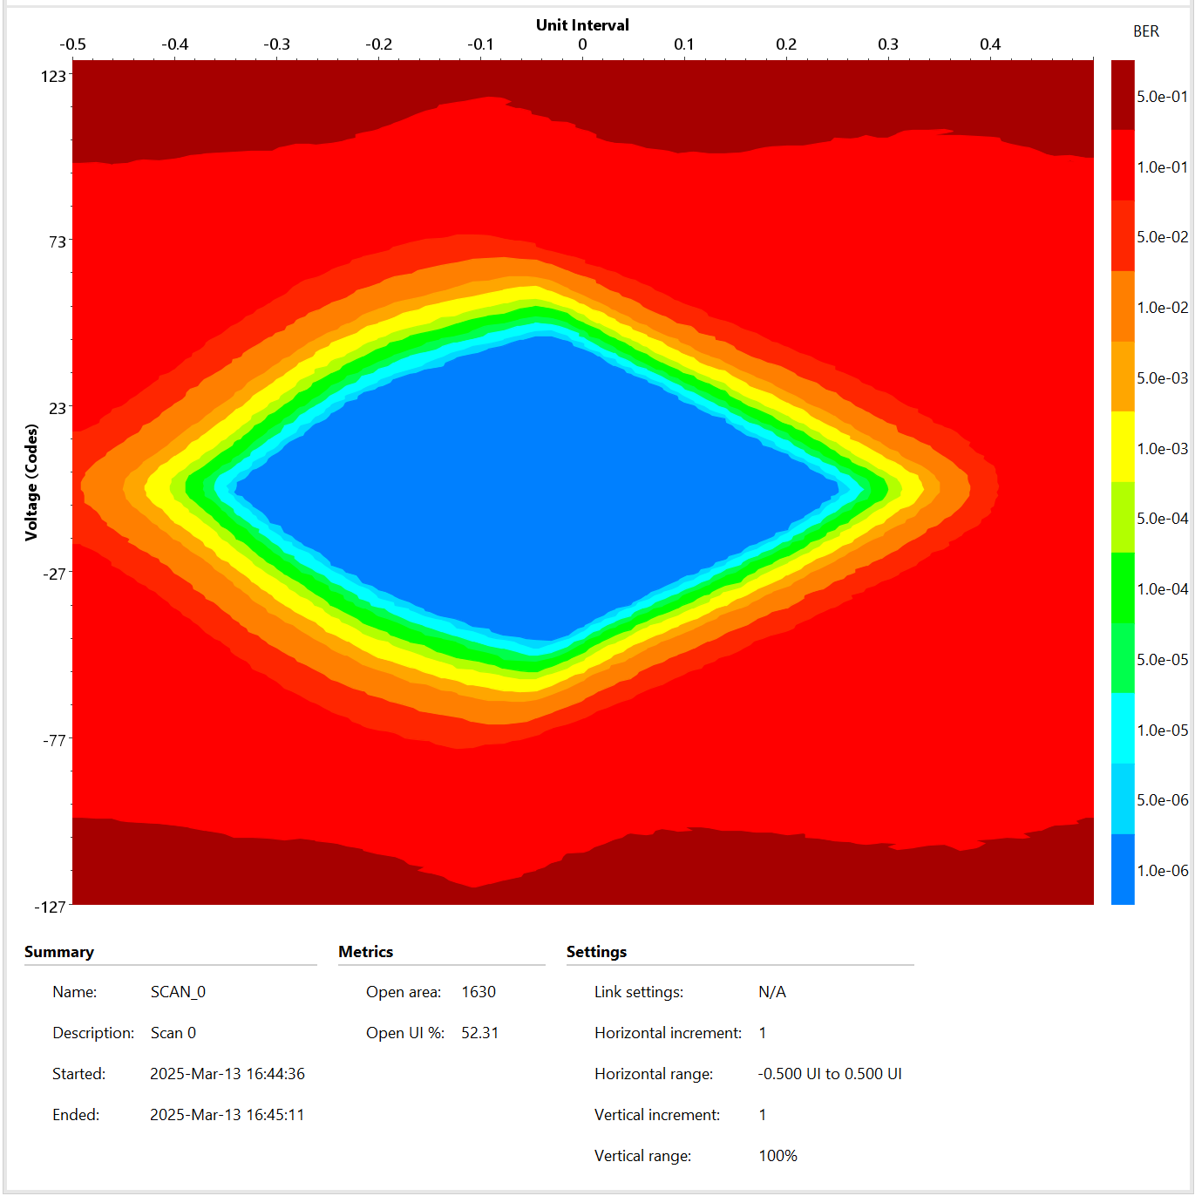
Slot 0 → QSFP1 to QSFP2
CRS-R4.0034
Slot0

Slide 22
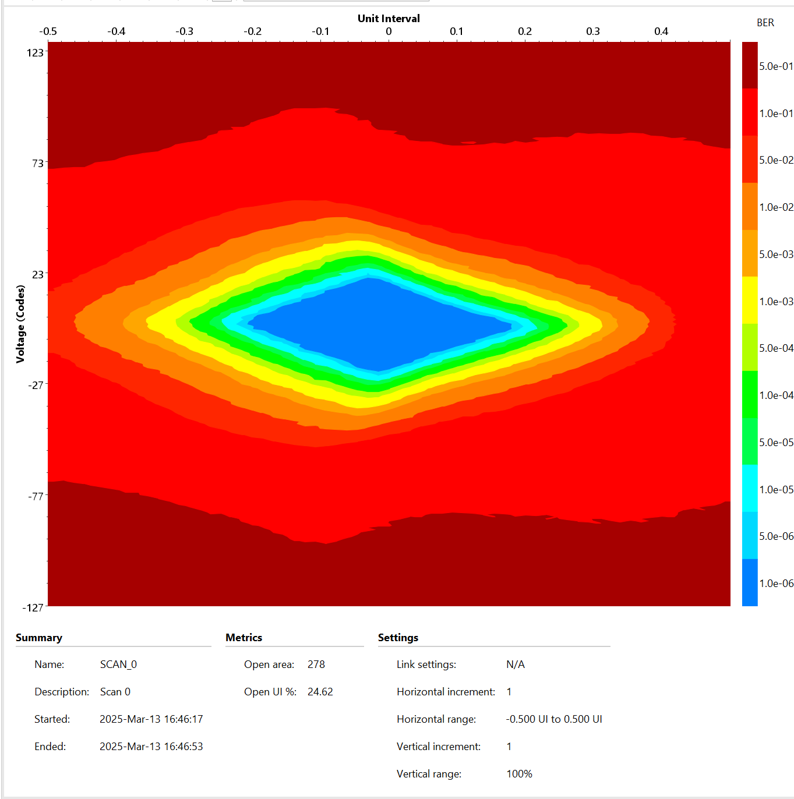
Slot 0 → QSFP2 to QSFP1
CRS-R4.0034
Slot0

Slide 23
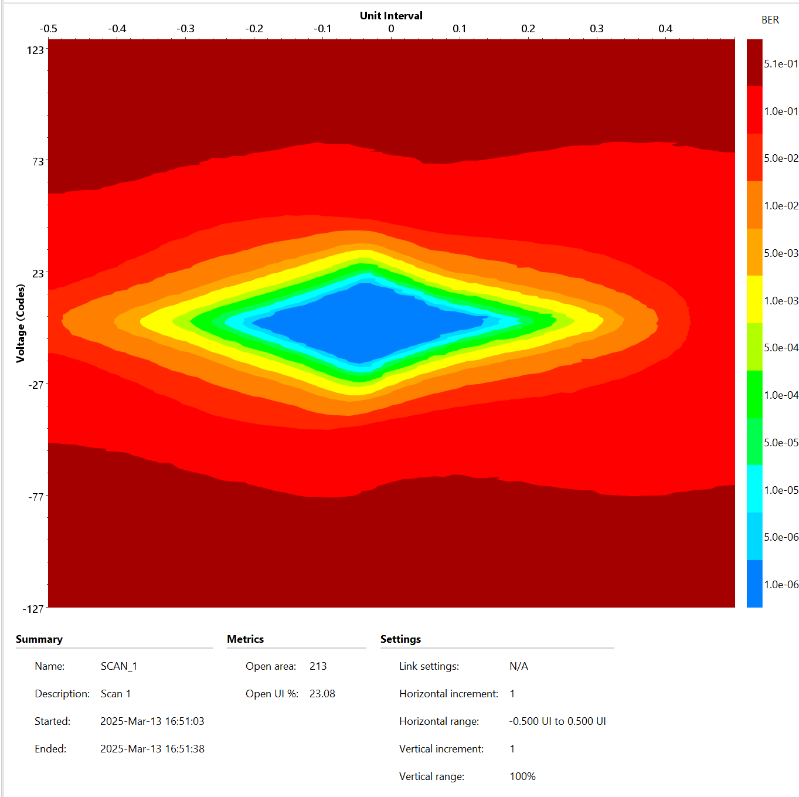
Slot 0 → QSFP2 to QSFP3
CRS-R4.0034
Slot0

Slide 24
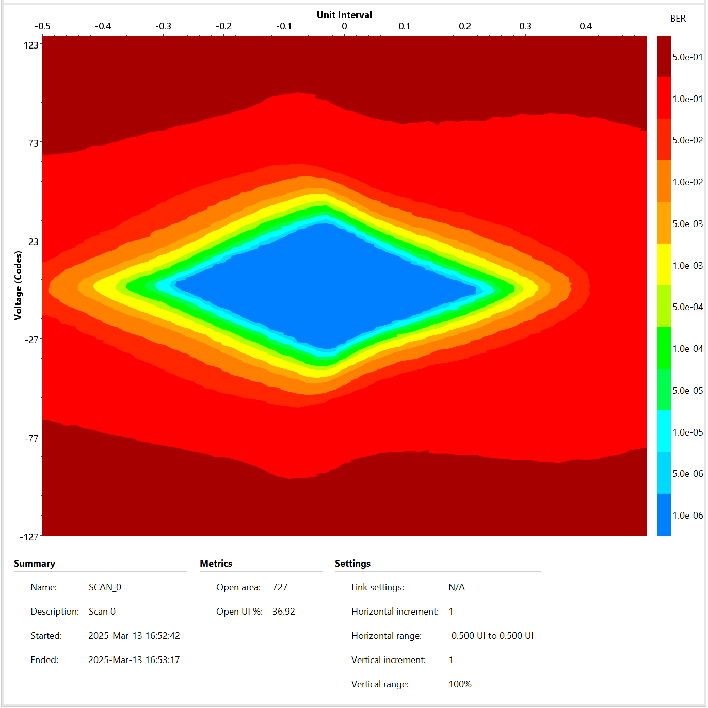
Slot 0 → QSFP3 to QSFP2
CRS-R4.0034
Slot0

Slide 25
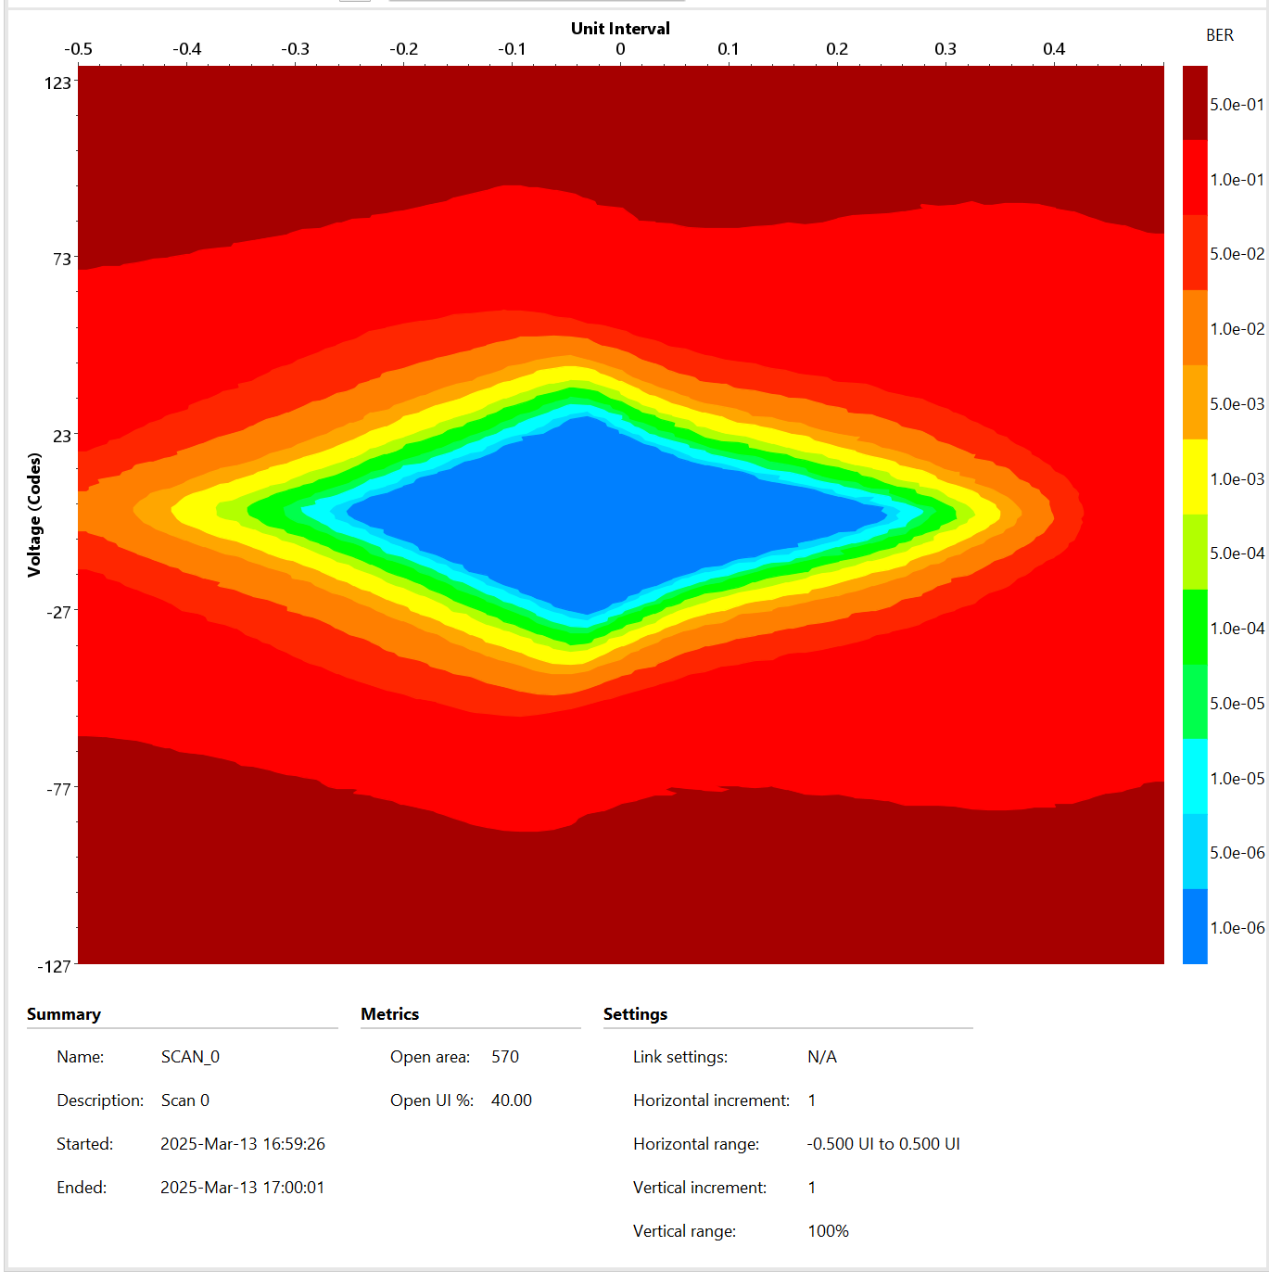
Slot 0 → QSFP1 to QSFP3
CRS-R4.0034
Slot0

Slide 26
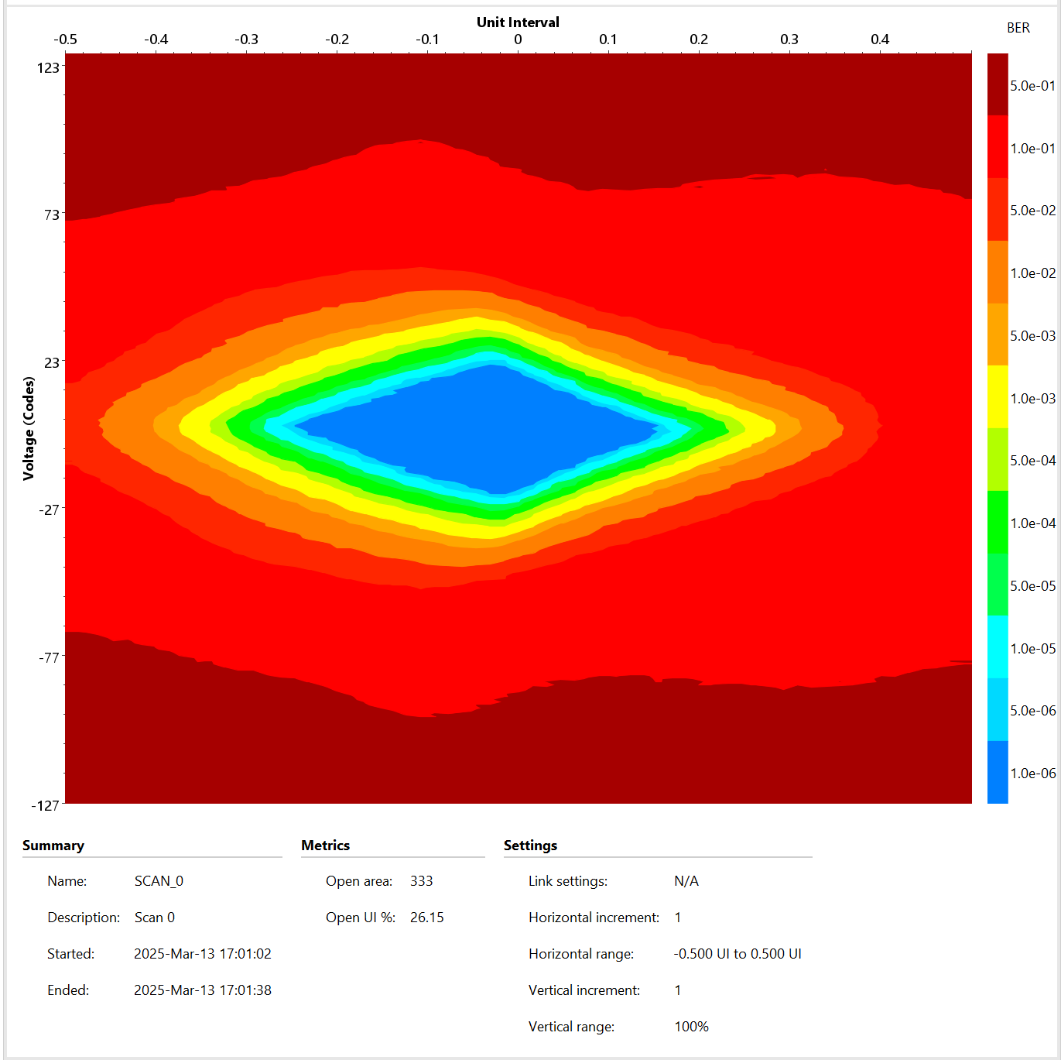
Slot 0 → QSFP3 to QSFP1
CRS-R4.0034
Slot0

Slide 27
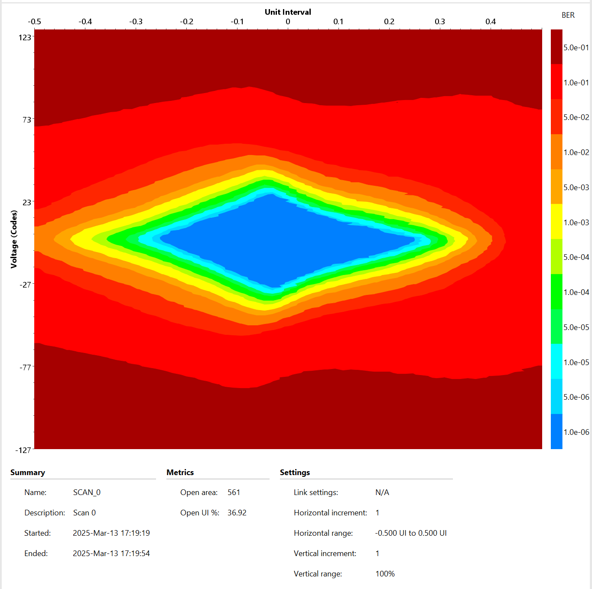
Slot 0 → QSFP1 to QSFP3
CRS-R4.0034
Slot0

Slide 28
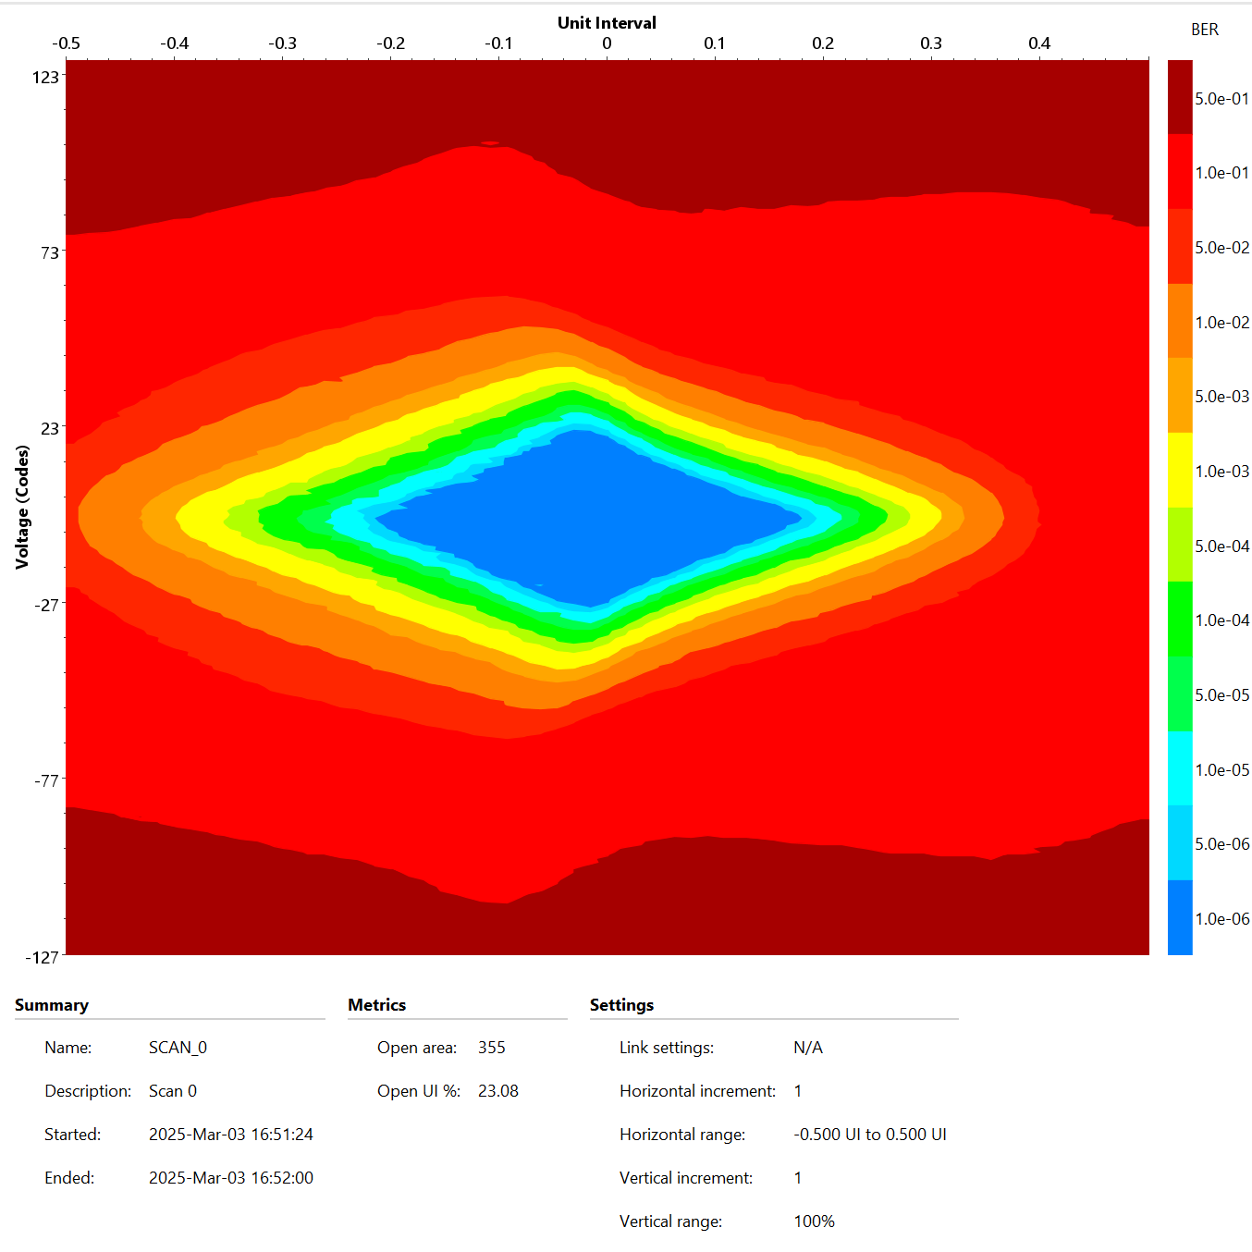
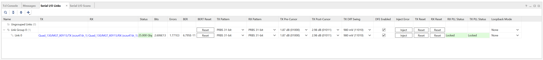
Slot 0 → QSFP1 to QSFP3
CRS-R4.0039
Slot0

Slide 29
SLOT1-QSFP+

Slide 30
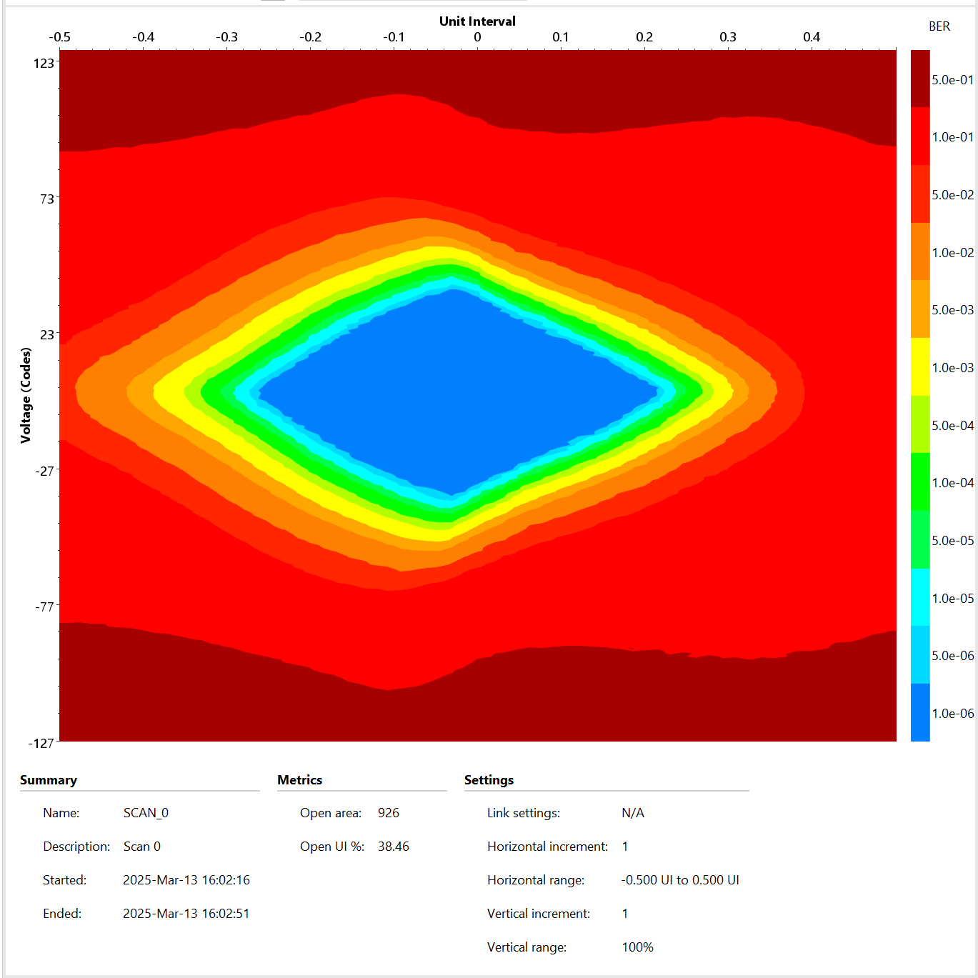
Slot 1 → QSFP1 to QSFP2
CRS-R4.0034
Slot1

Slide 31
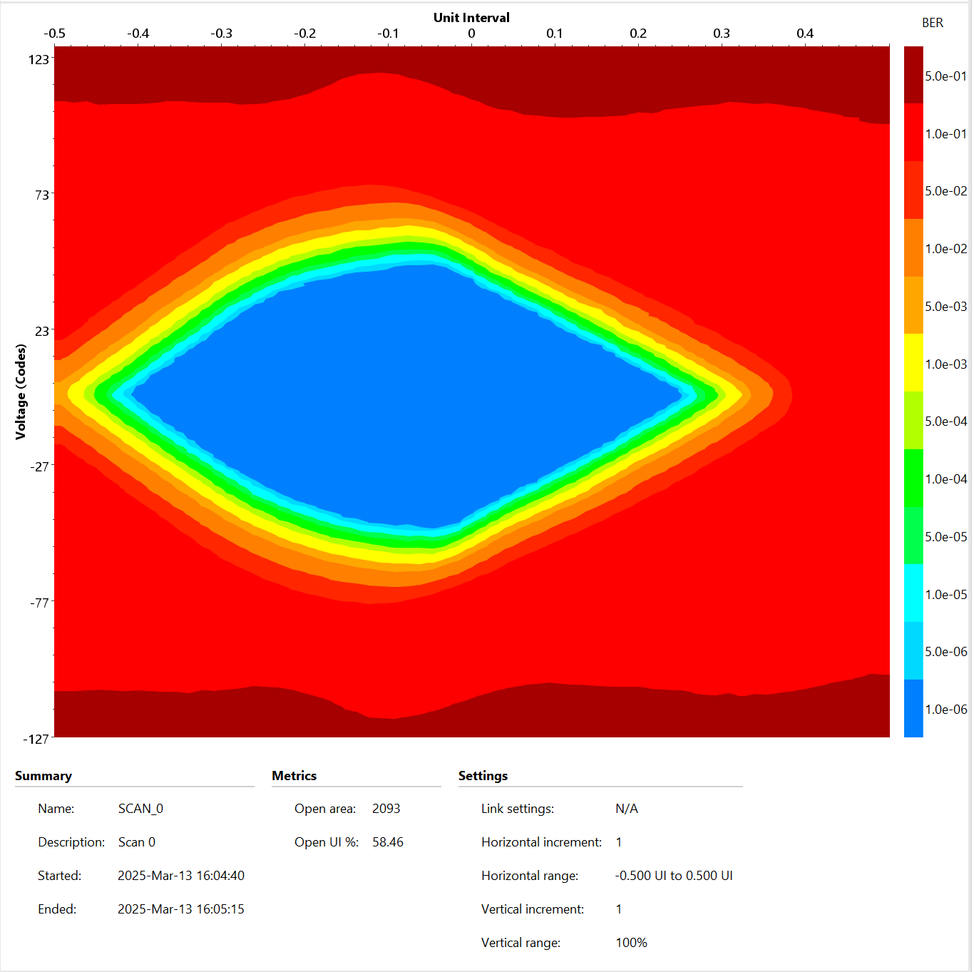
Slot 1 → QSFP2 to QSFP1
CRS-R4.0034
Slot1

Slide 32
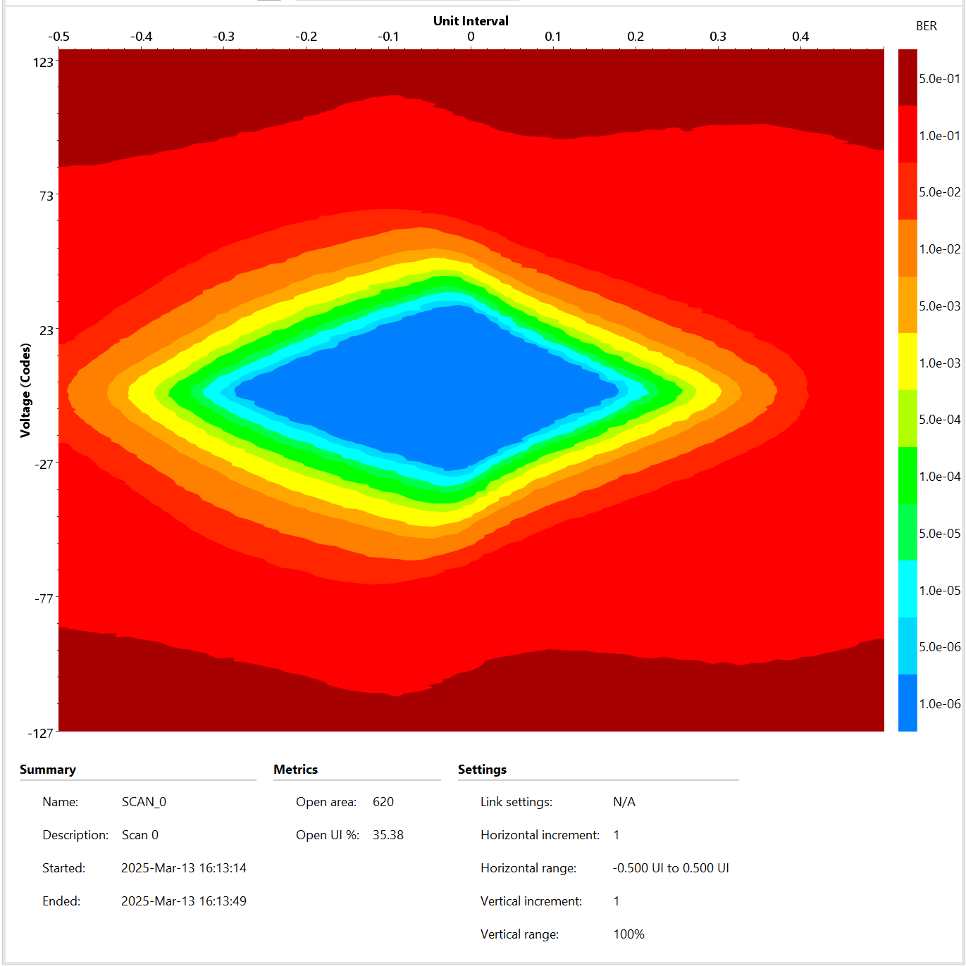
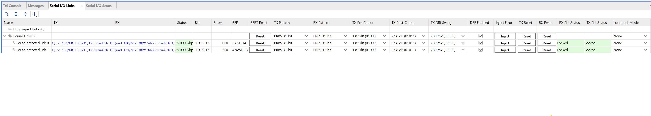
Slot 1 → QSFP1 to QSFP3
CRS-R4.0034
Slot1

Slide 33
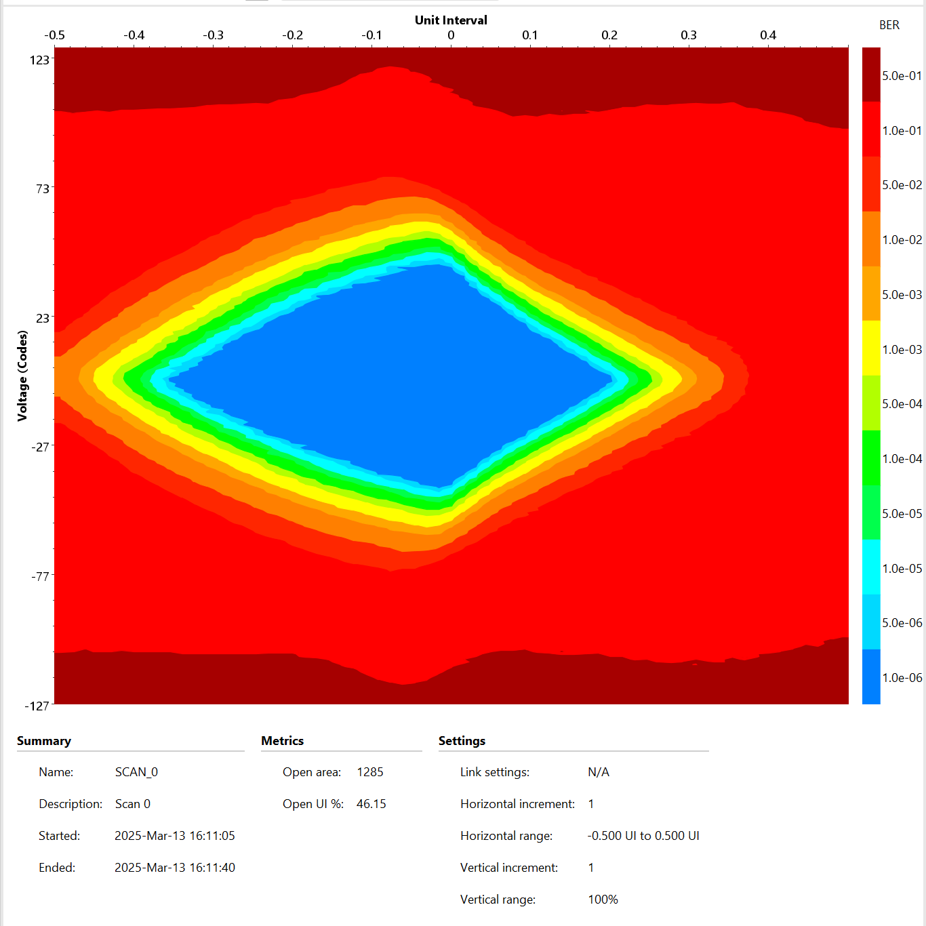
Slot 1 → QSFP3 to QSFP1
CRS-R4.0034
Slot1

Slide 34
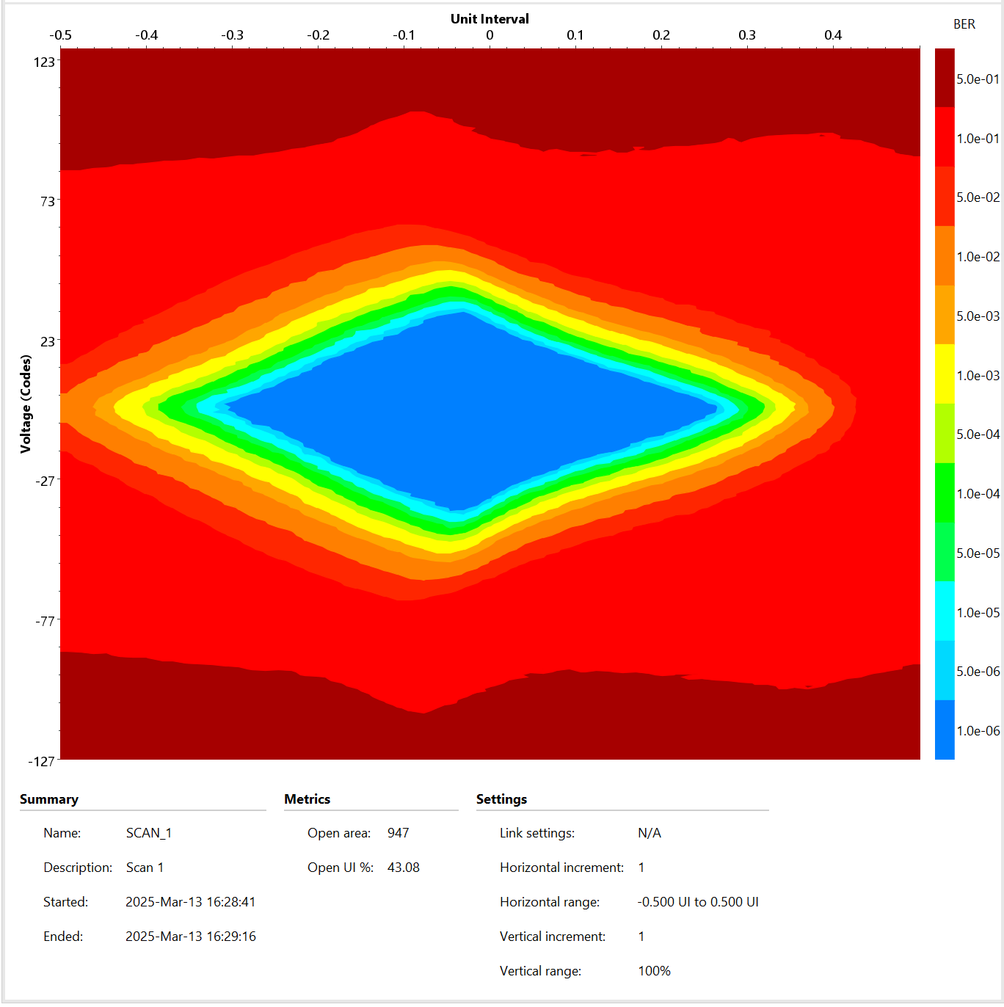
Slot 1 → QSFP2 to QSFP3
CRS-R4.0034
Slot1

Slide 35
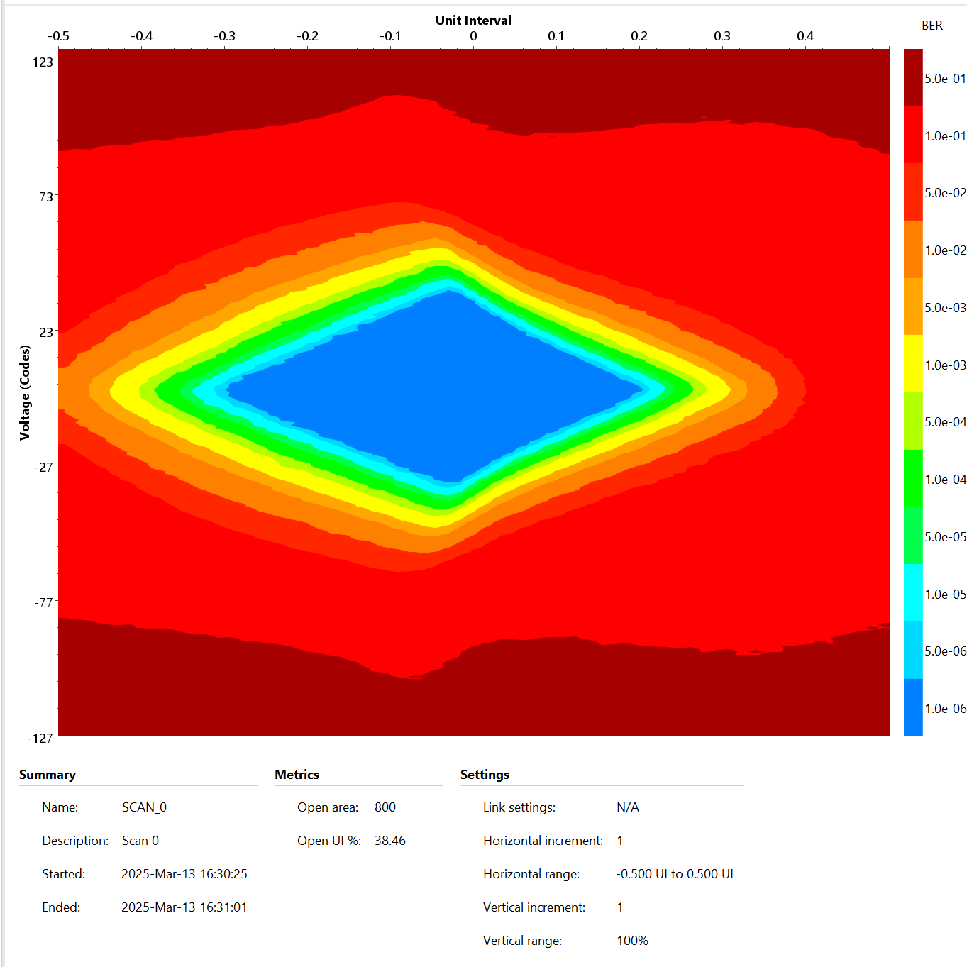
Slot 1 → QSFP3 to QSFP2
CRS-R4.0034
Slot1

Slide 36
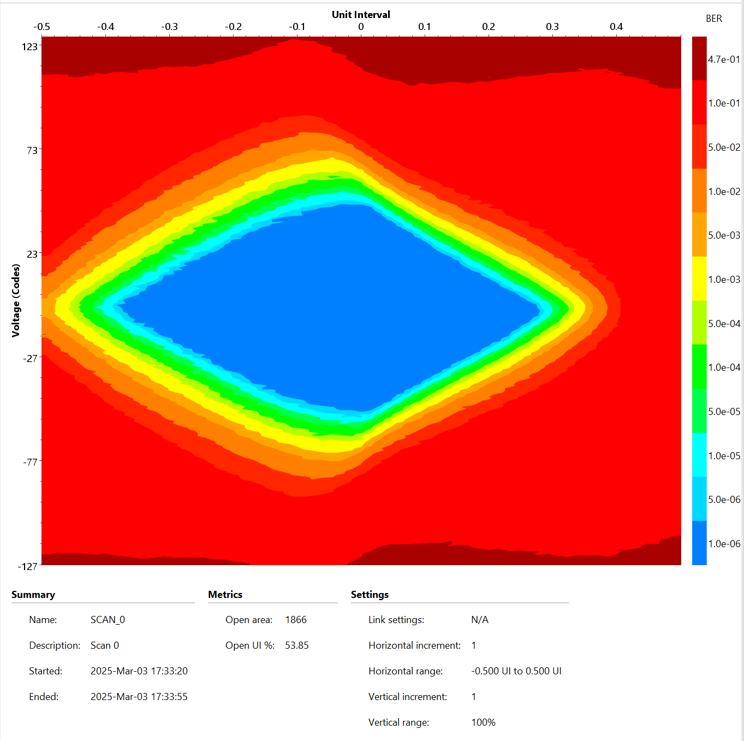
Slot 1 → QSFP1 to QSFP2
CRS-R4.0039
Slot1

Slide 37
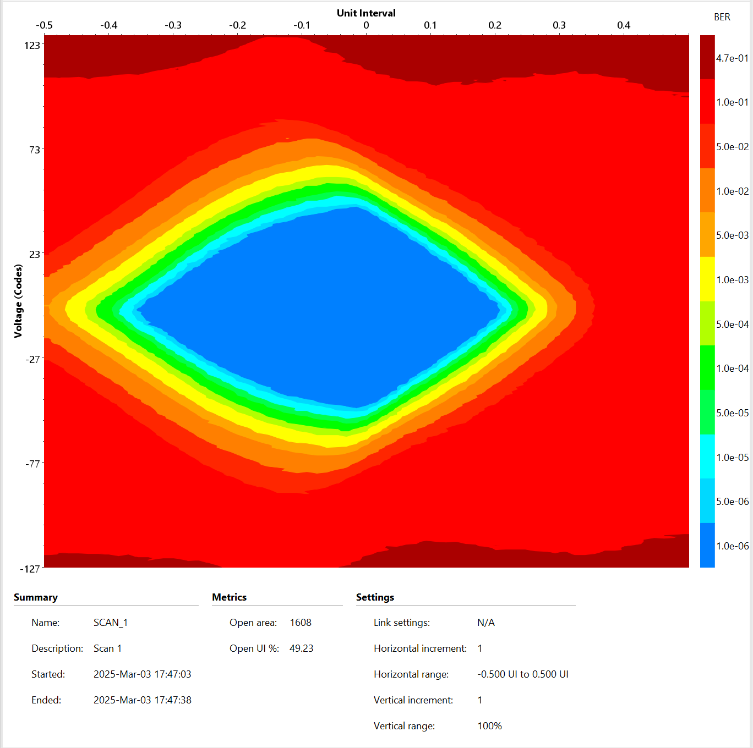
Slot 1 → QSFP1 to QSFP3
CRS-R4.0039
Slot1

Slide 38

Slot 1 → QSFP2 to QSFP3
CRS-R4.0039
Slot1

Slide 39
SLOT2-QSFP+

Slide 40
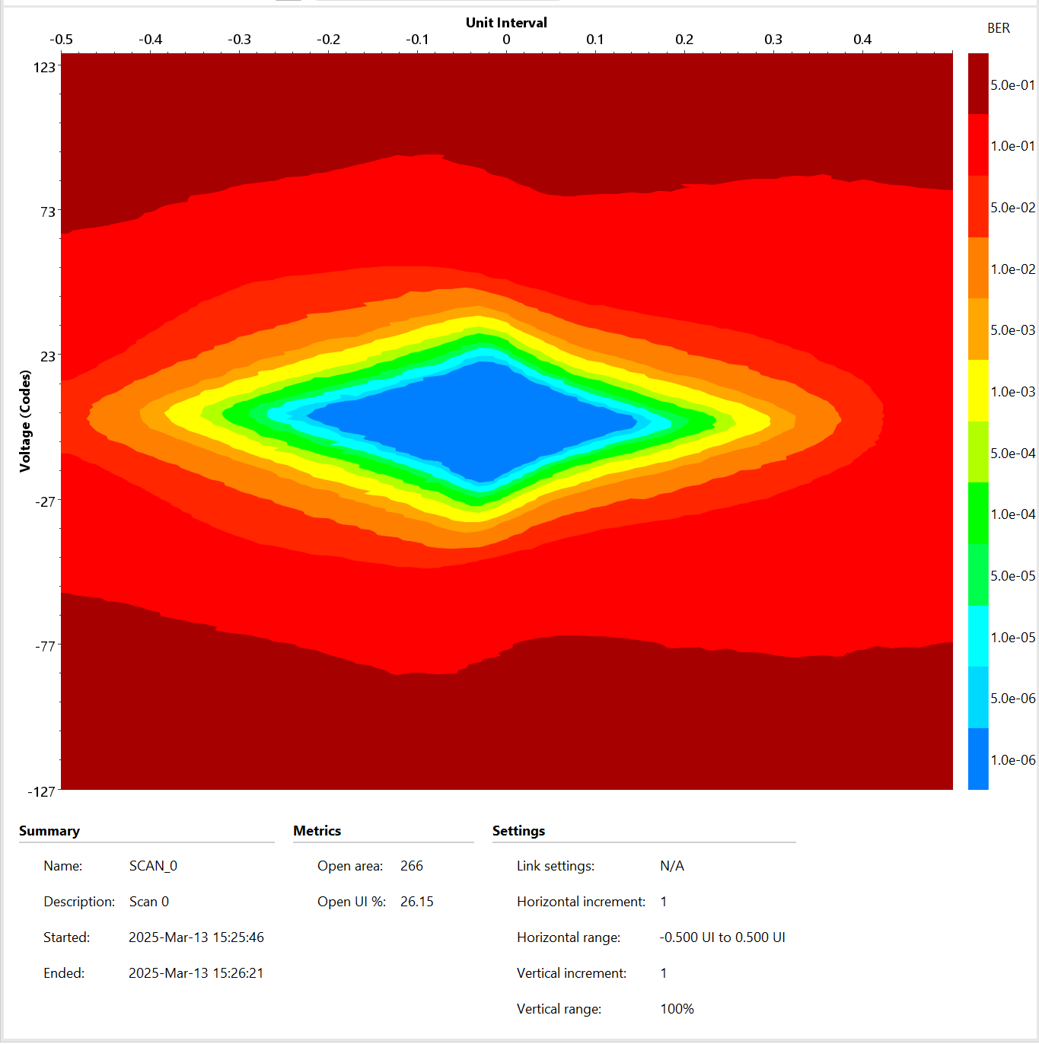
Slot 2 → QSFP1 to QSFP2
CRS-R4.0034
Slot2

Slide 41
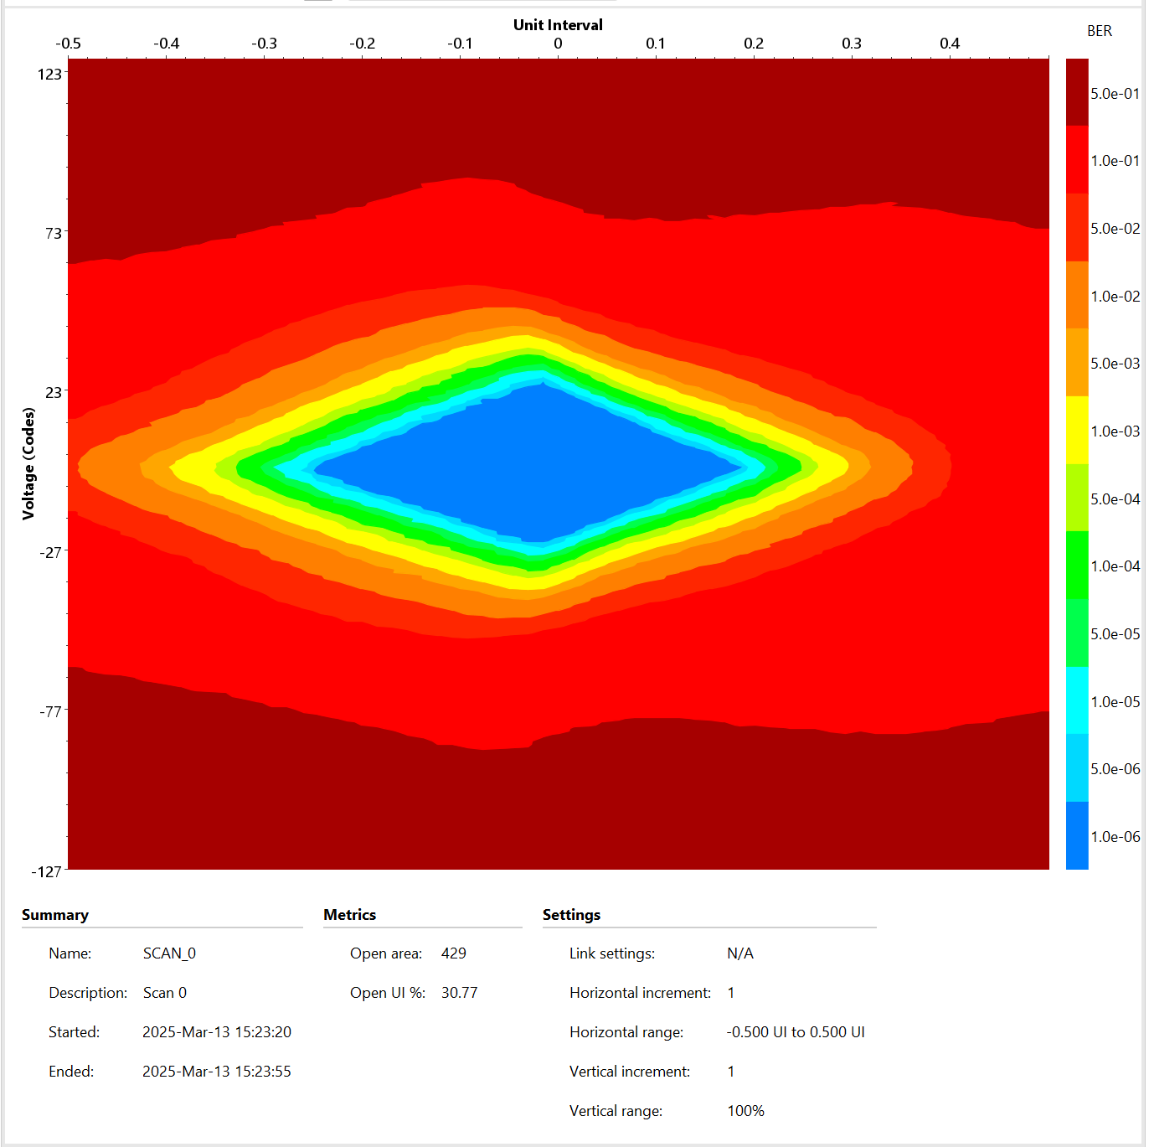
Slot 2 → QSFP2 to QSFP1
CRS-R4.0034
Slot2

Slide 42
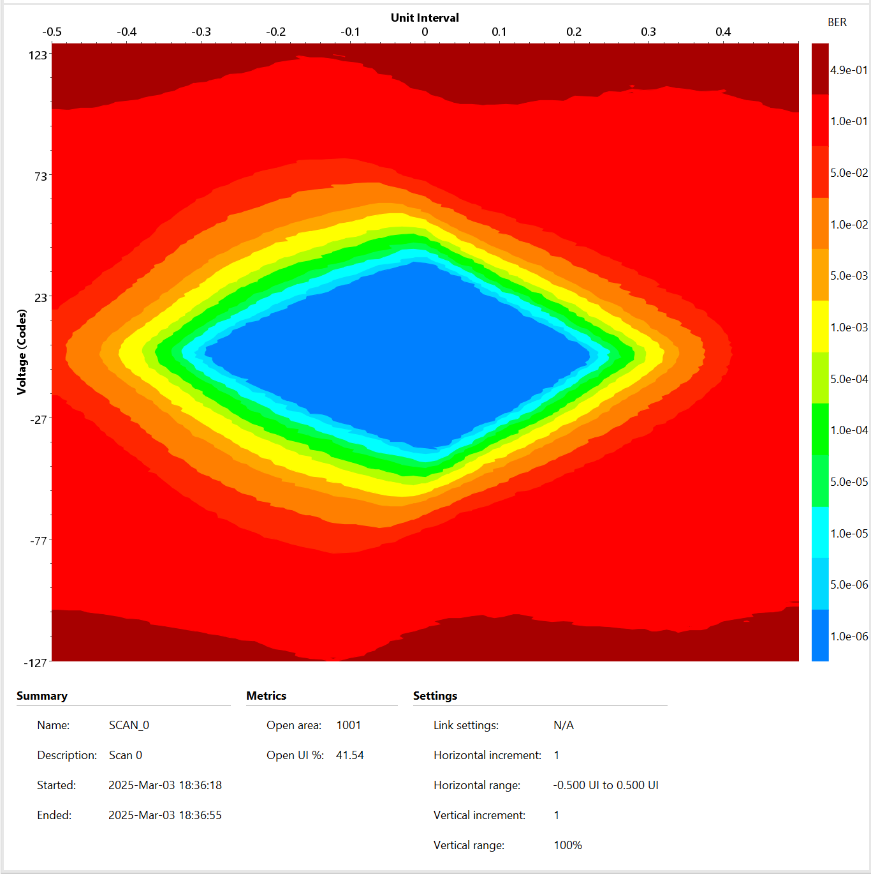
Slot 2 → QSFP1 to QSFP3
CRS-R4.0050
Slot2

Slide 43
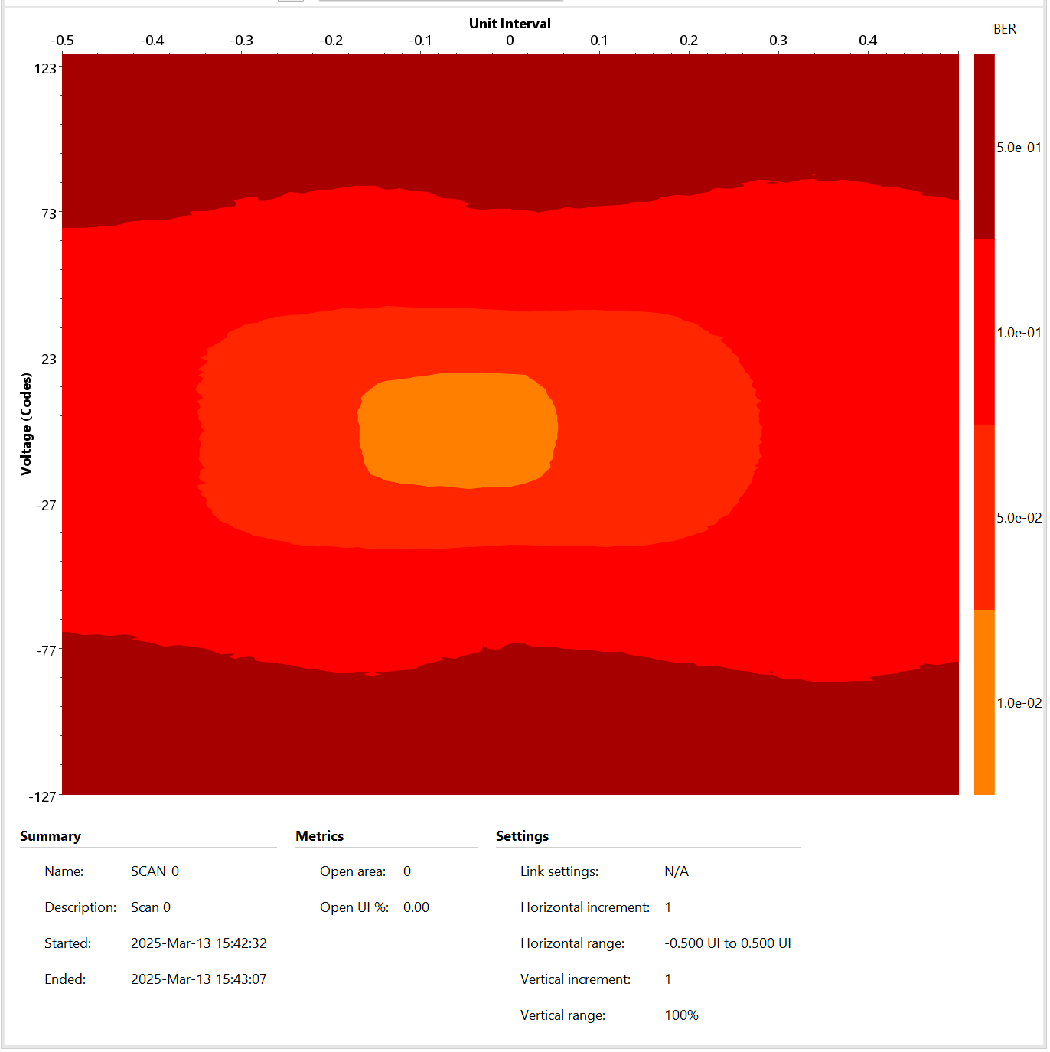
Slot 2 → QSFP1 to QSFP3
CRS-R4.0034
Slot2

Slide 44
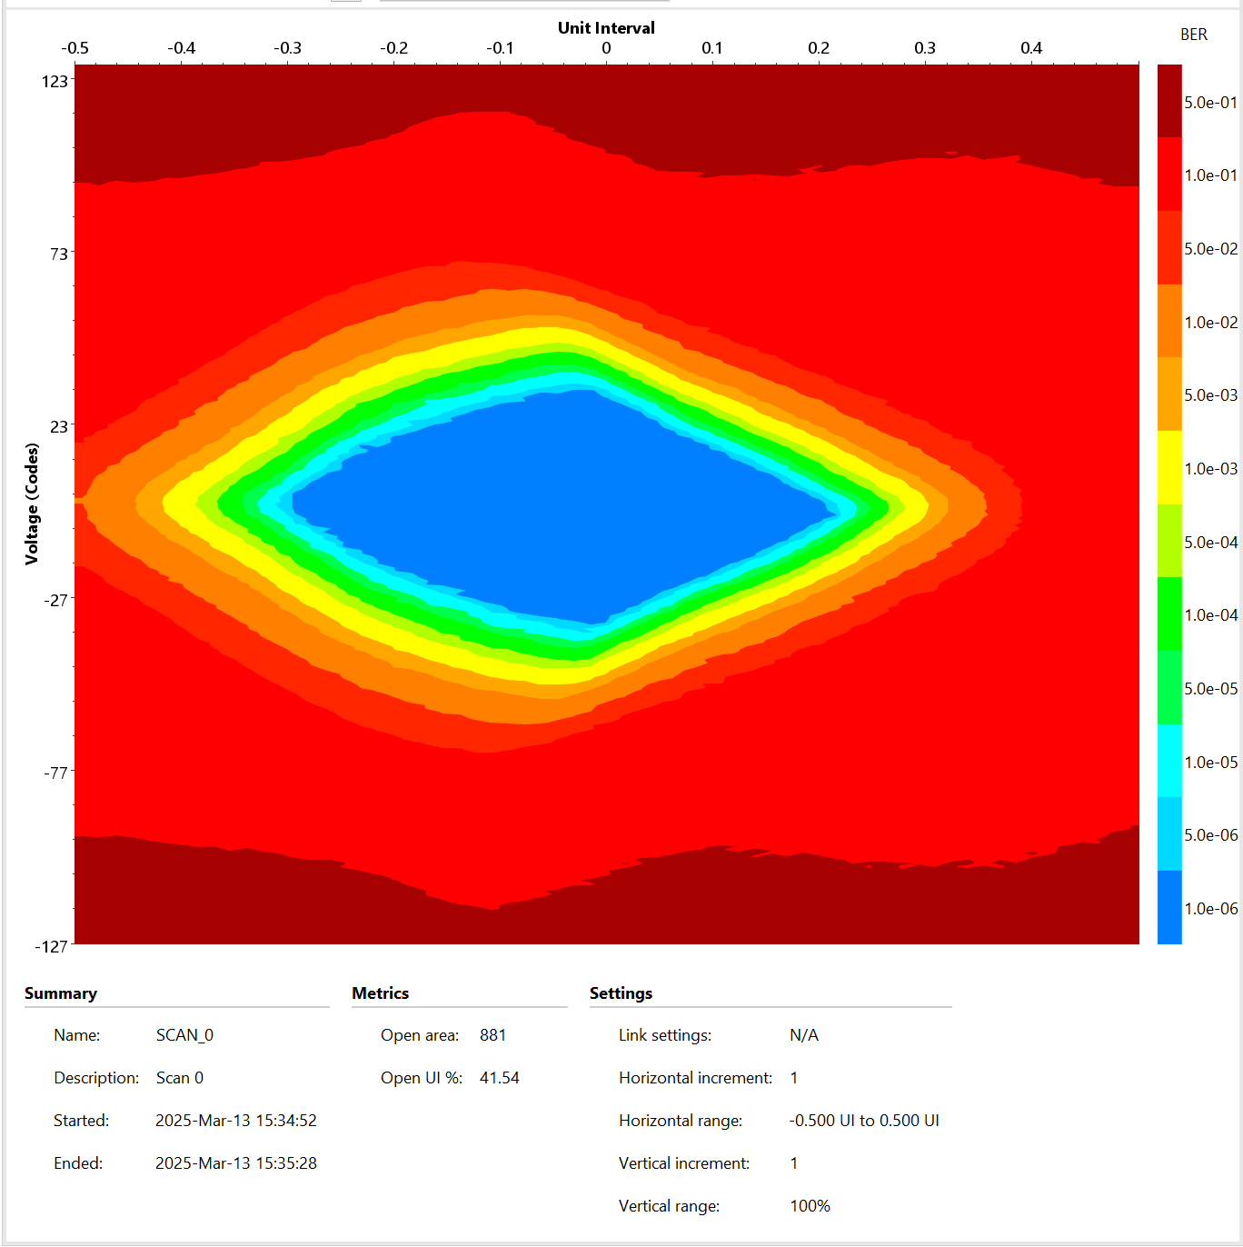
Slot 2 → QSFP3 to QSFP1
CRS-R4.0034
Slot2

Slide 45
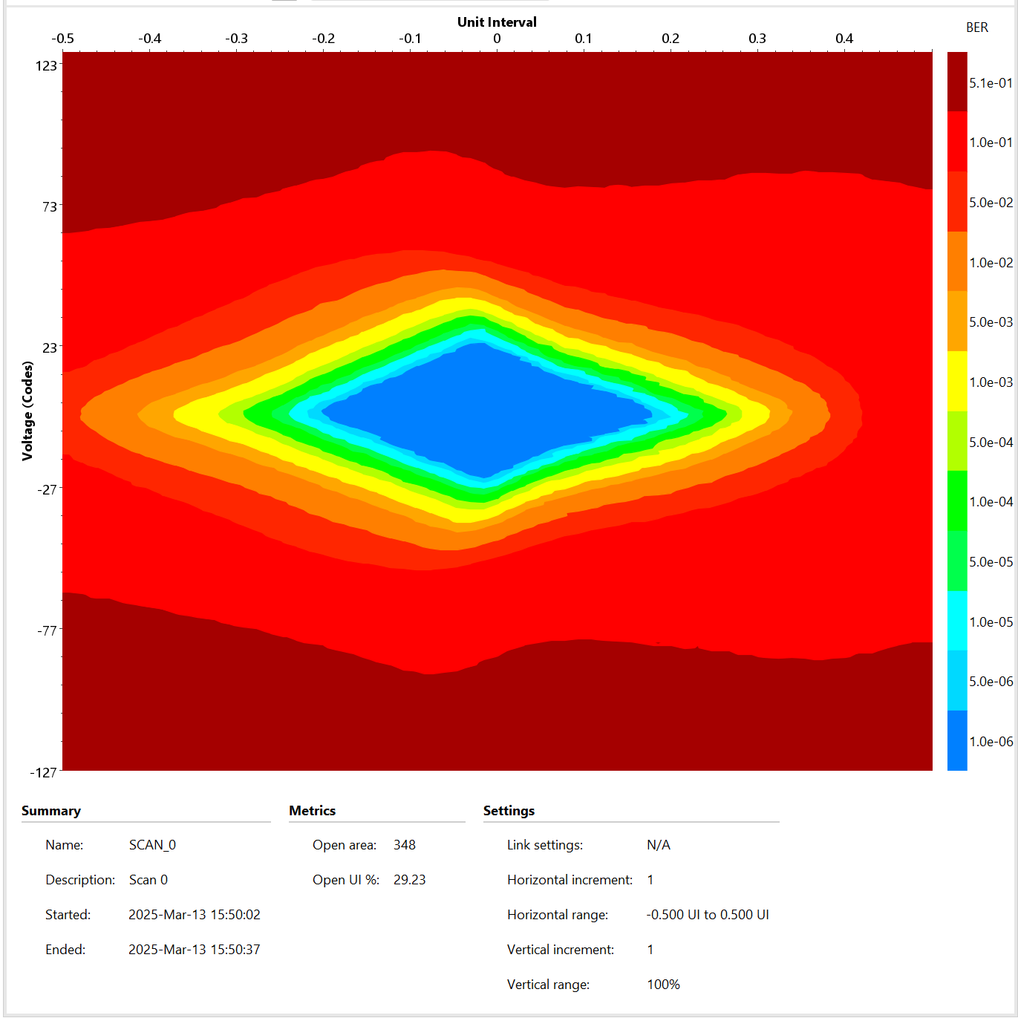
Slot 2 → QSFP2 to QSFP3
CRS-R4.0034
Slot2

Slide 46
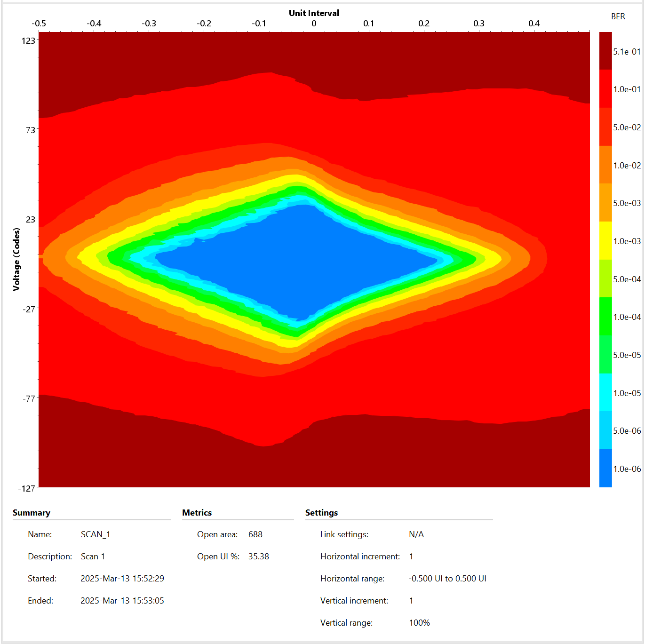
Slot 2 → QSFP3 to QSFP2
CRS-R4.0034
Slot2

Slide 47
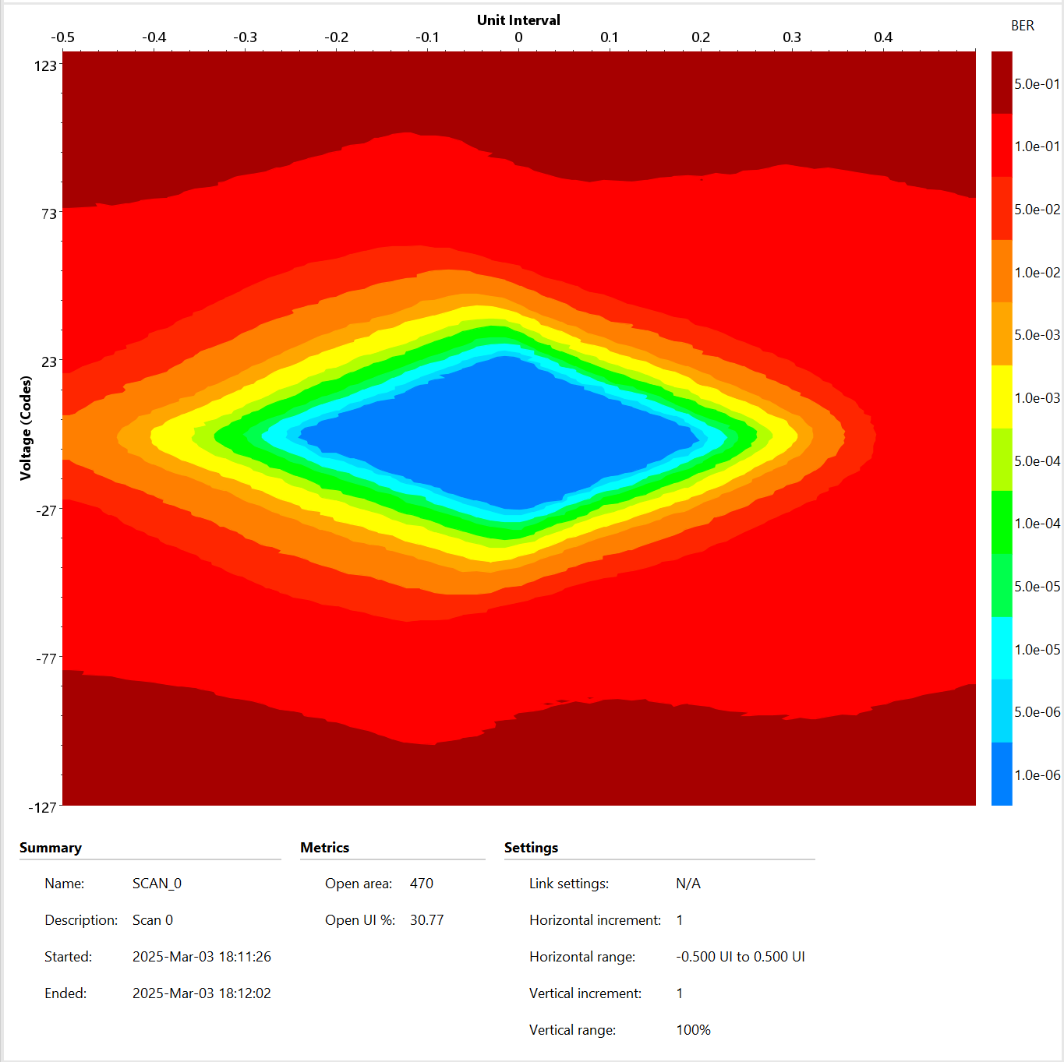
Slot 2 → QSFP1 to QSFP2
CRS-R4.0039
Slot2

Slide 48
SLOT3-QSFP+

Slide 49
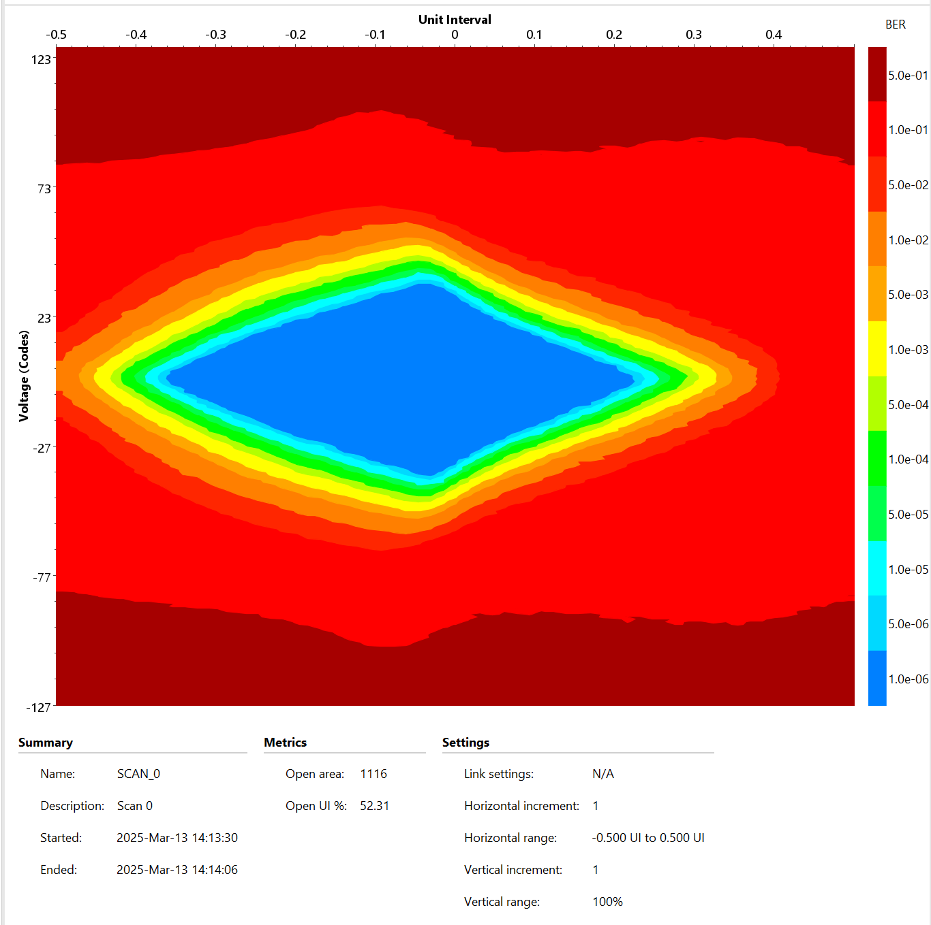
Slot 3 → QSFP1 to QSFP3
CRS-R4.0034
Slot3

Slide 50

Slot 3 → QSFP2 to QSFP3
CRS-R4.0034
Slot3

Slide 51

Slot 3 → QSFP3 to QSFP2
CRS-R4.0034
Slot3

Slide 52

Slot 3 → QSFP3 to QSFP1
CRS-R4.0034
Slot3

Slide 53

Slot 3 → QSFP1 to QSFP3
CRS-R4.0034
Slot3

Slide 54

Slot 3 → QSFP1 to QSFP2
CRS-R4.0034
Slot3

Slide 55

Slot 3 → QSFP2 to QSFP1
CRS-R4.0034
Slot3

Slide 56
QSFP+ links

Slide 57

QSFP1-controller to QSFP3-peripheral1 (slot2)
CRS-R4.0039
CRS-R4.0050
Slot2

Slide 58

Controller_rev1.0016.0 → peripheral_rev1.0027.0
CRS-R4.0039
CRS-R4.0050
Slot0 – slot 0

Slide 59

Controller_rev1.0016.1 → peripheral_rev1.0027.1
CRS-R4.0039
CRS-R4.0050
Slot1 – slot 1

Slide 60

Controller_rev1.0016.1 ← peripheral_rev1.0027.1
CRS-R4.0039
CRS-R4.0050
Slot1 – slot 1

Slide 61

Controller_rev1.0016.2 ← peripheral_rev1.0027.2
CRS-R4.0039
CRS-R4.0050
Slot2 – slot 2

Slide 62

Controller_rev1.0016.2 → peripheral_rev1.0027.2
CRS-R4.0039
CRS-R4.0050
Slot2 – slot 2

Slide 63

Controller_rev1.0016.3 → peripheral_rev1.0027.3
CRS-R4.0039
CRS-R4.0050
Slot3 – slot 3

Slide 64

Controller_rev1.0016.3 ← peripheral_rev1.0027.3
CRS-R4.0039
CRS-R4.0050
Slot3 – slot 3

Slide 65
On-board Links – rev1

Slide 66

Slot 0 → Slot3
CRS-R3.0039
receiver
Slot0 – Slot3

Slide 67

Slot 3 → Slot0
CRS-R3.0050
receiver
Slot3 – Slot0

Slide 68

Slot 1 → Slot2
CRS-R3.0039
receiver
Slot1 – Slot2

Slide 69

Slot 2 → Slot1
CRS-R3.0050
receiver
Slot2 – Slot1

Slide 70

Slot 0 → Slot1
CRS-R3.0050
receiver
Slot0 – Slot1

Slide 71

Slot 1 → Slot0
CRS-R3.0039
receiver
Slot1 – Slot0

Slide 72

Slot 1 → Slot3
CRS-R3.0050
receiver
Slot1 – Slot3

Slide 73

Slot 3 → Slot1
CRS-R3.0039
receiver
Slot3 – Slot1

Slide 74

Slot 3 → Slot2
CRS-R3.0039
receiver
Slot3 – Slot2

Slide 75

Slot 2 → Slot3
CRS-R3.0050
receiver
Slot2 – Slot3

Slide 76

Slot 0 → Slot2
CRS-R3.0050
receiver
Slot0 – Slot2

Slide 77

Slot 2 → Slot0
CRS-R3.0039
receiver
Slot2 – Slot0

Slide 78
QSFP+ Links
The links work only for speed less than 12.5 Gbps
Board design: I do not believe this is the cause because on-board lanes work well for 25 Gbps. In addition, back drill were placed to reduce stub effects.
Cables: I do not believe this is the cause as well. The absolute data rate for the cable used is 100Gbps.
GTY Transceivers: Ask to JF
QSFP Connector: Ask for specification. *** According to specification for QSFP+, they can operate only up to 14Gbps.
Mode of operation: All tests were done using only passive traces on the cable. Is there any mode where I can improve the internal transceivers internal to QSFP connector?

Slide 79
On-board Links – rev1
Redoing tests with 0034

Slide 80

Slot 0 → Slot1
Slot0(0034) – Slot1(0035)

Slide 81
Slot 1 → Slot0
Slot1(0035) – Slot0(0034)

Slide 82

Slot 1 → Slot2
Slot1(0035) – Slot2(0034)

Slide 83
Slot 2 → Slot1
Slot1(0035) – Slot2(0034)

