Slide 1


Off-Line electronic payment
Maximal Risk Management
Food
Merchandise
Ticketing
Notes:
Hi,
I gonna speak about Off-line electronic payment for F/M/T
In the resort, when there is no more connection with banks, today we cannot accept credit cards.
Impacts : fall of sales, increase queuing time and guests situations
We looking for a solution to avoid that . So our pinpad’s supplier have a fall back solution. This solution already work but it is not a solution with an agreement CB.
The most important for us to implement this solution is the negotiation with our bank.
Our bank agree with this project, but they will not take the risks on the unpaid debts.
To know the risk, I led a study on 3 days

Slide 2
Off-Line electronic payment
Maximal Risk Management
3 days audited
Friday, the 5th december – Low activity
Saturday, the 6th december – High activity
Sunday, the 21st december – High activity
Notes:
The 21st were during holidays

Slide 3
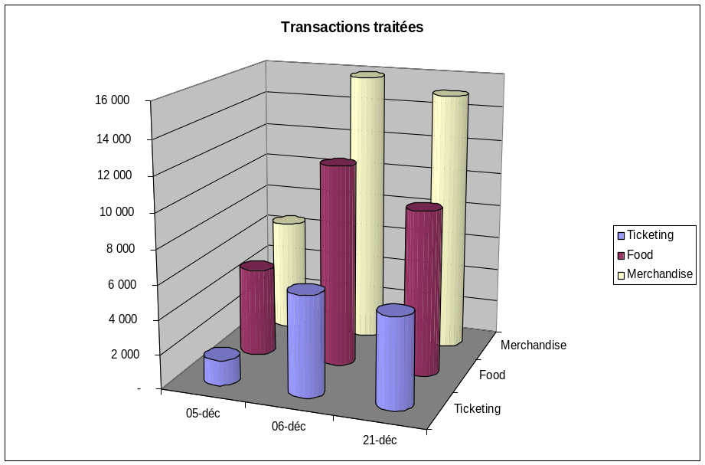
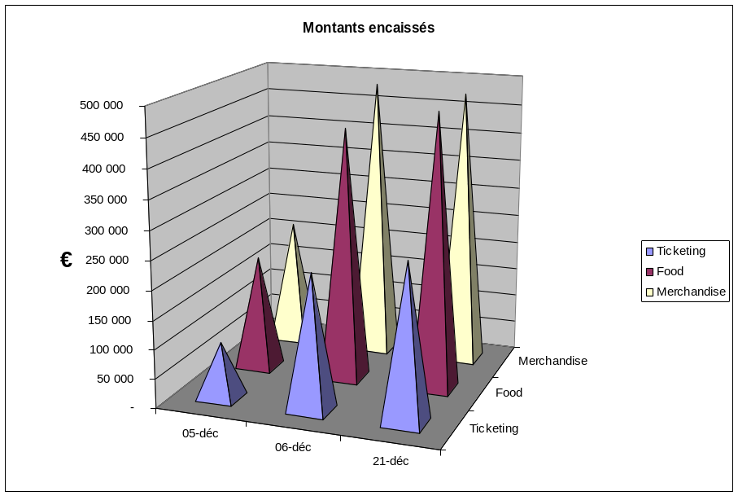
Volume & Revenues
Notes:
On this sheet, U have the transactions accepted
On the left chart, the number of transactions per day and activity.
On the right chart, the amount of the transactions per day and activity

Slide 4
Definate Risk
Transactions sent for authorization and declined
Food
Merchandise
Ticketing
Notes:
Before auditing the previous figures, we already know the maximum risk :
It is all the transactions declined by the bank authorization

Slide 5
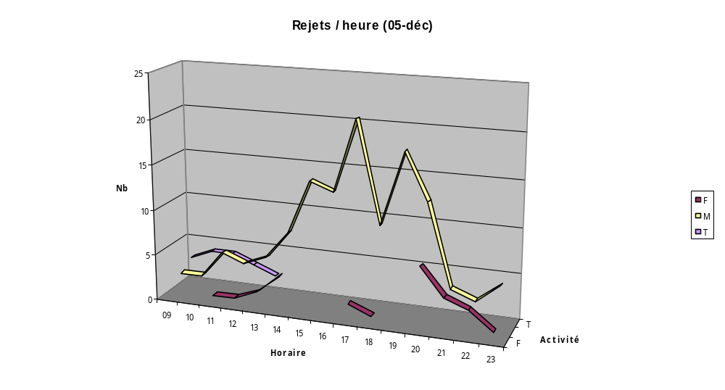
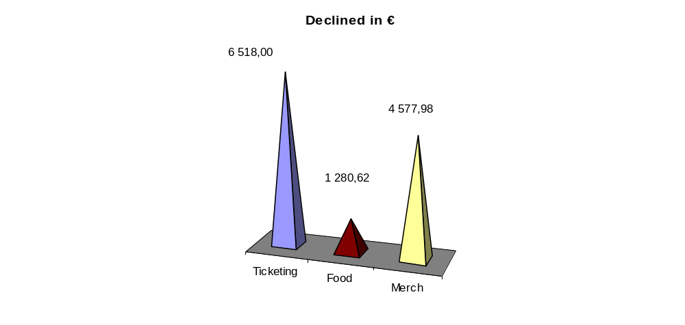
Declined Repartition
Total amount per day
Notes:
I begin by a low activity day, december the 5th
These 3 curves presents the number of declined for each activity.
We’re also see the « critical hour » during the day.
The small chart on the bottom right give the total financial impact for each activity
The curves and amount are not proportional. It’s normal because the average transaction is more important for ticketing
<>140 € Ticketing (one hundred forty)
<> 50 € food (fifty)
<> 40 € merch (forty)

Slide 6
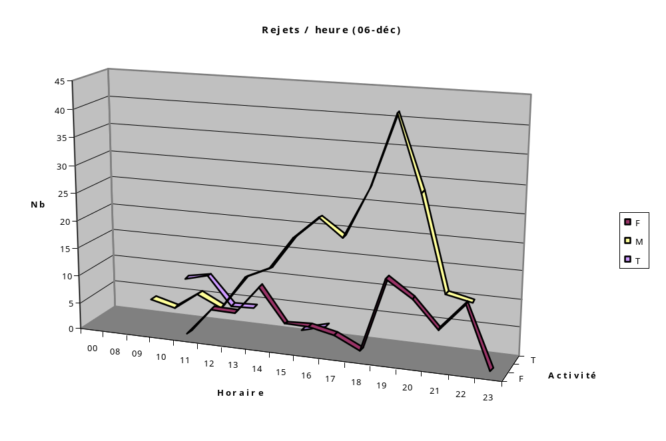
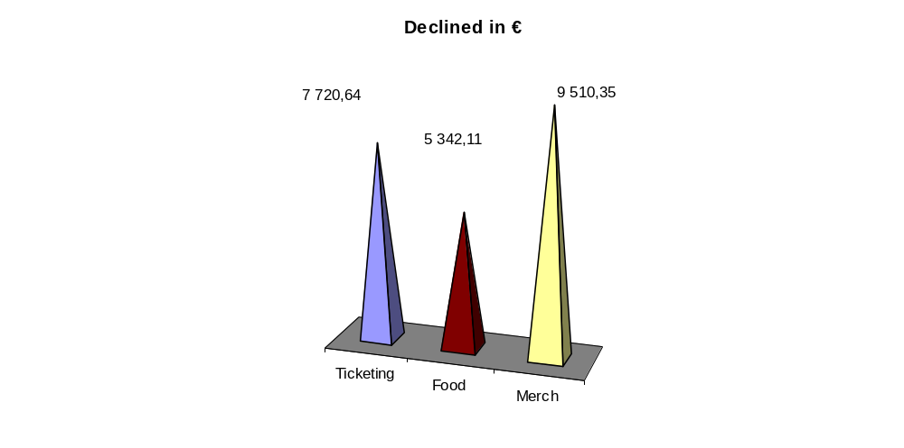
Declined Repartition
Total amount per day
Notes:
For december the 6th
All figures increases with the same scale

Slide 7
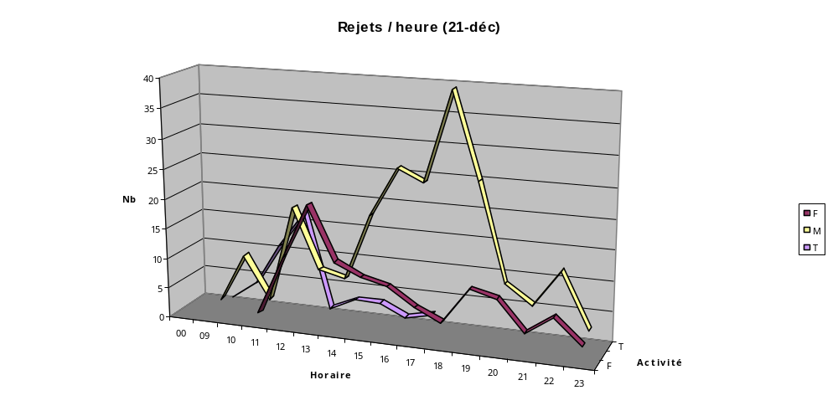
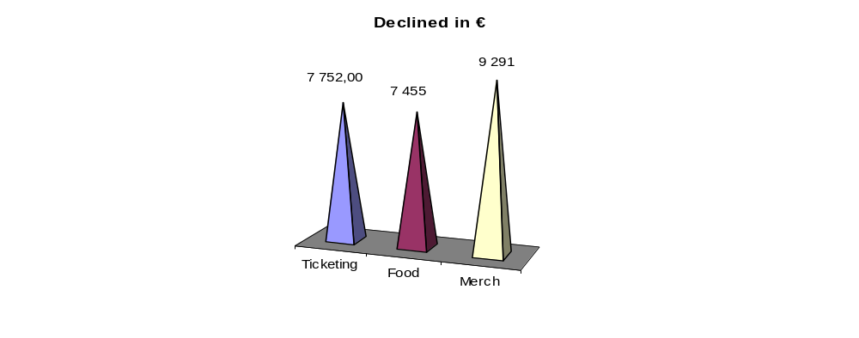
Declined Repartition
Total amount per day
Notes:
And december the 21st,
The repartition is like the december 6th.
So we can say in conclusion that the correlation exist between
ACTIVITY & RISK.
So it’s easy to estimate this definate risk : more you have activity more the risk is big

Slide 8
Possible Risk
Transactions sent for authorization and approved
➔ risk to not be paid
Food
Merchandise
Ticketing
Notes:
I speak now about a possible risk
Some cards like electron and maestro must communicate with the bank for each payment.
Offline mode doesn’t permit this.
The figures below show only transactions for wich we had an approval

Slide 9
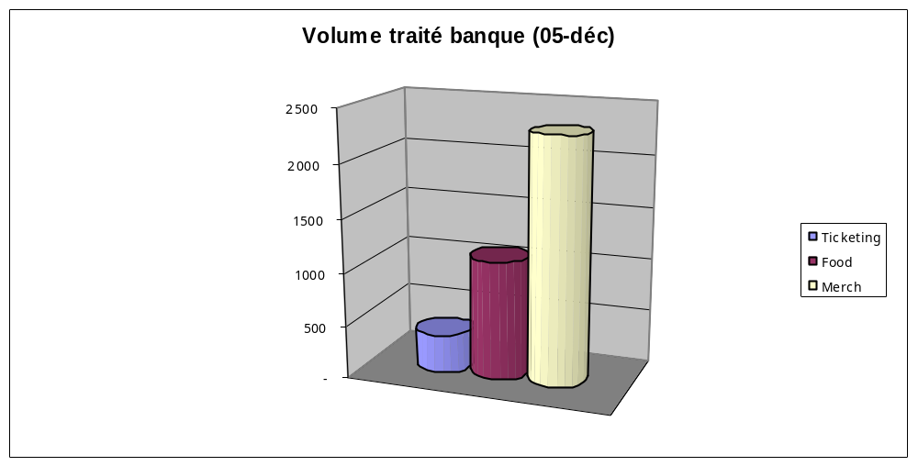
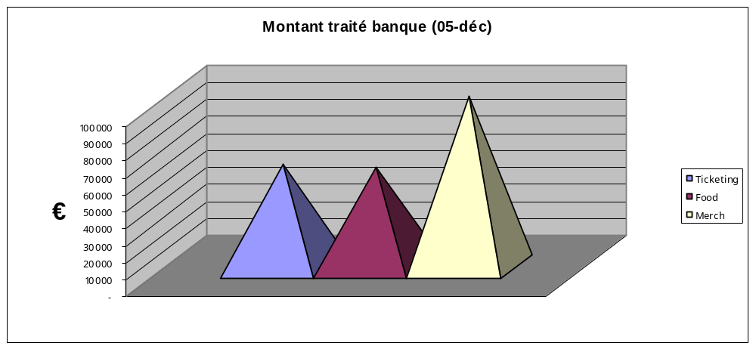
Volume & Revenues
Notes:
The 5th of december,
The first chart show the number of authorization per activity
The second one, show the amount, always per activity

Slide 10
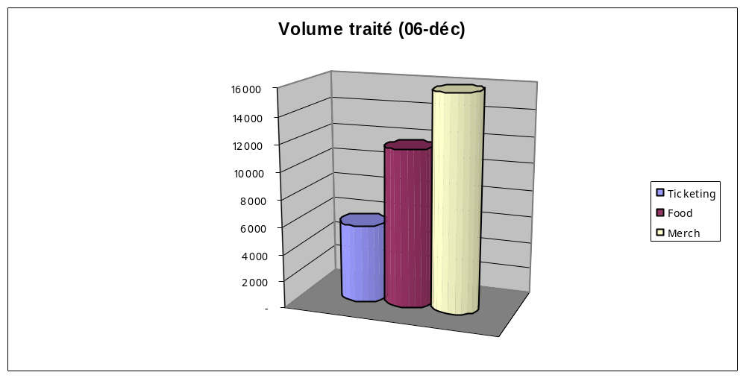
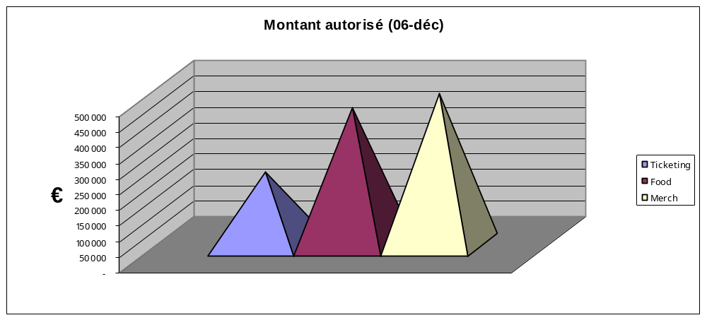
Volume & Revenues
Notes:
For december the 6th
All figures increases with the same scale

Slide 11
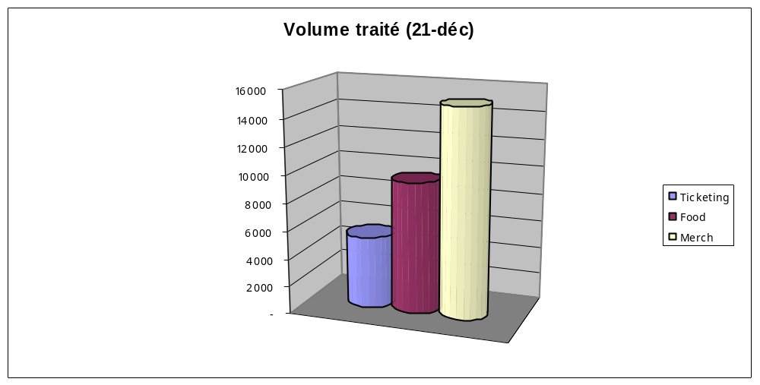
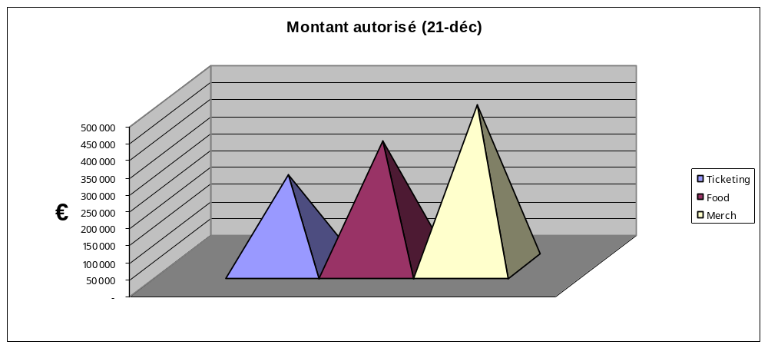
Volume & Revenues
Notes:
And december the 21st,
The repartition is like the december 6th.

Slide 12
Synthesis
Food
Merchandise
Ticketing
Notes:
All the precedent chart are now summarize in 2 pages

Slide 13
Key figures
 | Nombre Transactions | Ticketing | Merchandise | Food | Total
05-déc | Processed | 1 468 | 6 565 | 5 106 | 13 139
 | Authorized | 357 ( 24%) | 2293 ( 35%) | 1116 ( 22%) | 3 763 (29%)
 | Declined | 21 (1,4%) | 128 (1,9%) | 22 (0,4%) | 171 (1,3%)
21-déc | Processed | 5 269 | 15 104 | 9 584 | 29 957
 | Authorized | 894 (17%) | 5100 (34%) | 2308 (24%) | 8 302 (28%)
 | Declined | 43 (0,5%) | 222 (1,5%) | 109 (1,5%) | 374 (1,2%)
Notes:
There is only 2 days : the low activity and the high activity
This first page show the number of transaction per activity and also the total with the percent.

Slide 14
Key figures in K€
 | Amount in k € | Ticketing | Merchandise | Food | Total
05-déc | Processed | 95 | 217 | 197 | 509
 | Authorized | 60 (63%) | 100 (46%) | 58 (29%) | 218 (43%)
 | Declined | 7 (6,8%) | 5 (2,1%) | 1 (0,6%) | 13 (2,6%)
21-déc | Processed | 270 | 476 | 368 | 1 114
 | Authorized | 131 (48%) | 208 (44%) | 113 (31%) | 452 (41%)
 | Declined | 8 (2,9%) | 9 (2,0%) | 7 (2,0%) | 24 (2,2%)
Notes:
And to finish, this the same repartition in amount to show the financial impact of the risk in K €

Slide 15
QUESTIONS
Notes:
To conclude,
It is only the maximum risk, the worse.
Nocibe use this solution during one day and only one transaction has been unpaid.
For solution offline mode, our supplier Ingenico has determined that only
0,72 % of the of the transactions will be unpay.

