Slide 1
Amazon product pricing vs. ratings analysis
By Mike Wells

Slide 2
The problem
How should Amazon sellers price their items to maximize product ratings from buyers?
Importance: maximize good reviews to enhance performance in Amazon’s algorithm

Slide 3
Methodology (1/4)
Opened dataset file (CSV) in spreadsheet application to get initial look at the data and quickly identify data quality issues
Expunged any items with no reviews or price
Initially plotted raw data
Brushed up on statistics!

Slide 4
Methodology (2/4)
Noticed price-to-rating data looked logarithmic
Ran numpy’s polyfit model to find a logarithmic equation that best fit the line
y = 0.1547641801436791ln(x) + 4.0361871883006
Ran scipy’s chi-square model to test goodness of fit

Slide 5
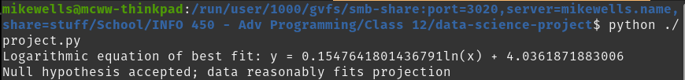
Output (simple; focus on graphs)

Slide 6
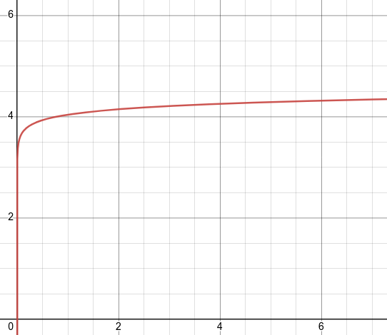
Regression equation graphed in Desmos

Slide 7
Methodology (3/4)
Wanted to examine price and rating variability
Two groupbys:
  Rating by number of each
  Price by number of each
Noted most ratings are in the 4.0-5.0 range
Noted most price variability below $200

Slide 8
Methodology (4/4)
Lastly, examined “staying power” of products
Inner join on first and last 100 products
Noted 21 commonalities

Slide 9
Recommendations
Diminishing returns on ratings for increasing price
Therefore, focus on lower production and SG&A costs
Price below $200 to stay competitive and flexible
Lower price encourages more user ratings

Slide 10
Future work
Get more data!
Run more computationally-intensive ML models for more accurate predictions

