Slide 1
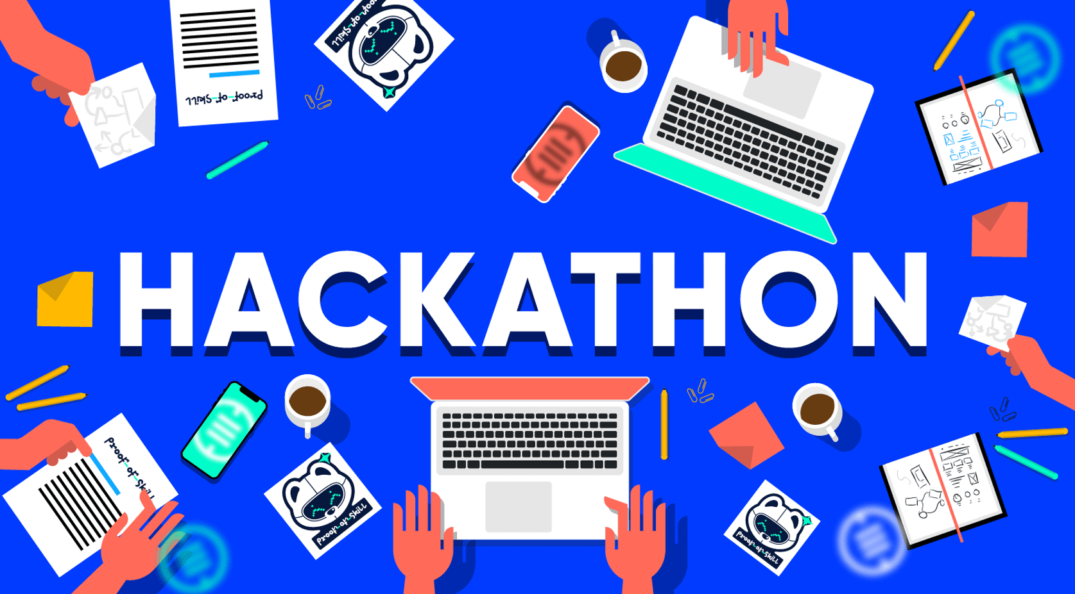
WFT Hackathon 2022 Name Pronunciation – Cloud API Solution
Team Orion
Akshay Agarwal
Rajesh Budithi
Srikanth Polisetty
Vasudha Karri
Biju Paulose
Mohammad Mastan Baig
5/15/2022

Slide 2
Agenda
Team
Solution Overview
Architecture
Pronunciation API – Sequence Diagram
User Experience
Process
Documentation
Future Enhancements

Slide 3
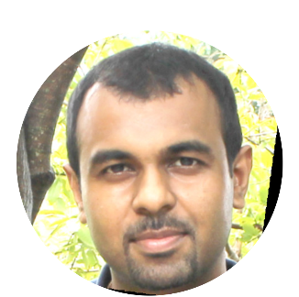
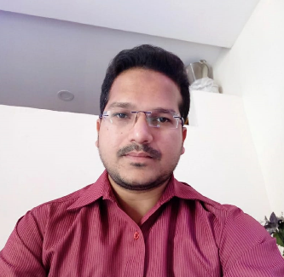
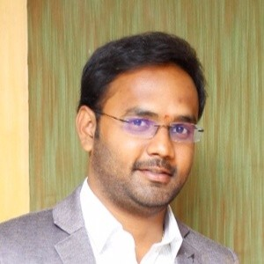
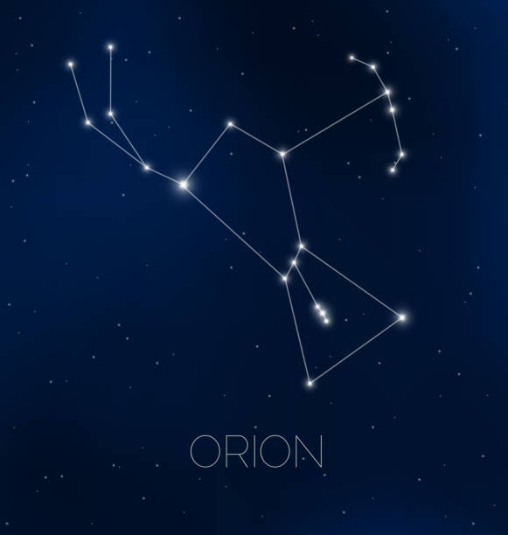
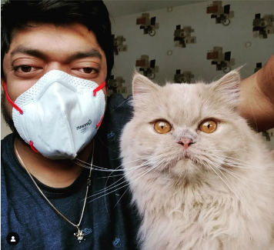
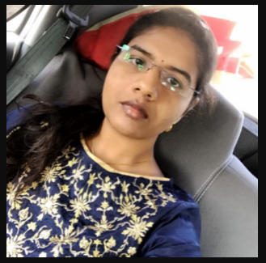
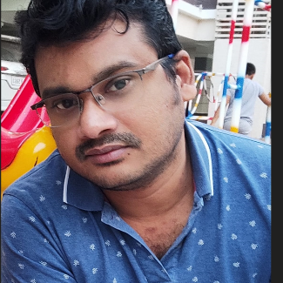
Team Orion
Team Orion - "Group of motivated individuals, diverse skills and experience, united by the challenge and ideas“
Biju Paulose
Srikanth Polisetty
Vasudha Karri
Rajesh Budithi
Akshay Agarwal
Mohammad Mastan Baig

Slide 4
Introduction
Objective
Wells Fargo employees and contingent workers come from an amazing diversity of backgrounds, and the variety of names within the company is profound. Often, employees find themselves struggling with the pronunciation of names. The goal is to make it easier for employees to pronounce others' names as they would like them to be pronounced, and for employees to let others know how they would like their names pronounced
Our Solution
The solution that we developed is cloud based API on Azure cloud infrastructure, which are targeted to be consumed by internal enterprise applications in Wells Fargo. Our solution provides capabilities listed below
API for standard pronunciation based on person's locale & language
API for recording a preferred pronunciation & playback
API to return phonetics generated from audio/pronunciation
User interface - Play standard name pronunciation in employee profile and approval workflow for recorded pronunciation
Integration to productivity & collaboration tools in Wells Fargo

Slide 5
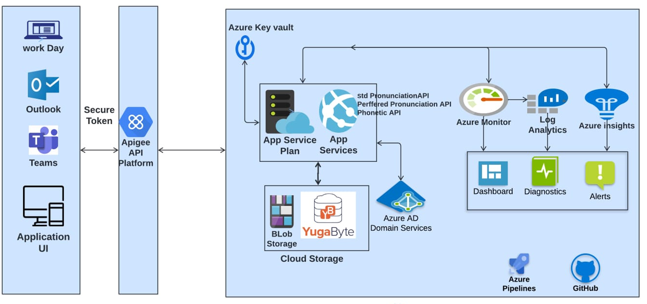
Pronunciation API - Architecture

Slide 6
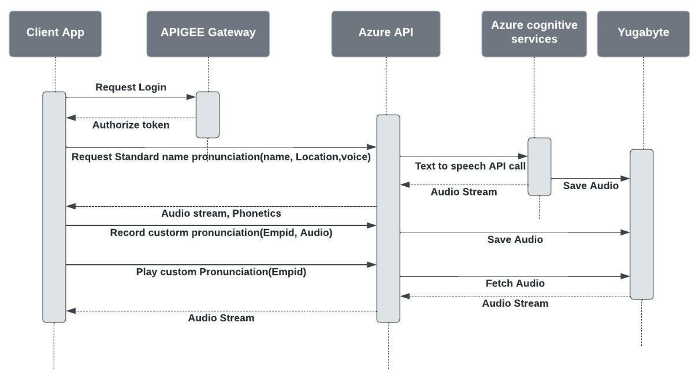
Pronunciation API – Sequence Diagram

Slide 7
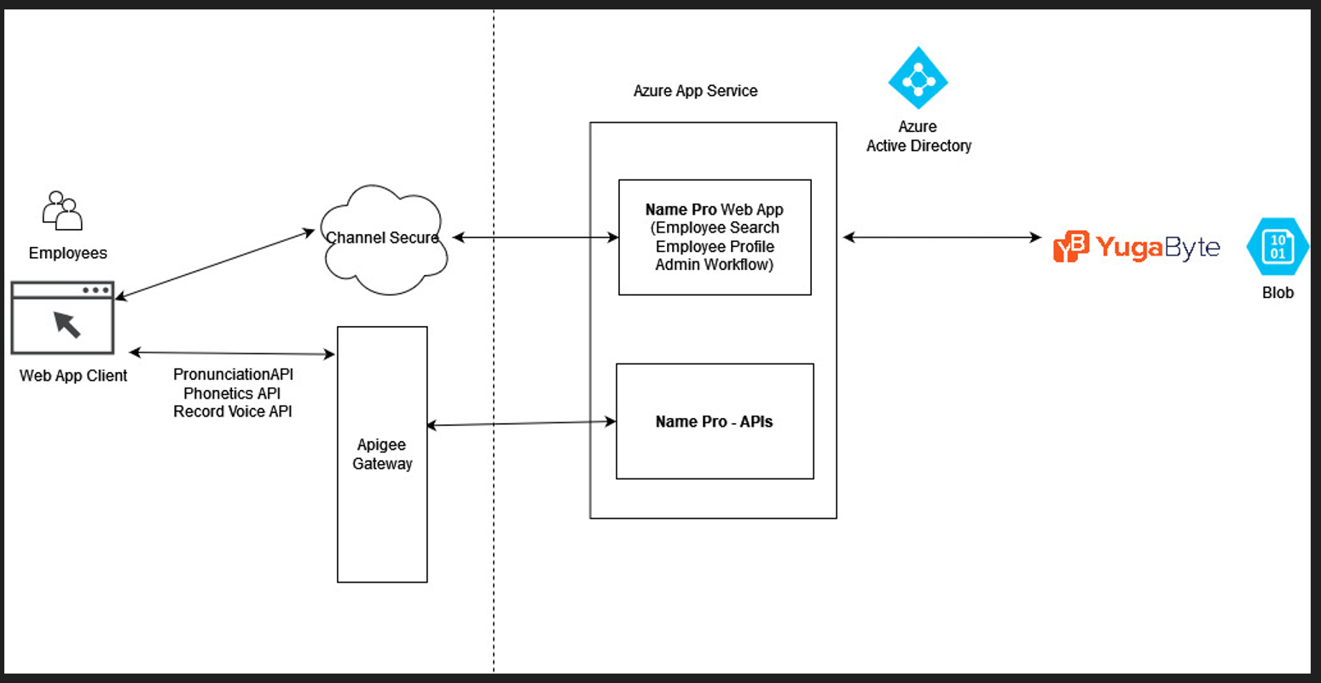
Web Application – Architecture Diagram

Slide 8
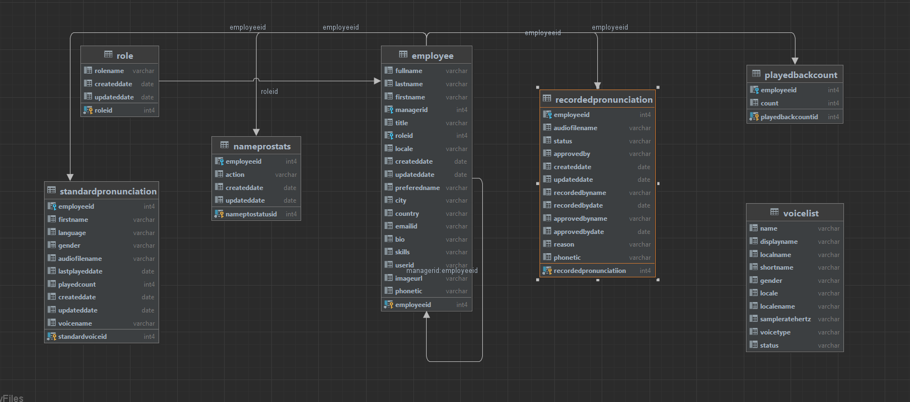
DB Diagram

Slide 9
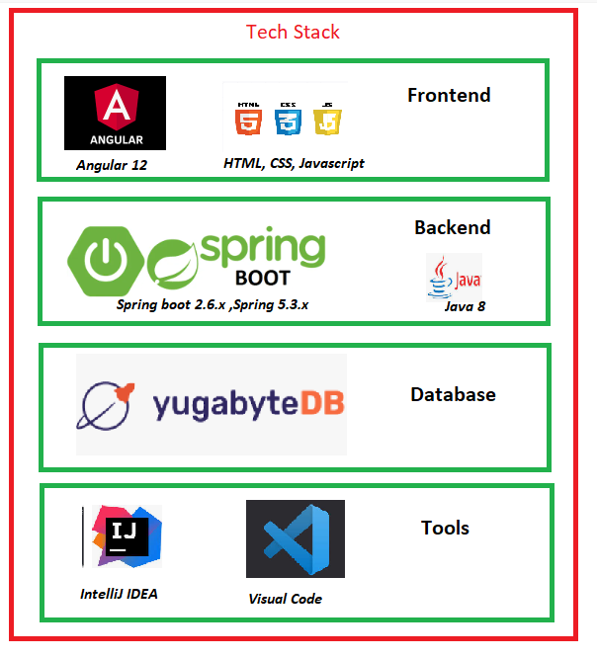
Technology Stack

Slide 10
Our Process
Team Orion followed agile scrum framework for developing this solution. We have finalized the agile roles for each team member and the mix of diverse skills and experience helped us immensely to focus on different tasks. At a high level the process that we followed is listed below
Finalized agile roles, initial meeting, common agreements
Scrum Master- prepared a template for product backlog and burn down chart
PO - has created 3 major epics for product capabilities. Prepared backlog with stories & acceptance criteria.
Scrum Team - Further break down of stories/tasks. Identified NFR stories
Scrum Team - Planned 3 Sprints (two sprints with 2 days, and 3rd Sprint on 5th day)
Stand up meetings 2 times a day. Team collaboration on Zoom meetings
Product Backlog
Sprint - 1
Day 1 - 2
Sprint - 2
Day 3 - 4
Sprint - 3
Day 5
- Standard Pronunciation API
- Record Custom Pronunciation API
- UI Login
- UI Employee Search
- Azure Deployments and Testing
- Audio to Phonetics
- UI Play and Recording
- UI Approval Workflow
- NFRs & Code Coverage
- Azure Deployments and Testing
- Phonetics integration
- UI Play and Recording
- NFRs & Code Coverage
- Azure Deployments and Testing
- Playbook and artifacts
Release/Submission

Slide 11
Documentation
API Swagger Documentation: https://nameprobyorion-service.azurewebsites.net/swagger-ui/#/
User Interface: https://nameprobyorion-ui.azurewebsites.net/#/auth

Slide 12
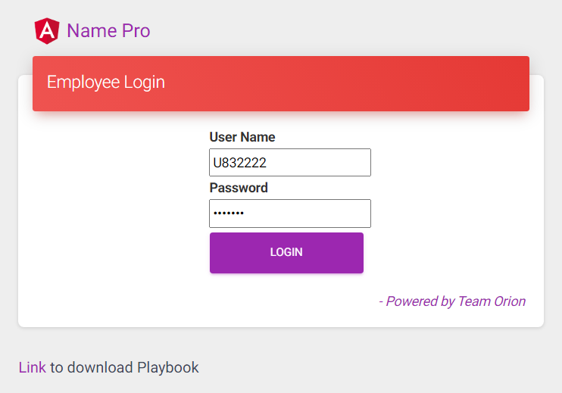
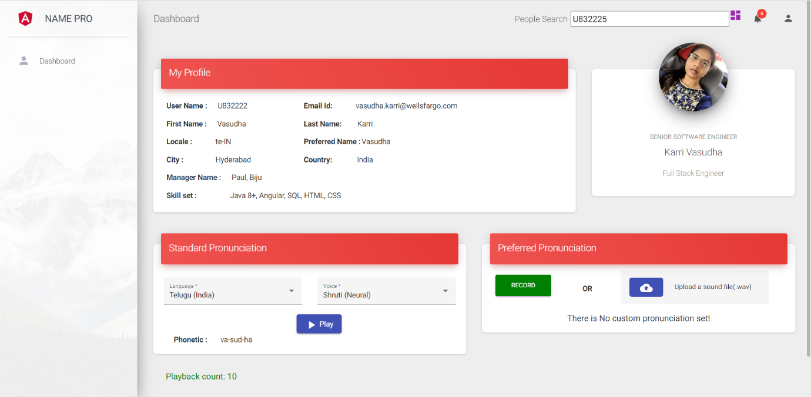
Name Pronunciation – User Experience
We developed an Angular Web application that allows internal users (Wells Fargo Employees) to search other employees and play the standard or custom recorded pronunciation from the employee profiles. This will be on Teamworks or Workday once API is integrated on these tools. We also have capability for each employee to record their preferred pronunciation and an approval workflow for admin before those are published for other users

Slide 13
Future Enhancements
Outlook Plug-in
Microsoft Teams integration
Workday Integration
Recorded voice data - Storage optimization

Slide 14
Thank You

