Slide 1


Protocol Buffers

Slide 2

What is it?
What is it?
Protobuf is a data serialization protocol similar to JSON and XML
Compiled in bytes though – not for human
Designed and used by Google
Open sourced in Jul 2008
Platform independent and version tolerant

Slide 3
Motivation for presentation
I have always tried to ignore, however there is something that always brings my attention back – lately while checking out Dapr, I was convinced there is a place for Protobufs
Modern applications have been built on microservices that are in constant communication
Services generally generate lots of messages, load the network and require a lot of resources, hence the constant need for a fast way of transferring compact data
Benchmarks have shown that the format is upto 8x faster than JSON and 60-89% smaller
On the cloud, these benefits might mean reduction on cost
I believe this is enough reason to explore potential use within our ecosystem

Slide 4
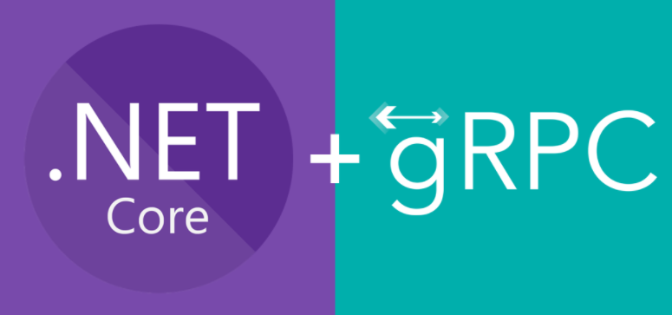
How would I use it, today?
Good news is .NET Core 3.1 has native support in the form of gRPC
- RPC stack developed and used by Google
- Open sourced in Feb 2015
gRPC is based on HTTP/2 and protobufs. It’s generally recommended as the primary choice for direct synchronous communication between services
It’s language agnostic and all services are defined using proto files (protobuf language files that define the interface of the service). Based on the proto file, the client and server code files can be generated using the protoc tool
gRPC works with HTP/2 only. Generally, server to client connection is on HTTP1.1 and only gets promoted to HTTP/2 is both support
This means additional configuration might be required in order to support HTTP1.1 cients

Slide 5
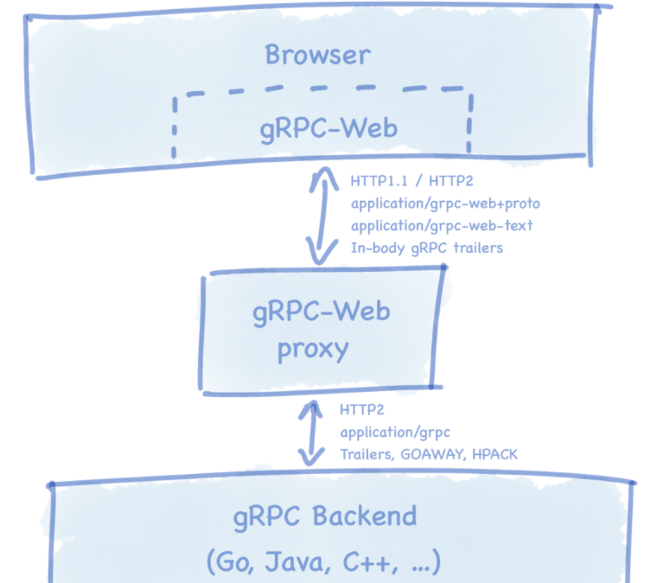
Ideal state However, we don’t have to start here – for example, only implement on bff / aggregators Ref: https://grpc.io/blog/state-of-grpc-web/

Slide 6
Demo..
A very basic setup – illustrating how easy it is to get started
Setting up a .Net Core project with protobuf support
Creating a .proto schema
The generated code for data contracts, service clients, and service implementations
How to implement and host a service
How to create a client
Project packages -> Google.Protobuf contains the protobuf message APIs for C#
A working client and server
In my mind, feels like WFC? At least the good parts

Slide 7

END
Thank you!

