Slide 1

TypeScript for Beginners

Slide 2
JAN SCHAFFRANEK

Slide 3
Who am I?
Master of Science in Applied Computer Science
Since 2018 instructor on Udemy
Since 2019 developer for automated driving at ZF

Slide 4
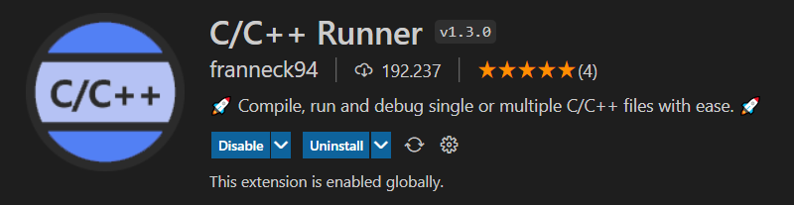

Slide 5
TypeScript for Beginners

Slide 6
Prior knowledge
Basic knowledge with Windows, Linux or MacOS
Programming experience in Javascript
If-queries, loops and logical expressions
Implement functions and classes

Slide 7
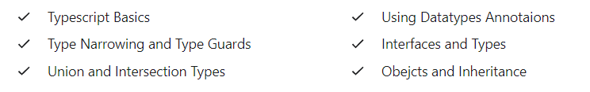
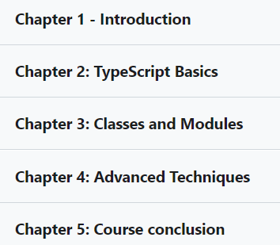
Course topics

