Slide 1
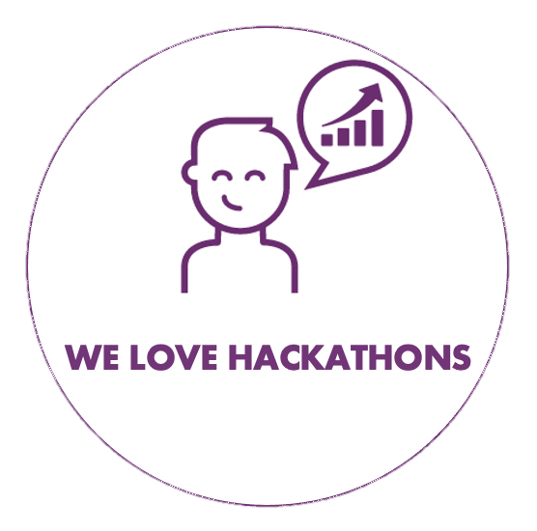

Slide 2

Team members
Eric Lecoutre
Data Scientist
WeLoveDataScience
Romain Hautecourt
Data Scientist
_______________
Madina TUSSUPOVA
Data Scientist
ENGIE IT

Slide 3

SNOWPAD
Mission: The relationship between sellers and buyers is not fully broken! But it is not efficient! The tools to make this process digital B2B sales digestible are not widespread yet; How do make this a better experience for all stakeholders? Providing the best experience; because the best buyer experience wins!

Slide 4
Our apprach
Process mining is a family of techniques relating the fields of data science and process management to support the analysis of operational processes based on event logs. The goal of process mining is to turn event data into insights and actions. Process mining is an integral part of data science, fueled by the availability of event data and the desire to improve processes. Process mining techniques use event data to show what people, machines, and organizations are really doing. Process mining provides novel insights that can be used to identify the executional path taken by operational processes and address their performance and compliance problems.

Slide 5
Process Mining
There have long been a few fundamental challenges associated with business process management, at least for as long as the two of us have been involved with the field (forty years or so, for better or worse). Two of the most troublesome problems, in our view, are at least partially responsible for the fact that process management and improvement is, among many companies, a back-burner issue at the moment. But a relatively new and innovative technology, process mining, has the capability to solve both of the problems and to revitalize process management in firms where it has lain fallow for years.
One problem involves the creation of “current state” processes — a description of how a business process is being performed today. In business process reengineering, organizations are primarily interested in an improved “to be” process, so often they have little interest in exploring “as is,” or how the process is currently performed. But understanding the current process is critical to knowing whether it is worth investing in improvements, where performance problems exist, and how much variation there is in the process across the organization. As a result, some companies tend to either skip current process analysis altogether, adopt shortcuts to it, or pay consultants a lot of money to analyze the “as is” process.

Slide 6
Data Analysis

Slide 7
Shiny APP

