Slide 1
targeter analyis
welovedatascience - targeter

Slide 2
Analysis parameters
Data used: adult
Descrition of data: no description provided.
Analysis performed the: 2025-03-05
Target: ABOVE50K [binary]
Number of variables: 12
Analysed population contains: 32561 records.
Analysis performed on: R version 4.4.2 (2024-10-31) with targeter 1.3.2

Slide 3
Introduction

Slide 4
This report contains a snapshot of the specific subpopulation «var: ABOVE50K » == 1`.
This subpopulation is characterized by performing bivariate analyses, crossing the variable of interest (target) with potential explanatory variables. Only most relevant (highest discriminative power) may be retained.
Report contains:
A summary overview table with selected retained criteria with some available information such as one statistic called information value (IV) that provides an idea of the explanatory power of the criteria.
Detailed analyses per criteria with graphics that highlight the reation between one of the candidate criteria and the target.
It can happen that one criteria contains some missing values. If such, we will introduce value “[Missing]” in the report, eventually with a cross [x]. Also, if two few data are available, we would use a minus [-] instead of reporting value.

Slide 5
Summary table interpretation
Criteria are sorted by decreasing importance order, which one is determined by the IV. One modality (value) index is also computed as the proportion of target «var: ABOVE50K» within the modality, that is the target penetration in the subpopulation selected by the specific modality of a criteria. A value near 1 would indicate a non-discriminative modality: selecting the corresponding subpopulation would result in the overall average target penetration. On the other way, the hightest the index (>1), the more target is over-representated in the subpopulation. Low index (<1) would be interpreted as under-representation. So high index modalities are of interest as they characterize subpopulation with high target penetration.
Note that index will always be computed for segments (modalities): continuous variables are cut into buckets. If a criteria/variable has no segment with any high index, it will not be of interest at all. Also, having one segment with an index greater than 1 implies that there are counterparts segments with index lower 1.
There is no special rule to say that an index is a good one as its interpretation has to take into account the natural (average) target pourcentage (penetration). Indeed, when the penetration is low, it is easier to observe eventually high index. Think that for a global penetration of 50% of target, maximal index is 2 (and more generally, index is bounded by 1/(target penetration))
For every criteria, summary table presents its possible value (modality) having the highest index along with the corresponding number of records. Pay attention that you might observe high index dealing with very restrictive sub-populations.

Slide 6
Populations
value | count | nNA | percNA | perc
0 | 24720 | 0 | 0 | 0.7591904
1 | 7841 | 0 | 0 | 0.2408096
Population
No description of the global population (data) have been provided during the analysis. Analyzed population contains 32561 records.
Target
No description of the target has been provided during the analysis.
Target used: var: ABOVE50K [ABOVE50K]

Slide 7
Summary
variable | type | IV | Level | #Records | %Records | Index
RELATIONSHIP | character | 1.536 | Wife | 745 | 47.51 | 1.97
MARITALSTATUS | character | 1.339 | Married-civ-spouse | 6,692 | 44.68 | 1.86
AGE | numeric | 1.218 | [j] from 48 to 52 | 926 | 39.97 | 1.66
OCCUPATION | character | 0.776 | Exec-managerial | 1,968 | 48.40 | 2.01
EDUCATION | character | 0.754 | Doctorate | 306 | 74.09 | 3.08
EDUCATIONNUM | numeric | 0.662 | [f] from 13 to 16 | 3,909 | 48.46 | 2.01
HOURSPERWEEK | numeric | 0.462 | [f] from 50 to 56 | 1,670 | 44.77 | 1.86
SEX | character | 0.303 | Male | 6,662 | 30.57 | 1.27
WORKCLASS | character | 0.167 | Self-emp-inc | 622 | 55.73 | 2.31
NATIVECOUNTRY | character | 0.081 | Iran | 18 | 41.86 | 1.74

Slide 8
Variables

Slide 9
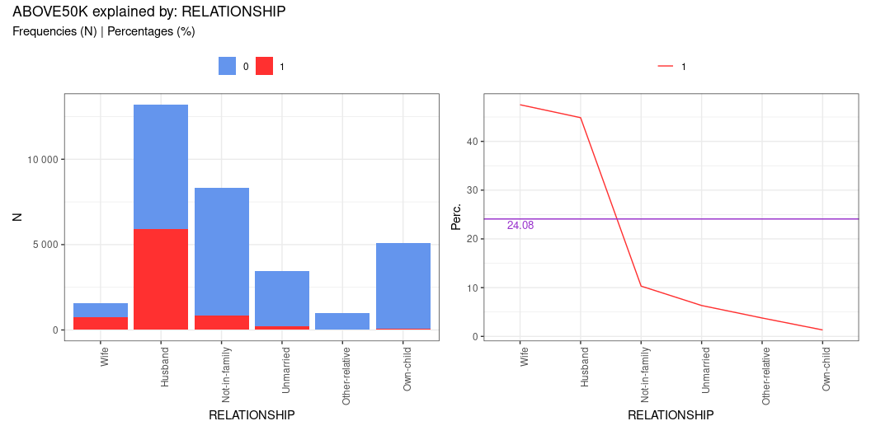
relationship
var: RELATIONSHIP
IV: 1.536

Slide 10
relationship [table]
 | N0 | N1 | Ntot | perc0 | perc1 | target%
Husband | 7275 | 5918 | 13193 | 55.143% | 44.857% | 75.475%
Not-in-family | 7449 | 856 | 8305 | 89.693% | 10.307% | 10.917%
Other-relative | 944 | 37 | 981 | 96.228% | 3.772% | 0.472%
Own-child | 5001 | 67 | 5068 | 98.678% | 1.322% | 0.854%
Unmarried | 3228 | 218 | 3446 | 93.674% | 6.326% | 2.78%
Wife | 823 | 745 | 1568 | 52.487% | 47.513% | 9.501%

Slide 11
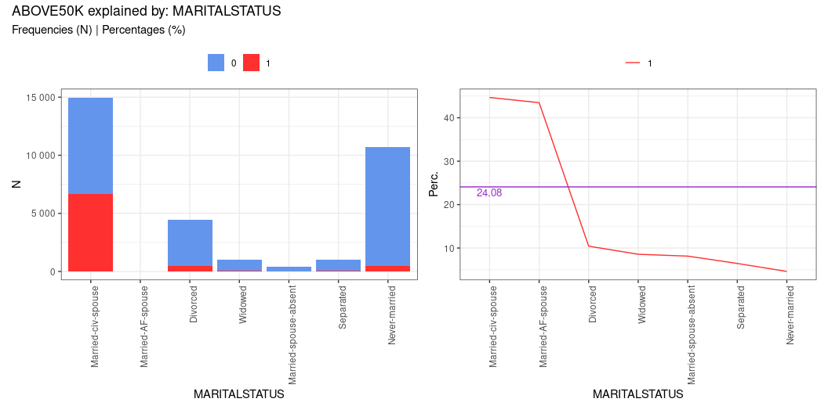
maritalstatus
var: MARITALSTATUS
IV: 1.339

Slide 12
maritalstatus [table]
 | N0 | N1 | Ntot | perc0 | perc1 | target%
Divorced | 3980 | 463 | 4443 | 89.579% | 10.421% | 5.905%
Married-AF-spouse | 13 | 10 | 23 | 56.522% | 43.478% | 0.128%
Married-civ-spouse | 8284 | 6692 | 14976 | 55.315% | 44.685% | 85.346%
Married-spouse-absent | 384 | 34 | 418 | 91.866% | 8.134% | 0.434%
Never-married | 10192 | 491 | 10683 | 95.404% | 4.596% | 6.262%
Separated | 959 | 66 | 1025 | 93.561% | 6.439% | 0.842%
Widowed | 908 | 85 | 993 | 91.44% | 8.56% | 1.084%

Slide 13
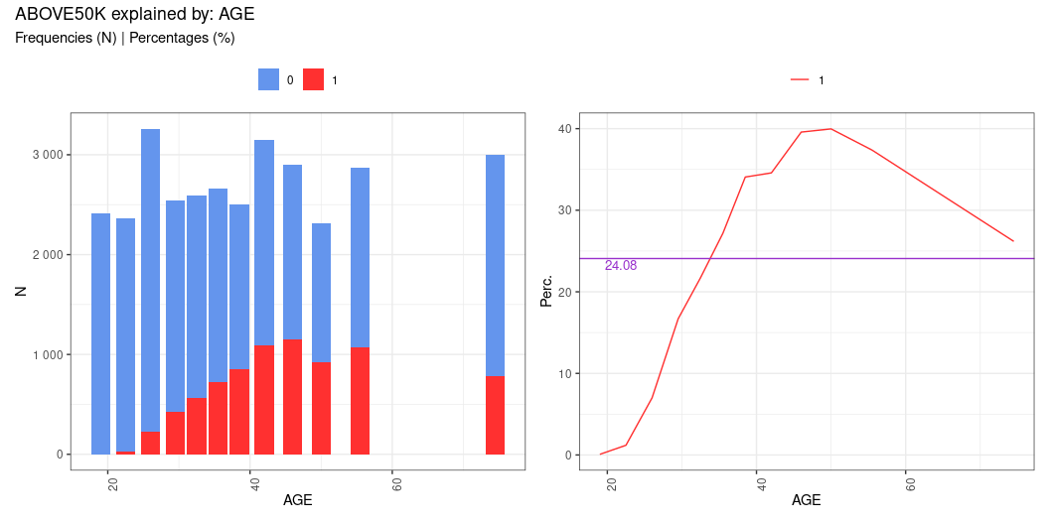
age
var: AGE
IV: 1.218

Slide 14
age [table]
 | N0 | N1 | Ntot | perc0 | perc1 | target%
[a] from 17 to 21 | 2408 | 2 | 2410 | 99.917% | 0.083% | 0.026%
[b] from 21 to 24 | 2334 | 28 | 2362 | 98.815% | 1.185% | 0.357%
[c] from 24 to 28 | 3031 | 228 | 3259 | 93.004% | 6.996% | 2.908%
[d] from 28 to 31 | 2117 | 424 | 2541 | 83.314% | 16.686% | 5.407%
[e] from 31 to 34 | 2028 | 563 | 2591 | 78.271% | 21.729% | 7.18%
[f] from 34 to 37 | 1937 | 723 | 2660 | 72.82% | 27.18% | 9.221%
[g] from 37 to 40 | 1649 | 852 | 2501 | 65.934% | 34.066% | 10.866%
[h] from 40 to 44 | 2062 | 1090 | 3152 | 65.419% | 34.581% | 13.901%
[i] from 44 to 48 | 1754 | 1149 | 2903 | 60.42% | 39.58% | 14.654%
[j] from 48 to 52 | 1391 | 926 | 2317 | 60.035% | 39.965% | 11.81%
[k] from 52 to 59 | 1795 | 1071 | 2866 | 62.631% | 37.369% | 13.659%
[l] from 59 to 90 | 2214 | 785 | 2999 | 73.825% | 26.175% | 10.011%

Slide 15
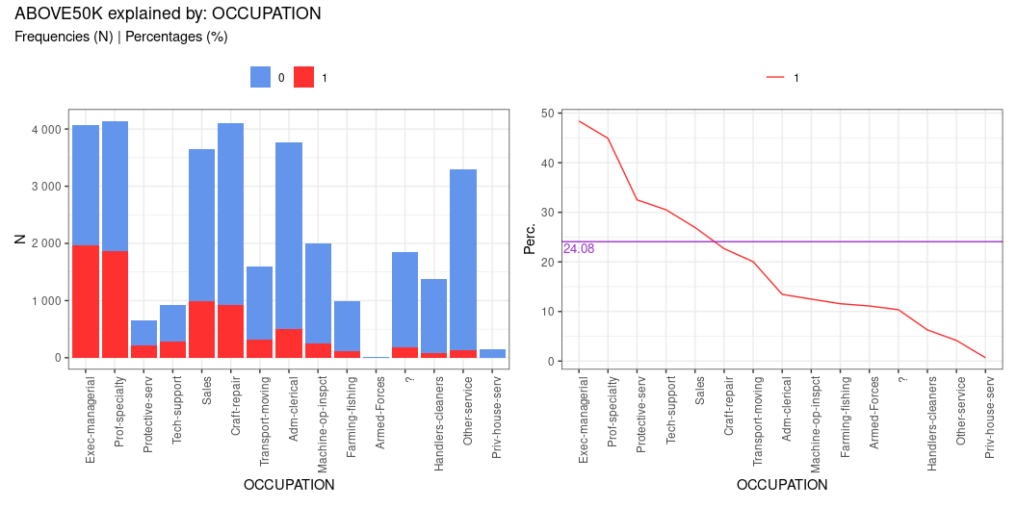
occupation
var: OCCUPATION
IV: 0.776

Slide 16
occupation [table]
 | N0 | N1 | Ntot | perc0 | perc1 | target%
? | 1652 | 191 | 1843 | 89.636% | 10.364% | 2.436%
Adm-clerical | 3263 | 507 | 3770 | 86.552% | 13.448% | 6.466%
Armed-Forces | 8 | 1 | 9 | 88.889% | 11.111% | 0.013%
Craft-repair | 3170 | 929 | 4099 | 77.336% | 22.664% | 11.848%
Exec-managerial | 2098 | 1968 | 4066 | 51.599% | 48.401% | 25.099%
Farming-fishing | 879 | 115 | 994 | 88.431% | 11.569% | 1.467%
Handlers-cleaners | 1284 | 86 | 1370 | 93.723% | 6.277% | 1.097%
Machine-op-inspct | 1752 | 250 | 2002 | 87.512% | 12.488% | 3.188%
Other-service | 3158 | 137 | 3295 | 95.842% | 4.158% | 1.747%
Priv-house-serv | 148 | 1 | 149 | 99.329% | 0.671% | 0.013%
Prof-specialty | 2281 | 1859 | 4140 | 55.097% | 44.903% | 23.709%
Protective-serv | 438 | 211 | 649 | 67.488% | 32.512% | 2.691%
Sales | 2667 | 983 | 3650 | 73.068% | 26.932% | 12.537%
Tech-support | 645 | 283 | 928 | 69.504% | 30.496% | 3.609%
Transport-moving | 1277 | 320 | 1597 | 79.962% | 20.038% | 4.081%

Slide 17
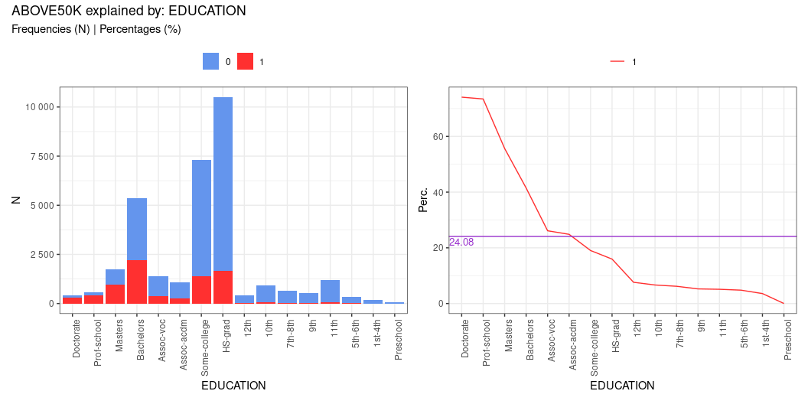
education
var: EDUCATION
IV: 0.754

Slide 18
education [table]
 | N0 | N1 | Ntot | perc0 | perc1 | target%
10th | 871 | 62 | 933 | 93.355% | 6.645% | 0.791%
11th | 1115 | 60 | 1175 | 94.894% | 5.106% | 0.765%
12th | 400 | 33 | 433 | 92.379% | 7.621% | 0.421%
1st-4th | 162 | 6 | 168 | 96.429% | 3.571% | 0.077%
5th-6th | 317 | 16 | 333 | 95.195% | 4.805% | 0.204%
7th-8th | 606 | 40 | 646 | 93.808% | 6.192% | 0.51%
9th | 487 | 27 | 514 | 94.747% | 5.253% | 0.344%
Assoc-acdm | 802 | 265 | 1067 | 75.164% | 24.836% | 3.38%
Assoc-voc | 1021 | 361 | 1382 | 73.878% | 26.122% | 4.604%
Bachelors | 3134 | 2221 | 5355 | 58.525% | 41.475% | 28.325%
Doctorate | 107 | 306 | 413 | 25.908% | 74.092% | 3.903%
HS-grad | 8826 | 1675 | 10501 | 84.049% | 15.951% | 21.362%
Masters | 764 | 959 | 1723 | 44.341% | 55.659% | 12.231%
Preschool | 51 | 0 | 51 | 100% | 0% | 0%
Prof-school | 153 | 423 | 576 | 26.562% | 73.438% | 5.395%
Some-college | 5904 | 1387 | 7291 | 80.977% | 19.023% | 17.689%

Slide 19
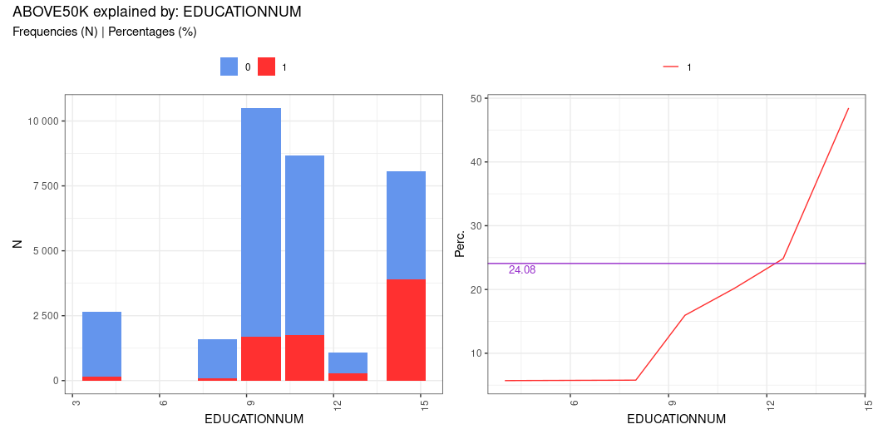
educationnum
var: EDUCATIONNUM
IV: 0.662

Slide 20
educationnum [table]
 | N0 | N1 | Ntot | perc0 | perc1 | target%
[a] from 1 to 7 | 2494 | 151 | 2645 | 94.291% | 5.709% | 1.926%
[b] from 7 to 9 | 1515 | 93 | 1608 | 94.216% | 5.784% | 1.186%
[c] from 9 to 10 | 8826 | 1675 | 10501 | 84.049% | 15.951% | 21.362%
[d] from 10 to 12 | 6925 | 1748 | 8673 | 79.845% | 20.155% | 22.293%
[e] from 12 to 13 | 802 | 265 | 1067 | 75.164% | 24.836% | 3.38%
[f] from 13 to 16 | 4158 | 3909 | 8067 | 51.543% | 48.457% | 49.853%

Slide 21
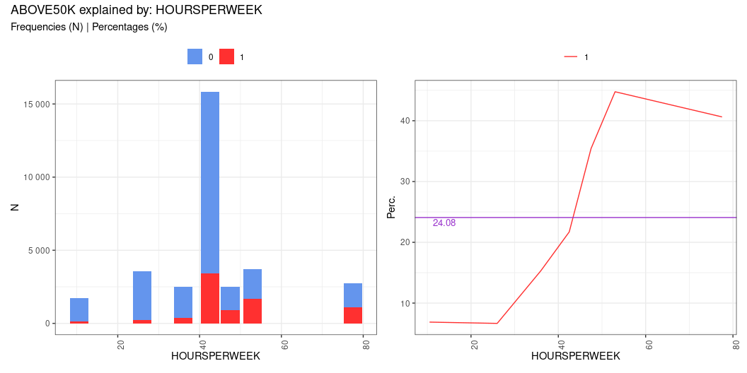
hoursperweek
var: HOURSPERWEEK
IV: 0.462

Slide 22
hoursperweek [table]
 | N0 | N1 | Ntot | perc0 | perc1 | target%
[a] from 1 to 20 | 1587 | 117 | 1704 | 93.134% | 6.866% | 1.492%
[b] from 20 to 32 | 3310 | 236 | 3546 | 93.345% | 6.655% | 3.01%
[c] from 32 to 40 | 2128 | 385 | 2513 | 84.68% | 15.32% | 4.91%
[d] from 40 to 45 | 12398 | 3437 | 15835 | 78.295% | 21.705% | 43.834%
[e] from 45 to 50 | 1615 | 886 | 2501 | 64.574% | 35.426% | 11.3%
[f] from 50 to 56 | 2060 | 1670 | 3730 | 55.228% | 44.772% | 21.298%
[g] from 56 to 99 | 1622 | 1110 | 2732 | 59.37% | 40.63% | 14.156%

Slide 23
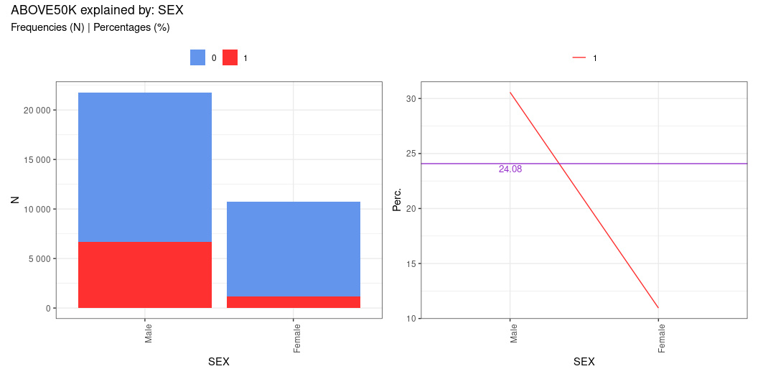
sex
var: SEX
IV: 0.303

Slide 24
sex [table]
 | N0 | N1 | Ntot | perc0 | perc1 | target%
Female | 9592 | 1179 | 10771 | 89.054% | 10.946% | 15.036%
Male | 15128 | 6662 | 21790 | 69.426% | 30.574% | 84.964%

Slide 25
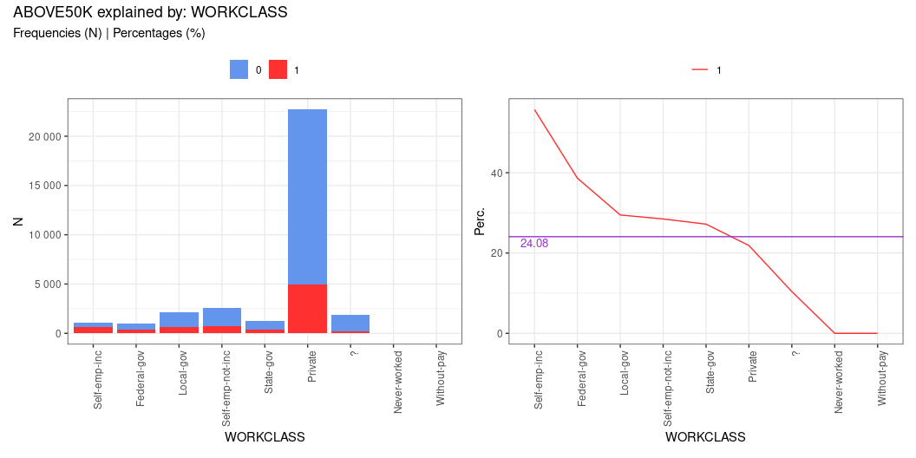
workclass
var: WORKCLASS
IV: 0.167

Slide 26
workclass [table]
 | N0 | N1 | Ntot | perc0 | perc1 | target%
? | 1645 | 191 | 1836 | 89.597% | 10.403% | 2.436%
Federal-gov | 589 | 371 | 960 | 61.354% | 38.646% | 4.732%
Local-gov | 1476 | 617 | 2093 | 70.521% | 29.479% | 7.869%
Never-worked | 7 | 0 | 7 | 100% | 0% | 0%
Private | 17733 | 4963 | 22696 | 78.133% | 21.867% | 63.295%
Self-emp-inc | 494 | 622 | 1116 | 44.265% | 55.735% | 7.933%
Self-emp-not-inc | 1817 | 724 | 2541 | 71.507% | 28.493% | 9.234%
State-gov | 945 | 353 | 1298 | 72.804% | 27.196% | 4.502%
Without-pay | 14 | 0 | 14 | 100% | 0% | 0%

Slide 27
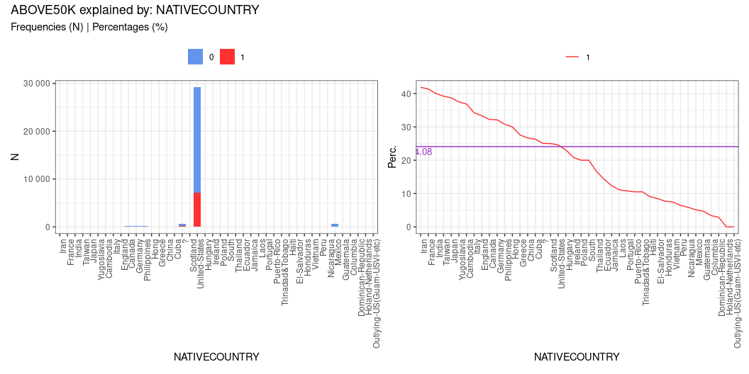
nativecountry
var: NATIVECOUNTRY
IV: 0.081

Slide 28
nativecountry [table]
 | N0 | N1 | Ntot | perc0 | perc1 | target%
? | 437 | 146 | 583 | 74.957% | 25.043% | 1.862%
Cambodia | 12 | 7 | 19 | 63.158% | 36.842% | 0.089%
Canada | 82 | 39 | 121 | 67.769% | 32.231% | 0.497%
China | 55 | 20 | 75 | 73.333% | 26.667% | 0.255%
Columbia | 57 | 2 | 59 | 96.61% | 3.39% | 0.026%
Cuba | 70 | 25 | 95 | 73.684% | 26.316% | 0.319%
Dominican-Republic | 68 | 2 | 70 | 97.143% | 2.857% | 0.026%
Ecuador | 24 | 4 | 28 | 85.714% | 14.286% | 0.051%
El-Salvador | 97 | 9 | 106 | 91.509% | 8.491% | 0.115%
England | 60 | 30 | 90 | 66.667% | 33.333% | 0.383%
France | 17 | 12 | 29 | 58.621% | 41.379% | 0.153%
Germany | 93 | 44 | 137 | 67.883% | 32.117% | 0.561%
Greece | 21 | 8 | 29 | 72.414% | 27.586% | 0.102%
Guatemala | 61 | 3 | 64 | 95.312% | 4.688% | 0.038%
Haiti | 40 | 4 | 44 | 90.909% | 9.091% | 0.051%
Holand-Netherlands | 1 | 0 | 1 | 100% | 0% | 0%
Honduras | 12 | 1 | 13 | 92.308% | 7.692% | 0.013%
Hong | 14 | 6 | 20 | 70% | 30% | 0.077%
Hungary | 10 | 3 | 13 | 76.923% | 23.077% | 0.038%
India | 60 | 40 | 100 | 60% | 40% | 0.51%
Iran | 25 | 18 | 43 | 58.14% | 41.86% | 0.23%
Ireland | 19 | 5 | 24 | 79.167% | 20.833% | 0.064%
Italy | 48 | 25 | 73 | 65.753% | 34.247% | 0.319%
Jamaica | 71 | 10 | 81 | 87.654% | 12.346% | 0.128%
Japan | 38 | 24 | 62 | 61.29% | 38.71% | 0.306%
Laos | 16 | 2 | 18 | 88.889% | 11.111% | 0.026%
Mexico | 610 | 33 | 643 | 94.868% | 5.132% | 0.421%
Nicaragua | 32 | 2 | 34 | 94.118% | 5.882% | 0.026%
Outlying-US(Guam-USVI-etc) | 14 | 0 | 14 | 100% | 0% | 0%
Peru | 29 | 2 | 31 | 93.548% | 6.452% | 0.026%
Philippines | 137 | 61 | 198 | 69.192% | 30.808% | 0.778%
Poland | 48 | 12 | 60 | 80% | 20% | 0.153%
Portugal | 33 | 4 | 37 | 89.189% | 10.811% | 0.051%
Puerto-Rico | 102 | 12 | 114 | 89.474% | 10.526% | 0.153%
Scotland | 9 | 3 | 12 | 75% | 25% | 0.038%
South | 64 | 16 | 80 | 80% | 20% | 0.204%
Taiwan | 31 | 20 | 51 | 60.784% | 39.216% | 0.255%
Thailand | 15 | 3 | 18 | 83.333% | 16.667% | 0.038%
Trinadad&Tobago | 17 | 2 | 19 | 89.474% | 10.526% | 0.026%
United-States | 21999 | 7171 | 29170 | 75.417% | 24.583% | 91.455%
Vietnam | 62 | 5 | 67 | 92.537% | 7.463% | 0.064%
Yugoslavia | 10 | 6 | 16 | 62.5% | 37.5% | 0.077%

Slide 29
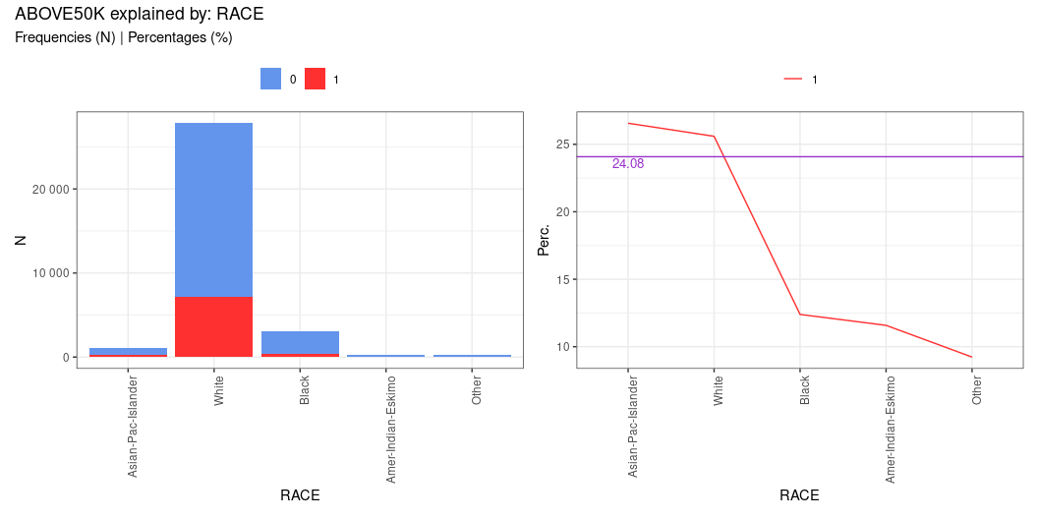
race
var: RACE
IV: 0.069

Slide 30
race [table]
 | N0 | N1 | Ntot | perc0 | perc1 | target%
Amer-Indian-Eskimo | 275 | 36 | 311 | 88.424% | 11.576% | 0.459%
Asian-Pac-Islander | 763 | 276 | 1039 | 73.436% | 26.564% | 3.52%
Black | 2737 | 387 | 3124 | 87.612% | 12.388% | 4.936%
Other | 246 | 25 | 271 | 90.775% | 9.225% | 0.319%
White | 20699 | 7117 | 27816 | 74.414% | 25.586% | 90.766%

Slide 31
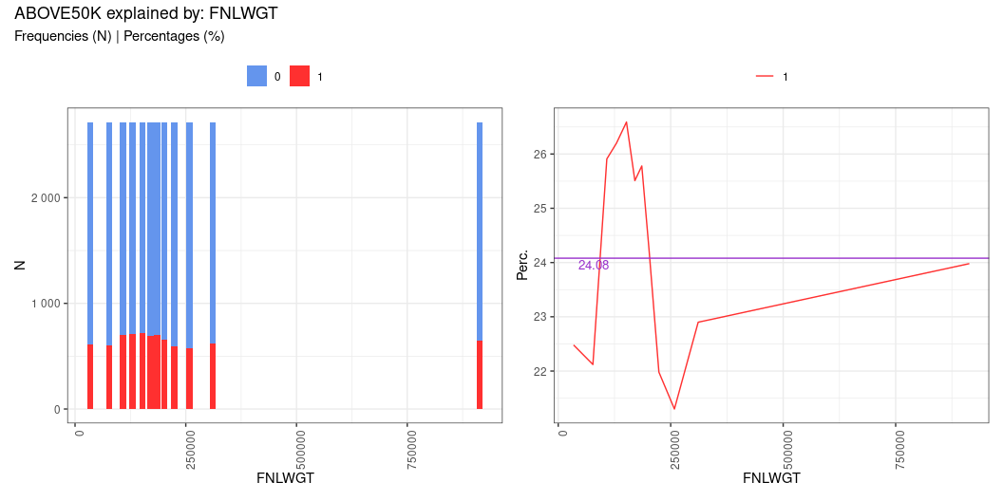
fnlwgt
var: FNLWGT
IV: 0.01

Slide 32
fnlwgt [table]
 | N0 | N1 | Ntot | perc0 | perc1 | target%
[a] from 12285 to 55900 | 2104 | 610 | 2714 | 77.524% | 22.476% | 7.78%
[b] from 55900 to 98253 | 2113 | 600 | 2713 | 77.884% | 22.116% | 7.652%
[c] from 98253 to 117827 | 2010 | 703 | 2713 | 74.088% | 25.912% | 8.966%
[d] from 117827 to 141067 | 2003 | 711 | 2714 | 73.803% | 26.197% | 9.068%
[e] from 141067 to 162343 | 1991 | 721 | 2712 | 73.414% | 26.586% | 9.195%
[f] from 162343 to 178356 | 2021 | 692 | 2713 | 74.493% | 25.507% | 8.825%
[g] from 178356 to 193160 | 2015 | 700 | 2715 | 74.217% | 25.783% | 8.927%
[h] from 193160 to 210474 | 2053 | 657 | 2710 | 75.756% | 24.244% | 8.379%
[i] from 210474 to 237051 | 2119 | 597 | 2716 | 78.019% | 21.981% | 7.614%
[j] from 237051 to 279465 | 2136 | 578 | 2714 | 78.703% | 21.297% | 7.372%
[k] from 279465 to 342730 | 2091 | 621 | 2712 | 77.102% | 22.898% | 7.92%
[l] from 342730 to 1484705 | 2064 | 651 | 2715 | 76.022% | 23.978% | 8.303%

