Slide 1
SNR-Conditioned Reconstruction of Sentinel-2 Ship Imagery
Progress Update: Evaluating Noise-Level Conditioning for Ship-Preserving Image Reconstruction
October 2026

Slide 2
RESEARCH QUESTIONS
Three questions under investigation
1
2
3
Does knowing the noise level help?
Does comparing color bands help?
Does protecting ships specifically help?
If the model is given the noise level of an image, does it restore it more accurately than a model without this information?
Satellite images have 12 color channels. Does allowing the model to cross-reference them improve results?
If training rewards the model for accuracy on ships, does this come at the cost of overall image quality?
SIGNIFICANCE
Each question corresponds to a hypothesis (H1, H2, H3) fixed in the project protocol before training began.
Hypotheses were pre-registered to prevent post-hoc redefinition of success criteria.
This update addresses Research Question 1. Questions 2 and 3 are addressed in the next phase (see Plan From Here).

Slide 3
METHODOLOGY
Methodology overview
1
2
3
4
1,053 real ships
Controlled noise added
Model trained on Kaggle GPUs
Every measurement verified
→
→
→
16 real Sentinel-2 satellite scenes, independently verified against published ship counts
A measured, repeatable amount of noise is added at 9 strength levels, from severe to minimal
A neural network is trained to remove the added noise while preserving ship shapes
Scoring code was checked against hand-derived analytic cases before any result was used
SIGNIFICANCE
Dataset provenance, the noise model, and the evaluation code were independently verified before any result was used.
Measurement correctness was checked against hand-derived analytic cases rather than assumed from a single run.
Results reported in this update reflect model behavior, not measurement error.

Slide 4
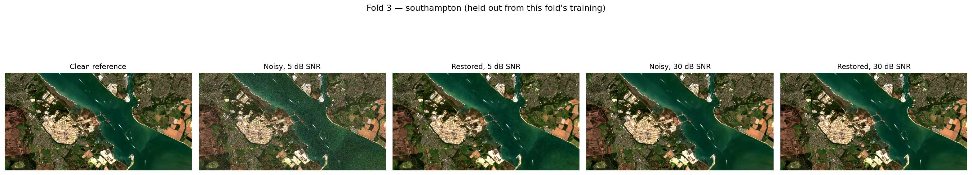
QUALITATIVE RESULTS
Full-scene reconstruction: Southampton, UK (fold 3)
Test scene excluded from training for fold 3. Left to right: original image, degraded input (5 dB), reconstruction (5 dB), degraded input (30 dB), reconstruction (30 dB).
SIGNIFICANCE
Provides direct visual evidence in addition to the quantitative comparison.
The scene is excluded from fold 3 training and evaluated only at test time.
5 dB represents a stress-test noise level; 30 dB represents a near-nominal sensor noise level.

Slide 5
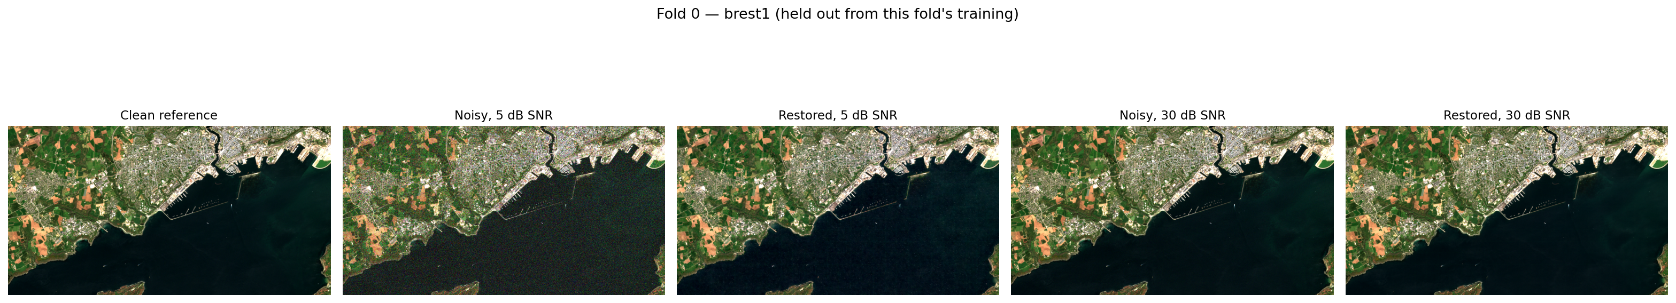
QUALITATIVE RESULTS
Full-scene reconstruction: Brest, France (fold 0)
Test scene excluded from training for fold 0. Left to right: original image, degraded input (5 dB), reconstruction (5 dB), degraded input (30 dB), reconstruction (30 dB).
SIGNIFICANCE
Independent region and fold, held out from fold 0 training.
Coastal and harbor structures are preserved under both noise levels tested.
Consistent with the result shown for fold 3.

Slide 6
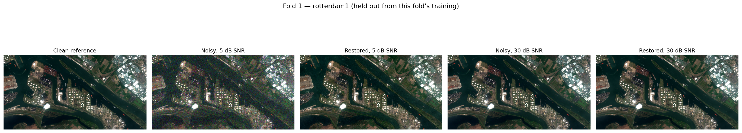
QUALITATIVE RESULTS
Full-scene reconstruction: Rotterdam, Netherlands (fold 1)
Test scene excluded from training for fold 1. Left to right: original image, degraded input (5 dB), reconstruction (5 dB), degraded input (30 dB), reconstruction (30 dB).
SIGNIFICANCE
Highest ship-pixel density among the four scenes shown.
Dense port infrastructure is preserved at both noise levels tested.
Independent region and fold, held out from fold 1 training.

Slide 7
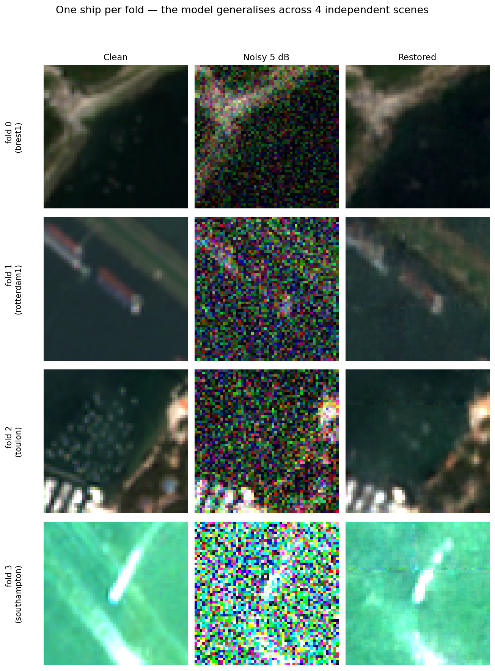
CROSS-FOLD CONSISTENCY
Consistent results across four independent regions
Each scene shown was excluded from training for its corresponding fold and evaluated only at test time.
Brest, France — fold 0
Rotterdam, Netherlands — fold 1
Toulon, France — fold 2
Southampton, UK — fold 3
SIGNIFICANCE
Demonstrates generalization across four independent geographic regions.
Each scene shown was also scored numerically as part of the quantitative evaluation.
Four independent regions rule out a single favorable scene as the explanation for the result.

Slide 8
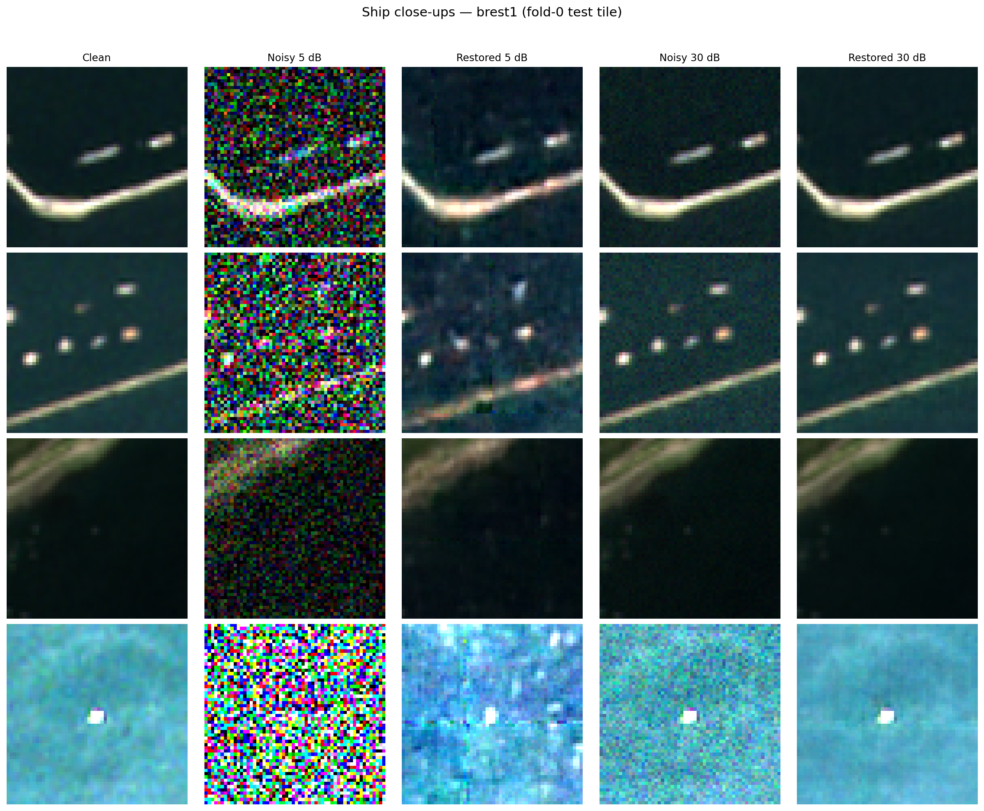
SHIP-LEVEL DETAIL
Detail recovery at ship scale
Ships occupy only a few pixels. At the most severe noise level tested (5 dB), shape, position, and color are recovered accurately.
SIGNIFICANCE
Evaluates ship preservation specifically, not only overall image quality.
Establishes the baseline against which ship-weighted training (Research Question 3) will be compared.
Addresses a known limitation of whole-image metrics, which can remain high while small objects degrade.

Slide 9
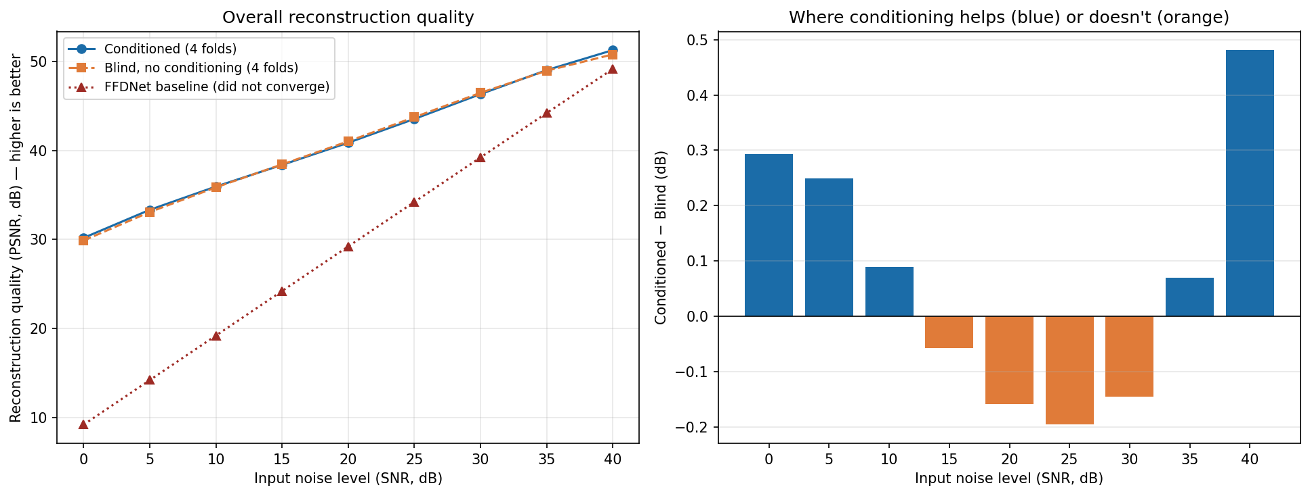
QUANTITATIVE RESULTS
With noise-level information vs. without
Left: reconstruction quality for both models across noise levels. Right: the difference between them.
SIGNIFICANCE
Provides the primary quantitative test of Research Question 1.
Identical metric, test noise, and evaluation procedure for every run, fixed in the protocol prior to training.
The right panel isolates the conditioning effect from factors shared by both models.

Slide 10
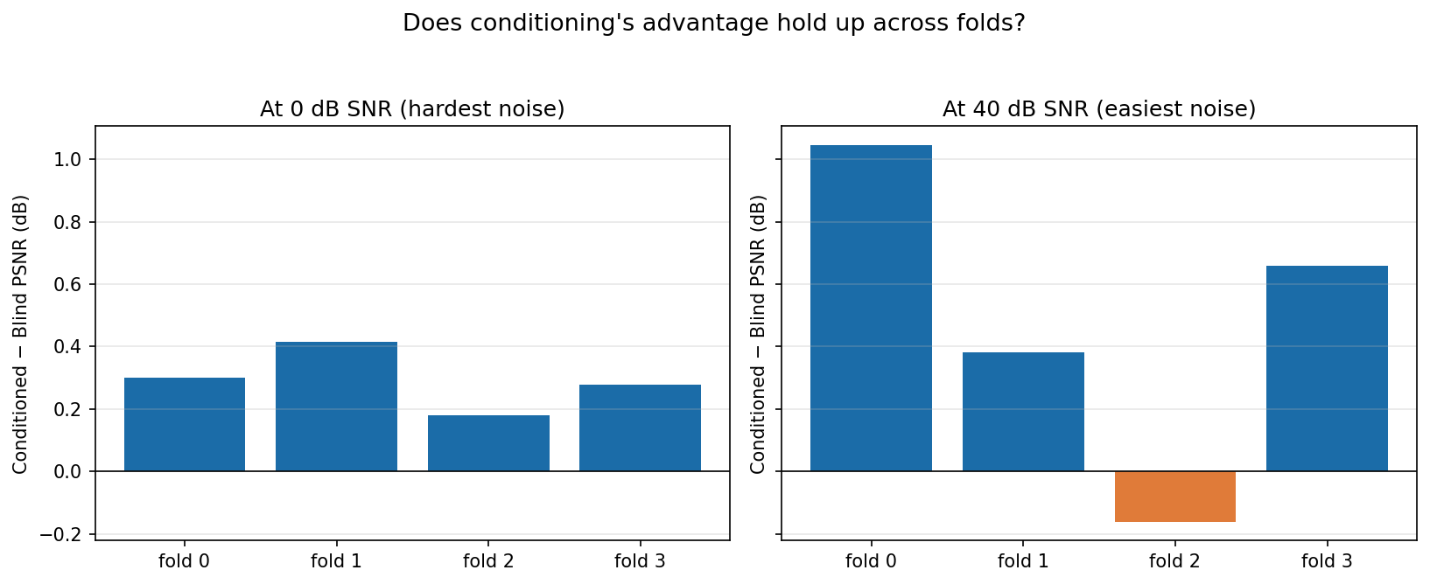
QUANTITATIVE RESULTS
Consistency of the advantage across folds
Each bar represents one of the 4 independent data splits.
SIGNIFICANCE
Confirms that the result is consistent across independent data splits.
Each fold uses non-overlapping test tiles, ruling out a single tile as the explanation.
Supports the cluster-robust confidence intervals reported on the following slide.

Slide 11
STATISTICAL VALIDATION
Statistical significance of the Research Question 1 result
Method: exact Wilcoxon signed-rank test, Holm-corrected across all 9 noise levels, cluster-robust 95% intervals (clusters = tiles sharing a scene), fixed in the protocol before training.
4 of 9
4 of 4
1 of 3
noise levels show a statistically significant advantage, after correcting for testing 9 levels at once
folds agree in direction at the most severe noise level (0 dB)
seeds completed per fold to date; additional seeds are in progress
SNR (dB) | With conditioning | Without (blind) | Gap | Significant?
0 | 30.19 | 29.90 | +0.29 | Yes
5 | 33.34 | 33.09 | +0.25 | Yes
10 | 35.95 | 35.86 | +0.09 | Yes
15 | 38.38 | 38.43 | -0.06 | Too close
20 | 40.87 | 41.02 | -0.16 | No
25 | 43.53 | 43.73 | -0.20 | No
30 | 46.32 | 46.47 | -0.15 | Too close
35 | 49.01 | 48.94 | +0.07 | Too close
40 | 51.26 | 50.78 | +0.48 | Yes
Underlying measurements are recorded in the project results database; the test definition is fixed in the evaluation protocol.

Slide 12
WHERE THINGS STAND
Status at a glance
Data and evaluation pipeline
Complete
Main model, all 4 folds
Complete
Blind baseline, all 4 folds
Complete
Published baseline (FFDNet)
Tested, limitation documented
First statistical result (RQ1)
Complete, preliminary (1 seed)
Additional seeds for full rigor
In progress
Cross-band attention test (RQ2)
In progress
Ship-focused training test (RQ3)
Not started

Slide 13
PLAN
Plan from here
Now
Complete additional training runs (2 more seeds per fold) to finalize the preliminary result.
Next
Evaluate the remaining two hypotheses: cross-band attention and ship-focused training, each with its own comparison.
Then
Compare against one to two additional published methods to broaden the baseline comparison.
Ongoing
Distribute remaining runs across the team using the established pipeline.

Slide 14
Summary
Noise-level conditioning provides a measurable advantage, confirmed across all 4 data splits, with the strongest effect at the most severe noise levels.

