Slide 1
The Climate Crisis:
Understanding Our
Changing Planet
Exploring the science, impacts, and solutions for a sustainable future.

Slide 2
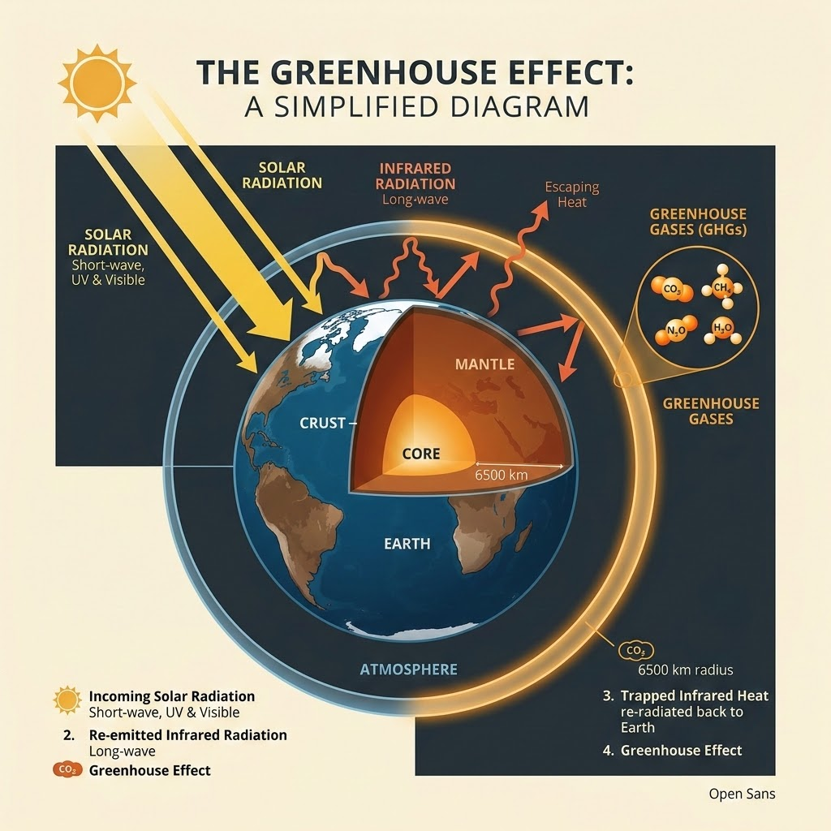
CLIMATE SCIENCE & ENVIRONMENT
The Science of
Global Warming
The Greenhouse Effect Explained
The climate has changed many times before in Earth's history. These historical shifts ranged from ice ages, where glaciers sat on top of regions like what is now Windsor, to the time of the dinosaurs, when the Earth was so warm that ice did not exist at the poles. Most of these historical climate changes were naturally caused and driven by the sun or events like asteroids.
However, in the last 200 years, that responsibility has fundamentally changed, and people are now the primary cause. Global warming is the direct result of increased CO2 emissions and other heat-trapping greenhouse gases accumulating in the atmosphere. This extra heat in the Earth system drastically affects the climate system and the weather we experience, fundamentally altering and impacting the ecosystems on Earth.

Slide 3
HUMAN IMPACTS & CLIMATE DRIVERS
HUMAN DRIVERS
How Industry, Deforestation, and Agriculture Accelerate Warming
01. FOSSIL FUELS & INDUSTRY
02. DEFORESTATION & LAND USE
03. INDUSTRIAL WASTE & PLASTICS
Burning fossil fuels and increased industrial production over the last two centuries are significant reasons for accelerated climate change. These activities lead to a massive influx of greenhouse gas emissions into the atmosphere.
Extensive deforestation for urban development and agricultural expansion serve as key drivers of warming. Recognizing these primary causes, from heavy fossil fuel reliance to clearing vital forests, is the first step to halt warming.
Modern industrial practices, such as the rapidly increasing production of disposable plastic products, severely influence the world's ability to manage waste and pollution, showcasing the undeniable human footprint on our planet.

Slide 4
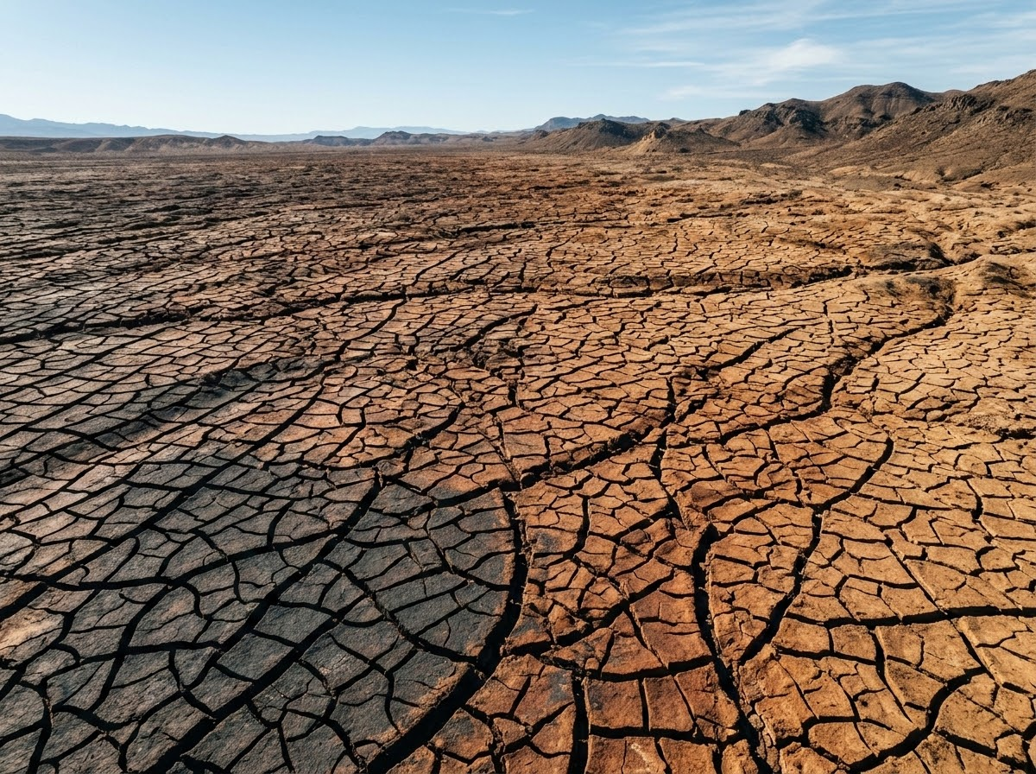
01. WEATHER EXTREMES
The extra heat trapped in the Earth system drastically affects the climate system and the daily weather we experience. We can directly tie this extra heat to a significant rise in extreme weather events, including stronger storms, devastating flooding, and intense heat waves.
CLIMATE CRISIS
Global Impacts
Extreme Weather, Wildfires, & Ecosystem Disruption
ECONOMIC TOLL
Massive Financial Losses
Beyond the environmental toll, these extreme weather events carry profound economic consequences, leading to massive potential financial losses for communities and businesses worldwide as they struggle to recover from continuous climate-related disasters.
02. ECOSYSTEM DISRUPTION
Warming temperatures are responsible for melting sea ice and the wider spread of disease vectors. Regional impacts are already visible; for instance, the ongoing severe drought in California is an event that scientists confirm is much more likely to occur in a warming climate.

Slide 5
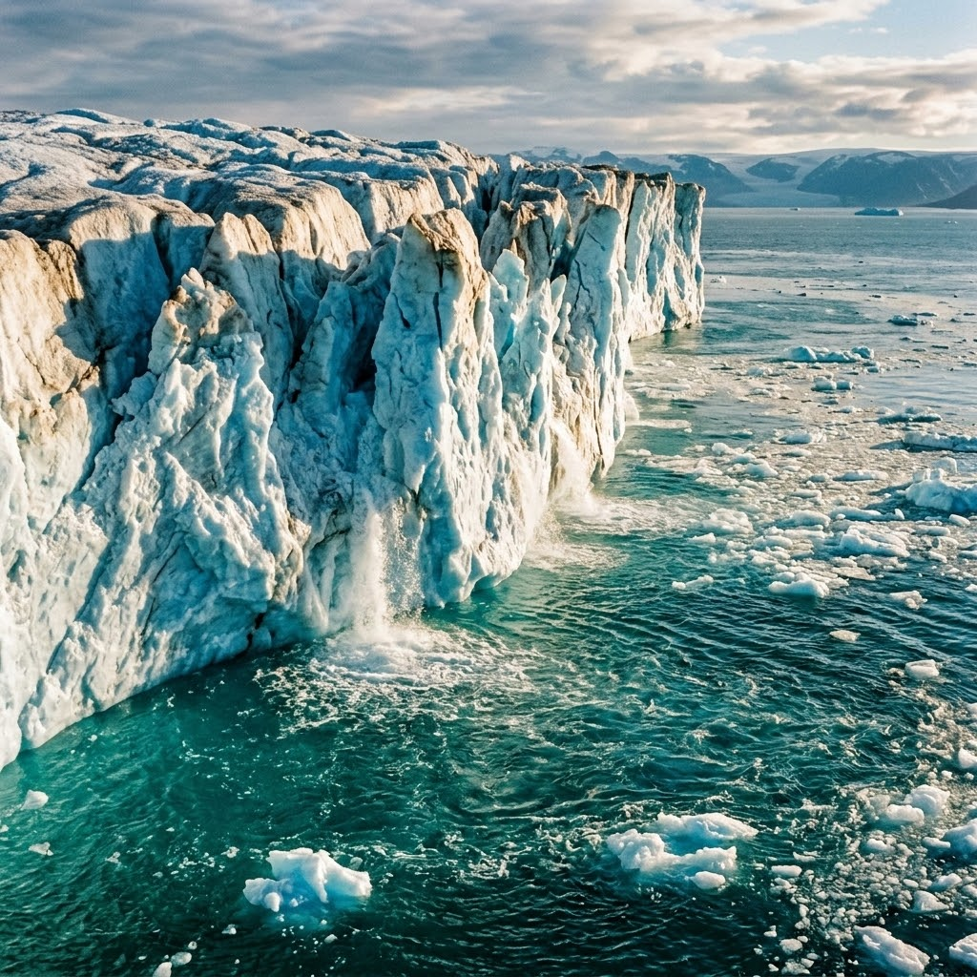
GLOBAL CLIMATE ACTION REPORT
Rising Seas: The Multi-Faceted Threat to Coastal Communities
Catastrophic Flooding & Land Loss
This phenomenon poses severe threats to coastal communities, primarily through catastrophic flooding and the gradual loss of habitable land.
ADAPTATION STRATEGIES
Building Coastal Resilience
To combat this, communities must focus on adaptation—developing ways to protect people and places from a changing climate.
Rapidly Melting Glaciers
Global climate change is rapidly melting the world's glaciers, which directly results in raising sea levels across the globe.
PRACTICAL SOLUTIONS
Architectural
Constructing raised houses that will not flood.
Municipal Defenses
Towns rapidly setting up temporary or permanent walls.
Stark Economic Costs
Massive potential financial losses are associated directly with sea level rise and related extreme weather events across vulnerable areas.

Slide 6
GLOBAL SOLUTIONS: SCALING RENEWABLE ENERGY & POLICY
Global Solutions: Scaling Renewable Energy
Together, these mitigation efforts are essential to minimize global warming and promote better climate conditions.
01 / MITIGATIONTransition to Renewable Energy
The clean energy transition is already underway and serves as a primary solution. By shifting to renewable resources, such as using solar panels to produce clean energy from the sun, we can drastically cut emissions.
02 / MOBILITYElectric Transportation
Adopting electric cars that run off electricity produced from clean sources, rather than gas, is vital for curbing carbon pollution from top-emitting sectors.
03 / BIO-STORAGENatural Carbon Sequestration
Beyond technology, natural solutions play a crucial role; sequestering carbon dioxide in trees and soil through agroforestry farm systems helps minimize greenhouse gas emissions and enhances overall ecosystem resilience to climate variability.

Slide 7
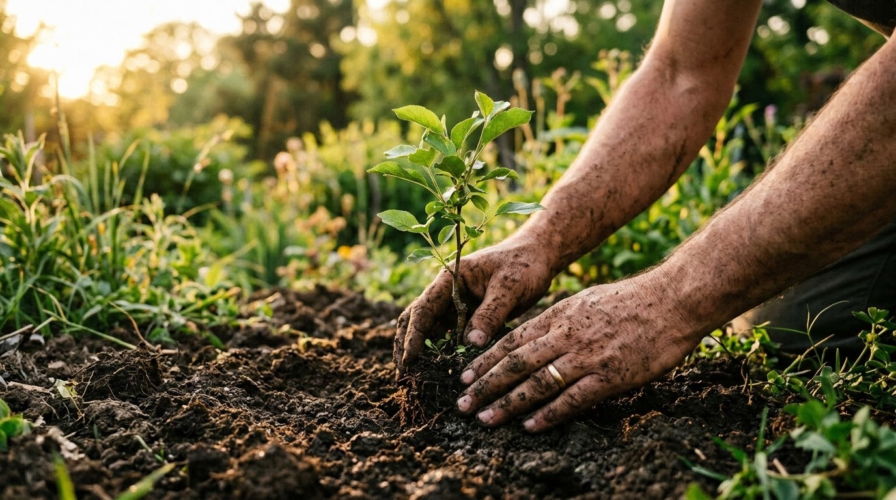
CLIMATE CRISIS SOLUTIONS
Individual Power
Everyday Actions
While global policies are crucial, everyday actions like reducing daily plastic play a significant role in tackling waste and pollution.
Moreover, communication is a powerful solution. Simply talking about climate change raises awareness, empowers people with facts to make informed decisions, and improves public understanding.
SPREAD KNOWLEDGE & REDUCE WASTE
Reducing daily plastic directly tackles waste, while sharing facts about human-caused climate change empowers others to make informed decisions. Talking about solutions is one of our most powerful tools.

Slide 8
CONCLUSION
Joining the Collective Fight for a Sustainable Future
FINAL CALL
Act Today.
The choices we make now will define the climate path for generations to come. Collective action is our most powerful economic and ecological asset.
The climate crisis is one of the greatest challenges facing humanity today, but urgent global action can mitigate its effects. We have effective options available right now to slow warming, adapt to current risks, and ensure a safer future for generations to come.
By exploring the economic benefits of taking action to reduce emissions and adapt to climate change, we can see that sustainable practices are not just environmentally necessary, but financially sound. Whether it is through the adoption of renewable energy, implementing green business practices, or improving water quality and income diversification through sustainable agriculture, the path forward requires collective effort. We must all work together to minimize greenhouse gas emissions and build a resilient, sustainable future.

