Slide 1

Evangelism Organization & Planning

Slide 2
Organization

Slide 3
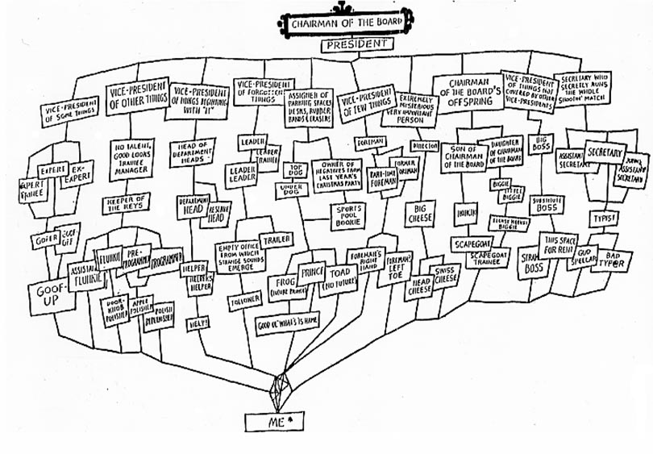
* Subject to change without notice

Slide 4
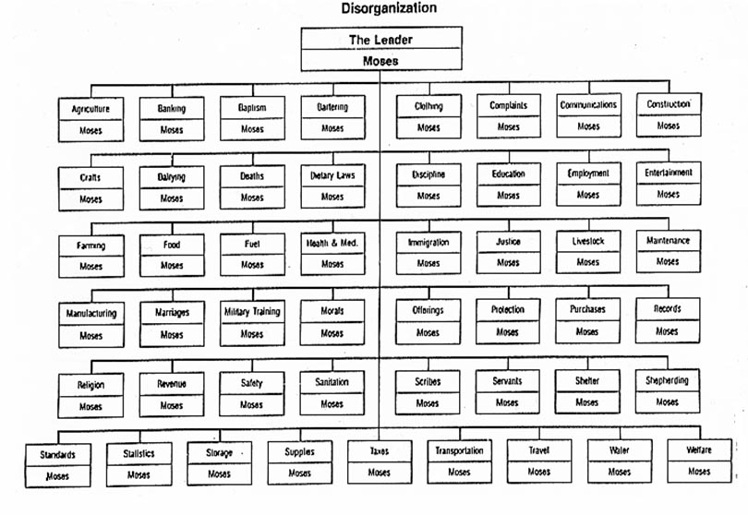

Slide 6
Israel’s Org Chart (Pre-Jethro)
God
Interface to God
[Moses]
All Israel
Cf. Exodus 18

Slide 7
Israel’s Org Chart (Post-Jethro)
God
Interface to God
[Moses]
Leader of Thousands
…
Leader of Thousands
Leader of Hundreds
…
Leader of Hundreds
Leader of Fifties
…
Leader of Fifties
Leader of Tens
…
Leader of Tens
Cf. Exodus 18

Slide 8
TWO KEY PRINCIPLES
Organization is Necessary
________________________
Use the Right Tool for the Job
________________________

Slide 9
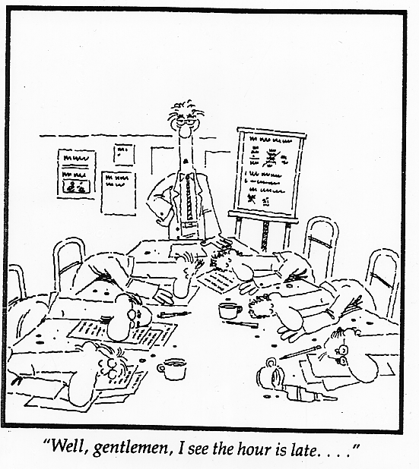

Slide 10
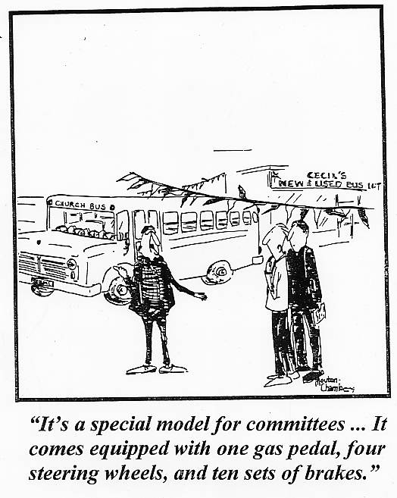

Slide 11
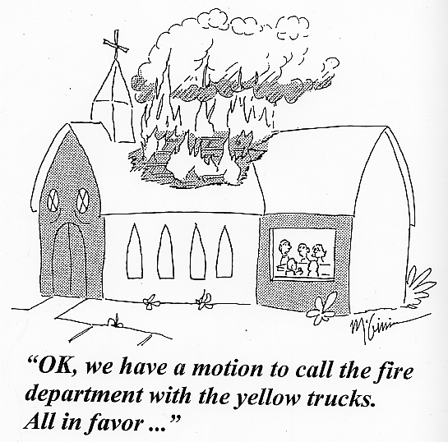

Slide 12
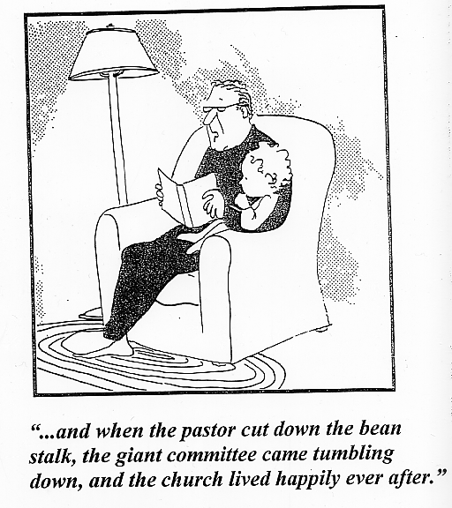

Slide 13
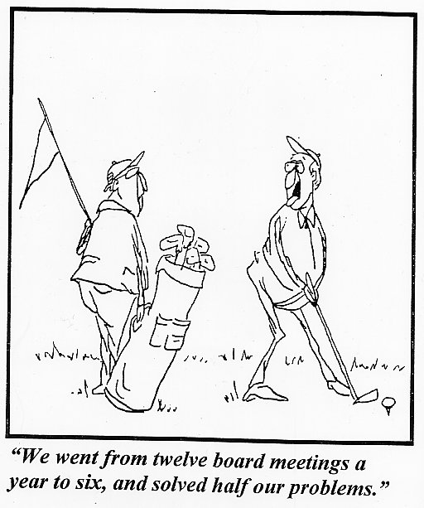

Slide 14
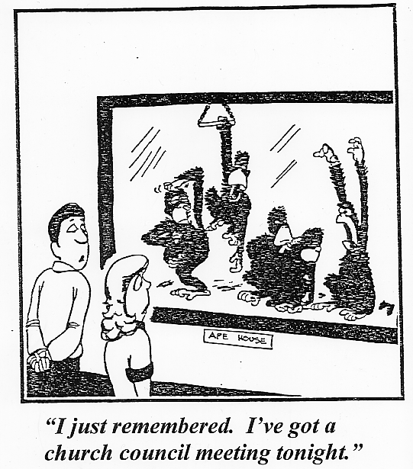

Slide 15
Key Questions:
Organizing For Outreach
Define the Problem Before You Propose the Solution
Committees – necessary or not?
Evangelism committee, or
“coordinator” and task forces?

Slide 16
Defining the Problem
What are you trying to accomplish?
What is your congregation’s situation (personality, challenges)?
What gifts are available?
What is your current organization—does it fit?
Notes:
Planning involves four steps:
The Mission Statement is drawn from the study of the Scriptures. The statement helps to answer the question for the congregation: Why are we here? It is vital that God’s mission for the church be clear and be emphasized for all members.
Long-range Planning. When we understand our mission, then we can ask ourselves where we are going -- what will the ministry of our church look like in 3, 5 or more years.
Strategies. When we have determined where we are going, then we can develop strategies for achieving our plan. Strategies are the planned steps we need to take in order to get from point A… where we presently are…to point B…where we want to go. We determine specifics of who does what, when, where, and how much.
Ministry. Finally, we work at implementation. All the best plans are of little value unless they are implemented. This is the Nike step: Just do it.

Slide 17
Evangelism Essentials
Prospect
Discovery
Prospect
Nurture
Witness
Training
Church
Identity
Worship
Welcome
Notes:
Planning involves four steps:
The Mission Statement is drawn from the study of the Scriptures. The statement helps to answer the question for the congregation: Why are we here? It is vital that God’s mission for the church be clear and be emphasized for all members.
Long-range Planning. When we understand our mission, then we can ask ourselves where we are going -- what will the ministry of our church look like in 3, 5 or more years.
Strategies. When we have determined where we are going, then we can develop strategies for achieving our plan. Strategies are the planned steps we need to take in order to get from point A… where we presently are…to point B…where we want to go. We determine specifics of who does what, when, where, and how much.
Ministry. Finally, we work at implementation. All the best plans are of little value unless they are implemented. This is the Nike step: Just do it.

Slide 18
Evangelism Coordinator
Training
Planning and implementing outreach strategies
Communication

Slide 19
Evangelism Leadership
Prospect Discovery
Coordinator
Member Witness
Coordinator
Prospect Nurture
Coordinator
Media
Coordinator
Worship Welcome
Coordinator
Notes:
The Evangelism Committee plans the work according to the mission and establish vision of the congregation. The committee will recommend as many coordinators as needed to carry out the work, all approved by the council.
Each coordinator specializes in an area of work for evangelism.

Slide 20
Prospect Discovery
Coordinator
Come Events
- Special Worship Services
- Christmas/Easter for Kids/VBS
- Sports Camp
- Seminars
Go Events
- Neighborhood Interviews
- New Resident Outreach
- Community Service Project
Notes:
The Evangelism Committee will assist coordinators in developing detailed action plans that organize the key goals of the year into manageable functions.
Coordinators will recruit and assign functions to individuals and task forces as needed. They will provide training, assistance, and encouragement for those who carry out these tasks and events.
This slide illustrates the work of the Prospect Discover Coordinator. This person will work to have various members leading ministry events under Come and Go strategies.

Slide 21
Evangelism Leadership
Prospect Discovery
Coordinator
Member Witness
Coordinator
Prospect Nurture
Coordinator
Media
Coordinator
Worship Welcome
Coordinator
Notes:
The Evangelism Committee plans the work according to the mission and establish vision of the congregation. The committee will recommend as many coordinators as needed to carry out the work, all approved by the council.
Each coordinator specializes in an area of work for evangelism.

Slide 22
Prospect Nurture
Coordinator
Prospect List Management
- Gather information
- Keep list current & sort
- Provide labels & addresses
On-Going Prospect Contacts
- Mail Outreach Newsletter
- E-mail devotions
- Visitation
- Send invitations to services and events
Notes:
This slide illustrates the work of the Prospect Nurture Coordinator. This person will work to carefully manage the prospect list and connect prospects with the Word and the ministry of the congregation.

Slide 23
Evangelism Leadership
Prospect Discovery
Coordinator
Member Witness
Coordinator
Prospect Nurture
Coordinator
Media
Coordinator
Worship Welcome
Coordinator
Notes:
The Evangelism Committee plans the work according to the mission and establish vision of the congregation. The committee will recommend as many coordinators as needed to carry out the work, all approved by the council.
Each coordinator specializes in an area of work for evangelism.

Slide 24
Member Witness
Coordinator
Friendship Witnessing
Arrange training (Bible classes, seminars) to help members gain confidence in sharing Jesus with people they know
Evangelist Training
- Classroom training
- Calling experience
Notes:
This slide illustrates the work of the member witness coordinator. This person is responsible for encouraging and assisting members in their everyday life of witness by arranging for training sessions, discussion groups, seminars, and also providing useful resources.

Slide 25
Evangelism Leadership
Prospect Discovery
Coordinator
Member Witness
Coordinator
Prospect Nurture
Coordinator
Media
Coordinator
Worship Welcome
Coordinator
Notes:
The Evangelism Committee plans the work according to the mission and establish vision of the congregation. The committee will recommend as many coordinators as needed to carry out the work, all approved by the council.
Each coordinator specializes in an area of work for evangelism.

Slide 26
Media
Coordinator
Positive Church Identity
- Logo
- Publicity materials
- Website
Awareness
- Mailings
- Signs, banners
- Newspaper, radio
Notes:
The Evangelism Committee will assist coordinators in developing detailed action plans that organize the key goals of the year into manageable functions.
Coordinators will recruit and assign functions to individuals and task forces as needed. They will provide training, assistance, and encouragement for those who carry out these tasks and events.
This slide illustrates the work of the Prospect Discover Coordinator. This person will work to have various members leading ministry events under Come and Go strategies.

Slide 27
Evangelism Leadership
Prospect Discovery
Coordinator
Member Witness
Coordinator
Prospect Nurture
Coordinator
Media
Coordinator
Worship Welcome
Coordinator
Notes:
The Evangelism Committee plans the work according to the mission and establish vision of the congregation. The committee will recommend as many coordinators as needed to carry out the work, all approved by the council.
Each coordinator specializes in an area of work for evangelism.

Slide 28
Worship Welcome
Coordinator
Impression Before Service
Parking, signage, greeters
Impression During Service
Bulletin, pastor’s greeting, friendship register, nursery
Impression After Service
Engagement by members, refreshments, follow-up
Notes:
This slide illustrates the work of the Media Coordinator. This person will manage efforts to make local residents aware of our congregation’s ministries, striving to create for our church a positive image in the community.

Slide 29
Church Size
Organize according to church size
Measure church size by attendance
Small - below 100
Medium - up to 200
Large - over 200

Slide 30
Total # of Churches (2010 data)
Church Size in the WELS
1288

Slide 31
Churches with 500 + Average Worship Attendance
34
(out of 1288)

Slide 32
Churches with 200 + Average Worship Attendance
237
(out of 1288)

Slide 33
Average Church Size in WELS
Baptized 303
Attendance 128

Slide 34
Median Attendance │----644----│----644----│ ?
82

Slide 35



Characteristics Of And
Strategies For
Churches Of Various Sizes
200+
p.12
100-200
p. 11
Up to 100
p. 10

Slide 36
Which Organization?
We Are Not Quite Ready Yet
There Still Some Other Things to Consider….

Slide 37
Planning

Slide 38
A Year of
Outreach
Worship &
Fellowship
Christmas Eve
Event
Event
Friendship Fest
Easter
Event
Event
Outdoor Service

Slide 39
Planning…
…Is Hard Work
…Takes Time
…Requires Good, Detailed Input
…Requires Feedback
…Is Not Useful If Plans Not Maintained
…Requires A Specific Skill-set

Slide 40
Planning Questions
Who?
What?
Where?
When?
How?
?

Slide 41
S.M.A.R.T. Goal Setting
Specific
Measurable
Attainable
Relevant
Timed
Evaluate:
Reach Dallas with the gospel
Double the number of first-time visitors
Quarterly canvasses to reach at least 5000 homes by year-end

Slide 42
Focus on What You Control
# of gospel tracts distributed by evangelism team
# of homes canvassed
# of mailings/contacts with top prospects
# of events for members to invite their FRAN

Slide 43
Planners vs. Actors
Both are Important
Naturally in Conflict (personalities, values, priorities)
Planners Need
Advance info
Updates
Time to react
Actors Need
Defined goals
Resources
Roadblock removal

Slide 44
Planners vs. Actors (Balance)
Planning-Heavy (Analysis Paralysis)
Budget always underspent
Gospel rarely shared
Action-Heavy (Choas vs. Progress)
Never enough budget
Frustrated volunteers
Lots of short-lived programs

Slide 45
Who’s in charge?

Slide 46
Evangelism Leadership
Prospect Discovery
Coordinator
Member Witness
Coordinator
Prospect Nurture
Coordinator
Media
Coordinator
Worship Welcome
Coordinator
By Evangelism Essential
Appendix A (p.15)
Notes:
The Evangelism Committee plans the work according to the mission and establish vision of the congregation. The committee will recommend as many coordinators as needed to carry out the work, all approved by the council.
Each coordinator specializes in an area of work for evangelism.

Slide 47
Evangelism Committee
Prospect Discovery
Team
Evangelism Planner
Prospect Nurturer
Media
Team
Worship Welcome
Team
Actors/Action Teams w/Central Planning
Notes:
The Evangelism Committee plans the work according to the mission and establish vision of the congregation. The committee will recommend as many coordinators as needed to carry out the work, all approved by the council.
Each coordinator specializes in an area of work for evangelism.

Slide 48
Evangelism Chairman
Soccer Camp Team
Food Pantry
Team
Canvassing Team
Media
Team
Worship Welcome
Team
By Project, Each Team Plans & Executes
Notes:
The Evangelism Committee plans the work according to the mission and establish vision of the congregation. The committee will recommend as many coordinators as needed to carry out the work, all approved by the council.
Each coordinator specializes in an area of work for evangelism.

Slide 49
Last Things—Evaluations
Praise God for his blessings
Thank people for their ministry
Revise – Replace – Repeat
Before You Can Evaluate, You Need Evaluation Criteria

Slide 50
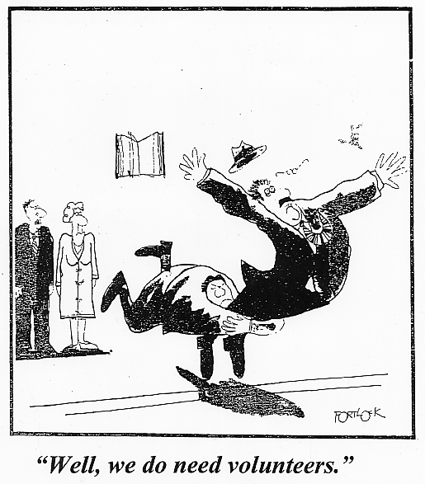

Slide 51
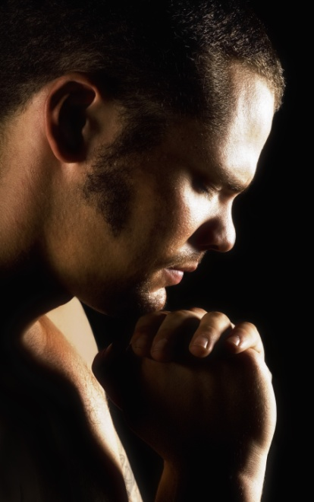


Recruiting Evangelism Workers
Pray
Specify
Needs
Expectations
Recruit Personally
Notes:
People want to be committed to something that gives significance to their lives. They respond to responsibilities that give life meaning. They are attracted by a challenging vision. They want to be a part of something worthwhile.
Be specific in asking for commitment Tell people exactly what is expected of them. If ministry coordinators have low expectations, people will not take the job seriously; they will not think that it is very important. Help people see how the job for which they are being recruited fits the big picture of the church’s work to fulfill its mission and vision.
Explain the benefits of commitment Another key to developing commitment in people is to identify the benefits of the task/event they are asked to accomplish. Explain the personal benefits, the family benefits, the benefits to the church.
Ask people personally. Talk to them. The days of asking people in a bulletin announcement to sign-up for ministry are probably over.

Slide 52
Evangelism Organization & Planning
Additional Resources

Slide 53

Organizational Tool – Mind Map
Helpful to organize disparate data, track ideas
FreePlane (freeplane.sourceforge.net)

Slide 54
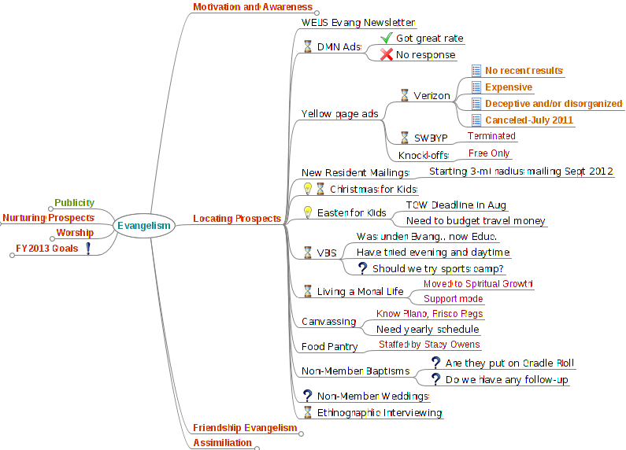
Organizational Tool – Mind Map

Slide 55
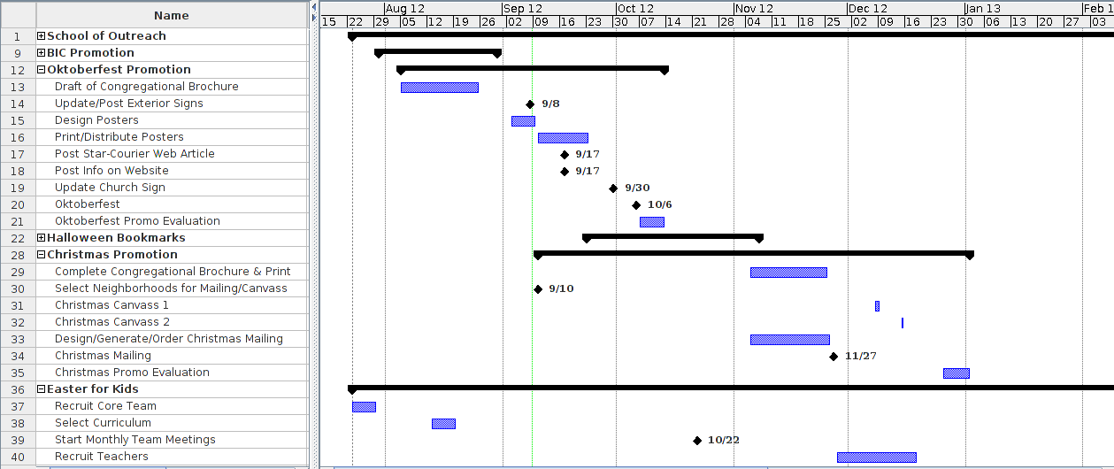
Planning Tool – Gantt Chart
Plot of tasks, dependencies against timeline
ProjectLibre (projectlibre.org)

