Slide 1


June 2026
WELS Home Missions
Report to the Twelve Districts
Rev. Matt Brown
Chairman, WELS Home Missions

Slide 2
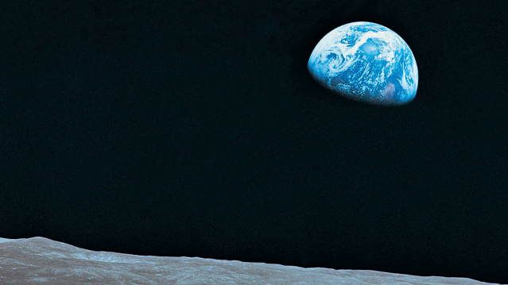
He chose us in him before the creation of the world to be holy and blameless in his sight. – Eph. 1:4
God was reconciling the world to himself in Christ, not counting men’s sins against them. And he has committed to us the message of reconciliation. ²⁰ We are therefore Christ’s ambassadors, as though God were making his appeal through us. – 2 Cor. 5:19-20
Notes:
How many of you know the title and history of this photo?

Slide 3
He chose us in him before the creation of the world to be holy and blameless in his sight. – Eph. 1:4
“When I looked up and saw the Earth coming up on this very stark, beat-up Moon horizon, I was immediately almost overcome with the thought, 'Here we came all this way to the Moon, and yet the most significant thing we're seeing is our own home planet, the Earth.’”
⁻ Apollo 8 astronaut, Bill Anders
“Earthrise”
God was reconciling the world to himself in Christ, not counting men’s sins against them. And he has committed to us the message of reconciliation. ²⁰ We are therefore Christ’s ambassadors, as though God were making his appeal through us. – 2 Cor. 5:19-20
Notes:
It’s called “Earthrise,”
Taken Christmas Eve, 1968, by astronaut, Bill Anders, during the Apollo 8 mission to the moon as they made their fourth orbit around the dark side of the moon
This view is from 250,000 miles away.
Bill Anders later recalled his first reaction when seeing this, "When I looked up and saw the Earth coming up on this very stark, beat-up Moon horizon, I was immediately almost overcome with the thought, 'Here we came all this way to the Moon, and yet the most significant thing we're seeing is our own home planet, the Earth.'"^{[1]}
It isn’t surprising that as astronauts view our planet from such a perspective, they are struck with awe. It reminds us that there is something bigger than us.

Slide 4
He chose us in him before the creation of the world to be holy and blameless in his sight. – Eph. 1:4
The Overview Effect
“A profound cognitive shift experienced by some astronauts when viewing Earth from orbit or space. Characterized by an overwhelming sense of awe and self-transcendence, it triggers a radical change in perspective—dissolving national borders and fostering a deep, unifying connection to humanity and the planet as a fragile whole.”
God was reconciling the world to himself in Christ, not counting men’s sins against them. And he has committed to us the message of reconciliation. ²⁰ We are therefore Christ’s ambassadors, as though God were making his appeal through us. – 2 Cor. 5:19-20
Notes:
In fact, this effect on astronauts was later given a name: The “overview effect.”
Wikipedia defines it this way: “A profound cognitive shift experienced by some astronauts when viewing Earth from orbit or space. Characterized by an overwhelming sense of awe and self-transcendence, it triggers a radical change in perspective (dissolving national borders and fostering a deep, unifying connection to humanity and the planet as a fragile whole.”)
Even the Artemis II astronauts that returned from their recent mission around the moon noted that you can’t leave this earth and have the perspective that they had without being changed. It’s impossible.
As Christians, though, we have a far greater perspective…God’s perspective through the pages of Scripture…

Slide 5
He chose us in him before the creation of the world to be holy and blameless in his sight. – Eph. 1:4
In the beginning God created the heavens and the earth.
Gen. 1:1
God was reconciling the world to himself in Christ, not counting men’s sins against them. And he has committed to us the message of reconciliation. ²⁰ We are therefore Christ’s ambassadors, as though God were making his appeal through us. – 2 Cor. 5:19-20
Notes:
…“In the beginning God created the heavens and the earth.” We know, believe, and confess that this bright blue and white marble, as some astronauts have described it, didn’t get here by accident or chance, but we believe in God the Father Almighty, Maker of heaven and earth.

Slide 6
He chose us in him before the creation of the world to be holy and blameless in his sight. – Eph. 1:4
The Lord saw how great the wickedness of the human race had become on the earth…
Gen 6:5
God was reconciling the world to himself in Christ, not counting men’s sins against them. And he has committed to us the message of reconciliation. ²⁰ We are therefore Christ’s ambassadors, as though God were making his appeal through us. – 2 Cor. 5:19-20
Notes:
And yet, this beautiful blue and white marble in the middle of a vast sea of endless darkness, isn’t so beautiful. After The Fall into sin, the Lord saw how great the wickedness of the human race had become on the earth.
God saw…and we see it not just around us but in us. We see the destruction and death, suffering and sadness. We see our own wickedness, and yet filled with its own darkness, the darkness of sin, guilt, shame, suffering, sadness, destruction, and death. We see this wickedness happening all around us. We see this wickedness in our own hearts. Yet, there’s this…

Slide 7
He chose us in him before the creation of the world to be holy and blameless in his sight. – Eph. 1:4
God chose us in him before the creation of the world to be holy and blameless in his sight.
Eph. 1:4
God so loved the world that he gave his one and only Son…
John 3:16
God was reconciling the world to himself in Christ, not counting men’s sins against them. And he has committed to us the message of reconciliation. ²⁰ We are therefore Christ’s ambassadors, as though God were making his appeal through us. – 2 Cor. 5:19-20
Notes:
Yet, in eternity, before the earth was formed, before he carved out the seas and mountain, before the planets and stars were spread throughout the universe, before our first parents took their first breath, God chose us to be holy and blameless in his sight…God chose you and knew you by name.
In eternity, God loved the world and knew that he would send his only Son into the world to save the world, that whoever believes in him would have eternal life.

Slide 8
He chose us in him before the creation of the world to be holy and blameless in his sight. – Eph. 1:4
God was reconciling the world to himself in Christ…
2 Cor. 5:19
God was reconciling the world to himself in Christ, not counting men’s sins against them. And he has committed to us the message of reconciliation. ²⁰ We are therefore Christ’s ambassadors, as though God were making his appeal through us. – 2 Cor. 5:19-20
Notes:
Through the Word made flesh, God reconciled, THE WORLD, to himself…not just us, but all people, everyone you encounter and meet in your life – your neighbor, the lady you meet on a local hike, those you stand next to in line at the store, the stranger that helps you fix car in the parking lot of Auto Zone…EVERYONE…God was reconciling THE WORLD to himself. There isn’t a single person you will ever meet or encounter in life that Christ didn’t die for to forgive their sins. Not one.

Slide 9
He chose us in him before the creation of the world to be holy and blameless in his sight. – Eph. 1:4
We are therefore Christ’s ambassadors, as though God were making his appeal through us.
2 Cor. 5:20
God was reconciling the world to himself in Christ, not counting men’s sins against them. And he has committed to us the message of reconciliation. ²⁰ We are therefore Christ’s ambassadors, as though God were making his appeal through us. – 2 Cor. 5:19-20
Notes:
And grace upon grace, Christ makes his ambassadors, giving us the Great Commission to spread the Gospel, starting in our families, our communities, across and country, and throughout the world. Christ lived, died, and rose again for us. Christ lives in us. And now Christ works through us…through everyone single one of us! Talk about an overview effect! Stunning…amazing!
Transition: God through Christ…Christ Through Us

Slide 10

Impact of Home Mission churches in 2025:
456 adults confirmed
228 children and 115 adults baptized
700+ first-time visitors per Sunday across 150 missions
He chose us in him before the creation of the world to be holy and blameless in his sight. – Eph. 1:4
God was reconciling the world to himself in Christ, not counting men’s sins against them. And he has committed to us the message of reconciliation. ²⁰ We are therefore Christ’s ambassadors, as though God were making his appeal through us. – 2 Cor. 5:19-20
Notes:
Christ works through us individually, congregationally, and as a synod.
Through us, the work of our synod and Home Missions, our missionaries are reaching people one person at a time, real people, with real struggles, who are still walking in darkness, struggling and searching, until the Gospel touches their hearts through the ministry of our missions. These real people have names, names like Clark, Roy, Marta and Wojtek, Sean, Jerry and Denise, Jett, Jill, and more...
In 2025, this is how Christ has worked through us:
456 adult confirmations,
228 children baptized & 115 adults baptized
700+ first time visitors each Sunday across our 150 missions (avg of 5 per Sunday)
POINT: Christ through us is making an impact!

Slide 11
HOME MISSION HAS:
14 Mission Districts with 100+ volunteers
6 Mission Counselors
13 Coaches
WELS Church Extension Fund
Other partnerships
He chose us in him before the creation of the world to be holy and blameless in his sight. – Eph. 1:4
God was reconciling the world to himself in Christ, not counting men’s sins against them. And he has committed to us the message of reconciliation. ²⁰ We are therefore Christ’s ambassadors, as though God were making his appeal through us. – 2 Cor. 5:19-20
Notes:
Through Us (you, our congregations, as a synod), we can carry out our work in Home Missions through 14 District Mission Boards throughout North America (including Canada), with 100+ volunteers. We have 6 Mission Counselors that work with our missionaries, missions, district mission boards, and leaders to encourage, advise and support. We have 13 coaches working closely with our new missionaries. We have the Church Extension Fund which provides generous grants and loans to mission congregations so that we can own our churches one day.
POINT: Home Missions is able to do what a single WELS congregation is not able to do – start new missions.

Slide 12

Home Missions’ Purpose:
Plant Churches
He chose us in him before the creation of the world to be holy and blameless in his sight. – Eph. 1:4
God was reconciling the world to himself in Christ, not counting men’s sins against them. And he has committed to us the message of reconciliation. ²⁰ We are therefore Christ’s ambassadors, as though God were making his appeal through us. – 2 Cor. 5:19-20
Notes:
All this points to Home Missions’ Purpose: We are the church-planting entity of WELS. With our DMBs, our MC’s and Coaches, CEF, and other partnerships, we do together what a single congregation can’t: Plant churches. So, when WELS adopted the 100 in 10 initiative in 2021, it was an initiative to do more aggressively what Home Missions has always done – plant churches.
Four years into the initiative, we give great thanks that we have approved funding for 31 new missions in places like Boston MA, Marquette MI, Idaho Falls ID, Bentonville AR, Kronenwetter WI, Cedar Lake IN, San Tan Valley AZ, Naples FL and more. We thank the Lord for the resources to plant these and many other new missions.

Slide 13
Church Planting vs. Church Funding
Balancing Aggressive Expansion and Diligent Stewardship
He chose us in him before the creation of the world to be holy and blameless in his sight. – Eph. 1:4
God was reconciling the world to himself in Christ, not counting men’s sins against them. And he has committed to us the message of reconciliation. ²⁰ We are therefore Christ’s ambassadors, as though God were making his appeal through us. – 2 Cor. 5:19-20
Notes:
Yet, here’s another reality: We must balance aggressive church expansion with wise and diligent stewardship.
In other words, we must distinguish between church planting and church funding. They might seem to be the same, but they aren’t.
Here’s why: In a single mission, the total subsidy for that mission can be $2M+ over 15+ years, not including CEF grants and local offerings. Planting mission isn’t cheap.
As diligent stewards we expect our missions to demonstrate a viable path to being self-supporting. It’s never perfect, but when we approve a new start, we believe that with the Lord’s blessing they will be off subsidy in a reasonable amount of time. As subsidy decreases during those latter years, those dollars can be used to support other missions and can continue to start new missions.
If a mission isn’t producing the expected results and reaches a point where there is no longer a reasonable path to being off subsidy, we can’t become the church funding entity that funds a church indefinitely. Instead, as the church planting entity we have to make the difficult decision to end subsidy at times, not because of a lack of effort and faithfulness, but because we’re not seeing the blessings expected.
This last year alone we discontinued funding for four of our missions.

Slide 14
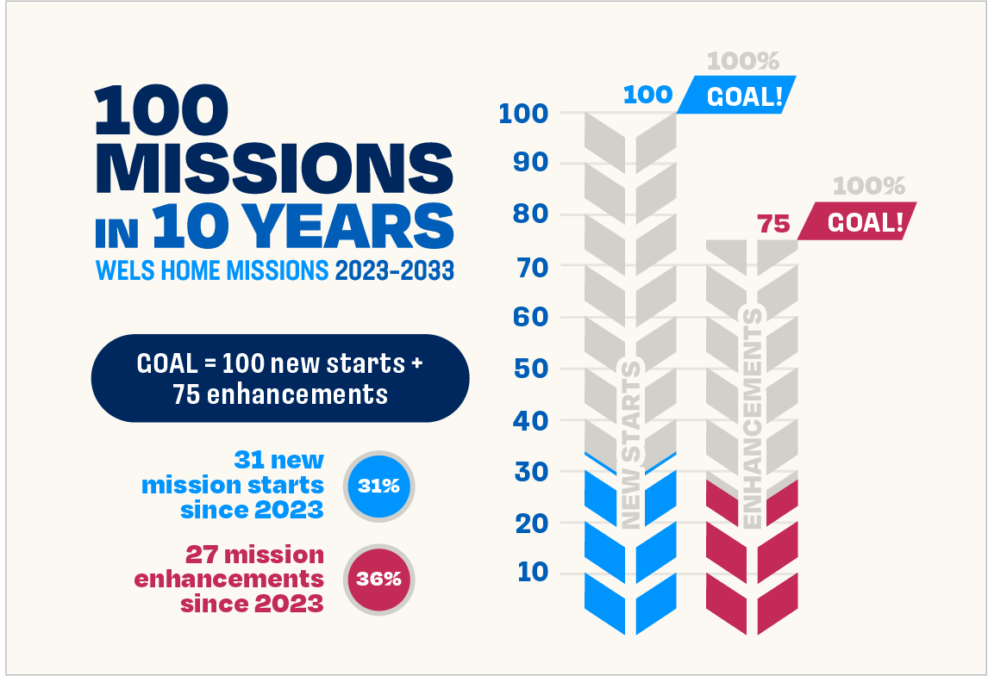
What about the “100 in 10?
He chose us in him before the creation of the world to be holy and blameless in his sight. – Eph. 1:4
God was reconciling the world to himself in Christ, not counting men’s sins against them. And he has committed to us the message of reconciliation. ²⁰ We are therefore Christ’s ambassadors, as though God were making his appeal through us. – 2 Cor. 5:19-20
Notes:
So what about the “100 in 10”? Do we continue, recalibrate, or discontinue? It’s a question we must ask and will continue to ask. Here’s what I can tell you:
The initiative continues to be a catalyst for rallying God’s people to do more, whatever that “more” might be. This has been a blessing.
Also, the goal has always been aggressive and aspirational, but not to the exclusion of diligent stewardship.

Slide 15
What about the “100 in 10?”
He chose us in him before the creation of the world to be holy and blameless in his sight. – Eph. 1:4
Strive to balance aggressive expansion with diligent stewardship
God was reconciling the world to himself in Christ, not counting men’s sins against them. And he has committed to us the message of reconciliation. ²⁰ We are therefore Christ’s ambassadors, as though God were making his appeal through us. – 2 Cor. 5:19-20
Notes:
Also, the goal has always been aggressive and aspirational, but not to the exclusion of diligent stewardship. We must always work to strike a balance between the two.
This is what it looks like for Home Missions:
-Before the 100 in 10 we averaged 6-7 new starts annually
-In the first three years of the 100 in 10, we averaged 9+ new starts annually
-Now in Year 4, we approved 3 new starts so far because we believed that was what diligent stewardship required
So, what about the 100 in 10? Let’s continue balancing aggressive expansion (challenging ourselves) while also being diligent stewards of our money and manpower resources and let’s see how the Lord continues to bless it trusting…

Slide 16

Notes:
As we do, we trust the he will do immeasurable more than all we ask or imagine.

Slide 17
Your role:
Pray and Encourage
Increase your congregation’s CMO?
He chose us in him before the creation of the world to be holy and blameless in his sight. – Eph. 1:4
God was reconciling the world to himself in Christ, not counting men’s sins against them. And he has committed to us the message of reconciliation. ²⁰ We are therefore Christ’s ambassadors, as though God were making his appeal through us. – 2 Cor. 5:19-20
Notes:
So what might you do? What is your role in all this?
Mission work is hard…very hard for all of us in all our congregations. But it can be especially challenging for our core members, missionaries and their families. Like astronauts asked to travel where no one else has gone, we ask our core groups and our missionaries, their wives, and their children to do the same. The joys they experience are high, but the lows they experience can be very low. The work can be discouraging and lonely. But they will tell you, “It’s worth it!” because we’re reaching more of the lost and serving the found. As you have chance, please thank them…encourage them…pray for them and our work so that we can aggressively plant churches while diligently and wisely being good stewards, to the glory of God’s name and for the growth of his Kingdom.
2. Consider this: CMO, Congregational Mission Offerings, are still the main way we support our mission work.
What has happened over the years is this: While local congregation offerings have kept pace with (or even outpaced) inflation, CMO support has not.
So, while overall local congregational offerings have increased the percentage they give for CMO has decreased.
Today the synod average for CMO per congregation is less than 6%.
If all our congregation gave an average of 10% of their local offerings to WELS, that would be an additional $10M for ministry, not just Home Missions ministry, but WELS ministry.
Before some might think, we can’t do that, consider going back to your congregation, finding out what your current CMO is. Share with them what WELS is doing and ask that question: Might we be able to do more? Might we lay out a plan to reach 10% in the upcoming years, not out of obligation but because of the overview effect on us…because we see what Christ has done for and is promises he will do through us?

Slide 18
He chose us in him before the creation of the world to be holy and blameless in his sight. – Eph. 1:4
God placed all things under his feet and appointed him to be head over everything for the church.
Eph. 1:22
God was reconciling the world to himself in Christ, not counting men’s sins against them. And he has committed to us the message of reconciliation. ²⁰ We are therefore Christ’s ambassadors, as though God were making his appeal through us. – 2 Cor. 5:19-20
Notes:
Finally, let’s finish where we started…looking at the big picture.
Christ has died. Christ has risen. Christ will come again.
Until then, Christ has commissioned us, working through us to gather his elect home through the work of his people.
May we do so aggressively and diligently to the glory of his name and the benefit of his kingdom trusting that…

Slide 19
Notes:
As we do, we trust the he will do immeasurable more than all we ask or imagine.

