Slide 1
Internet of things - IoT

Slide 2
Agenda
IoT
Introduction
Scenarios
Use cases

Slide 3
Internet of Things (IoT) Introduction

Slide 4
Internet of Things - 1
After the computer era the miniaturization continues
From classic PCs some hardware components were split
The idea is to have a small component of functionality instead a huge multi-functionality device (PC)
So a „thing“ is some daily use device which has some non-IT function, e.g. Camera or coffee machine

Slide 5
Internet of Things - 2
These things
have a limited functionality
ought to be connected to internet or computer enabled scenarios
should be controllable via the internet
Future scenario: lots of semi-purpose small devices that can be IT controlled and Internet accessible

Slide 6
Internet of Things - 3
Since the „thing“ has limited scenarios on how it can/should be used
Control is easy
The „commands set“ is very limited
Hardware to power this is very small
It doesn‘t require necessarily a complex and heavy-loaded OS or programming

Slide 7
Real World IoT Use Cases
Street sweepers
Aircrafts
Auto
Cows
Electric charging stations
Fryers
Oil equipment
Vending machines
Dogs
Buses
Power plant
Internet of Things
Buildings
Factory floor
Racing
Trucks
Oil distribution
Elevators
Power tools
Vaccine dispensers
Mining equipment
Surveillance
Postboxes
Engines
Smart meters
Smart grids
Medical devices

Slide 8
Azure IoT Hub features
Telemetry
Send high throughput telemetry data
Device Twin (coming soon)
Synchronize configuration properties between Cloud and device
Methods (coming soon)
Imagine calling a method on a device from the Cloud… and vice-versa
Device Management (Public Preview)
Enroll, organize, maintain, decommission devices

Slide 9
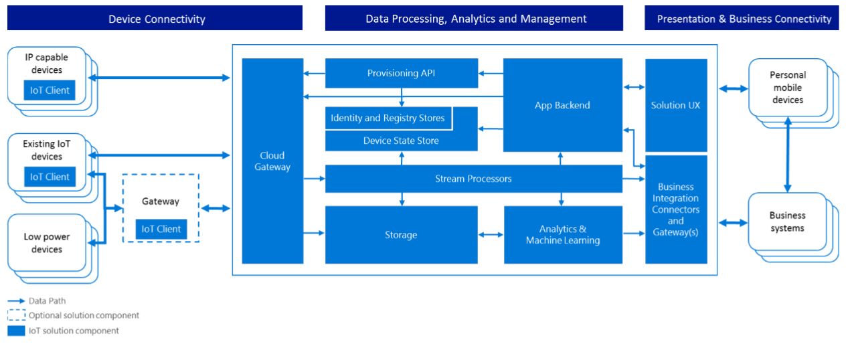
IoT Reference Architecture
https://azure.microsoft.com/en-us/updates/microsoft-azure-iot-reference-architecture-available/

Slide 10
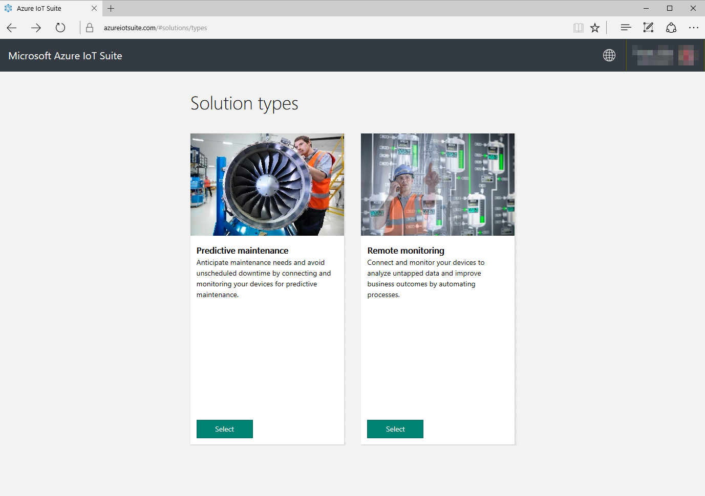
Azure IoT Suite
Notes:
Quickly provision working solutions for Predictive Maintenance and Remote Monitoring scenarios into your Azure subscription. Uses device emulators to generate data, and can be extended or simply used to demonstrate capabilities. All code is available to be used as a reference at:
https://github.com/Azure/azure-iot-remote-monitoring
https://github.com/Azure/azure-iot-predictive-maintenance
Visit http://azureiotsuite.com

Slide 11
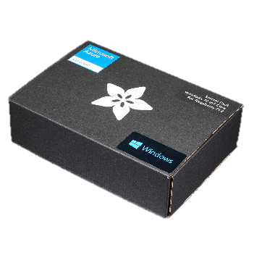
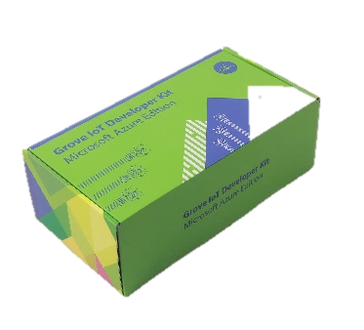
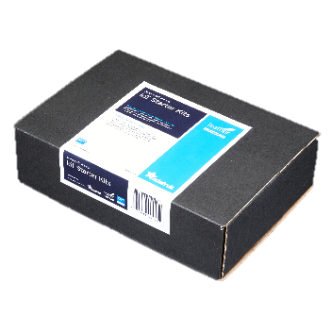
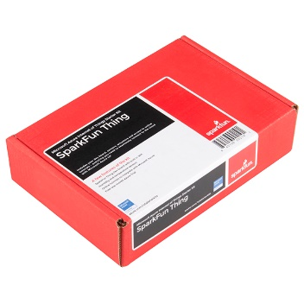
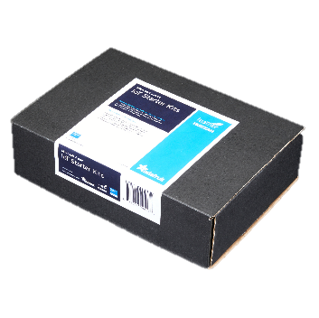
Azure IoT Starter Kits
Raspberry Pi 3 Kit
Windows 10 and Raspbian
Samples in C and C#
Intel Edison Kit
Linux Yocto
Samples in JavaScript (Node.js)
Feather M0 Wi-Fi Kit
RTOS
Samples in Arduino IDE and C
ThingDev Kit
RTOS
Samples in Arduino and C
Feather Huzzah ESP8266 Kit
RTOS
Samples in Arduino IDE and C
http://azure.com/iotstarterkits

Slide 12
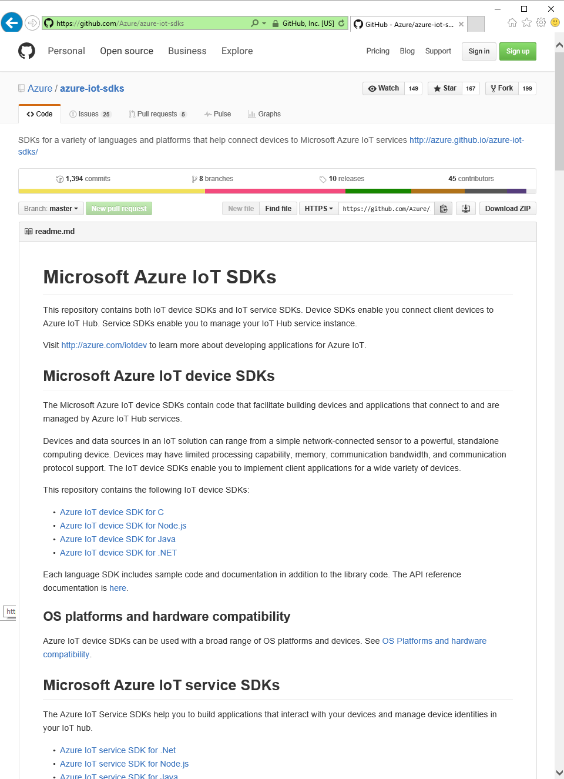
Azure IoT SDKs
Open Source
Everything is on GitHub, open source under MIT license
Cross-Platform Support
Microcontrollers (ARM Mbed, Arduino, ESP8622, TI CC3200,…)
RTOS, Linux (Ubuntu, Debian, Fedora, Raspbian), Windows 7/8/10, Android, iOS (with Xamarin)
Multi-Language Support
Service Client SDK – C#, Java, JavaScript, Python (on its way)
Device Client SDK – C, JavaScript, Java, C# (including PCL), Python
Xamarin Compatible
Includes Xamarin compatible libraries
Packages
NuGet, npm, maven, apt-get
Tools
X-plat CLI (iothub-explorer) and for Windows (Device-Explorer)
Easy To Get Started
Samples, walkthroughs to get you started quickly

Slide 13
Device & Service Client SDKs
Client | OS/Runtime | Version | Protocols | Packages
C device client | Debian Linux | 7.5 | HTTPS, AMQP, MQTT, AMQP over WebSockets | None
 | Fedora Linux | 20 | HTTPS, AMQP, MQTT, AMQP over WebSockets | None
 | mbed OS | 2 | HTTPS, AMQP, MQTT | https://developer.mbed.org/users/AzureIoTClient/
 | TI-RTOS | 2.x | HTTPS | None
 | Ubuntu Linux | 14.04 | HTTPS, AMQP, MQTT, AMQP over WebSockets | https://launchpad.net/~aziotsdklinux/+archive/ubuntu/ppa-azureiot
 | Windows desktop | 10 | HTTPS, AMQP, MQTT, AMQP over WebSockets | https://www.nuget.org/packages/Microsoft.Azure.IoTHub.IoTHubClient/
 | Yocto Linux | 2.1 | HTTPS, AMQP | None
 | Arduino (MKR1000, Zero, ESP8266, Feather M0) | IDE 1.6.8 | HTTPS | https://github.com/arduino-libraries/AzureIoTHub
Node.js Device client | Node.js | 0.10+ | HTTPS, AMQP, MQTT, AMQP over WebSockets | https://www.npmjs.com/package/azure-iot-device
Node.js Service client | Node.js | 0.10+ | N/A | https://www.npmjs.com/package/azure-iothub
Java Device client | Java SE (Windows) | 1.7 | HTTPS, AMQP, MQTT | http://mvnrepository.com/artifact/com.microsoft.azure.iothub-java-client/iothub-java-device-client
 | Java SE (Linux) | 1.7 | HTTPS, AMQP, MQTT | http://mvnrepository.com/artifact/com.microsoft.azure.iothub-java-client/iothub-java-device-client
 | Android | API 15 | HTTPS, MQTT
Java Service client | Java SE | 1.8 | N/A | http://mvnrepository.com/artifact/com.microsoft.azure.iothub-java-client/iothub-java-service-client
C# Device client | .Net | 4.5 | HTTPS, AMQP, MQTT, AMQP over WebSockets | https://www.nuget.org/packages/Microsoft.Azure.Devices.Client/
 | UWP | 10 | HTTPS, AMQP | https://www.nuget.org/packages/Microsoft.Azure.Devices.Client/
 | PCL (Xamarin, Mono, UWP, WP8.1, Win8.1) |  | HTTPS, AMQP, MQTT, AMQP over WebSockets | https://www.nuget.org/packages/Microsoft.Azure.Devices.Client.PCL/
C# Service client | .Net | 4.5 | N/A | https://www.nuget.org/packages/Microsoft.Azure.Devices/
Python Device client | Python | 2.7.x, 3.4.x, 3.5.x | HTTPS, AMQP, MQTT | none

Slide 14
Resources
Azure IoT Client SDKs: github.com/azure/azure-iot-sdks
Get started with Azure IoT Hub device management: azure.microsoft.com/en-us/documentation/articles/iot-hub-device-management-get-started/
Azure IoT Gateway SDK repo: github.com/Azure/azure-iot-gateway-sdk
Microsoft Azure IoT reference architecture: azure.microsoft.com/en-us/updates/microsoft-azure-iot-reference-architecture-available/
Azure IoT Partner Portal: aka.ms/AzureIoTPartner
Certified for Azure IoT: www.azure.com/certifiedforiot
Azure IoT User Voice forum: feedback.azure.com/forums/321918-azure-iot
IoT Advisors on Yammer: www.yammer.com/azureadvisors/#/threads/inGroup?type=in_group&feedId=5495841

Slide 15
HOL scenario
Use a small ESP8266 device (NodeMCU) with one LED and a Wifi chip. Create program to control and trigger the LED with Visual Studio
If Issue submitted in City Power n lights-> LED flashes
(checking URL for Bit-change)
Showcase that IoT is EASY and Microsoft has all the toolset you need

