Slide 1
Microsoft brand template
White
Dark Purple
PowerPoint template for the
Microsoft brand – January 2016
Questions: brand@microsoft.com

Slide 2
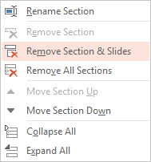
This template has 3 sections
View slides in sorter mode to see all 3 sections
  1st section: Instructions, (this section)
  2nd section: Slide layouts using the WHITE TEMPLATE master
  3rd section: Slide layouts using the COLOR TEMPLATE master
Delete any slides or sections you don’t need
  To remove a slide, select it and then hit Delete
  To remove an entire section, change the view to Slide Sorter mode:
  View menu > Slide Sorter. Then right-click on the section name, and
  choose “Remove section and slides”

Slide 3
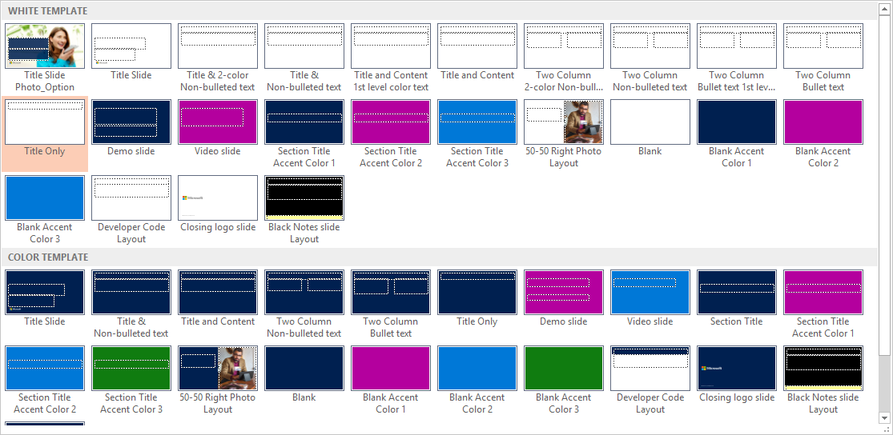
Working with slide layouts
To add a new slide, click the Insert menu along the top. On the far left, click on the words New Slide (not the slide icon), which will reveal the Slide Layout menu. (See below – colors and photos may vary from your template.)
Select a layout from the dropdown menu. Scroll down to see all the layouts. Notice that there are 2 masters: WHITE TEMPLATE and a second COLOR TEMPLATE. While both masters provide some slides with color backgrounds, the WHITE TEMPLATE provides a variety of text layouts with white backgrounds, and the COLOR TEMPLATE provides a variety of text layouts with color backgrounds. Refer to the text descriptions below each layout for additional information about each.
For questions: email slides

Slide 4
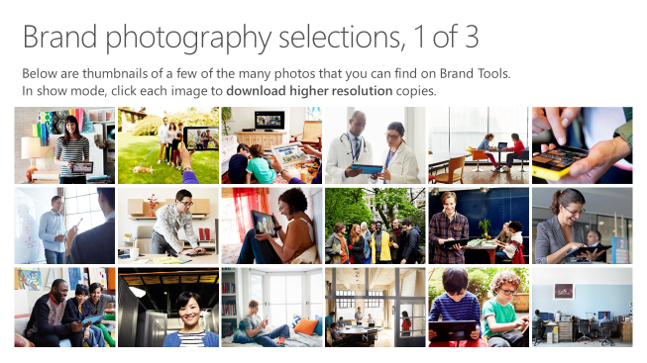
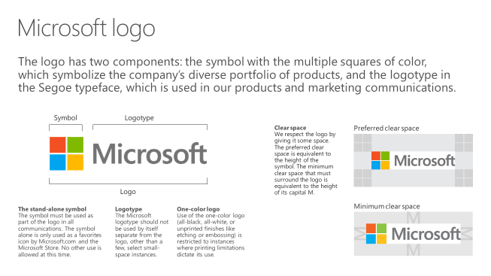
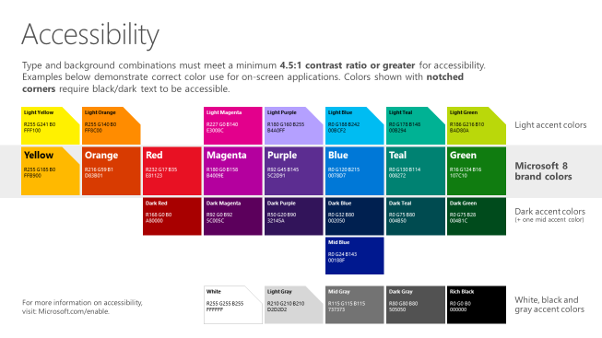
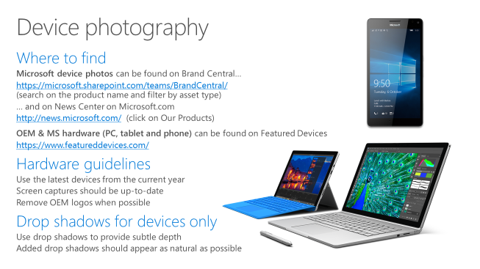
Microsoft brand guidelines
Looking for more slide resources?
Brand guidelines for PowerPoint templates is a separate slide deck that provides an overview of the Microsoft brand, guidelines, resources, tips and much more.
A few of the slides are shown
at right.
Download from: https://microsoft.sharepoint.com/teams/BrandCentral/Pages/Presentations.aspx

Slide 5
Presentation title goes here
Speaker name
Title

Slide 6
Preferred text layout (no bullets)
Main topic 1: size 40pt
  Size 20pt for the subtopics
  Size 20pt for the subtopics
Main topic 2: size 40pt
  Size 20pt for the subtopics
  Size 20pt for the subtopics
Main topic 3: size 40pt
  Size 20pt for the subtopics
  Size 20pt for the subtopics

Slide 7
Bullet points layout with subtitle
Subtitle
Example of a bulleted slide with a subhead
  Set the slide title to “Sentence case”
  Set subheads to “Sentence case”
Hyperlink style
  www.microsoft.com

Slide 8
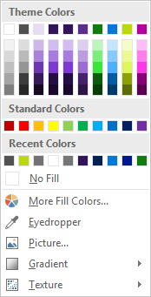
Slide palette info
The PowerPoint palette for this template has been built for you and is shown below. Avoid using too many colors in your presentation.
Select the 4th color from the left for subheads and 1st level non-bulleted text color, or wherever “color” text is preferred over the default black/white text
Accent colors 1-6 – (6 Theme Colors to the far right)
Text
Dark 2
Accent 1
Accent 2
Accent 3
Accent 4
Accent 5
Accent 6
Use Accent 1 as the main accent color. Use Accent 2 and Accent 3 when additional colors are needed.
Use Accents 4-6 sparingly – only when more colors are necessary.

Slide 9
Section title

Slide 10
Photo layout 1

Slide 11
Software code slide
This slide layout uses Consolas, a monotype font which is ideal for showing software code.

Slide 12
Notes (hidden)
Some speakers at Microsoft like to use this slide for hidden “notes slides”.
Delete it if you don’t want to use it.
NEXT: <next slide title>

Slide 14
Presentation title goes here
Speaker name
Title

Slide 15
Presentation title goes here
Speaker name
Title

Slide 16
Preferred text layout (no bullets)
Main topic 1: size 40pt
  Size 20pt for the subtopics
  Size 20pt for the subtopics
Main topic 2: size 40pt
  Size 20pt for the subtopics
  Size 20pt for the subtopics
Main topic 3: size 40pt
  Size 20pt for the subtopics
  Size 20pt for the subtopics

Slide 17
Bullet points layout with subtitle
Subtitle
Example of a bulleted slide with a subhead
  Set the slide title to “Sentence case”
  Set subheads to “Sentence case”
Hyperlink style
  www.microsoft.com

Slide 18
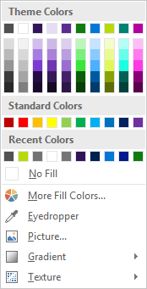
Slide palette info
The PowerPoint palette for this template has been built for you and is shown below. Avoid using too many colors in your presentation.
Accent colors 1-6 – (6 Theme Colors to the far right)
Accent 1
Accent 2
Accent 3
Accent 4
Accent 5
Accent 6
Use Accent 1 as the main accent color. Use Accent 2 and Accent 3 when additional colors are needed.
Use Accents 4-6 sparingly – only when more colors are necessary.

Slide 19
Section title

Slide 20
Photo layout 1

Slide 21
Software code slide
This slide layout uses Consolas, a monotype font which is ideal for showing software code.

Slide 22
Notes (hidden)
Some speakers at Microsoft like to use this slide for hidden “notes slides”.
Delete it if you don’t want to use it.
NEXT: <next slide title>

