Slide 1
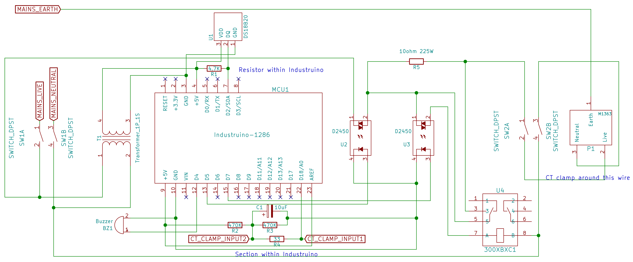
Short circuit limiter instructions
1. Do NOT set up without prior training.
2. Connect this downstream to the 10ma RCCB
3. Temperature warning is 70C with maximum 85C
4. Use arrow keys to adjust current enable threshold
5. If in doubt, ask Kheng Meng ☺

