Slide 1
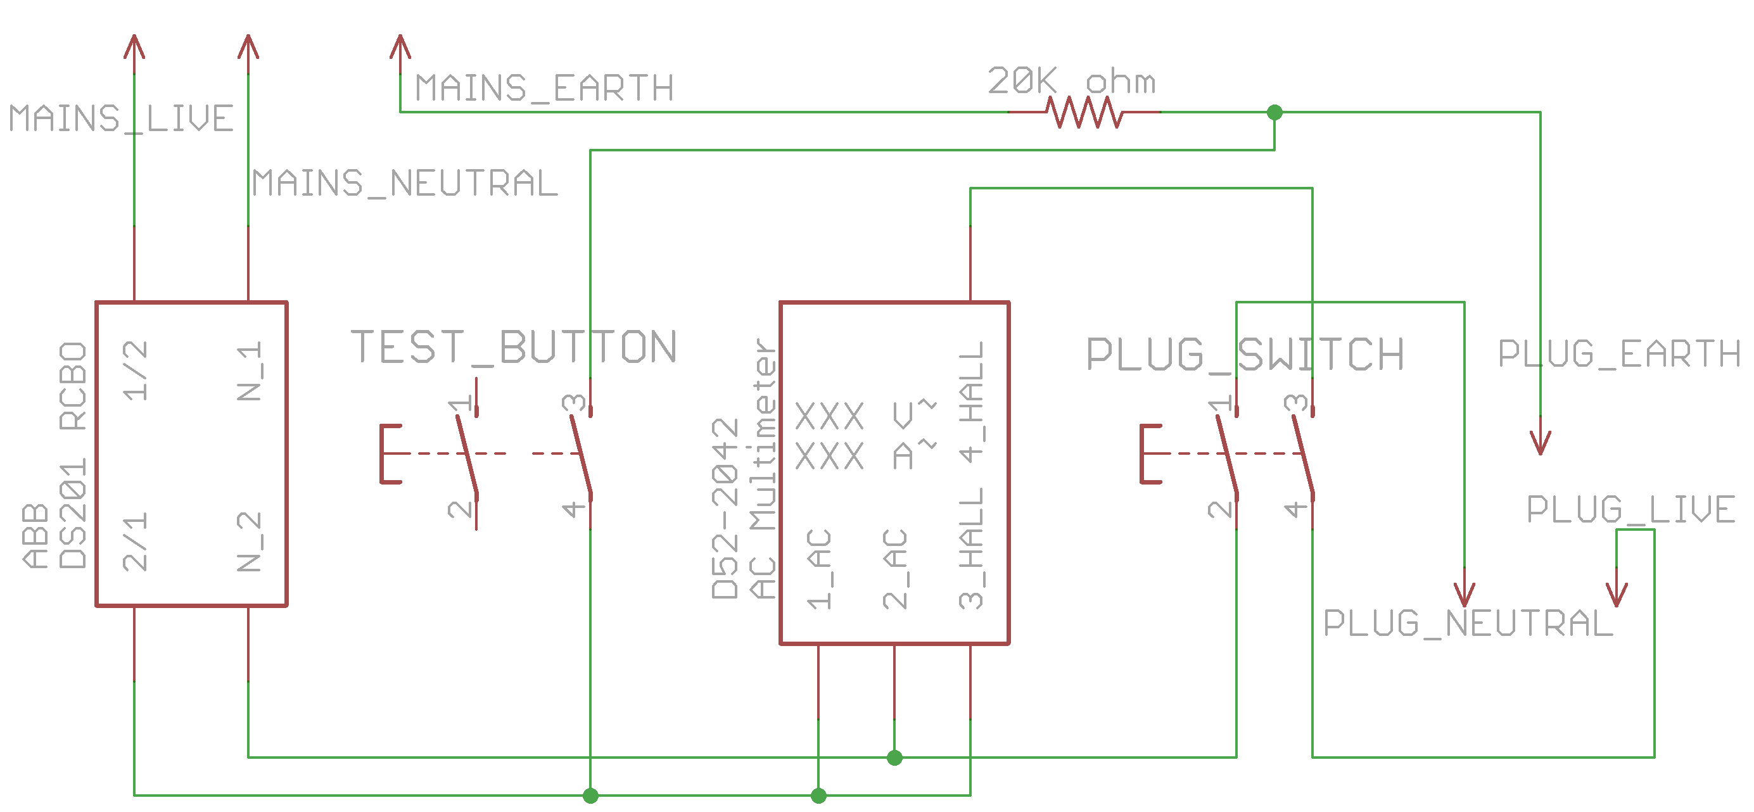
10ma-rcbo-and-anti-external-cb-trip instructions
1. Do NOT set up without prior training.
2. Always test before use.
Only the 10mA RCCB should trip
If it does not, there may be a problem with the external Earth connection or with this tool. Do not continue to use.
3. All other RK electrical connections
will be connected through this.
ALWAYS TEST BEFORE USE: Only 10mA RCCB trips -> Working
If in doubt, ask Kheng Meng ☺

