Slide 1
Impact of Money Supply and Swiss Average Rate Overnight on the Stock Market in Switzerland
Author: Valentin Arbenz & Matthias Wenger

Slide 2
Content
Introduction & Visual Analysis
Research Questions & Motivation
Methodology & Results
Q & A

Slide 3
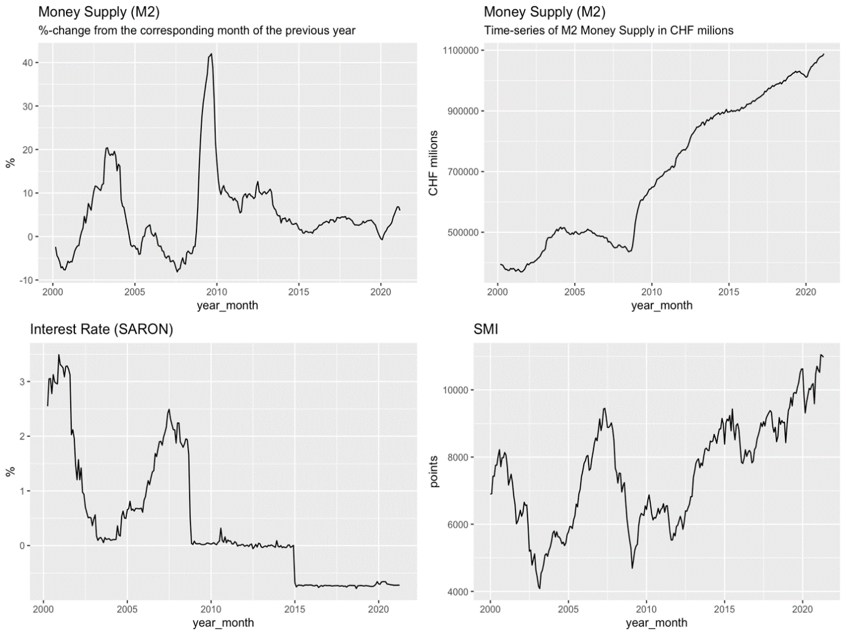
Introduction

Slide 4
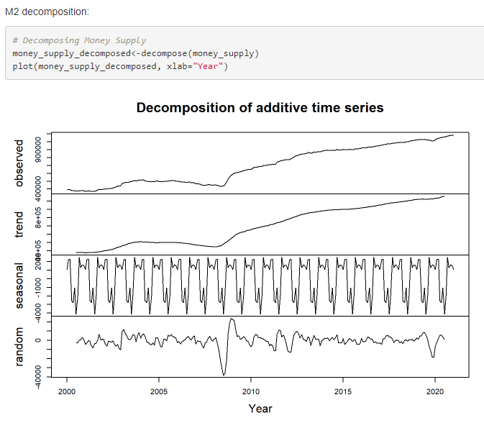
Money Supply (M2)

Slide 5
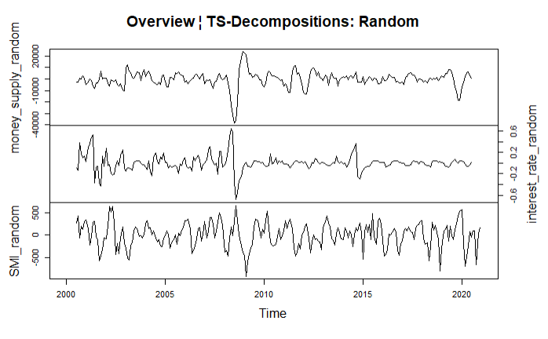
Remainder Analysis
May 2002 => Feb. 2003
Lowering of Libor
Holocaust fund dissolved
Feb. 2008 => Jan. 2009
Lowering of Libor
USD liquidity through repo auctions
Transfer of illiquid UBS assets (USD 60 billion)
June 2019 => May 2020
Introduction SNB policy rate
COVID-19 refinancing

Slide 6
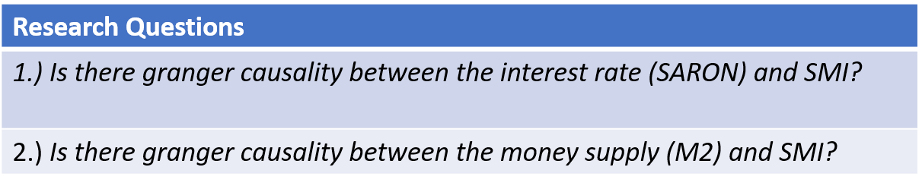
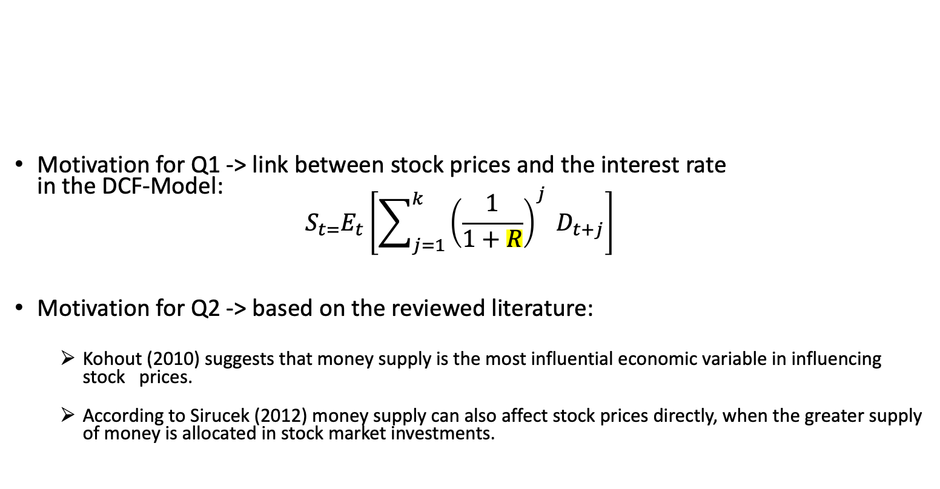
Research Questions & Motivation
Motivation for Q1 -> link between stock prices and the interest rate in the DCF-Model: $S_{t=}E_{t}\left[\sum_{j=1}^{k}{{\left(\frac{1}{1+R}\right)}^{j}} D_{t+j}\right]$
Motivation for Q2 -> based on the reviewed literature:
Kohout (2010) suggests that money supply is the most influential economic variable in influencing stock prices.
According to Sirucek (2012) money supply can also affect stock prices directly, when the greater supply of money is allocated in stock market investments.

Slide 7

Methodology & Results
Methodology: Dickey Fuller, VAR-Models and Granger Causality Testing
→ Changes in interest rate (SARON) appear to be followed by a quick response of stock prices.
→ Changes of money supply appear to trigger a lagged response of stock prices.
Results:
M2 -> SMI: Significant Granger Test at Lag 4 and later.
SARON -> SMI: Significant Granger Test at Lag 1 significant.
estimated coefficients (VAR-Model):
$$∆SMI=4.63 +345∗﻿∆{SARON}_{t−1}+0.055∗﻿∆{M2}_{t−4}$$
Granger Causality Tests with different lags

Slide 8
Q & A

